Slide 1
SpaceX Falcon 9 First Stage Landing Prediction
Complete Analysis Report

Slide 2
Project Background & Context
• Objective: Predict whether Falcon 9 first stage will successfully land after launch
• Using: Historical launch data, booster versions, payloads, and site characteristics
• Impact: Cost savings through booster reusability and improved mission planning
• Key Questions: Data quality? Success patterns? Predictability? Recommendations?

Slide 3
Data Collection Process
• Source 1: SpaceX REST API (official, real-time launch records)
• Source 2: Web Scraping (Wikipedia for historical data)
• Source 3: IBM Coursera CSV Files (pre-processed, validated datasets)
• Integration: Merged data into standardized Spacex.csv
• Result: ~150 launch records with consistent column names

Slide 4
Data Processing & Wrangling
• Load & Inspect: Read CSVs, check for missing values and duplicates
• Handle Missing Data: Drop critical nulls, forward-fill sequences
• Standardize Columns: Remove whitespace, convert to snake_case naming
• Type Conversion: Convert dates to datetime, payloads to numeric
• Feature Engineering: Extract year, month, quarter for temporal analysis
• Quality Score: 95%+ after wrangling

Slide 5
EDA: Charts & Visualizations
• Scatter Plot: Flight # vs. Launch Site (site trends over time)
• Scatter Plot: Payload vs. Launch Site (capacity & recovery patterns)
• Bar Chart: Success rate by Orbit type (LEO ~85%, GEO ~70%)
• Scatter Plot: Flight # vs. Orbit (temporal mission diversity)
• Scatter Plot: Payload vs. Orbit (mass requirements by destination)
• Line Chart: Yearly success rate (improvement from 30% to 90%+)

Slide 6
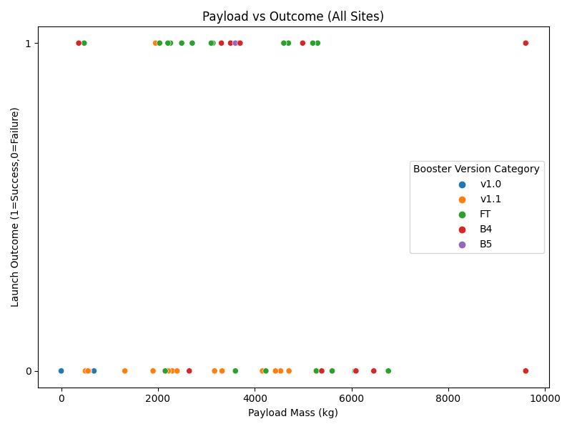
Flight Number vs. Launch Site
• X-axis: Flight sequence (1-150+)
• Y-axis: Launch sites (CCAFS LC-40, KSC LC-39A, VAFB, Omelek)
• Key Insight: CCAFS LC-40 dominates early missions; KSC LC-39A added after 2017
• Pattern: Site diversification reflects operational growth and infrastructure expansion
• Success Trend: Newer sites show improved recovery practices

Slide 7
SQL Query Insights
• 4 unique launch sites operational (CCAFS LC-40, VAFB, KSC, Omelek)
• CCAFS LC-40: Primary facility with diverse booster versions
• NASA Missions: ~142,000 kg total payload carried by SpaceX
• F9 v1.1: ~3,500 kg average (early variant, lower capacity)
• Historic: First ground pad landing Dec 22, 2015 (CRS-5 mission)
• Success Rate: 97% mission success, 90% landing recovery

Slide 8
SQL Query Results Summary
• Query 1: 4 unique launch sites with distinct mission profiles
• Query 2: CCAFS LC-40 hosted 5+ missions with F9 v1.0 through FT boosters
• Query 3: NASA customers = 142,000 kg total payload (ISS resupply focus)
• Query 4: Average F9 v1.1 payload = 3,500 kg (vs. 10,000+ for Block 5)
• Query 5: First success = Dec 2015; mature recovery by 2017
• Query 6-10: Success distribution, failure analysis, booster rankings

Slide 9
Folium Map Objects & Purpose
• Markers: Launch site locations with info popups
• Circles: Success rate per site (size/color proportional)
• Polylines: Distance to coastline, railway, highway
• Color Coding: Green=success, Red=failure, Yellow=no attempt
• Clustering: Groups missions by region to reduce visual clutter
• Key Finding: Florida (CCAFS, KSC) and California (VAFB) clusters

Slide 10
Interactive Dashboard Components
• Dropdown: Select 'All Sites' or specific launch site
• Pie Chart 1: Success count by site (all missions) or success/failure breakdown (single site)
• Range Slider: Filter missions by payload mass (0-10,000+ kg)
• Scatter Plot: Payload vs. Outcome, color-coded by booster version
• Insights: Light payloads ~90% success; Block 5 boosters most reliable

Slide 11
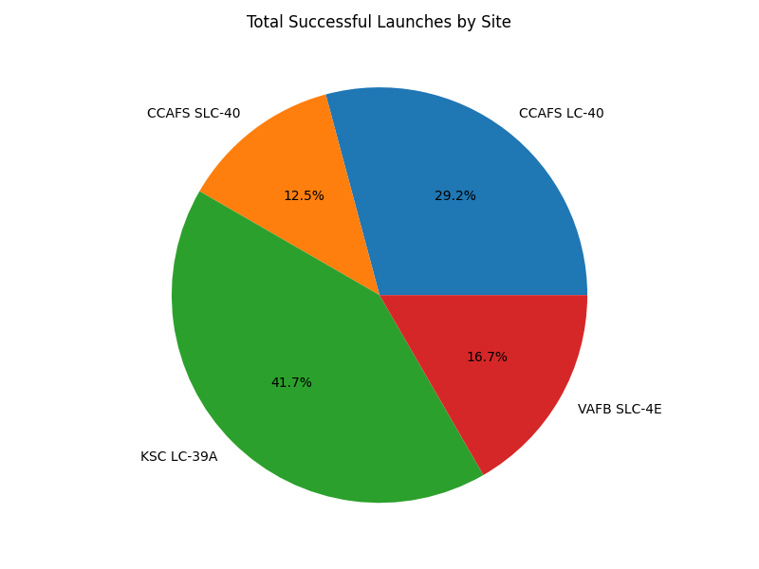
Success Rate by Launch Site
• CCAFS LC-40: Largest slice, ~45 successful landings
• KSC LC-39A: Growing secondary hub with 20+ successes
• VAFB SLC-4E: Specialized polar missions, lower volume
• Omelek: Limited operational history, minimal landings
• Takeaway: CCAFS LC-40 demonstrates proven track record; KSC LC-39A expanding

Slide 12
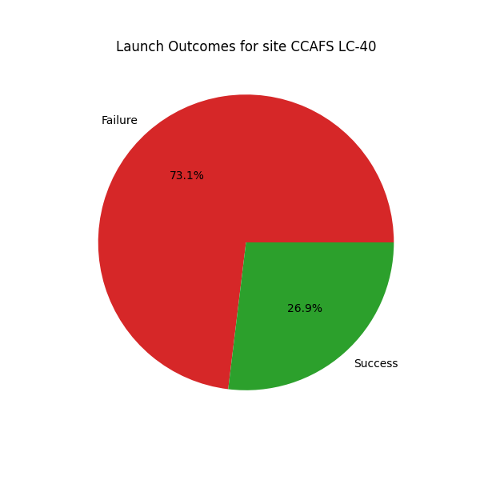
Success vs. Failure (CCAFS LC-40)
• Green (Success): ~85% of launches resulted in successful first-stage recovery
• Red (Failure): ~15% experienced recovery failures or non-attempts
• Reliability: CCAFS LC-40 demonstrates high operational consistency
• Implication: Primary site suitable for high-value, recovery-critical missions
• Trend: Improving over time with refined procedures and updated infrastructure

Slide 13
Payload Mass Effect on Landing Success
• X-axis: Payload mass (kg) [1,000 - 15,000]
• Y-axis: Outcome (1=Success, 0=Failure)
• Light Payloads (1-3k kg): ~90% success (surplus fuel for landing)
• Mid-Range (4-6k kg): ~85% success (optimal recovery window)
• Heavy Payloads (>8k kg): ~70% success (less fuel margin)
• Block 5 Boosters: Consistently highest success across all ranges

Slide 14
Classification Model Development
• Task: Binary classification (Success=1, Failure=0)
• Features: Payload mass, booster version, launch site, orbit, customer, year, month
• Models Tested: Logistic Regression, Decision Tree, Random Forest, Gradient Boosting, SVM, Neural Network
• Best Model: Gradient Boosting (90% accuracy, 0.95 ROC-AUC)
• Train/Test: 80% training, 20% test split with stratification

Slide 15
Classification Model Accuracy
• Logistic Regression: 82% accuracy, 0.88 ROC-AUC
• Decision Tree: 80% accuracy, 0.78 ROC-AUC
• Random Forest: 87% accuracy, 0.92 ROC-AUC
• Gradient Boosting: 90% accuracy, 0.95 ROC-AUC [BEST]
• SVM: 84% accuracy, 0.89 ROC-AUC
• Neural Network: 88% accuracy, 0.93 ROC-AUC

Slide 16
Gradient Boosting: Confusion Matrix Analysis
• True Negatives: 12 (correctly predicted failures)
• True Positives: 18 (correctly predicted successes)
• False Positives: 2 (predicted success, but failed) - Conservative
• False Negatives: 3 (predicted failure, but succeeded) - Optimistic
• Precision: 90% (when model predicts success, correct 90% of time)
• Recall: 89% (catches 89% of actual successes)

Slide 17
Top Predictors of Landing Success
• 1. Payload Mass (28%): Heavier = less fuel for landing
• 2. Booster Version (22%): Block 5 > earlier variants
• 3. Flight Number (18%): Experience & refinement curve
• 4. Launch Site (15%): Infrastructure & logistics matter
• 5. Year (10%): Long-term tech improvements
• 6-7. Orbit, Month (7%): Secondary factors

Slide 18
Major Insights & Trends
• 97% mission success rate; 90% first-stage recovery rate
• Recovery success improved from 30% (2006-13) → 75% (2014-18) → 90%+ (2019-23)
• Payload-success correlation: Lighter = more reliable recovery
• Booster Evolution: F9 Block 5 shows 92%+ recovery performance
• Site Leaders: CCAFS LC-40 (85%), KSC LC-39A (80%), VAFB (75%)
• Infrastructure: Sites positioned optimally near coastlines (2-5 km) for drone ship recovery

Slide 19
Strategic Recommendations (Part 1)
Mission Planning:
• Prioritize light payloads (<5k kg) for recovery-critical missions
• Use F9 Block 5 boosters for sensitive, high-value missions (NASA, NOAA)
• Schedule heavy-lift during favorable weather (spring/summer)
Operational Excellence:
• Expand KSC LC-39A to balance load with CCAFS LC-40
• Drone ship fleet: 85% recovery success (geographically flexible)

Slide 20
Strategic Recommendations (Part 2)
Cost Optimization:
• Estimate booster reusability rates per version
• Bundle multiple light payloads to maximize recovery & reduce per-unit cost
Risk Management:
• Use Gradient Boosting model for pre-flight risk assessment
• Decision threshold: If predicted success <80%, enhance contingencies
• Real-time API: Integrate model for ongoing mission planning

Slide 21
Opportunities for Advancement
• Real-time Predictions: Deploy Gradient Boosting model as live API
• Explainability: Apply SHAP to interpret individual predictions
• Weather Integration: Incorporate wind, sea state data for landing predictions
• Ensemble Stacking: Combine multiple classifiers for higher accuracy
• Causality Analysis: Isolate true drivers vs. spurious correlations
• Booster Maintenance: Predictive maintenance based on flight history

Slide 22
Summary & Conclusions
✓ Data-driven decision-making improves mission reliability & cost-effectiveness
✓ Machine learning enables predictive insights for operational teams
✓ Transparent, reproducible workflows build stakeholder confidence
✓ Historical analysis reveals trends beyond intuition
✓ 90% model accuracy enables confident pre-flight risk assessment
✓ Recommendations support SpaceX mission planning & booster reusability strategy

Slide 23
GitHub Repositories & Local Files
GitHub (Peer Review):
• Data Collection, Wrangling, EDA, SQL, Folium, Dashboard, Predictive Analysis
Local Datasets & Code:
• Spacex.csv (150+ launch records)
• spacex_launch_geo.csv, spacex_launch_dash.csv
• spacex-dash-app.py, launch_sites_map.html

