Slide 1
Artificial Intelligence Self Driving Rides
Introduction
Millions of people commute by car every day; for example, to school or to their workplace. We’ll be looking at how a fleet of self-driving vehicles can efficiently get commuters to their destinations in a simulated city using numeric notation in text files (.in and .out).
Project goals
This project aims to solve an optimization problem of self driving rides, with the goal of efficiently getting commuters to their destinations on time, by assigning optimal rides to vehicles on the map.
Task
There should be a list of pre-booked rides in a city as well as a fleet of self driving rides given as input and with this information the program should be able to determine an efficient solution.
Checkpoint slides for AI Project 1
March 2020
Francisco Gonçalves
Luís Ramos
Martim Silva
Class no. 4 (3MIEIC04)

Slide 2
Problem Description
Map: The city is represented by a rectangular grid of streets, with R horizontal streets (rows) and C vertical streets (columns). Street intersections are referenced by integer, 0-based coordinates of the horizontal and the vertical street. For example, [r, c] means the intersection of the r-th horizontal and the c-th vertical street ( 0 ≤ r < R, 0 ≤ c < C ).
Vehicles: There are F vehicles in the fleet. At the beginning of the simulation, all vehicles are in the intersection [0, 0]. There is no limit to how many vehicles can be in the same intersection.
Time and distance: The simulation proceeds in T steps, from 0 to T − 1 . The distance between two intersections is defined as the minimum total number of city blocks (cells in the grid) that a vehicle has to pass in each direction to get from one intersection to the other. That is, the distance between intersection [a, b] and intersection [x, y] is equal to |a − x| + |b − y| .
Rides: There are N pre-booked rides. Each ride is characterized by the following information:
● start intersection – to begin the ride, the vehicle must be in this intersection.
● finish intersection – to end the ride, the vehicle must be in this intersection. Finish intersection is always different than start intersection.
● earliest start – the earliest step in which the ride can start. It can also start at any later step.
● latest finish – the latest step by which the ride must finish to get points for it. ○ Note that the given “latest finish” step is the step in which the ride must already be over (and not the last step in which the vehicle moves) – see example below.
Simulation: Each vehicle makes the rides you assign to it in the order that you specify:
● first, the vehicle drives from its current intersection ([0,0] at the beginning of the simulation) to the start intersection of the next ride (unless the vehicle is already in this intersection)
● then, if the current step is earlier than the earliest start of the next ride, the vehicle waits until that step
● then, the vehicle drives to the finish intersection ○ the vehicle does this even if the arrival step is later than the latest finish; but no points are earned by such a ride
● then, the process repeats for the next assigned ride, until the vehicle handles all scheduled rides or the simulation reaches its final step T (whichever comes first)
● any remaining assigned rides are simply ignored

Slide 3
References
During the research stage of the project, the group came across several implementations of algorithms that can be adapted and used on our own project, such as Python implementations of greedy algorithms, genetic algorithms and web articles explaining different approaches.
Greedy Approaches:
https://github.com/n1try/hashcode-2018/blob/master/qualification/python/
https://github.com/papachristoumarios/HashCode-Team111/blob/master/selfdriving.py
Genetic Algorithm:
https://github.com/schesa/hashcode2018
https://github.com/devspaceship/google-hash-code-2018
https://albertherd.com/2018/03/03/google-hash-code-2018-solution-and-source-code-1st-in-malta-and-top-20-worldwide/
Article:
https://medium.com/plapadoo/lessons-learned-from-google-hash-code-9982e5e207d

Slide 4
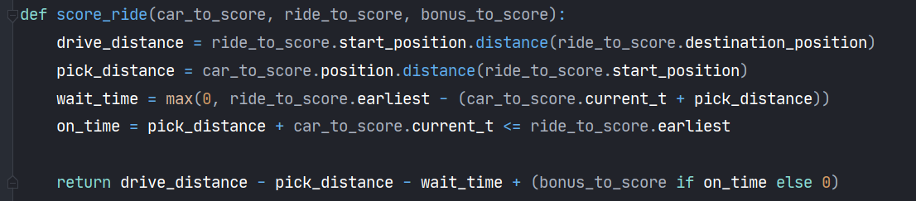
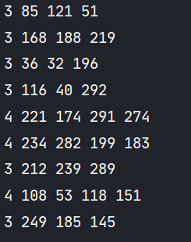
Problem Formulation
Evaluation Function
Solution Representation
The solution is provided in an output file (.out).
Each line corresponds to a vehicle.
The first number (let’s call it n) is the amount of rides that have been assigned to each vehicle. Following this number there another n numbers representing the index of each assigned ride.
On the right there is an extract of an output file (first vehicle - first line - has 3 rides [85, 121, 51]).

Slide 5

Implementation
The project will be developed mostly in Python 3 with a possible visualization using JavaScript.
The development environment used by the group to develop the project is PyCharm by JetBrains.
Data structures that will be used are trees for the most part.
The project directory will follow this structure:
doc: where all documents will be stored;
src: where the project’s source code is located;
objects: folder that contains all the classes, representing the entities involved: Car, Ride, Position, Rides, FIFO, Car Genetic Rides.
solvers: solver files for all implemented algorithms: hill climbing, simulated annealing, genetic (car), genetic (rides)
assets: where code developed by others and the input is located (5 different files).
Each input file contains 6 integers in each line. The first line contains [grid rows, grid columns, vehicles, rides, bonus per ride, steps].
All the other lines contain [row1, column1, row2, column2, earliest start, latest finish]. As it is, the program can be run with or without arguments. If the program is executed with an argument it should be the title of an input (.in) file. If not, the program will test all 5 input files determining the sum of all 5 scores. Both ways of running will print the details of all rides for each tested input file.
1st and 2nd files are almost instantly processed and as for the other 3 they all take around 4 and half minutes each (almost 14 minutes in total).
The console will show the details of every ride and when it’s done it will show the score for the input file (using the evaluation function)

Slide 6
Approach

Slide 7
Algorithms
The group implemented the following algorithms:
Greedy search: this algorithm was implemented before the checkpoint delivery but was then removed due to it not being an optimization algorithm. Although this method was the one that provided our first results and solution for the problem.
Local search algorithms:
Hill climbing: this algorithm usually finds the local maximum, although it can get stuck on a local minimum, depending on the initial state.
Simulated annealing: .

