Slide 1

Traffic simulation
Made by: D13 KafijaArSviestu
Developed during Ventspils IT challenge 2020

Slide 2
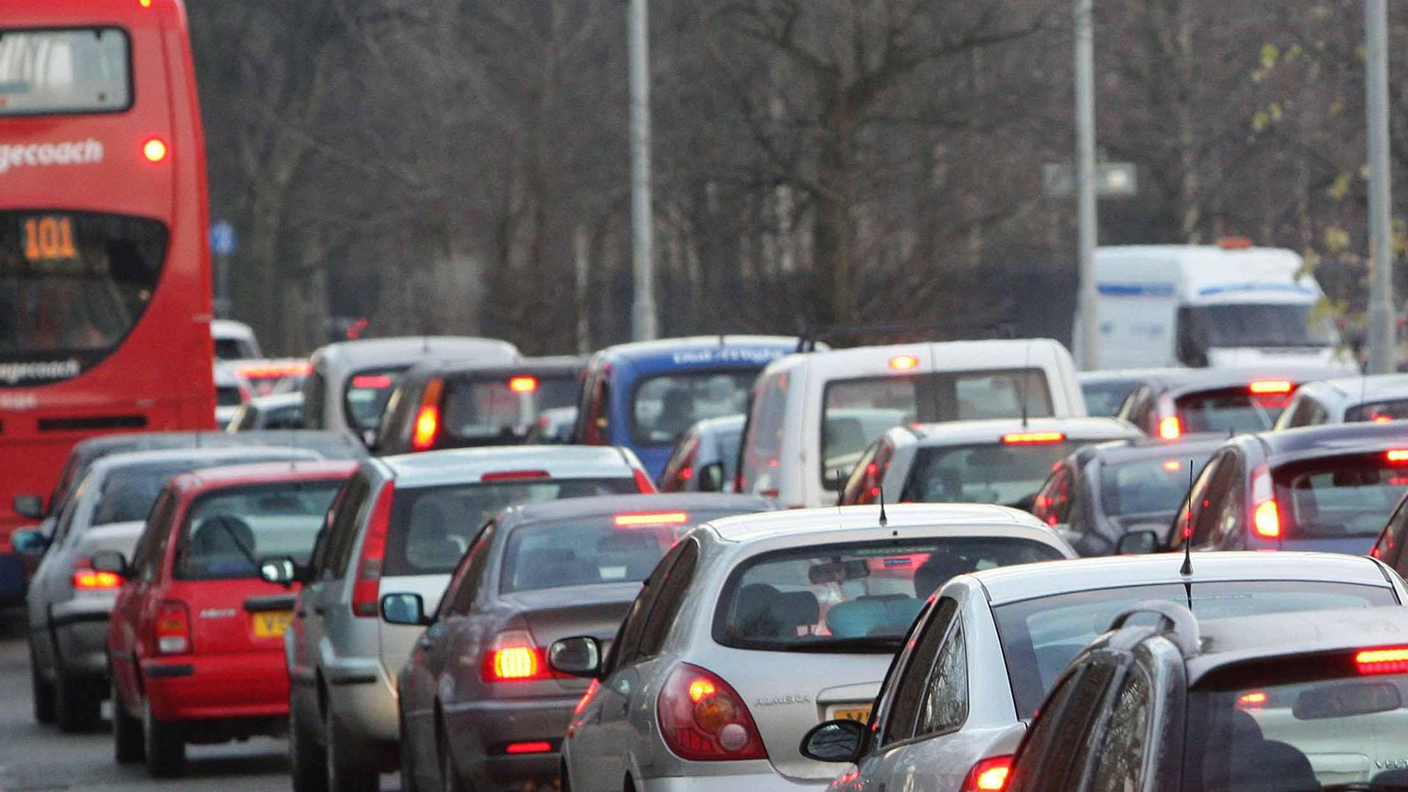
Source: https://news.sky.com/story/congestion-costs-uk-economy-8bn-in-2018-an-average-of-1-300-per-driver-11635271
Developed during Ventspils IT challenge 2020

Slide 3

30 people in a bus
(75% full)
30 people in 20 cars
(1,5 per car)
Source: https://nhts.ornl.gov/
Developed during Ventspils IT challenge 2020

Slide 4







Source: https://www.pinterest.nz/pin/502292164688540867/
Developed during Ventspils IT challenge 2020

Slide 5

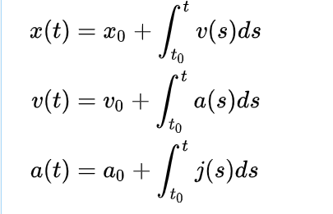
The idea
One car on average = 1,59 people
75% of busses volume = 30 people
30 cars ~ 1 bus
Developed during Ventspils IT challenge 2020

Slide 6
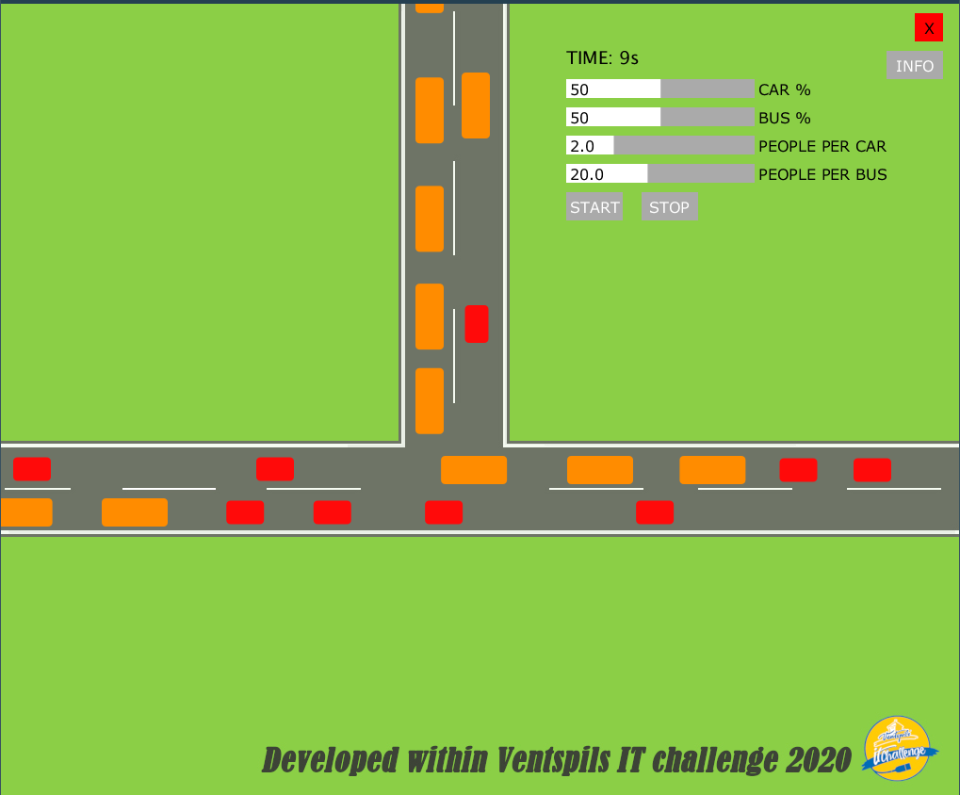
Implementation
Developed during Ventspils IT challenge 2020

Slide 7
Future
Companies abroad
Flawless traffic
Improvement of people lifes in big cities
Source: http://clipart-library.com/clipart/rTnrMn6gc.htm
Developed during Ventspils IT challenge 2020

Slide 8

Team - KafijaArSviestu
Members:
Aija Monika Vainiņa
Kristofers Barkāns
Džonatans Miks Melgalvis
Mentor:
Raivis Ieviņš
Developed during Ventspils IT challenge 2020

Slide 9
Thanks for listening ☺
Developed during Ventspils IT challenge 2020

