Slide 1

Centralized logging Graylog
Kristijan Trajkosvki

Slide 2
Why graylog?
Free and open source log management system.
Pattern detection, interactive visualization, dynamic queries, anomaly detetion, more sharing…etc

Slide 3
What does graylog
Receives messages from multiple input protocols GELF via HTTP/UDP/TCP, Syslog ,….
Assign messages to stream
Trigger user-defined alerts per streams
Stores messages in ElasticSearch for graphing
Provides messages to different outputs based on streams
Uses MongoDB to store metadata and alerts

Slide 4
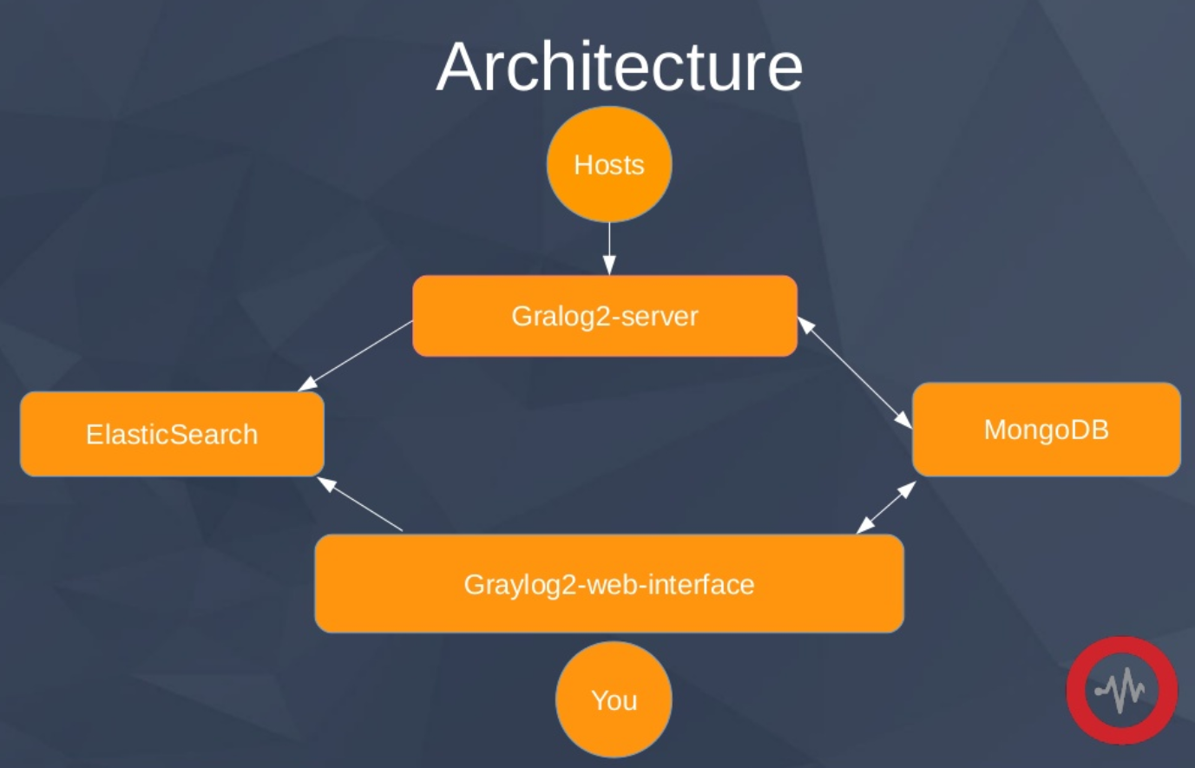
Architecture

Slide 5
Plugins
Are written in Java
Nearly all parts of Graylog are extensible:
Inputs
Outputs
Services
Alarm callbacks
Filters
REST API resources
Periodical tasks

Slide 6
How to send your logs?
1.Classic syslog via TCP/UDP
2.GELF via HTTP/TCP/UDP
3.Write your own input plugin

Slide 7
GELF
Graylog Extended Log Format – Lets you structure your logs
Compressed or uncompressed JSON string
JSON Hash with mandatory fields: host, version, short_message, full_message, timestamp, level
Additional custom fields start with an underscore
Many libraries for different systems and language available

Slide 8
Example gelf message
{
"version": "1.1",
"host": "example.org",
"short_message": "A short message that helps you identify what is going on",
"full_message": "Backtrace here\n\nmore stuff",
"timestamp": 1385053862.3072,
"level": 1,
"_user_id": 9001,
"_some_info": "foo",
"_some_env_var": "bar"
}

Slide 9
Sending GELF messages
NETCAT GELF UDP
echo -n '{ "version": "1.1", "host": "example.org", "short_message": "A short message", "level": 5, "_some_info": "foo" }' | nc -w0 -u graylog.example.com 12201
NETCAT GELF TCP
echo -n -e '{ "version": "1.1", "host": "example.org", "short_message": "A short message", "level": 5, "_some_info": "foo" }'"\0" | nc -w0 graylog.example.com 12201

Slide 10
Python graypy
import logging
import graypy
my_logger = logging.getLogger('test_logger')
my_logger.setLevel(logging.DEBUG)
handler = graypy.GELFTCPHandler('10.0.75.1', 12201)
my_logger.addHandler(handler)
my_logger.debug('Hello Graylog3.')

Slide 11
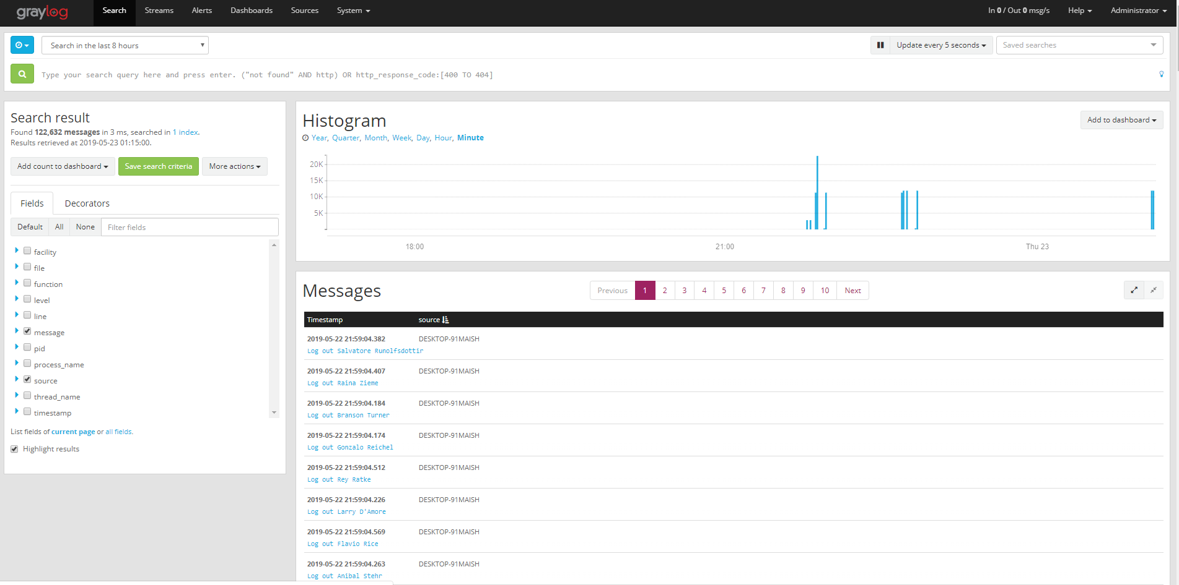

Slide 12
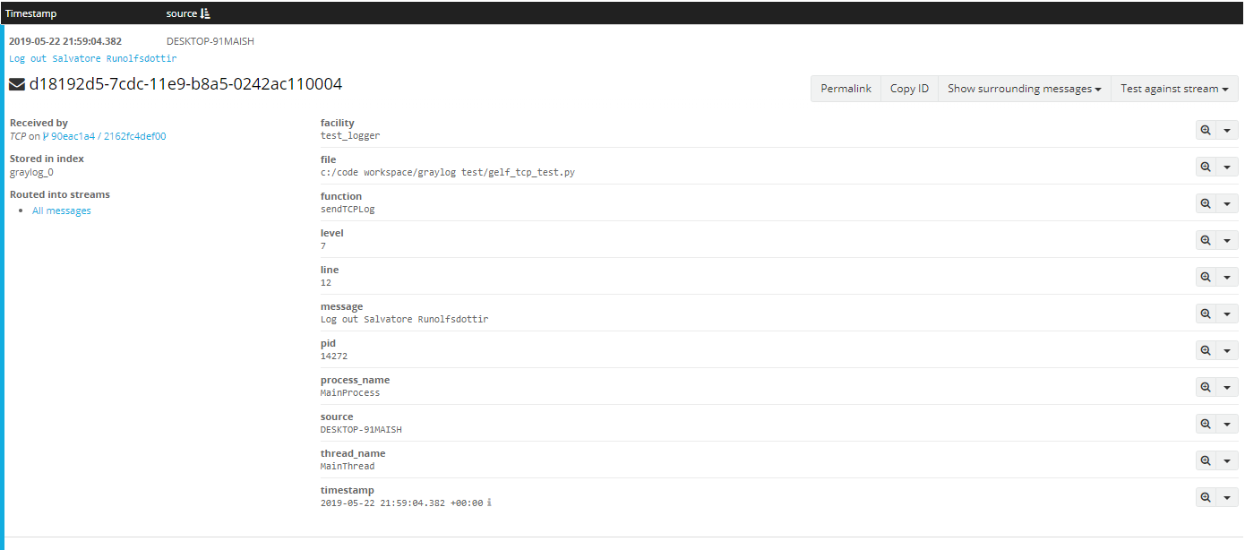

Slide 13
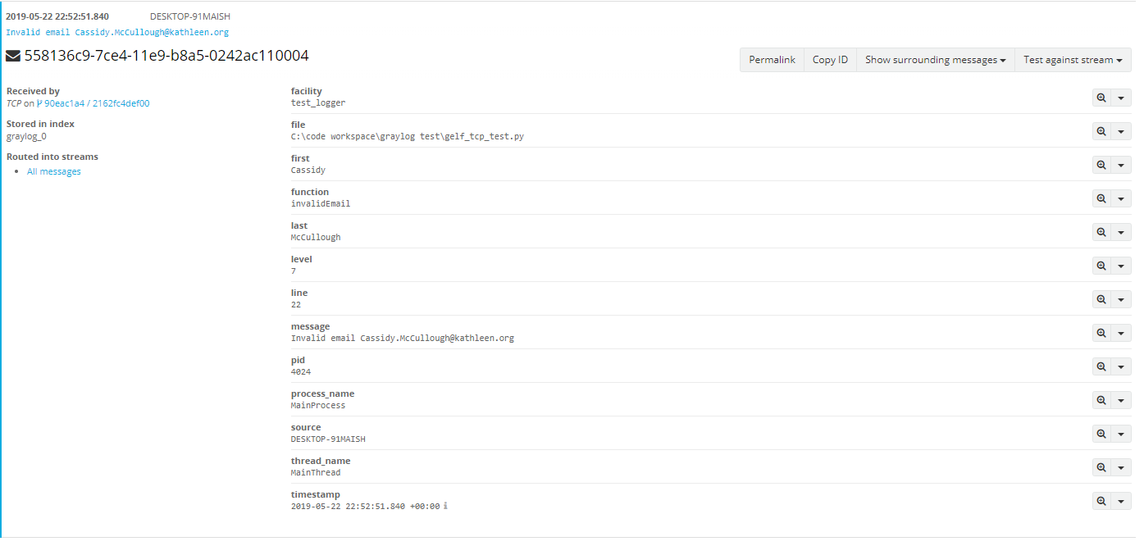

Slide 14
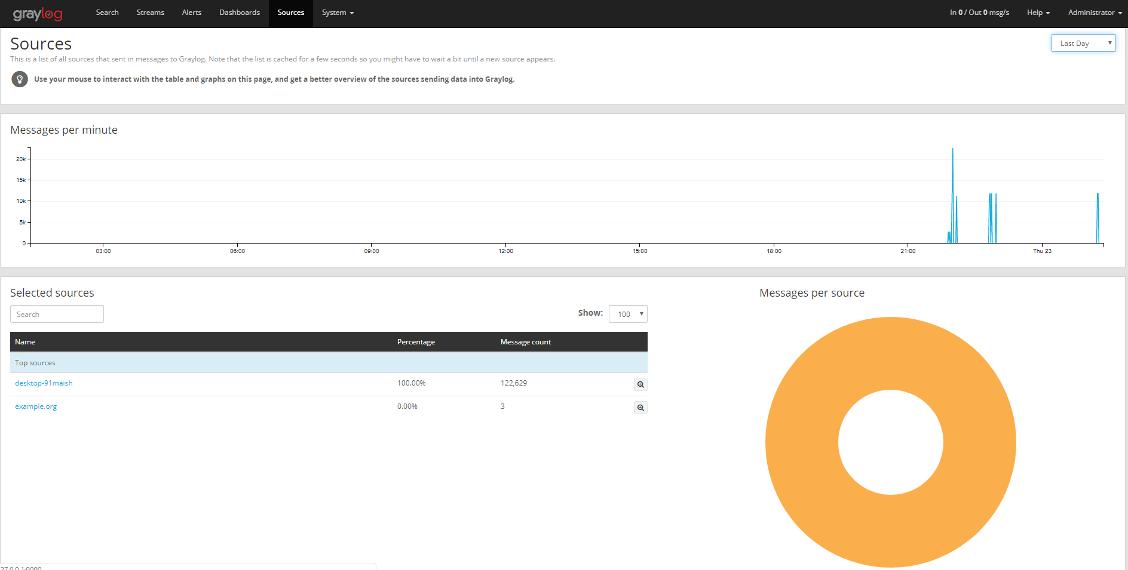

Slide 15
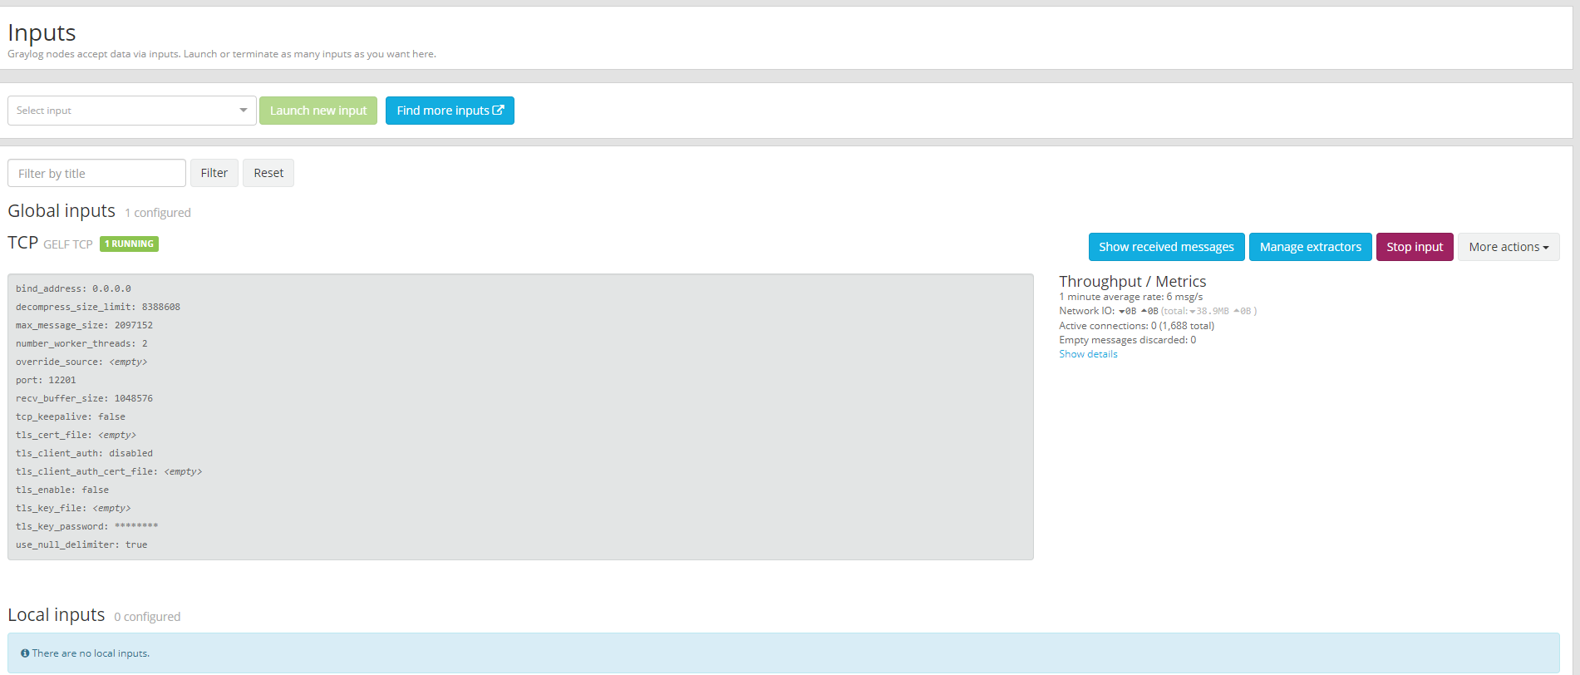

Slide 16
