Slide 1

Making your Xamarin App Kawaii
Ricardo Vila

Slide 2
LayoutOptions
They can be set through two attributes
HorizontalOptions
VerticalOptions
Alternatives:
Start
Center
End
Fill
Default is “Fill”
StartAndExpand
CenterAndExpand
EndAndExpand
FillAndExpand

Slide 3
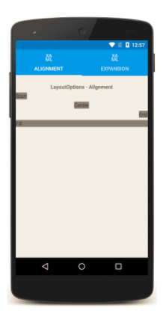
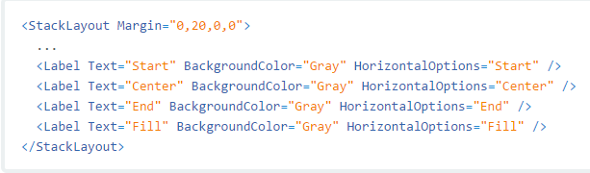
Example

Slide 4
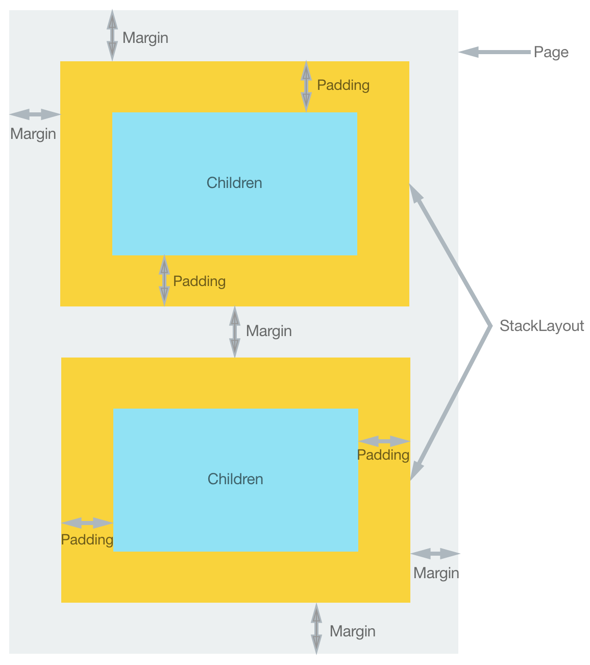
Margin and Padding
You can specify four values
Margin=0 (left), 20 (Top), 15 (Right) , 20 (Bottom)
Same with Padding
Padding and Margins are of type Thickness
Thickness values can be negative

Slide 5
Layouts

Slide 6
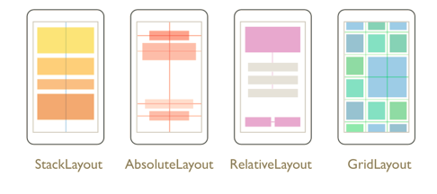

Slide 7
StackLayout
Are best used for simple layouts
If a lot of nested layouts are needed, consider another layout

Slide 8
GridLayout
Two dimensional grid pattern
Width and Height Values: *, Auto, Absolute Value
Use star over auto (increases performance)

Slide 9
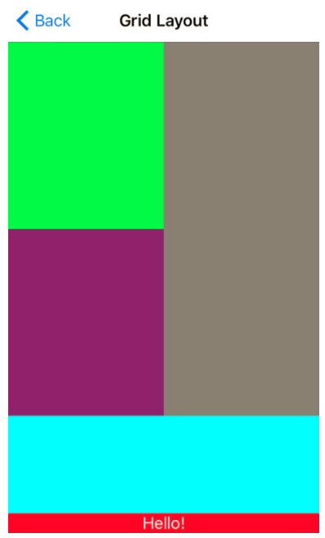
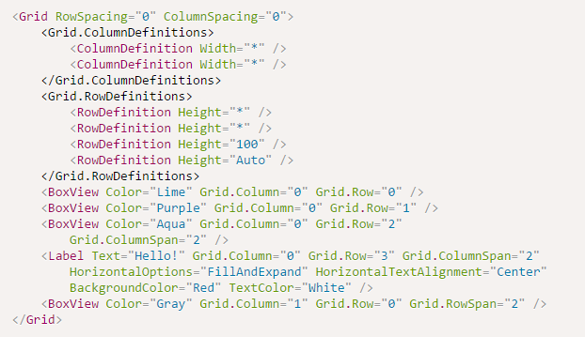
Grid Structure

Slide 10
AbsoluteLayout
Can use absolute and proportional values
Good for centering elements
Good for overlaying elements on the entire view
Multiple values can be entered for LayoutFlags

Slide 11
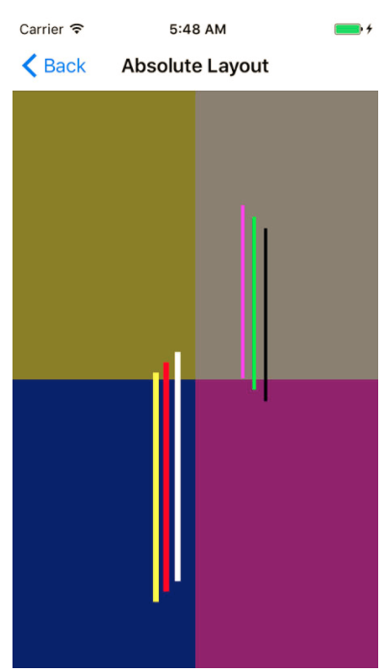
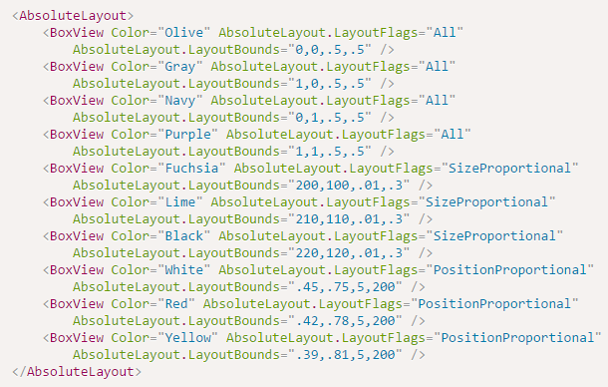
AbsoluteLayout

Slide 12
RelativeLayout
Establish positions and sizes based on parent or other views
Heaviest layout in terms of performance

Slide 13
Styles

Slide 14
Styles
Are defined in the ResourceDictionary of the Page or App class
Are consumed using the StaticResource markup extension
You can change styles dynamically
You can set global styles which are accessible from any page from the StaticResource extension

Slide 15
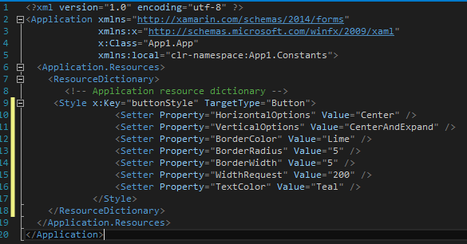
Global Styles

Slide 16
Global Colors
If you’re okay with using Xamarin’s default colors, you can set store them in your App.Resources dictionary also (XAML or C#)

Slide 17
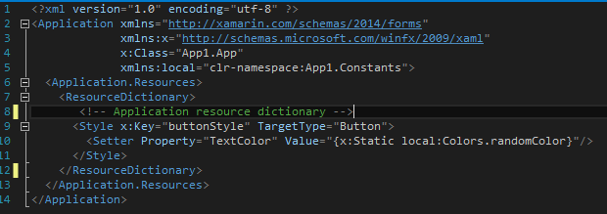
Custom Global Colors
Namespace
Static member of class Color

Slide 18
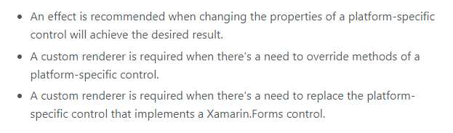
Effects
Simple Custom Renderers
Used for simple customizations

Slide 19
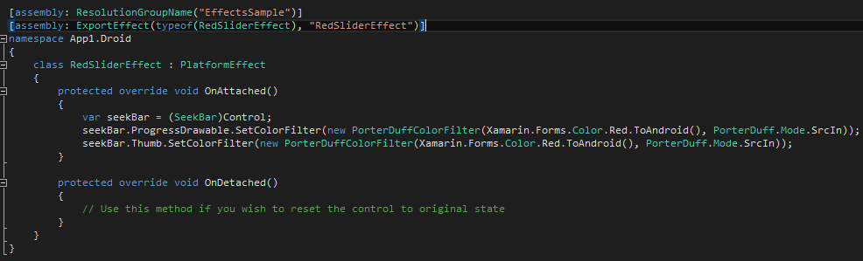
Effects Example
slider.Effects.Add(Effect.Resolve("EffectsSample.RedSliderEffect"));

Slide 20
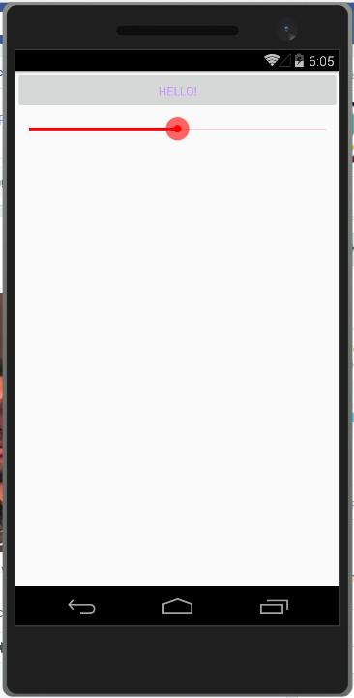
Result

Slide 21
Custom Renderers
Full customization freedom of controls
You have access to almost all of the native APIs
Custom Renderer have to be established for every platform your app supports
You can look at the Xamarin source code for the control renderer you want to customize for guidance

Slide 22
Animations

Slide 23
Animations
Example
TranslateTo
ScaleTo
RelScaleTo
RotateTo
RelRotateto
RotateXTo
RotateYTo
FadeTo
http://www.redbitdev.com/cross-platform-animations-using-xamarin-forms/

Slide 24
Talleres de Mobile Development y Cloud Computing
Mayo 15 – Microsoft San Juan
T-rivila@Microsoft.com

