Slide 1
CSCI251
Advanced Programming (S1)
Subject Content Introduction

Slide 2
Assumed background
This subject is in transition.
This session there will be students taking this subject via a range of pathways.
CSCI114 → CSCI124 → CSCI251
CSCI114/ISIT111 → CSIT121 → CSCI251
CSIT111 → CSIT121 → CSCI251
Probably some programming → CSCI851

Slide 3
Subject Description
The subject develops a thorough understanding of programming features, which are implemented in the C++ programming language.
It comprises of four main components, namely procedural-based, object-based, object-oriented and generic programming.
The subject addresses topics including memory management issues and dynamic memory allocation; classes; STL sequential and associative containers; operator overloading; advanced features in object-oriented programming; C++ RTTI; templates and exception handling; the latest C++ features (e.g. C++11 and C++14 standards).

Slide 4
So … what is this subject about?
This subject looks beyond the object-based/object-oriented content of CSIT111 and CSIT121, and beyond the limitations of Java.
We use C++ as a vehicle for exploring a range of programming: Procedural, object-based, object-oriented, and generic.
We look at the differences between Java and C++, for example the memory management models.
  Due to the undergraduate structure there will be references to Java.

Slide 5
Topics covered …
The following are the list of topics (though it may include other sub-topics if time allows)
Review. Intro to C++. Procedural programming
C++ files. String streams, Binary & formatted I-O
Memory management: Dynamics, pointers, containers
Object oriented C++
Encapsulation, inheritance, polymorphism
Overloading
Generic programming. Templates.
STL and STL containers.
C++: new features and standards (e.g. C++11 & C++14)
Likely integrated

Slide 6
Languages evolve
C++ continues to evolve.
Don’t think of it as a static tool.
  This is true of most (programming) languages.
We will try an integrate some of the more modern features of C++ (11, 14, 17?) into this subject; but the scope is HUGE and there isn’t time to cover everything.

Slide 7
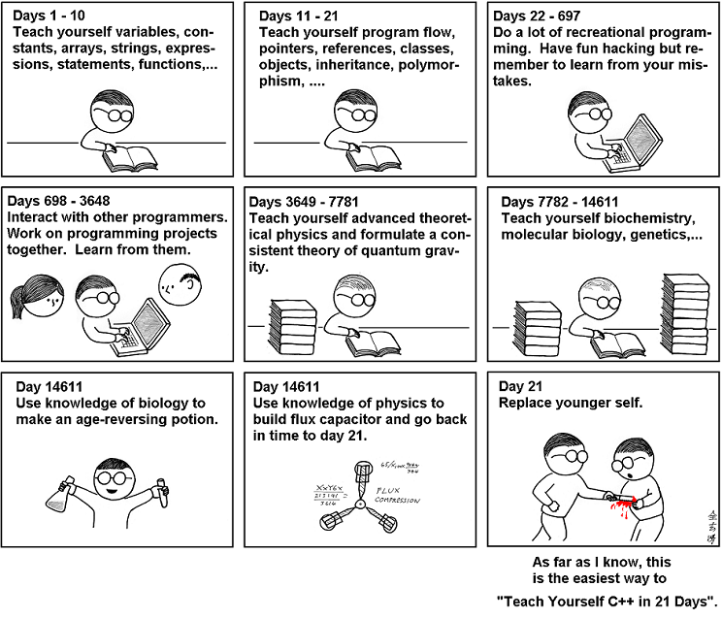
Learning to code in 21 days …
http://abstrusegoose.com/249

Slide 8
Practice makes better …
21 days isn’t enough
  For this subject or for competence.
When there are examples in the lecture notes they are just that -> examples, not points to learn.
  You should practice variations and learn by making mistakes.
  It’s better to make mistakes in your own practice than in the assignment.
There are many code snippets provided in lectures:
  Attempt them, and clarify with tutor during labs

