Slide 1
CSCI317 – Database Performance Tuning
Tutorial
Clustering Relational Tables
Sionggo Japit
sjapit@uow.edu.au
21 January 2019

Slide 2
What is a cluster?
Cluster is a group of tables that share the same data blocks because they share the same columns and are frequently used together
Clusters are transparent to query languages
Clusters are logically and physically dependent of the data in the associated tables
Once created, a cluster is automatically maintained and used by a database system
Retrieval performance of clustered tables may be better than retrieval performance of non-clustered tables
Presence of clusters decreases performance of update, delete and insert operations

Slide 3
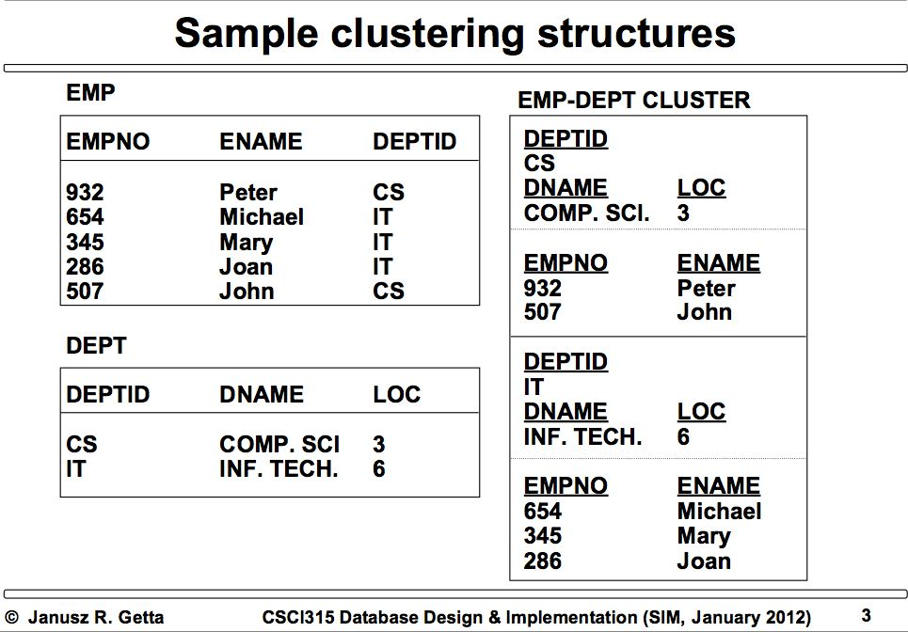
Question
Sample Clustering Structures

Slide 4
Clustering Relational Tables
With 3 relations (tables), there are 3 possible clusters.
With 4 relations (tables), there are 6 possible clusters.
With 5 relations (tables), there are 10 possible clusters.
With 6 relations (tables), how many possible clusters are there?

Slide 5
Clustering Relational Tables
Consider the relational tables
Part(p#, pname, price)
SP(p#, s#, qty)
Supplier(s#, sname, address)
Two possible clusters are:
1. Part and SP over p#
2. SP and Supplier over s#

Slide 6
Clustering Relational Tables
Retrieval performance of clustered tables may be better than retrieval performance of non-clustered tables.
Possible saving from clustering tables:

Slide 7
Clustering Relational Tables
Example:
Consider the relational tables
Part(p#, pname, price) occupies 300 blocks
SP(p#, s#, qty) occupies 50 blocks
Supplier(s#, sname, address) occupies 100 blocks
Joining the relational tables Part and SP needs to read 7000 blocks, and it is done on average 10 timer per day.
Joining the relational tables Supplier and SP needs to read 2500 blocks, and it is done on average 30 times per day.
What is the best (optimal) cluster can be formed?

Slide 8
Clustering Relational Tables
Saving from clustering Part and SP over p#:
= (7000 – (300 + 50)) * 10 = 66,500 read blocks
Saving from clustering Supplier and SP over s#:
= (2500 – (100 + 50)) * 30 = 70,500 read blocks
Thus we would form the cluster Supplier and SP over s#.

Slide 9
Clustering Relational Tables
Algorithm
Make a set of clustering variants V empty, repeat
Find in a clustering graph a variant V_{max} that maximises savings;
Add V_{max} to V;
Remove from a clustering graph an edge that represents a variant V_{max} and all edges that represent variants inconsistent with V_{max} ;
until clustering graph has no edges;

Slide 10
Clustering Relational Tables
Assume that database consists of the following relational tables:
R size 100 blocks,
S size 50 blocks,
T size 200 blocks,
U size 80 blocks,
V size 50 blocks,
Assume that tables:
R and S are joined on average 10 times per day,
S and T are joined on average 5 times per day,
T and U are joined on average 10 times per day,
T and V are joined on average 15 times per day

Slide 11
Clustering Relational Tables
Assume that join of:
R and S needs 200 read block operations
S and T needs 300 read block operations
T and U needs 300 read block operations
T and V needs 320 read block operations

Slide 12
Clustering Relational Tables
What are the clusters can be formed to obtain optimal saving?

Slide 13
Clustering Relational Tables
200 rb, 10 time/day
S
R
50 blocks
100 blocks
300 rb, 5 time/day
V
320 rb, 15 time/day
50 blocks
T
300 rb, 10 time/day
200 blocks
U
80 blocks

Slide 14
Clustering Relational Tables
500
S
R
250
V
1050
T
200
U

Slide 15
Clustering Relational Tables
500
S
R
250
V
1050
T
200
U

Slide 16
Clustering Relational Tables
500
S
R
V
1050
T
U

Slide 17
Clustering Relational Tables
500
S
R
V
1050
T
U

