Slide 1
CSCI317 – Database Performance Tuning
Tutorial – Denormalization
Sionggo Japit
sjapit@uow.edu.au
14 October 2019

Slide 2
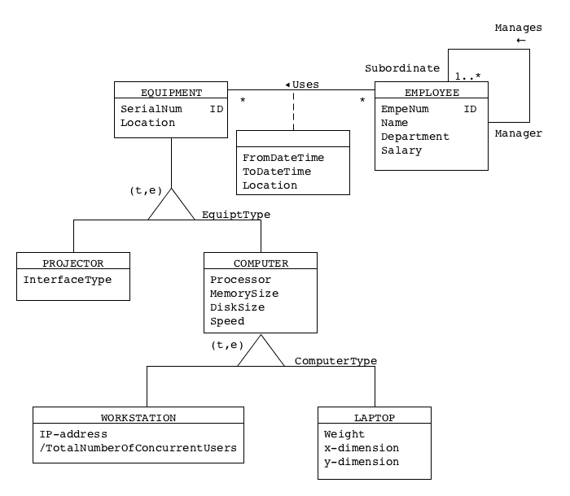
Computer Equipment

Slide 3
Problem statement:
Assume that:
The queries related to Projectors, Laptops, and computer components are very rare,
A lot of queries are consistent with the following patterns:
“find the names of all employees using a workstation identified by a given IP address just now”
“find all workstations which are used in a given period of time by employees from a given department.”

Slide 4
Problem statement:
Eliminate generalization hierarchy from the conceptual model given above. Assume that objective of this transformation is to optimize the performance of applications consisted with the patterns listed above.

Slide 5
Steps involved:
Elimination of generalization
Association method
Subset method
Superset method
Simplifications
Elimination of association classes
Elimination of link attributes
Elimination of many-to-many associations
Decomposition (Horizontal)
Migrate/copy attributes

Slide 6
Elimination of generalization using association method

Slide 7
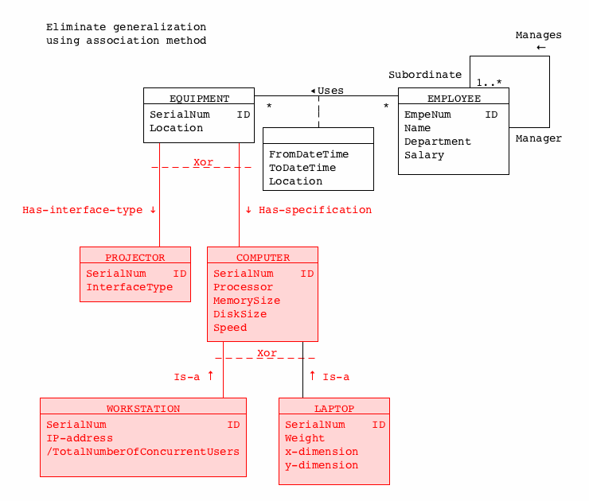
Eliminate generalization using Association Method
Elimination of generalization using association method.

Slide 8
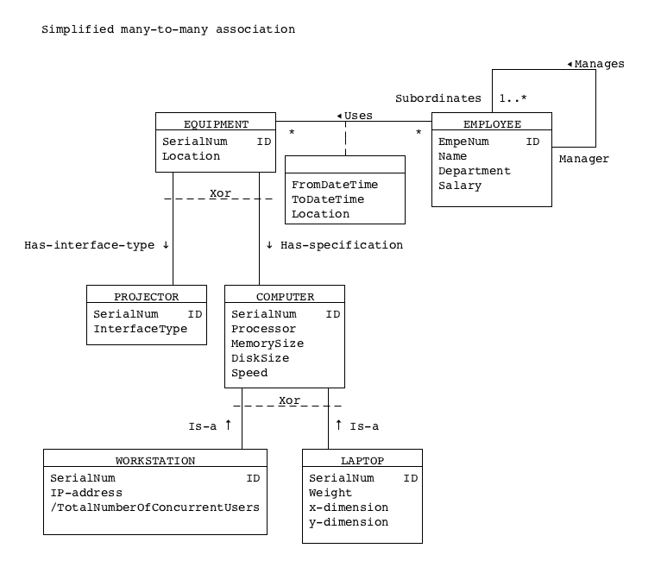
Conceptual Model With Generalization Removed
Next, we need to eliminate the link-attributes.

Slide 9
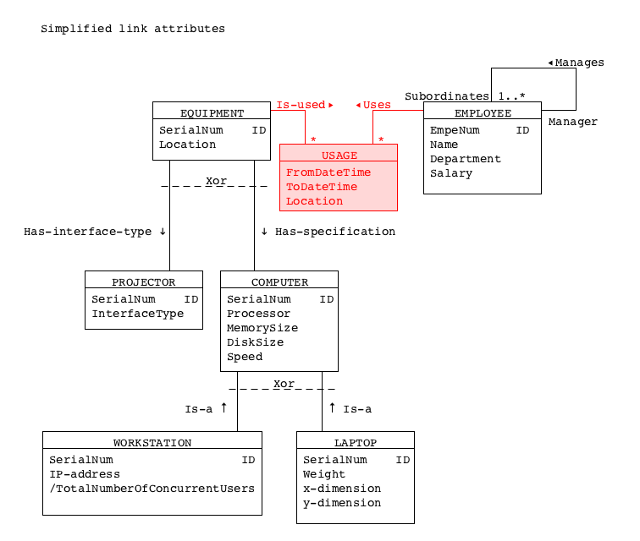
Eliminate the link attribute
But this poses a problem. An employee (EmpeNum) may be using the same equipment (SerialNum) in a different day and time. In such a situation, the primary key of the association class USAGE is not unique.
How to solve this problem?

Slide 10
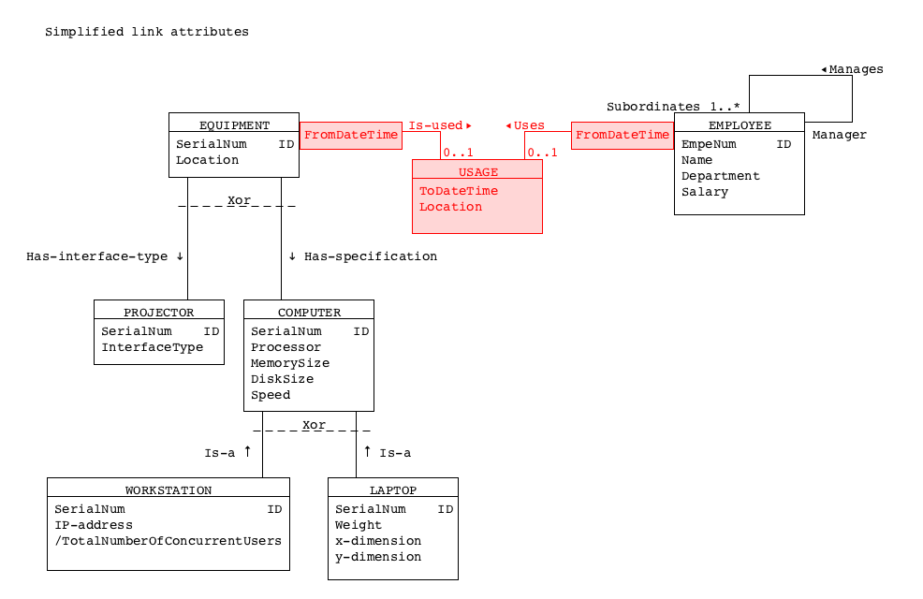
Eliminate the link attribute
We can qualify the one-to-many associations to solve the problem. The FromDateTime will qualify the association and uniquely identify the usage (or connection) to the equipment done by the employee at a particular date and time.

Slide 11
Attribute migration
A lot of queries are consistent with the following patterns:
“find the names of all employees using a workstation identified by a given IP address just now”
“find all workstations which are used in a given period of time by employees from a given department.”

Slide 12
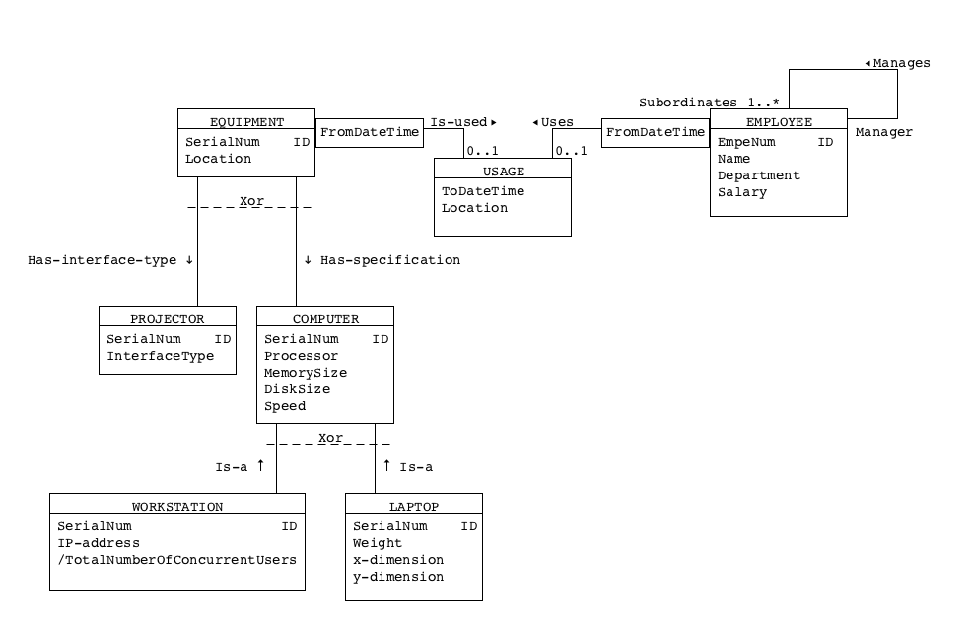
Attribute migration
Find the names of all employees using a workstation identified by a given IP address just now
Rule to migrate/copy an attribute:
An attribute can be migrated/copied from one class to another class along an association with ‘One-to-many’ or ‘One-to-one’ multiplicity. NEVER FROM ‘MANY-TO-ONE’ MULTIPLICITY.

Slide 13
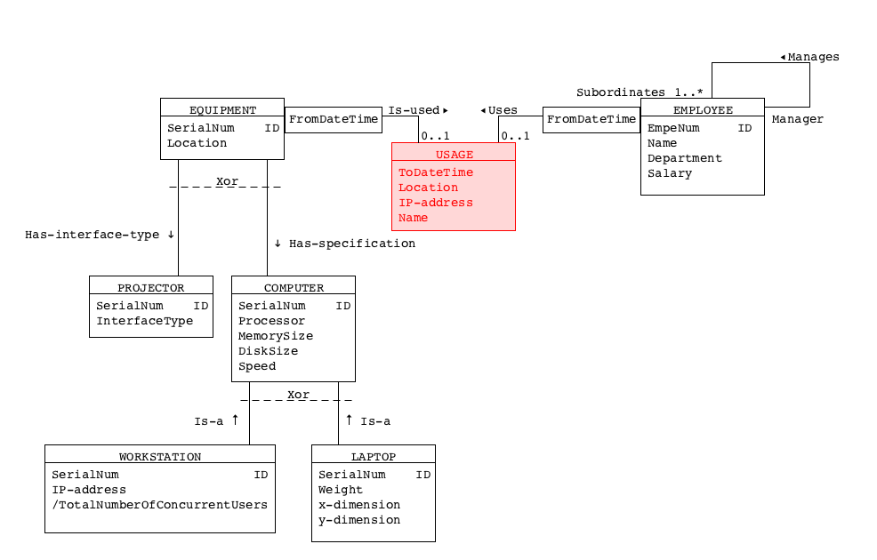
Attribute migration
SELECT Name, IP-address
FROM USAGE
WHERE to_char (FromDateTime, ’YYYYMMDD-HHMM’) = ‘20140502-0830’;

Slide 14
Attribute migration
How about this query?
“Find all workstations which are used in a given period of time by employees from a given department.”
Try to do it yourself as an exercise.

Slide 15
Eliminate Generalization Using Subset Method

Slide 16
Computer Equipment

Slide 17
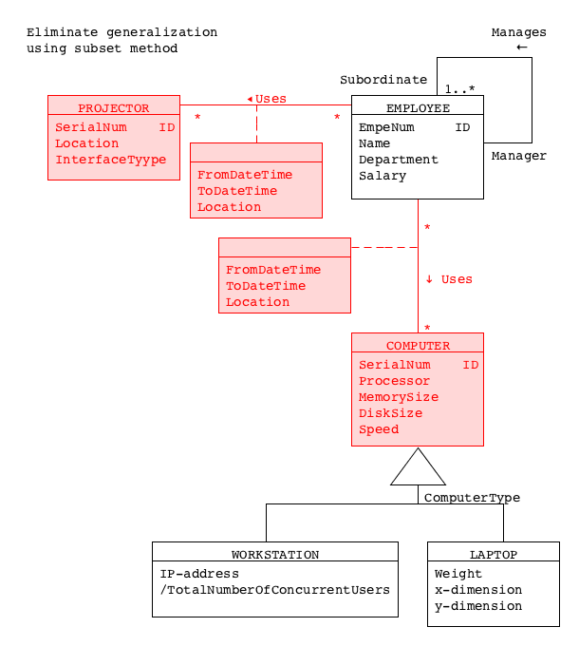
Eliminate Generalization Using Subset Method
Eliminating generalization using subset method.

Slide 18
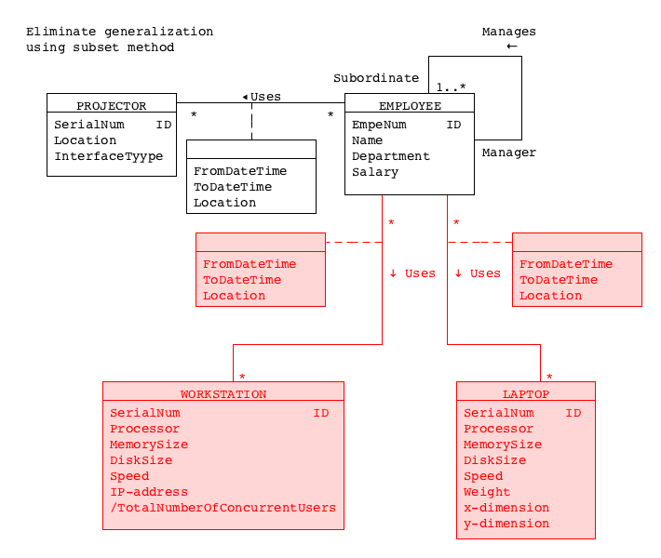
Eliminate Generalization Using Subset Method
Eliminating generalization using subset method.

Slide 19
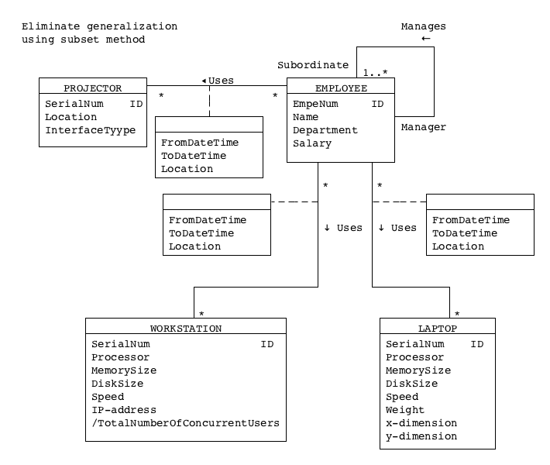
Conceptual Model With Generalization Removed

Slide 20
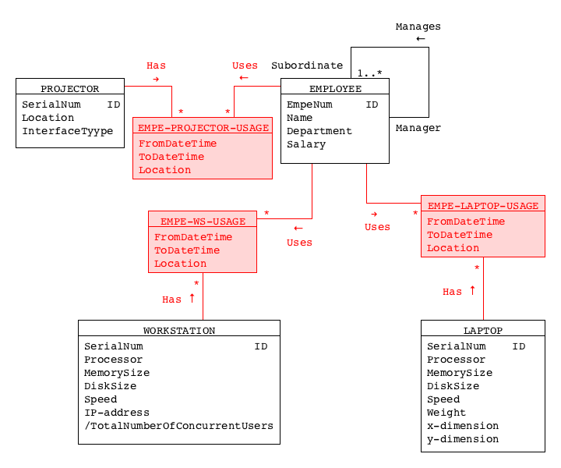
Simplify Link Attributes
Next, we need to eliminate the link-attributes.

Slide 21
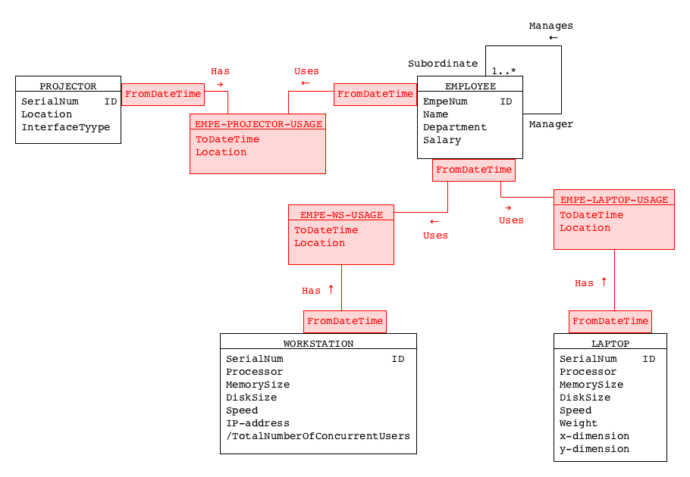
Simplify Link Attributes

Slide 22
Migrate/Copy Attributes
“find the names of all employees using a workstation identified by a given IP address just now”
“find all workstations which are used in a given period of time by employees from a given department.”

Slide 23
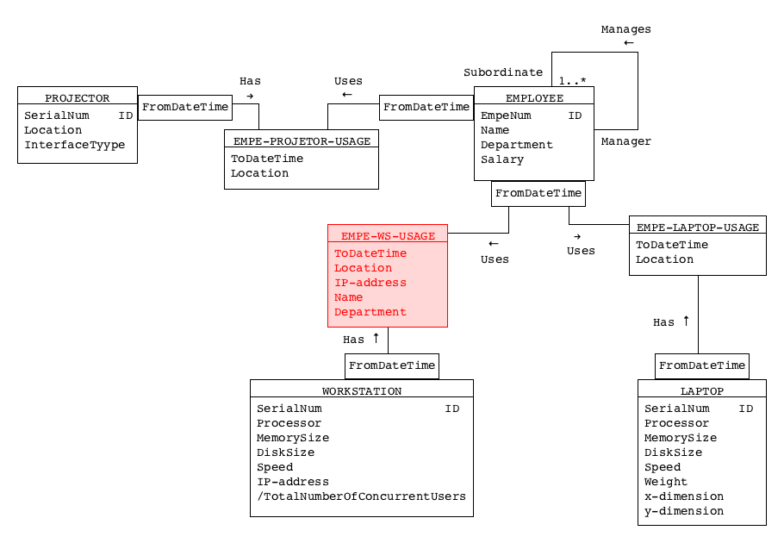
Migrate/Copy Attributes
SELECT EmpeNum,
Name,
Department,
SerialNum,
IP-address,
FromDateTime
FROM EMPE-WS-USAGE
WHERE to_char(FromDateTime, ‘YYYYMMDD-HHMM’) = ‘20140502-1030’;

