Slide 1
CSCI317 – Database Performance Tuning
Tutorial – Partitioning of Conceptual Schema
Sionggo Japit
sjapit@uow.edu.au
14 October 2019

Slide 2
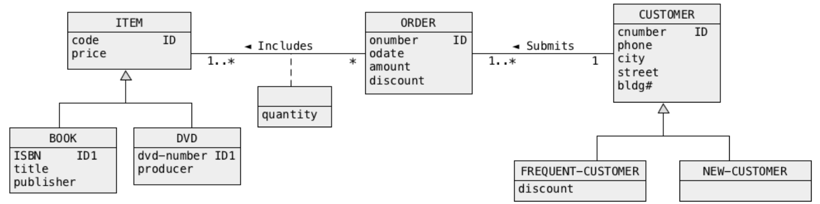
Partitioning of Conceptual Schema
Consider a conceptual schema given below.
Consider the database applications consistent with the following template.
Find the total amounts (attribute amount in the class ORDER) of all orders submitted by a frequent customer with a given number (attribute cnumber in a class CUSTOMER) and such that each order included a book with a given ISBN (attribute ISBN in a class BOOK).

Slide 3
Partitioning of Conceptual Schema
A sample application consistent with the template above is as follows.
Find the total amounts (attribute amount in a class ORDER) of all orders submitted by a frequent customer number 007 and such that each order included a book with ISBN: 978-1-4643-2137-3

Slide 4
Partitioning of Conceptual Schema
We would like to improve the performance of all applications consistent with the template given above through partitioning of object classes and through appropriate transformation of generalization hierarchies. There is no need to perform denormalization.
Find a transformed conceptual schema that improves the performance of a given class of applications and redraw the entire conceptual schema after the transformation. To draw a transformed conceptual schema you can use UMLet and a file task2.uxf that contains the drawing of the original conceptual schema.

Slide 5
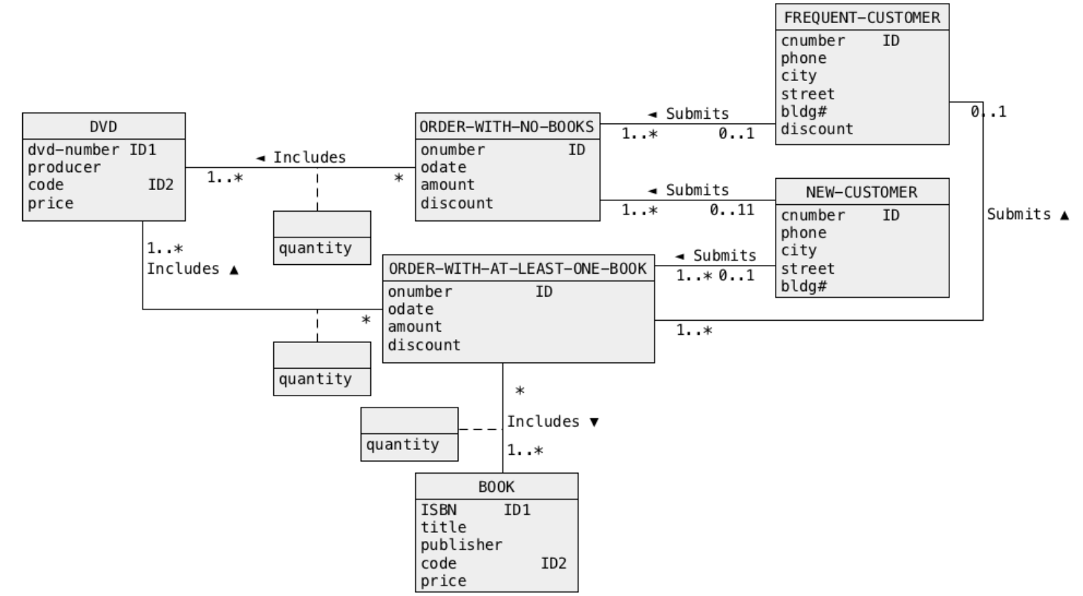
Partitioning of Conceptual Schema

