Slide 1
CSCI262 – Systems Security
More example on BLP Lattice
sjapit@uow.edu.au
15 October 2020

Slide 2
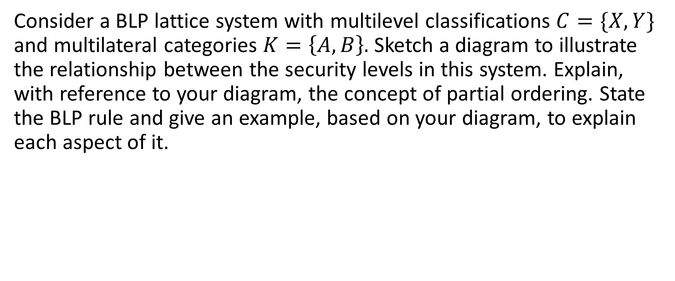
BLP Lattice
Consider a BLP lattice system with multilevel classifications $C=\{X, Y\}$ and multilateral categories $K=\left\{A, B\right\}.$ Sketch a diagram to illustrate the relationship between the security levels in this system. Explain, with reference to your diagram, the concept of partial ordering. State the BLP rule and give an example, based on your diagram, to explain each aspect of it.
Notes:
The partial ordering <= is defined by (x, {A}) <= (y, {A}) if and only if x <= y and {A} <= {A}.
ss-property, *-property and ds-property.

Slide 3
{A,B}
{A}
{B}
{B}
{A}
{ø}
(X, {A,B})
(X, {A})
(X, {B})
(X, {ø})

Slide 4
(Y, {A,B})
(Y, {A})
(Y, {B})
(Y, {ø})
(X, {A,B})
(X, {A})
(X, {B})
(X, {ø})

Slide 5
(Y, {A,B})
(Y, {A})
(Y, {B})
(Y, {ø})
(X, {A,B})
(X, {A})
(X, {B})
(X, {ø})

Slide 6
(Y, {A,B})
(Y, {A})
(Y, {B})
(Y, {ø})
(X, {A,B})
(X, {A})
(X, {B})
(X, {ø})

Slide 7
Example of the dominances:
(Y, {A,B})
(Y,{ø}) ≥ (X,{ø})
(Y,{A}) ≥ (X,{A})
(Y,{B}) ≥ (X,{B})
(Y,{A,B}) ≥ (X,{A,B})
(Y,{A}) ≥ (Y,{ø})
(Y,{B}) ≥ (Y,{ø})
(X,{A}) ≥ (X,{ø})
(X,{B}) ≥ (X,{ø})
(X,{A,B}) ≥ (X,{A})
(X,{A,B}) ≥ (X,{B})
(Y, {A})
(Y, {ø})
(Y, {B})
(X, {A,B})
(X, {A})
(X, {B})
(X, {ø})

Slide 8
Partial Order
(Y, {A,B})
The partial ordering <= is defined by (x, {A}) <= (y, {A}) if and only if x <= y and {A} <= {A}.
Hence, in the above example, (Y,{B}) ≥ (X,{B}) forms a partial ordering because Y ≥ X and {B} ≥ {B}.
(Y, {A})
(Y, {ø})
(Y, {B})
(X, {A,B})
(X, {A})
(X, {B})
(X, {ø})
However, (Y,{B}) ≥ (X, {A,B}) does not form a partial ordering because {B} does not dominate {A,B} although Y dominate X.

Slide 9
BLP properties (Rules)
Ss-property
Subject S(n) can WRITE object O(n) iff level of clearance of subject L(S) is less than or equal the level of clearance of the object L(O), that is, L(S) ≤ L(O), and the subject has permission to WRITE the object.
*-property
Subject S(n) can READ object O(n) iff level of clearance of subject L(S) is greater than or equal (dominant) the level of object L(O), that is, L(S) ≥ L(O), and the subject has permission to READ the object.
Discretionary
Subject S(n) can discretionarily transfer his/her authorization to Subject at a different clearance level (subject to organization policy).

Slide 10
Subjects and Object at various level of clearance
For example, we have three subjects Alice, Bob and Charlie and four objects O1, O2, O3 and O4 with the following level of clearance defined:
Subject | Level |  | Object | Level
Alice | (X,{A}) |  | O1 | (X,{A})
Bob | (Y,{B}) |  | O2 | (Y,{ø})
Charlie | (Y,{A,B}) |  | O3 | (Y,{B})
 |  |  | O4 | (X, {A,B})

Slide 11
(Y, {A,B})
Charlie
(Y, {A})
(Y, {ø})
O2
(Y, {B})
Bob
O3
Subject | Level |  | Object | Level
Alice | (X,{A}) |  | O1 | (X,{A})
Bob | (Y,{B}) |  | O2 | (Y,{ø})
Charlie | (Y,{A,B}) |  | O3 | (Y,{B})
 |  |  | O4 | (X, {A,B})
(X, {A,B})
O4
(X, {A})
Alice,
O1
(X, {B})
(X, {ø})
Access Control Matrix:
 | O1 | O2 | O3 | O4
Alice | R, W | - | - | W
Bob | - | R | R,W | -
Charlie | R | R | R | R
What if user want to allow Bob to access (read or write or both) O4?

Slide 12
Yet anther BLP lattice example
A company has two department, A and B and has determined that it is appropriate to have three levels of sensitivity, in increasing order X, Y and Z. Draw a BLP lattice system to represent this scenario. Using examples, explain the three BLP rules, 2 mandatory and 1 discretionary.
Notes:
ss-property only can read below, *-property only can write up, ds-property – permission may be passed from an authorised person to a another, level authorized person

Slide 13
{A,B}
{A}
{B}
{B}
{A}
{ø}
(X, {A,B})
(X, {A})
(X, {B})
(X, {ø})

Slide 14
(Z, {A,B})
(Z, {A})
(Z, {B})
(Z, {ø})
(Y, {A,B})
(Y, {A})
(Y, {B})
(Y, {ø})
(X, {A,B})
(X, {A})
(X, {B})
(X, {ø})

Slide 15
Example of the dominances:
(Z, {A,B})
(Z, {A})
(Z,{ø}) ≥ (Y,{ø}) ≥ (X,{ø})
(Z,{A}) ≥ (Y,{A}) ≥ (X,{A})
(Z,{A}) ≥ (Z,{ø})
(Z,{B}) ≥ (Y,{B}) ≥ (X,{B})
(Z,{B}) ≥ (Z,{ø})
(Z,{A,B}) ≥ (Y,{A,B}) ≥ (X,{A,B})
(Z,{A,B}) ≥ (Z,{A})
(Z,{A,B}) ≥ (Z,{B})
(Y,{A}) ≥ (Y,{ø})
(Y,{B}) ≥ (Y,{ø})
(X,{A}) ≥ (X,{ø})
(X,{B}) ≥ (X,{ø})
(Z, {B})
(Z, {ø})
(Y, {A,B})
(Y, {A})
(Y, {B})
(Y, {ø})
(X, {A,B})
(X, {A})
(X, {B})
(X, {ø})

Slide 16
BLP properties (Rules)
Ss-property
Subject S(n) can WRITE object O(n) iff level of clearance of subject L(S) is less than or equal the level of clearance of the object L(O), that is, L(S) ≤ L(O), and the subject has permission to WRITE the object.
*-property
Subject S(n) can READ object O(n) iff level of clearance of subject L(S) is greater than or equal (dominant) the level of object L(O), that is, L(S) ≥ L(O), and the subject has permission to READ the object.
Discretionary
Subject S(n) can discretionarily transfer his/her authorization to Subject at a different clearance level (subject to organization policy).

Slide 17
Subjects and Object at various level of clearance
For example, we have three subjects Alice, Bob and Charlie and three objects O1, O2 and O3 with the following level of clearance defined:
Subject | Level |  | Object | Level
Alice | (X,{A}) |  | O1 | (X,{A})
Bob | (Y,{B}) |  | O2 | (Y,{ø})
Charlie | (Z,{A,B}) |  | O3 | (Z,{B})

Slide 18
Charlie
(Z, {A,B})
Subject | Level |  | Object | Level
Alice | (X,{A}) |  | O1 | (X,{A})
Bob | (Y,{B}) |  | O2 | (Y,{ø})
Charlie | (Z,{A,B}) |  | O3 | (Z,{B})
(Z, {A})
(Z, {B})
O3
(Z, {ø})
(Y, {A,B})
(Y, {A})
Access Control Matrix:
O2
(Y, {B})
 | O1 | O2 | O3
Alice | R, W | - | -
Bob | - | R | W
Charlie | R | R | R
Bob
(Y, {ø})
(X, {A,B})
(X, {A})
(X, {B})
Alice
O1
(X, {ø})

