Slide 1
CSCI262 – System Security
Bayesian Probability
Sionggo Japit
sjapit@uow.edu.au
22 October 2021

Slide 2
Bayesian Probability
Bayesian inference is a method of statistical inference in which Bayes' theorem is used to update the probability for a hypothesis as more evidence or information becomes available.
Bayesian inference is an important technique in statistics, and especially in mathematical statistics.
Bayesian updating is particularly important in the dynamic analysis of a sequence of data.
Bayesian inference has found application in a wide range of activities, including science, engineering, philosophy, medicine, sport, and law.
In the philosophy of decision theory, Bayesian inference is closely related to subjective probability, often called "Bayesian probability".
Source: https://en.wikipedia.org/wiki/Bayesian_inference, Referenced on 22 Jan 2018

Slide 3
Bayesian Probability – Example
Some example:
The accuracy of a malware checker is 87%, meaning the malware checker will correctly identify a message as viral 87% of the time and the malware checker will correctly identify a message as non-viral 87% of the time. The incidence of malware attachments in email messages is 1% , that is 1 in 100 email messages is a malware. This is the base-rate. The malware checker has just flagged a message as being malware. What is the probability that the message is actually clean (not a malware)? Justify your answer.
Notes:
1% is because 1 out of a 100 messages. For assignment, is 1/800 = 0.00125

Slide 4
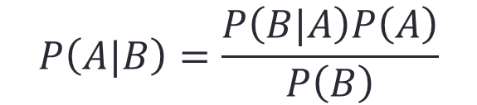
Bayesian Probability – Example
According to Baye’s theorem, the probability of event A occurs given that event B has already occurred is given by the formula:
Let A be the event that the message is clean, and
Let B be the event that the message is flagged as malware.
$$P\left(A|B\right)=\frac{P\left(B|A\right)P\left(A\right)}{P\left(B\right)}$$

Slide 5
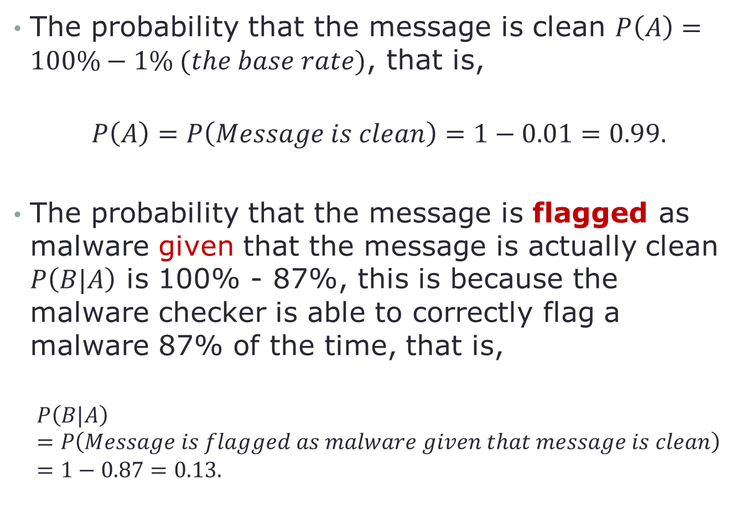
Bayesian Probability – Example
The probability that the message is clean $P\left(A\right)=100\%−1\% (the base rate)$, that is,
$$P\left(A\right)=P\left(Message is clean\right)=1−0.01=0.99.$$
The probability that the message is flagged as malware given that the message is actually clean $P\left(B|A\right)$ is 100% - 87%, this is because the malware checker is able to correctly flag a malware 87% of the time, that is,
$$P\left(B|A\right)=P\left(Message is flagged as malware given that message is clean\right)=1−0.87=0.13.$$
Notes:
1% is because 1 out of a 100 messages. For assignment, is 1/800 = 0.00125
So 100% - 0.00125%, $P\left(A\right)=P\left(Message is clean\right)=$ 800-0.00125 = x
$P\left(B|A\right)$ $=P\left(Message is flagged as malware given that message is clean\right)$ = 100% - 95% = 5%

Slide 6
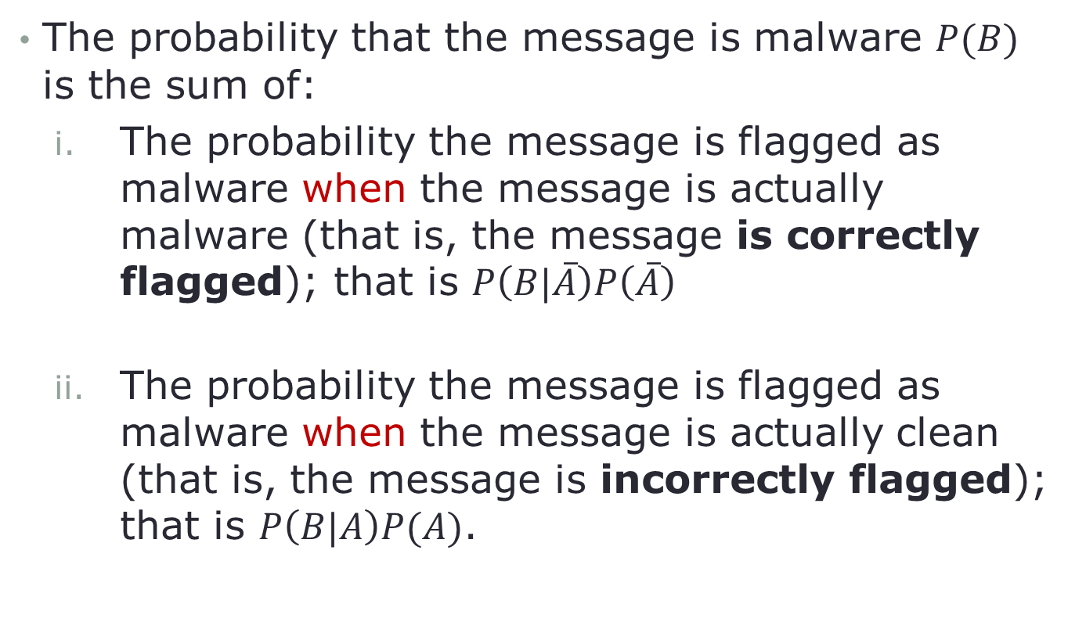
Bayesian Probability – Example
The probability that the message is malware $P(B)$ is the sum of:
The probability the message is flagged as malware when the message is actually malware (that is, the message is correctly flagged); that is $P\left(B|\overline{A}\right)P\left(\overline{A}\right)$
The probability the message is flagged as malware when the message is actually clean (that is, the message is incorrectly flagged); that is $P\left(B|A\right)P(A)$.

Slide 7
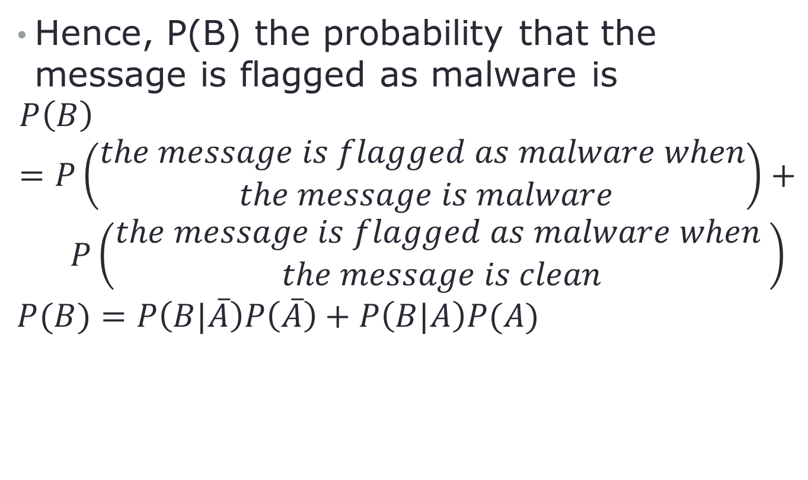
Bayesian Probability – Example
Hence, P(B) the probability that the message is flagged as malware is
$$P\left(B\right)=P\left(\begin{aligned}the message is flagged as malware when \\ the message is malware\end{aligned}\right)+$$
$$P\left(\begin{aligned}the message is flagged as malware when \\ the message is clean\end{aligned}\right)$$
$$P(B)=P\left(B|\overline{A}\right)P\left(\overline{A}\right)+P\left(B|A\right)P(A)$$

Slide 8
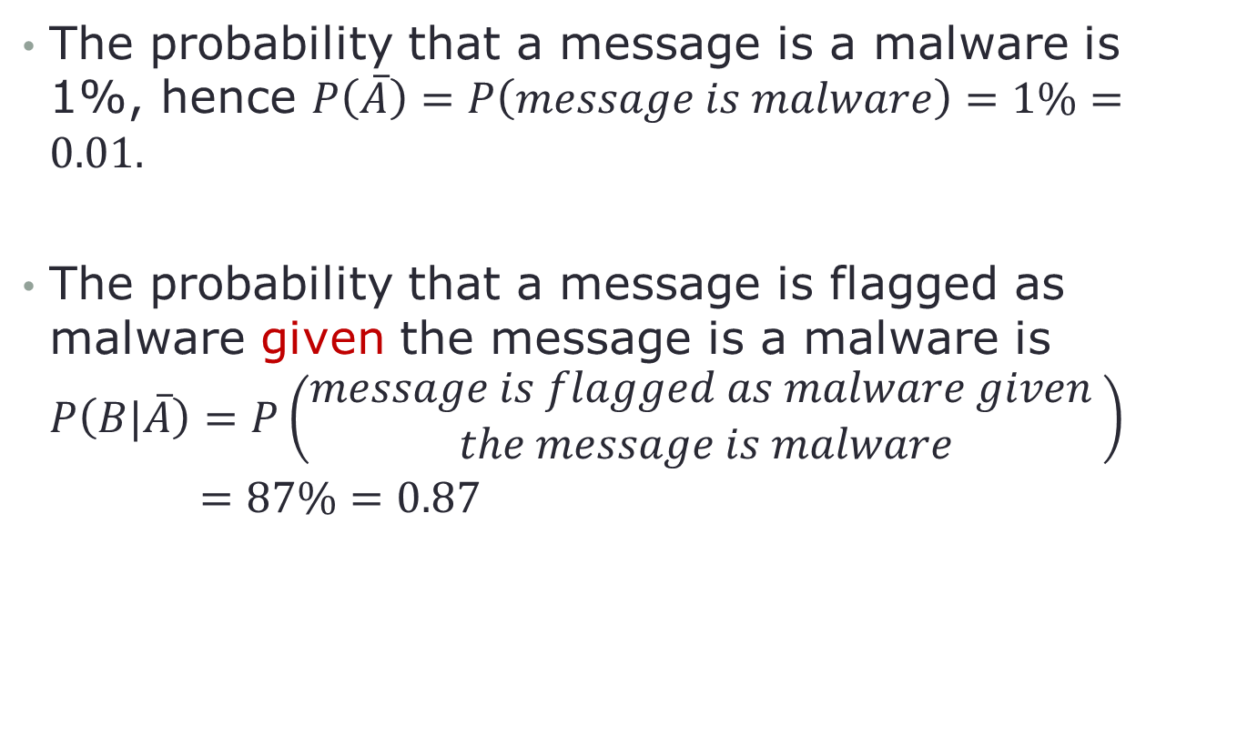
Bayesian Probability – Example
The probability that a message is a malware is 1%, hence $P\left(\overline{A}\right)=P\left(message is malware\right)=1\%=0.01.$
The probability that a message is flagged as malware given the message is a malware is $P\left(B|\overline{A}\right)=P\left(\begin{aligned}message is flagged as malware given \\ the message is malware\end{aligned}\right)$
$$=87\%=0.87$$

Slide 9

Bayesian Probability – Example
Hence,
$$P\left(A|B\right)=\frac{P\left(B|A\right)P\left(A\right)}{P\left(B\right)}$$
$P\left(A|B\right)=\frac{P\left(B|A\right)P(A)}{P\left(B|\overline{A}\right)P\left(\overline{A}\right)+P\left(B|A\right)P(A)}$
$$=\frac{0.13×0.99}{\left(0.87×0.01\right)+\left(0.13×0.99\right)}$$
$$=\frac{0.1287}{0.0087+0.1287}$$
$$=0.93668$$
Hence, there is 93.67% chance that the email attachment clean.
Notes:
The occurrences depends on the base rate.
If occurrences are low, algorithm do not have enough evidence/support to prove that its working -> Easily determined as false positive
Therefore, to accurately use the theory, occurrences rate must be higher to prove that the theory works.

Slide 10
Bayesian Probability – Example
From the above example, what do you think of Baye’s theorem being used in intrusion detection system?
Intrusion detection systems don’t cope very well with this type of problem.
The relevance of the Base-Rate Fallacy to intrusion detection systems is that, from Stallings and Brown:
In general, if the actual numbers of intrusions is low compared to the number of legitimate uses of a system, then the false alarm rate will be high unless the test is extremely discriminating.
The fallacy is a feature of Bayes' theorem. This theorem relates to conditional probability, and tells you the probability of some outcome in the context of known information.
Notes:
The occurrences depends on the base rate.
If occurrences are low, algorithm do not have enough evidence/support to prove that its working -> Easily determined as false positive
Therefore, to accurately use the theory, occurrences rate must be higher to prove that the theory works.
Requires support/evidence. Enough evidence/support for base rate is high. Then Bayesian will be accurate.
IF base rate low, will have high false alarm/false positive.
> have a very accurate malware checker but very high chances that the email is clean which is contradicting due to the low base rate
If B happens, how would A react.

