Slide 1

CSCI262 – Computer Security
Distinguishable Permutation Objects

Slide 2

Distinguishable Permutation Object
Suppose we have a number of letters:
1 W,
3 Os,
2 Ls,
2 Ns, and
2 Gs.
How many ordered (different ways of) arrangements are there to arrange the letters?

Slide 3

Distinguishable Permutation Objects
All together we have 10 letters.
To start with, we have 10 different possible position to place the letter ‘W’.
W
$$\left({10 \atop 1}\right)$$

Slide 4
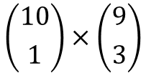
Distinguishable Permutation Objects
We have 9 different possible position left to place the remaining 9 letters.
Let’s say we place the 3 letters ‘O’.
W | O | O | O
$$\left({10 \atop 1}\right)×\left({9 \atop 3}\right)$$

Slide 5
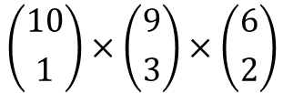
Distinguishable Permutation Objects
We have 6 different possible position left to place the remaining 6 letters.
Let’s say we place the 2 letters ‘L’ next.
W | O | O | O
$$\left({10 \atop 1}\right)×\left({9 \atop 3}\right)×\left({6 \atop 2}\right)$$

Slide 6
Distinguishable Permutation Objects
We have 6 different possible position left to place the remaining 6 letters.
Let’s say we place the 2 letters ‘L’ next.
W | O | O | O | L | L
$$\left({10 \atop 1}\right)×\left({9 \atop 3}\right)×\left({6 \atop 2}\right)$$

Slide 7
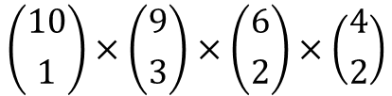
Distinguishable Permutation Objects
We have 4 different possible position left to place the remaining 4 letters.
Let’s say we place the 2 letters ‘N’ next.
W | O | O | O | L | L | N | N
$$\left({10 \atop 1}\right)×\left({9 \atop 3}\right)×\left({6 \atop 2}\right)×\left({4 \atop 2}\right)$$

Slide 8
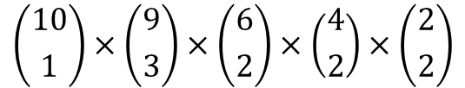
Distinguishable Permutation Objects
We have 2 different possible position left to place the remaining last 2 letters.
Let’s say we place the remaining 2 letters ‘G’.
W | O | O | O | L | L | N | N | G | G
$$\left({10 \atop 1}\right)×\left({9 \atop 3}\right)×\left({6 \atop 2}\right)×\left({4 \atop 2}\right)×\left({2 \atop 2}\right)$$

Slide 9
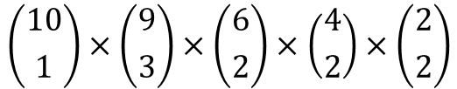
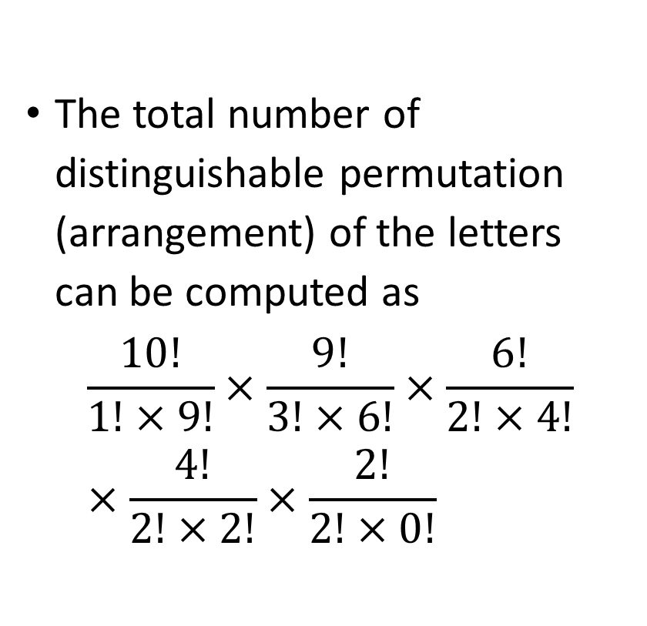
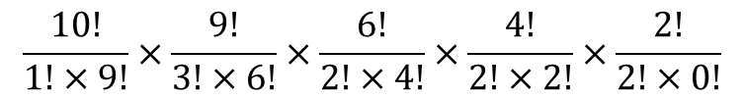
Distinguishable Permutation Objects
The total number of distinguishable permutation (arrangement) of the letters can be computed as
$$\frac{10!}{1!×9!}×\frac{9!}{3!×6!}×\frac{6!}{2!×4!}×\frac{4!}{2!×2!}×\frac{2!}{2!×0!}$$
W | O | O | O | L | L | N | N | G | G
$$\left({10 \atop 1}\right)×\left({9 \atop 3}\right)×\left({6 \atop 2}\right)×\left({4 \atop 2}\right)×\left({2 \atop 2}\right)$$
$$\frac{10!}{1!×9!}×\frac{9!}{3!×6!}×\frac{6!}{2!×4!}×\frac{4!}{2!×2!}×\frac{2!}{2!×0!}$$

Slide 10
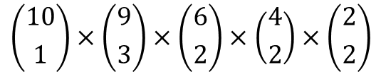
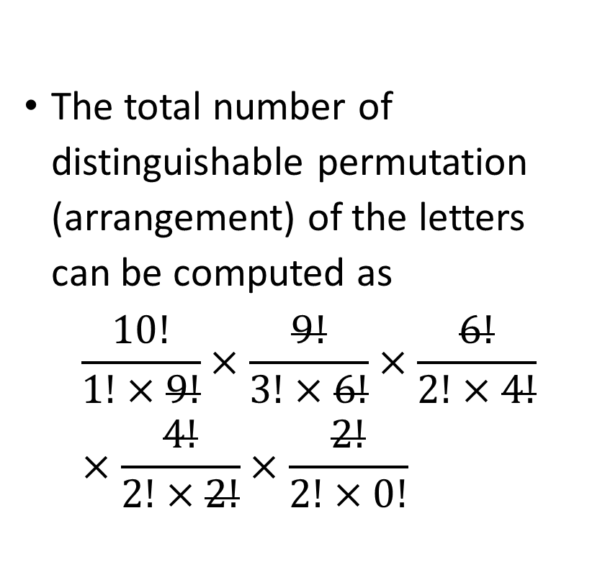
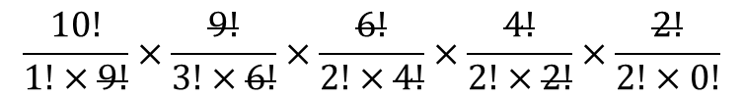
Distinguishable Permutation Objects
The total number of distinguishable permutation (arrangement) of the letters can be computed as
$$\frac{10!}{1!×9!}×\frac{9!}{3!×6!}×\frac{6!}{2!×4!}×\frac{4!}{2!×2!}×\frac{2!}{2!×0!}$$
W | O | O | O | L | L | N | N | G | G
$$\left({10 \atop 1}\right)×\left({9 \atop 3}\right)×\left({6 \atop 2}\right)×\left({4 \atop 2}\right)×\left({2 \atop 2}\right)$$
$$\frac{10!}{1!×9!}×\frac{9!}{3!×6!}×\frac{6!}{2!×4!}×\frac{4!}{2!×2!}×\frac{2!}{2!×0!}$$

Slide 11
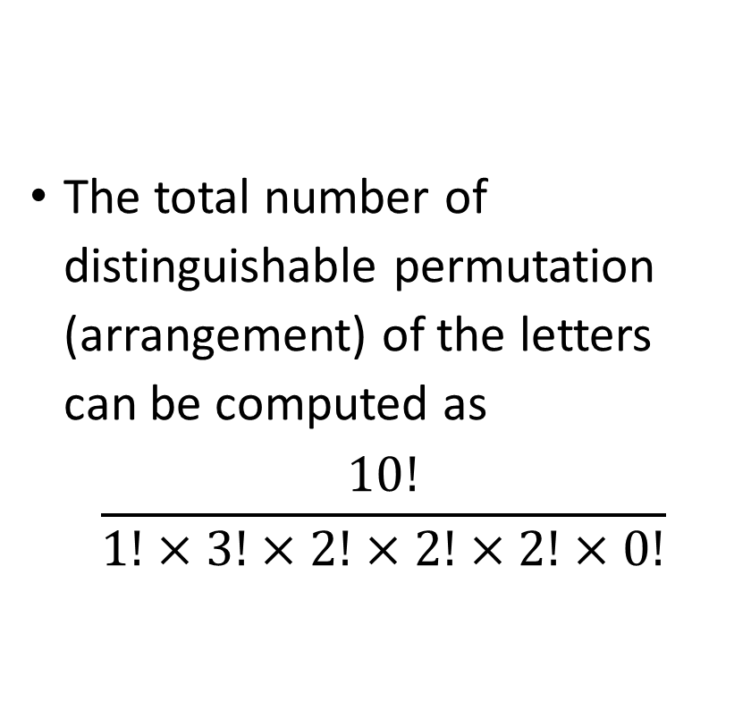
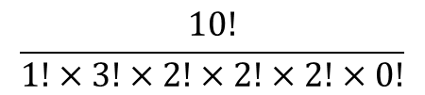
Distinguishable Permutation Objects
The total number of distinguishable permutation (arrangement) of the letters can be computed as
$$\frac{10!}{1!×3!×2!×2!×2!×0!}$$
W | O | O | O | L | L | N | N | G | G
$$\left({10 \atop 1}\right)×\left({9 \atop 3}\right)×\left({6 \atop 2}\right)×\left({4 \atop 2}\right)×\left({2 \atop 2}\right)$$
$$\frac{10!}{1!×3!×2!×2!×2!×0!}$$

Slide 12
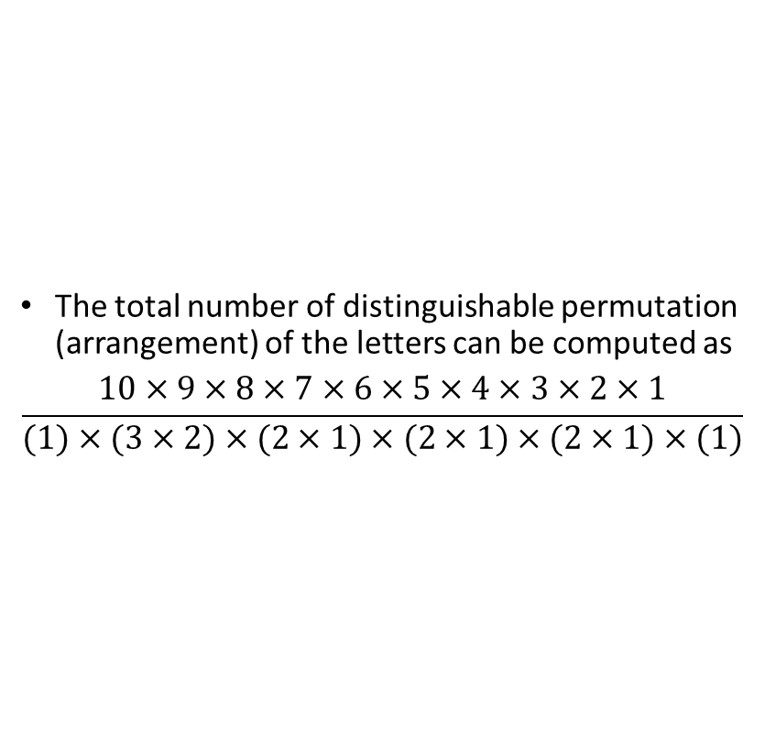
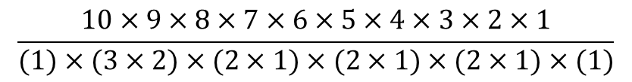
Distinguishable Permutation Objects
The total number of distinguishable permutation (arrangement) of the letters can be computed as
$$\frac{10×9×8×7×6×5×4×3×2×1}{(1)×(3×2)×(2×1)×(2×1)×(2×1)×(1)}$$
W | O | O | O | L | L | N | N | G | G
$$\left({10 \atop 1}\right)×\left({9 \atop 3}\right)×\left({6 \atop 2}\right)×\left({4 \atop 2}\right)×\left({2 \atop 2}\right)$$
$$\frac{10×9×8×7×6×5×4×3×2×1}{(1)×(3×2)×(2×1)×(2×1)×(2×1)×(1)}$$

Slide 13
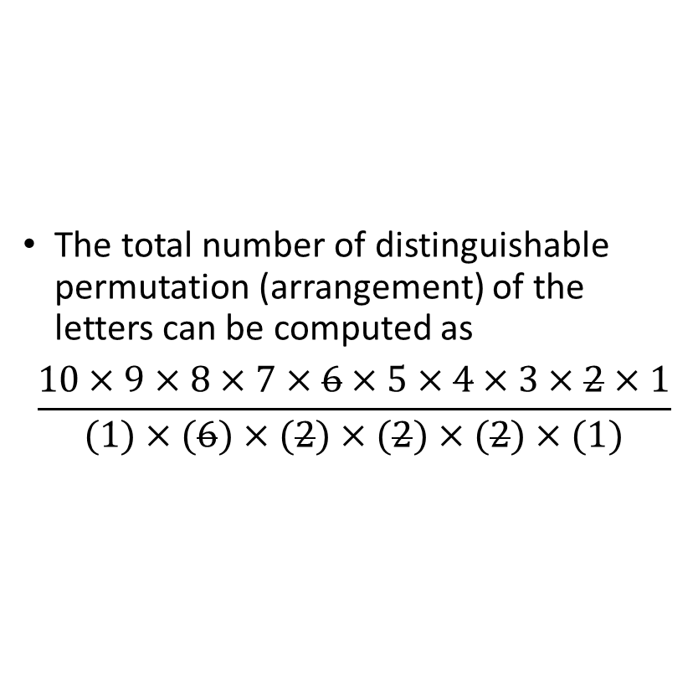
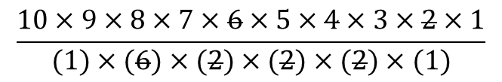
Distinguishable Permutation Objects
The total number of distinguishable permutation (arrangement) of the letters can be computed as
$$\frac{10×9×8×7×6×5×4×3×2×1}{(1)×(6)×(2)×(2)×(2)×(1)}$$
W | O | O | O | L | L | N | N | G | G
$$\left({10 \atop 1}\right)×\left({9 \atop 3}\right)×\left({6 \atop 2}\right)×\left({4 \atop 2}\right)×\left({2 \atop 2}\right)$$
$$\frac{10×9×8×7×6×5×4×3×2×1}{(1)×(6)×(2)×(2)×(2)×(1)}$$

Slide 14
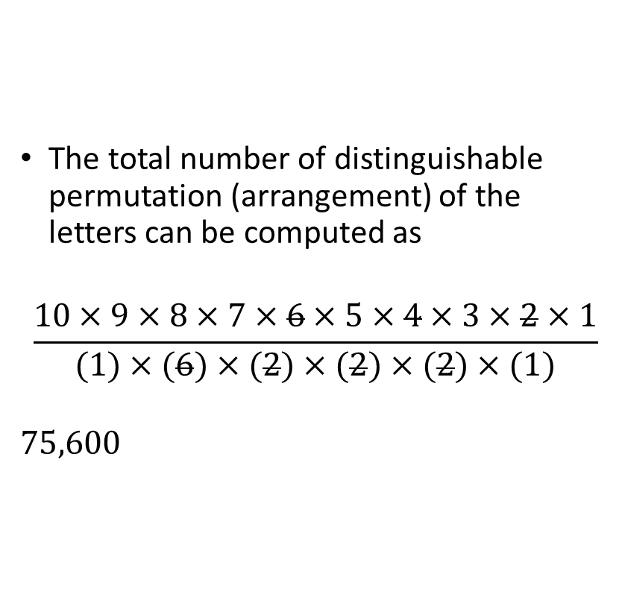

Distinguishable Permutation Objects
The total number of distinguishable permutation (arrangement) of the letters can be computed as
$$\frac{10×9×8×7×6×5×4×3×2×1}{(1)×(6)×(2)×(2)×(2)×(1)}$$
$$75,600$$
W | O | O | O | L | L | N | N | G | G
$$\left({10 \atop 1}\right)×\left({9 \atop 3}\right)×\left({6 \atop 2}\right)×\left({4 \atop 2}\right)×\left({2 \atop 2}\right)$$
$$\frac{10×9×8×7×6×5×4×3×2×1}{(1)×(6)×(2)×(2)×(2)×(1)}$$
$$75,600$$

Slide 15
Distinguishable Permutation Objects
One of the possible arrangement (permutation) is WOLLONGONG.
W | O | L | L | O | N | G | O | N | G

