Slide 1
CSCI262 – System Security
Tutorial Set C – 2015S4
Sionggo Japit
sjapit@uow.edu.au
28 October 2015

Slide 2
Tutorial Set A
Preparation:
Form a group of 2 to 3 students.
Create a temporary folder, e.g., CSCI262Lab, in C drive.
Logon to the subject website at the Moodle
Download, into the temporary folder you have just created, the practical/exercise question TS-C from the Lab materials section.
Unzip the TS-C

Slide 3
Tutorial Set A
You should be able to find the practical/exercise questions in a pdf file named SIM-2015-S4-CSCI262-TS-C.pdf
Work in a group to implement/solve the questions.
Discuss your solution with the class.

Slide 4
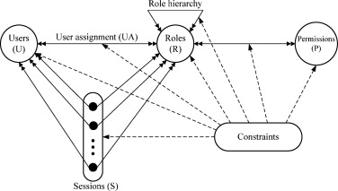
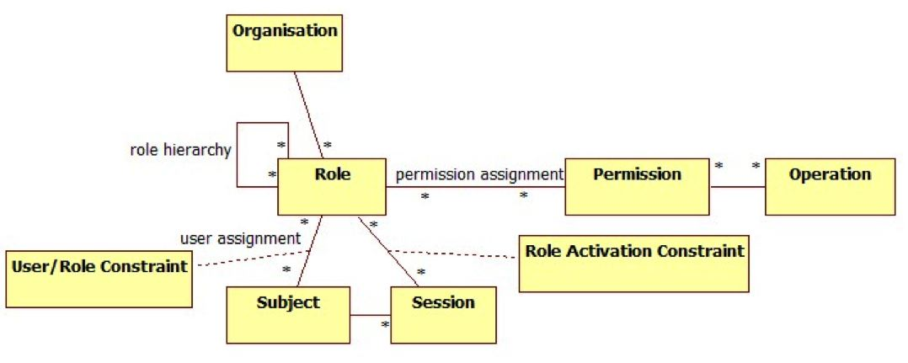
Tutorial Set C - Part One
Explain RBAC.jpg (taken from Wikipedia) and Figure 1 in SandhuET1996.pdf, in the context of Role Based Access Control. In particular, explain what is meant by the constraints and role hierarchies.

Slide 5
Tutorial Set C - Part One
Role-based Access Control (RBAC) defines the access rights of individuals based on the roles that users assume in a system.
Typically, a role is defined as a job function within an organization, for example, A director.
Access rights are assigned to roles, and in turn, users are assigned to different roles, either statically or dynamically.
RBAC is flexible; it can implement mandatory access control (MAC) or discretionary access control (DAC).
Take note of how you should implement the Task Two of your Assignment 2.
William Stallings and Lawrie Brown, Computer Security: Principles and Practice, Pearson Education, 2012, pp 143 - 151.

Slide 6
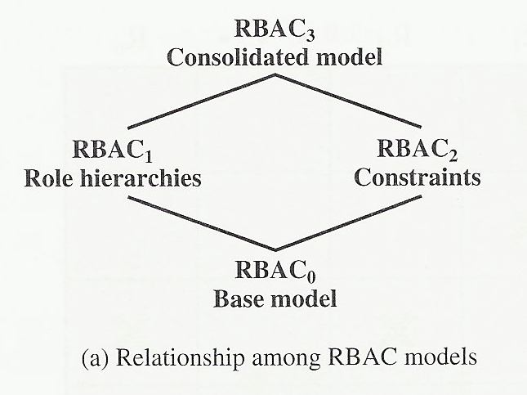
Tutorial Set C - Part One
For the ongoing standardization efforts, the RBAC model is defined using four conceptual model as shown below.

Slide 7
Tutorial Set C - Part One
Components of RBAC base Model (RBAC₀):
User: An individual that has access to a computer system. Each individual has an associated user ID.
Role: A named job function within an organization that controls a computer system. Typically, associated with each role is a description of the authority and responsibility conferred on this role, and on any user who assumes this role.
Permission: An approval of a particular mode of access to one or more objects. Equivalent terms are access right, privilege, and authorization.
William Stallings and Lawrie Brown, Computer Security: Principles and Practice, Pearson Education, 2012, pp 143 - 151.

Slide 8
Tutorial Set C - Part One
Session: a mapping between a user and an activated subset of the set of roles to which the user is assigned.
William Stallings and Lawrie Brown, Computer Security: Principles and Practice, Pearson Education, 2012, pp 143 - 151.

Slide 9
Tutorial Set C - Part One
The relationship of users to roles is many to many.
One user may have multiple roles, and multiple users may be assigned to a single role.
William Stallings and Lawrie Brown, Computer Security: Principles and Practice, Pearson Education, 2012, pp 143 - 151.

Slide 10
Tutorial Set C - Part One
A role can contains many permissions, and a permission may be granted to many roles.
The relationship between Role and Permission is many to many.
William Stallings and Lawrie Brown, Computer Security: Principles and Practice, Pearson Education, 2012, pp 143 - 151.

Slide 11
Tutorial Set C - Part One
A session is an association between a user and one or more roles to which the user has been assigned.
William Stallings and Lawrie Brown, Computer Security: Principles and Practice, Pearson Education, 2012, pp 143 - 151.

Slide 12
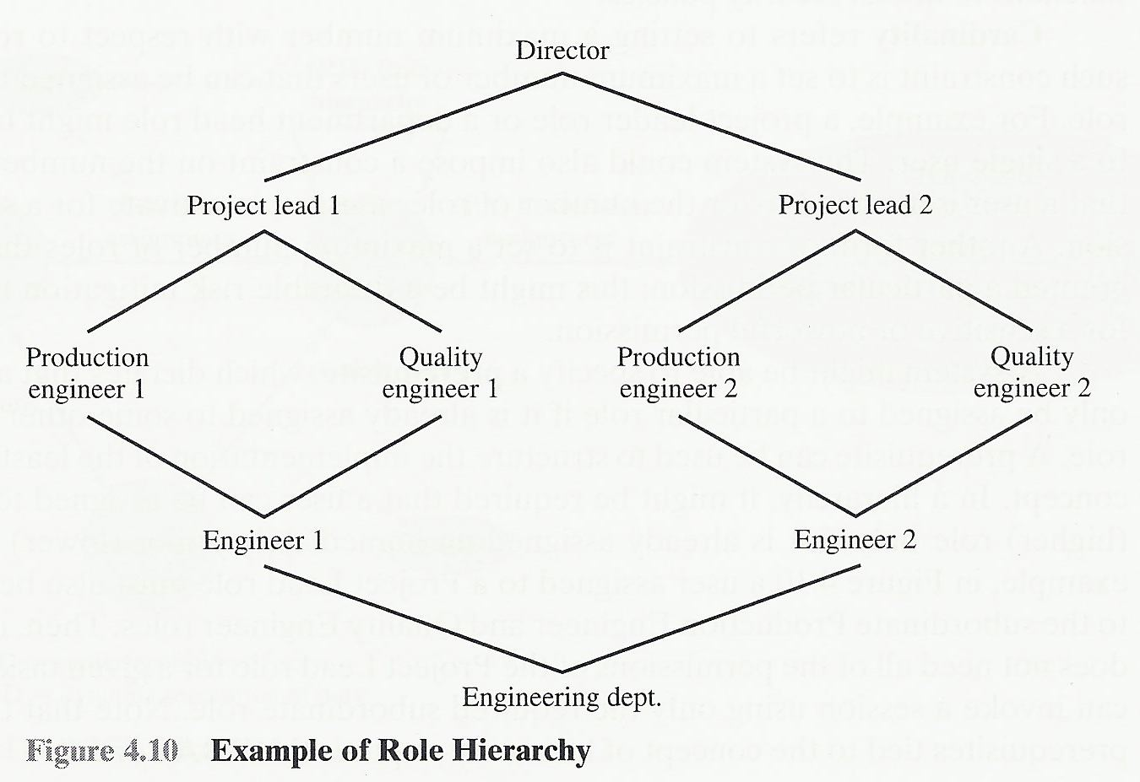
Tutorial Set C - Part One
Role Hierarchies Model (RBAC₁):
This model provides a means of reflecting the hierarchical structure of roles in an organization.
Typically, job functions with greater responsibility have greater authority to access resources.
A subordinate job function may have a subset of the access rights of the superior job function.
William Stallings and Lawrie Brown, Computer Security: Principles and Practice, Pearson Education, 2012, pp 143 - 151.

Slide 13
Tutorial Set C - Part One
Role hierarchies make use of the concept of inheritance to enable one role to implicitly include access rights associated with a subordinate role.
William Stallings and Lawrie Brown, Computer Security: Principles and Practice, Pearson Education, 2012, pp 143 - 151.

Slide 14
Tutorial Set C - Part One
Constraints Model (RBAC₂):
This model provides a means of adapting RBAC to the specifics of administrative and security policies in an organization.
Three types of constraints proposed and implemented:
Mutually exclusive roles
The same user can be assigned to at most one role in a mutually exclusive set. Mutually exclusive constraint supports a separation of duties and capabilities within an organization.
William Stallings and Lawrie Brown, Computer Security: Principles and Practice, Pearson Education, 2012, pp 143 - 151.

Slide 15
Tutorial Set C - Part One
Cardinality
Cardinality refers to setting a maximum number with respect to roles.
One such constraint is to set a maximum number of users that can be assigned to a given role. For example, only one person can fill the role of department chair.
Prerequisite
Prerequisite dictates that a user can only be assigned to a particular role if it is already assigned to some other specified role.
William Stallings and Lawrie Brown, Computer Security: Principles and Practice, Pearson Education, 2012, pp 143 - 151.

Slide 16
Tutorial Set C - Part One
A constraint is a defined relationship among roles or a condition related to roles.
William Stallings and Lawrie Brown, Computer Security: Principles and Practice, Pearson Education, 2012, pp 143 - 151.

Slide 17
Tutorial Set C - Part One
Consolidated model (RBAC₃):
Consolidated model provides both role hierarchies and constraints, as it combines RBAC₁ and RBAC₂.

Slide 18
Tutorial Set C - Part One
What is a zombie in the context of denial of service?
Zombie, also known as bot, is a malware (malicious software) that secretly takes control over a computer that is connected to the Internet, and use it to launch attack. With zombie, it is hard to trace to the attacker.
William Stallings and Lawrie Brown, Computer Security: Principles and Practice, Pearson Education, 2008, page 240.

Slide 19
Tutorial Set C - Part One
What is the default size of a ping?
A ping is normally 56 bytes in size; 84 bytes if the Internet Protocol header is considered.

Slide 20
Tutorial Set C - Part One
Find some example of typical bandwidth or link capacities by searching on the Internet.
Capacity: Maximum number of bits that can be transmitted through a channel.
Link: A connection between two nodes, which can be hosts, routers, or Ethernet switches.
Link Capacity:
Nominal physical link – the maximum number of bits that the link can support. This is the upper bound of a link layer.
IP-layer link – The maximum number of IP-layer bits that can be transmitted from the source and correctly received by the destination over the link during the interval T to T+1, divided by I, where T is the time, and I a time interval.

Slide 21
Tutorial Set C - Part One
The classical DoS flood attack overwhelms the bandwidth of a link, to effectively shut that link down. Consider that we use ICMP pings of size 500 bytes. How many packets do we need to send per second to flood links with the following capacities?
0.5 Mbps
2 Mbps
10 Mbps

Slide 22
Tutorial Set C - Part One
To flood a bandwidth of 0.5 Mbps with packets of length 500 bytes, the attacker would need at least (0.5 Mbps/(500 x 8) bits) of packets.
Thus, we need (0.5 x (1024 x 1024))/(500 * 8) <= 131.072 packets. In other words, we need 132 packets per second.

Slide 23
Tutorial Set C - Part One
To flood a bandwidth of 2 Mbps with packets of length 500 bytes, the attacker would need at least (2 Mbps/(500 x 8) bits) of packets.
Thus, we need (2 x (1024 x 1024))/(500 * 8) <= 524.288 packets. In other words, we need 525 packets per second.

Slide 24
Tutorial Set C - Part One
To flood a bandwidth of 10 Mbps with packets of length 500 bytes, the attacker would need at least (10 Mbps/(500 x 8) bits) of packets.
Thus, we need (10 x (1024 x 1024))/(500 * 8) <= 2621.44 packets. In other words, we need 2622 packets per second.

Slide 25
Tutorial Set C - Part One
More problematic than the DoS attack is the distributed DoS attack. Assume each captured system has an upload capacity of 128-kbps. Assuming the same sized pings are used in the previous questions, how many such captured systems would be required to flood links with the following capacities?
0.5 Mbps
2 Mbps
10 Mbps

Slide 26
Tutorial Set C - Part One
From the previous question, we know that we need to send 132 packets to flood a link capacity of 0.5 Mbps.
If each computer has an upload capacity of 128 Kbps, we need at least (132 x 500 x 8)/(128 x 1024) computer, which is = 4.028 ≈ 5 computers.

Slide 27
Tutorial Set C - Part One
From the previous question, we know that we need to send 525 packets to flood a link capacity of 2 Mbps.
If each computer has an upload capacity of 128 Kbps, we need at least (525 x 500 x 8)/(128 x 1024) computer, which is = 16.021 ≈ 17 computers.

Slide 28
Tutorial Set C - Part One
From the previous question, we know that we need to send 2622 packets to flood a link capacity of 10 Mbps.
If each computer has an upload capacity of 128 Kbps, we need at least (2622 x 500 x 8)/(128 x 1024) computer, which is = 80.01 ≈ 81 computers.

Slide 29
Tutorial Set C - Part One
What is a DNS?
DNS refers to Domain Name System. It is the protocol that defines the service that converts domain names to IP addresses. Its main objective is to be a mediator between the IP addresses, the system-side names of the websites and their respective domains, and their user-side alpha-numeric titles.
William Stallings and Lawrie Brown, Computer Security: Principles and Practice, Pearson Education, 2008, page 261 to 265.

Slide 30
Tutorial Set C - Part One
Describe DNS amplification.
What implication does it have for the resources required by an attacker?
How is DNS amplification different from general amplification, and how do they relate to a reflection attack?
DNS amplification and reflection attacks do not generate backscatter traffic. Explain what backscatter traffic is and why this is the case.

Slide 31
Tutorial Set C - Part One
DNS amplification is a type of DOS attack in which the attacker send a spoofed targeted address to a legitimate DNS server and use this server as the intermediary system to carry out the DOS attack.
The attacker gain attack amplification by exploiting the behavior of the DNS protocol to convert a small request into a much larger response (amplification).
William Stallings and Lawrie Brown, Computer Security: Principles and Practice, Pearson Education, 2008, page 261 to 265.

Slide 32
Tutorial Set C - Part One
In DNS amplification attack, the attacker creates a series of DNS requests containing the spoofed source address of the target system.
These requests are directed at a number of the selected name servers.
The servers respond to these requests, sending the replies to the spoofed source.
The target is then flooded with the responses.
William Stallings and Lawrie Brown, Computer Security: Principles and Practice, Pearson Education, 2008, page 261 to 265.

Slide 33
Tutorial Set C - Part One
All that is needed by an attacker to carry out this attack is a name server with DNS records large enough for the amplification. (Note: with a classic DNS protocol, a 60-byte UDP request packet can result in a 512-byte UDP response. The more recent DNS protocol is able to extend to a much larger responses of over 4000 bytes, to support extended DNS features such as IPv6.)
The attacker needs only generate a moderate flow of packets to cause a larger, amplified flow to flood and overflow the link to the target system.
William Stallings and Lawrie Brown, Computer Security: Principles and Practice, Pearson Education, 2008, page 261 to 265.

Slide 34
Tutorial Set C - Part One
With the general amplification, the attacker direct the original request to the broadcast address of some network. This resulted to all hosts on that network respond to the broadcasted request, and thus generating a flood of responses to the target. Thus the amplification is achieve through broadcasting.
With DNS amplification, the amplification is achieve through expanding the UDP responses.
Both general amplification and DNS amplification are a variant of reflector attacks that involve sending a packet with a spoofed source address for the target system to intermediaries.
William Stallings and Lawrie Brown, Computer Security: Principles and Practice, Pearson Education, 2008, page 261 to 265.

Slide 35
Tutorial Set C - Part One
Backscatter is a side-effect of a spoofed DOS attack. In the course of a DOS attack, the attacker sends the victim large amount of network packets (IPpackets) that contain the spoofed address. The victim’s machine is not able to differentiate the spoofed packets and the legitimate packets from its clients. So when the victim’s machine responds, it sends its replies to the spoofed (falsified) address as well as its legitimate clients. These response packets (to the spoofed address) are known as backscatter.

Slide 36
Tutorial Set C - Part One
Backscatter does not happen to DNS amplification and reflection attacks because the attacker sends the network packets to normal functioning network servers. The servers respond to the packets, and sending their responses to the spoofed source address that belongs to the actual attack target. The fact that normal functioning server systems are being used as intermediaries, and that their handling of the packets is entirely conventional, the responses from the victim are also normal.

Slide 37
Tutorial Set C - Part One
NuCaptcha: What is it? You should go to the website of the company and have a look at some examples. Look at the article in the lab directory too and see what claims they make.
It is a video-based CAPTCHA that can adapt to easy challenges for legitimate users and difficult ones for attackers. NuCaptcha uses measure indicators to identify high risk activity and combats it with a real-time adaptive Captcha.
http://en.wikipedia.org/wiki/NuCaptcha

Slide 38
Tutorial Set C - Part One
DeCaptcha: What is it?
http://www.ubergizmo.com/2011/05/decaptcha-defeats-captchas/

Slide 39
Tutorial Set C - Part One
Look at http://www.cloudfare.com/ddoc and find out something about the classes of DOS and the mechanism Cloudflare uses to provide protection.

Slide 40
Tutorial Set C – Part Three
What is the expected cost of calculating a puzzle consisting of m k–bit puzzles, in the Client Puzzle Protocol of Juels and Brainard (1999)?

Slide 41
Tutorial Set C – Part Three
Using the above formula, draw up a table demonstrating the cost for 1 ≤ m ≤ 20, 1 ≤ k ≤ 60.
TutorialSetC-Part3-Q2-PuzzleCost-2015S43

Slide 42
Tutorial Set C – Part Three
Assume a uniform distribution of hash values for the hash function used.
What is the probability of a single guess by an attacker solving the puzzle, as a function of m and k?
Using the above formula, draw up a table demonstrating the probability for 1 ≤ m ≤ 20, 1 ≤ k ≤ 60.
What if the distribution of hash values wasn't uniform? Would it increase or decrease the probabilities determined above?

Slide 43
Tutorial Set C – Part Three
What is the probability of a single guess by an attacker solving the puzzle, as a function of m and k?
Notes:
Probability to guess one bit puzzle correctly is (1/2).
Probability to guess a two bits puzzle correctly is (1/2)^2.
Probability to guess three bit puzzle correctly is (1/2)^3, etc.

Slide 44
Tutorial Set C – Part Three
Using the above formula, draw up a table demonstrating the probability for 1 ≤ m ≤ 20, 1 ≤ k ≤ 60.
TutorialSetC-Part3-Q3b-Probability-2015S43

Slide 45
Tutorial Set C – Part Three
What if the distribution of hash values wasn't uniform? Would it increase or decrease the probabilities determined above?
If the distribution of hash values was not uniform, then there is likely to have duplicate hash values which may increase the probability or the likely hood of getting the puzzle guessed correctly.

Slide 46
Tutorial Set C – Part Three
Why use multiple puzzles rather than one single large one?
If we use a single big puzzle instead of sub puzzles, then the difficulty level is hard to adjust. This is because one bit of change in k could require a much longer time to solve the puzzle. Using sub puzzles we can fine tune the difficulty level.

Slide 47
Tutorial Set C – Part Four
Construct a puzzle with two sub-puzzles, that involves no hashing in the generation of the puzzle.

Slide 48
Tutorial Set C – Part Four
Server:
Selects Ns, Ns’
Sends (1, Ns) and (2, Ns’) to Client
Client:
Finds x such that hash(1, C, Ns, x) = 111...111Y, where 111...111 denotes k 1’s, and Y can be any value.
Finds x’ such that hash(2, C, Ns’, x’) = 111...111Y’, where 111...111 denotes k 1’s, and Y can be any value.
Sends (1, C, Ns, x) and (2, C, Ns’, x’) to Server
Server checks if there are k 1’s in each solution.

Slide 49
Website
http://sites.google.com/site/sjapituow/csci262

Slide 50
Reference
William Stallings and Lawrie Brown, Computer Security: Principles and Practice, Pearson Education, 2012
3a_SandhuET1996
http://en.wikipedia.org/wiki/NuCaptcha

