Slide 1
ISIT312 – Big Data Management
Conceptual Warehouse Design
Sionggo Japit
sjapit@uow.edu.au
22 September 2012

Slide 2
Relational Data Warehouse Design – Star Schema
ROLAP systems can be organized using one of the following logical design:
Star Schema – Star Schema consists of one fact table and a set of dimension tables.
Referential integrity constraints between fact table and dimension tables exist
Dimension tables may contain redundancy in the presence of hierarchies
Dimension tables are denormalized, and fact tables are normalized.

Slide 3
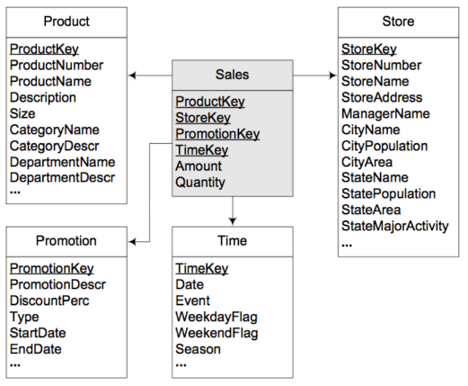
An example of star schema

Slide 4
Relational Data Warehouse Design – Snowflake Schema
Snowflake schema – Snowflake schema is similar to star schema except that the dimension tables are normalized to avoid redundancy. The fact that the dimension tables are normalized, the performance may be degraded because of cartesient product.

Slide 5
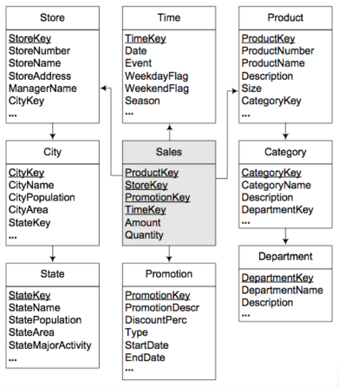
An example of a snowflake schema

Slide 6
Relational Data Warehouse Design – Starflake Schema
Starflake schema – A starflake schema is a combination of start schema and a snowflake schema, that is, some of the dimension tables are normalized while some are not.

Slide 7
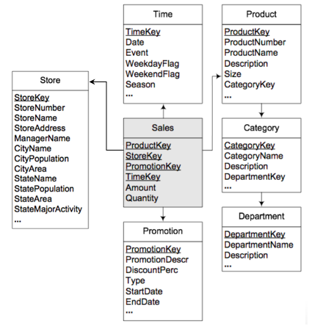
An example of a starflake schema

Slide 8
Relational Data Warehouse Design – Constellation Schema
Constellation schema – Constellation schema consists of multiple fact tables that share dimension tables.

Slide 9
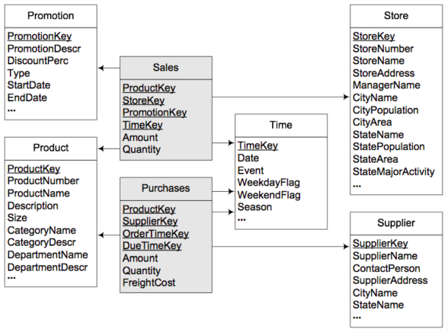
An example of a constellation schema

Slide 11
Conceptual Warehouse Design
A University consists of various department. Each department is described by a department identification, department name, address of the department, the dean of the department and total number of students registered to the department. Professors are affiliated to departments. The professors may involve in teaching as well as research. Professor is described by professor identification, name, status and the hiring date. The researches the professors done may be in the form of projects which are funded by research funding agency. The research agencies are identified by an agency number and described by the contact person, address of the agency that include city, state and country.

Slide 12
Conceptual Warehouse Design
The project is described by a project identification, project acronym, project name, project type, total person months and total amount.
Each department offers many courses. The course is described by a course identification, course name, credit for theory, credit for exercises, description of the courses, and an URL to the homepage of the course.

Slide 13
Conceptual Warehouse Design
The University want to maintain a data warehouse that contains information about teaching and research activities. On the one hand, the information about teaching activities is related to dimensions department, professor, course, and time, the latter at a granularity of academic semester. Measures for teaching activities are number of hours and number of credits. On the other hand, the information about research activities is related to dimensions professor, funding agency, project, and time, the latter twice for the start date and the end date, both at a granularity of day. In this case, professors are related to the department to which they are affiliated. Measures for research activities are the number of person months and amount.
Create a conceptual schema of a data warehouse domain described above. Use a notation explained to you during the lecture classes, presentation 04 Conceptual Data Warehouse Design.

Slide 14
Identify the entity
Department
Professor
Project
DepartmentID
DepartmentName
Address
DeanName
NoStudents
ProfessorID
ProfessorName
Status
HiringDate
ProjectID
ProjectAcronym
ProjectName
ProjectType
TotalPersonMonths
TotalAmount
FundingAgency
Course
AgencyName
ContactPerson
Address
City
State
Country
CourseID
CourseName
CreditTheory
CreditExercise
Descriptiion
Homepage

Slide 15
Identify the hierarchy
Calendar:
Time
Year
Month
Day
Academic Calendar:
Time
Academic Year
Academic Semester

Slide 16
Identify the dimension and measures
Teaching
Number of hours
Number of credits
Research
Person months
Amount

Slide 17
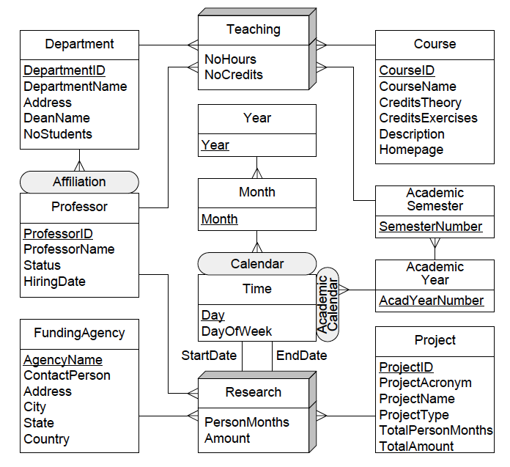

Slide 18
Constellation Schema

Slide 19
Constellation Schema
Transform the conceptual schema diagram obtained in the previous activity to a Constellation schema.

Slide 20
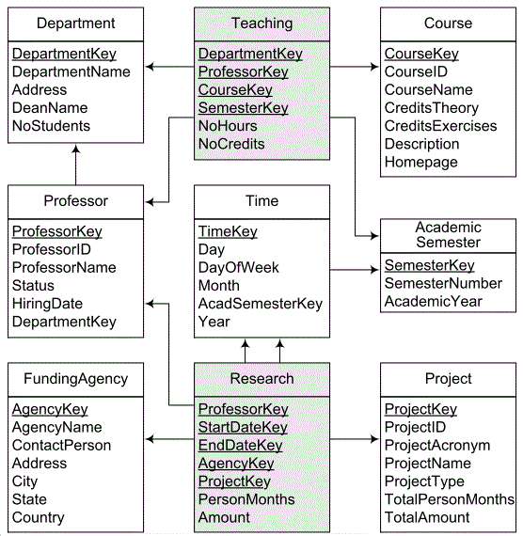
Constellation Schema
Constellation Schema

Slide 21
Query

Slide 22
Queries
For the constellation schema shown in the previous slide, write in SQL the queries given below:
By department, total number of teaching hours during the academic year 2012 – 2013.
SELECT DepartmentName, SUM(NoHours)
FROM Teaching T, AcademicSemester S,
Department D
WHERE T.SemesterKey = S.SemesterKey
AND T.DepartmentKey = D.DepartmentKey
AND AcademicYear = ‘2012-1023’
GROUP BY DepartmentName;

Slide 23
Queries
By department, total amount of research projects during the calendar year 2012.
SELECT DepartmentName, SUM(Amount)
FROM Research R,
Professor P,
Department D,
Time T
WHERE R.ProfessorKey = D.ProfessorKey
AND P.DepartmentKey = D.DeprtmentKey
AND R.StartDateKey = T.TimeKey
AND Year = ‘2012’
GROUP BY DepartmentName;

Slide 24
Queries
By department, total number of professors involved in research projects during the calendar year 2012.
SELECT DepartmentName, Count(ProfessorID)
FROM Research R,
Professor P,
Department D,
Time T
WHERE R.ProfessorKey = P.ProfessorKey
AND P.DepartmentKey = D.DepartmentKey
AND R.StartDateKey = T.TimeKey
AND Year = ‘2012’
GROUP BY DepartmentName;

Slide 25
Queries
By professor, total number of courses delivered during the academic year 2012-2013.
SELECT DepartmentName, COUNT(CourseID)
FROM Teaching T,
AcademicSemester S,
Department D
WHERE T.SemesterKey = S.SemesterKey
AND T.DepartmentKey = D.DepartmentKey
AND AcademicYear = ‘2012-2013’
GROUP BY DepartmentName;

Slide 26
Queries
By department and funding agency, total number of projects started in 2012.
SELECT DepartmentName, AgencyName,
COUNT(ProfessorID)
FROM Research R,
Professor P,
Department D,
FundingAgency F,
Time T
WHERE R.ProfessorKey = P.ProfessorKey
AND P.DepartmentKey = D.DepartmentKey
AND R.StartDateKey = T.TImeKey
AND Year = ‘2012’
AND R.AgencyKey = F.AgencyKey
GROUP BY DepartmentName, AgencyName;

