Slide 1
LLVM Architecture Overview
Software Systems Architecture
José Francisco Veiga (up202108753)
Marco Vilas Boas (up202108774)
Pedro Lima (up202108806)
Pedro Januário (up202108768)
Pedro Marcelino (up202108754)

Slide 2

What is LLVM?
Open-source compiler infrastructure
Provides modular and reusable compiler and toolchain technologies

Slide 3
Architecture
Summary
LLVM as a modular, library-based design for a compiler, instead of the traditional monolith.
Allows for easy integration of new source languages and target architectures, as well as reusability of modules in new projects.
LLVM IR is a key secret for its success: a self-contained, first-class language that provides a common interface for all compiler components.
Many advantages over traditional architecture (e.g. GCC) because of customizability and reusability.

Slide 4
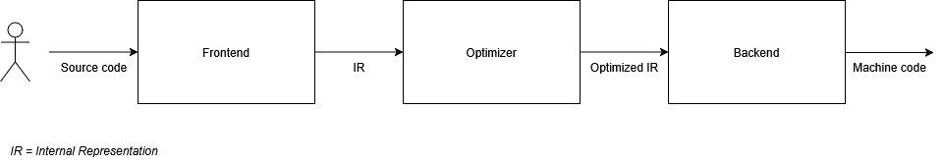
3-Phase Compiler Architecture
Frontend
Parses and validates input code
Translates to LLVM Intermediate Representation (IR)
Optimizer
Performs analysis and optimization passes
Improves performance and efficiency
Backend
Generates native machine code from IR

Slide 5
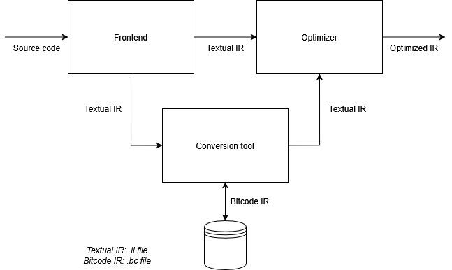
IR Transactions
Frontend generates IR
Optimizer refines and improves IR
IR can be saved as bitcode for reuse

Slide 6
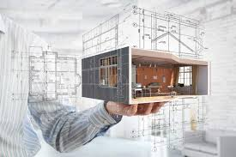
Architectural Patterns
Interpreter
Pipes and Filters
Layers Patterns
Broker Pattern
Encapsulated Implementation

Slide 7
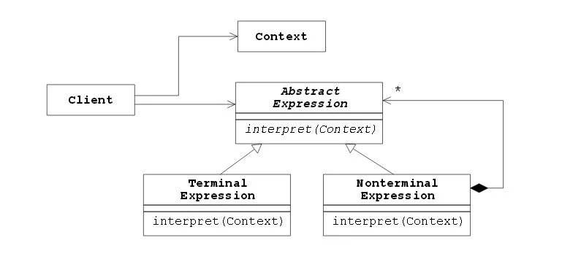
Interpreter
Defines a way to interpret and evaluate language grammar or expressions.
High-level language to IR
IR to machine code

Slide 8
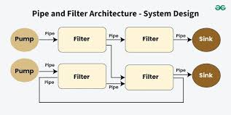
Pipes and Filters
Data flows through pipes and transformed by filters
Programming languages (pipes) flow through frontend, optimizer and backend (filters)
Allows modular and sequential data processing

Slide 9
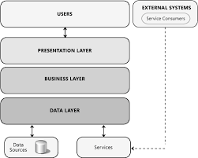
Layers Patterns
System divided into clear layers interacting only with adjacent layers
Frontend
Optimizer
Backend
IR acts as interface
+ Maintainable
+ Scalable

Slide 10
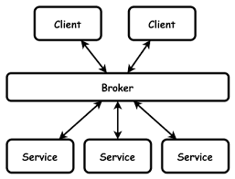
Broker Pattern
Mediator facilitates communication between components
Optimizer acts as a broker between various frontends and backends
Modular enough to allow distributed execution

Slide 11
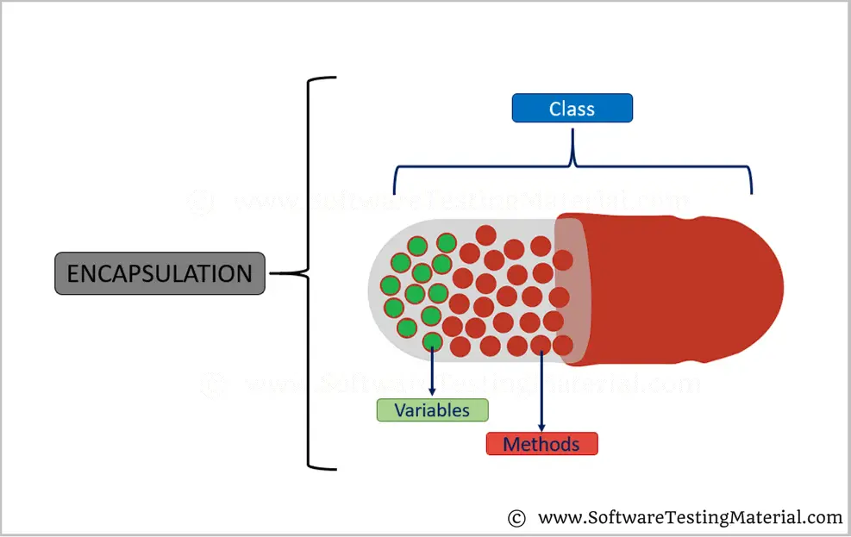
Encapsulated Implementation
Hide implementation details behind interfaces
Pass classes for optimizations
Template-based approach
+ Flexibility
+ Resilience

Slide 12
Quality Attributes
Modularity
Reusable libraries with well-defined interfaces
Reusability
Supports various languages and architectures
Neutral IR format
Performance
Powerful Optimization Pipeline
Link-time and install-time optimizations

Slide 13
Conclusion
LLVM is a prime example of a modular and efficient compiler architecture
Multiple architectural patterns
Focus on Adaptability, Modularity and Performance
Globally used

