Slide 1
Turtle

Slide 2
LOGO
LOGO, a turtle-based programming language, was developed by Seymour Papert and a group of collaboraters in the late 1960s. It was presented as a novel way to introduce children to computer programming and mathematics. LOGO and Turtle Geometry remain strongly associated with children and education, but are full of beautiful tools and ideas that adult artists and programmers can fruitfully explore. A previous turtle library for Processing, Terrapin, is great, but somewhat limited in functionality. This library provides a more full-featured implementation, including "push" and "pop" functionality as well as high-resolution drawing capabilities.

Slide 3
SOURCE CODE
The source code of Turtle is available at https://github.com/leahbuechley/Turtle, and its repository can be browsed here: https://github.com/leahbuechley/Turtle.git.

Slide 4
Basics
import Turtle.*; size(500,500); background(255); stroke(0);
Turtle t = new Turtle(this); t.forward(100);
import Turtle.*;
size(500,500);
background(255);
stroke(0);
Turtle t = new Turtle(this); t.forward(50);
t.penUp();
t.forward(50);
t.penDown();
t.forward(50);
forward () back () right () left () penUp () penDown () push () pop () goToPoint () drawTurtle ()
import Turtle.*;
size(500,500);
background(255);
stroke(0);
Turtle t = new Turtle(this);
t.forward(100);
t.right(45);
t.drawTurtle();

Slide 5
push ()
Push() - Saves the current state of the turtle to the stack. Enables you to jump back to this state (turtle position, pen state, angle, etc.) at a later point in program
Pop() - Must be used after a push () statement. Returns turtle to the last pushed state. Removes last pushed state from the stack. No line is drawn in the jump.
import Turtle.*;
size(500,500);
background(255);
stroke(0);
Turtle t = new Turtle(this); t.push(); //save the current state
t.right(45);
t.forward(50);
t.left(30);
t.forward(50);
t.pop(); //return to the previously saved state
t.forward(100);

Slide 6
Turtle State
import Turtle.*;
size(500,500);
background(255);
stroke(0);
Turtle t = new Turtle(this);
float x; //print Turtle's x coordinate
t.forward(50);
x=t.getX();
println(x);
getX () getY () getHeading () setX () setY () setHeading ()
import Turtle.*;
size(500,500);
background(255);
stroke(0);
Turtle t = new Turtle(this);
float y; //print Turtle's x coordinate
t.forward(50);
y=t.getY();
println(y);

Slide 7
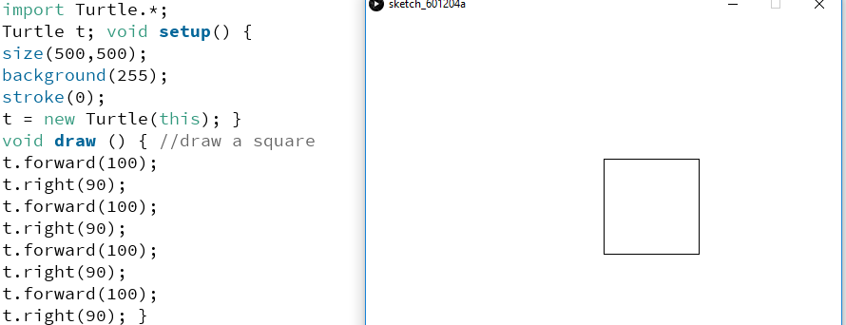
Square
import Turtle.*;
Turtle t; void setup() {
size(500,500);
background(255);
stroke(0);
t = new Turtle(this); }
void draw () { //draw a square
t.forward(100);
t.right(90);
t.forward(100);
t.right(90);
t.forward(100);
t.right(90);
t.forward(100);
t.right(90); }

Slide 8
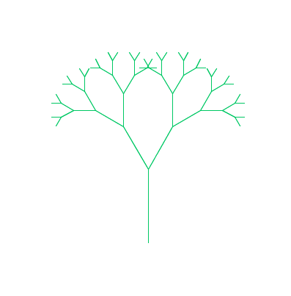
Tree
//a recursive tree-drawing method
void branch( int iteration, float branchLength, int angle) {
if (iteration == 0)
return;
t.forward(branchLength);
t.left(angle);
branch(iteration-1, branchLength/1.5, angle);
t.right(angle);
t.right(angle);
branch(iteration-1, branchLength/1.5, angle);
t.left(angle);
t.back(branchLength); }
import Turtle.*;
Turtle t;
void setup() {
size(500,500);
background(255);
stroke(0,200,100);
t = new Turtle(this);
noLoop();
}
void draw () {
//move turtle back 100 steps
t.penUp();
t.back(100);
t.penDown(); //draw tree
branch(6,100,30); }

Slide 9
Recursion
void someFunction() {
//Calling the function background() in the definition of someFunction()
background(0); }
n! = n * n – 1 * . . . . * 3 * 2 * 1 0! = 1
void someFunction() {
someFunction();
}
int factorial(int n) {
int f = 1;
//Using a regular loop to compute factorial
for (int i = 0; i < n; i++) {
f = f * (i+1);
}
return f; }
http://natureofcode.com/book/chapter-8-fractals/

Slide 10
Upon close examination, you’ll notice something interesting about how factorial works. Let’s look at 4! and 3!
4! = 4 * 3 * 2 * 1 3! = 3 * 2 * 1
Therefore. . .
4! = 4 * 3!
In more general terms, for any positive integer n:
n! = n * (n-1)! 1! = 1
int factorial(int n) {
if (n == 1) {
return 1;
}else {
return n * factorial(n-1);
} }

Slide 11
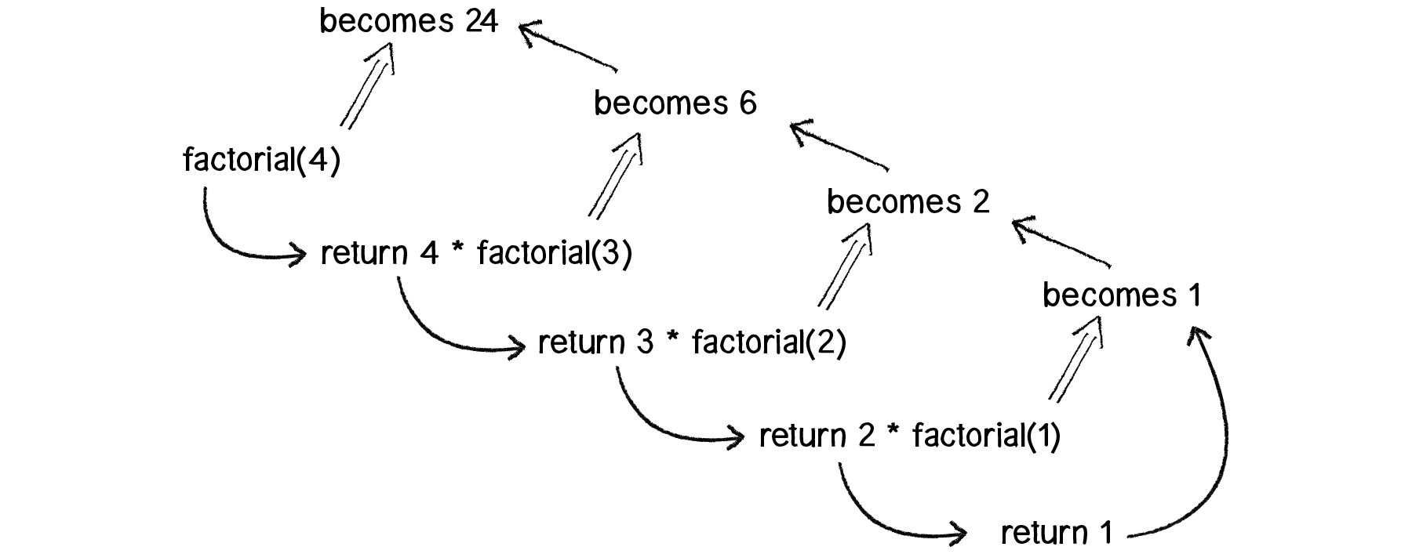
4! = 4 * 3 * 2 * 1 3! = 3 * 2 * 1
Therefore. . .
4! = 4 * 3!
In more general terms, for any positive integer n:
n! = n * (n-1)! 1! = 1

Slide 12
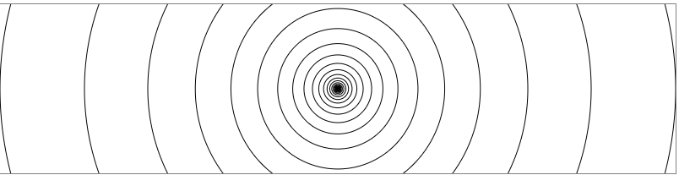
void drawCircle(int x, int y, float radius)
{
ellipse(x, y, radius, radius);
if(radius > 2) {
radius *= 0.75f;
//The drawCircle() function is calling itself recursively.
drawCircle(x, y, radius);
}
}

Slide 13
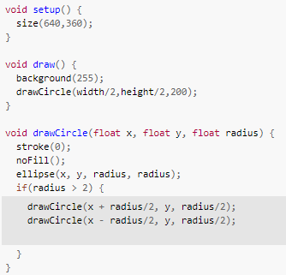
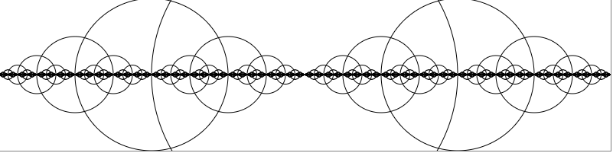

Slide 14
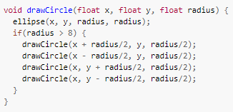
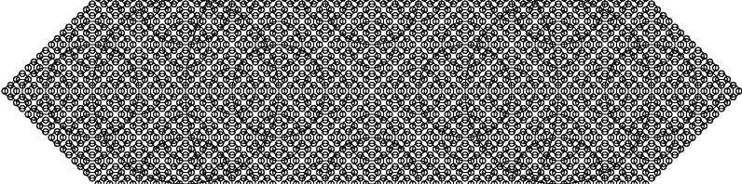

Slide 15
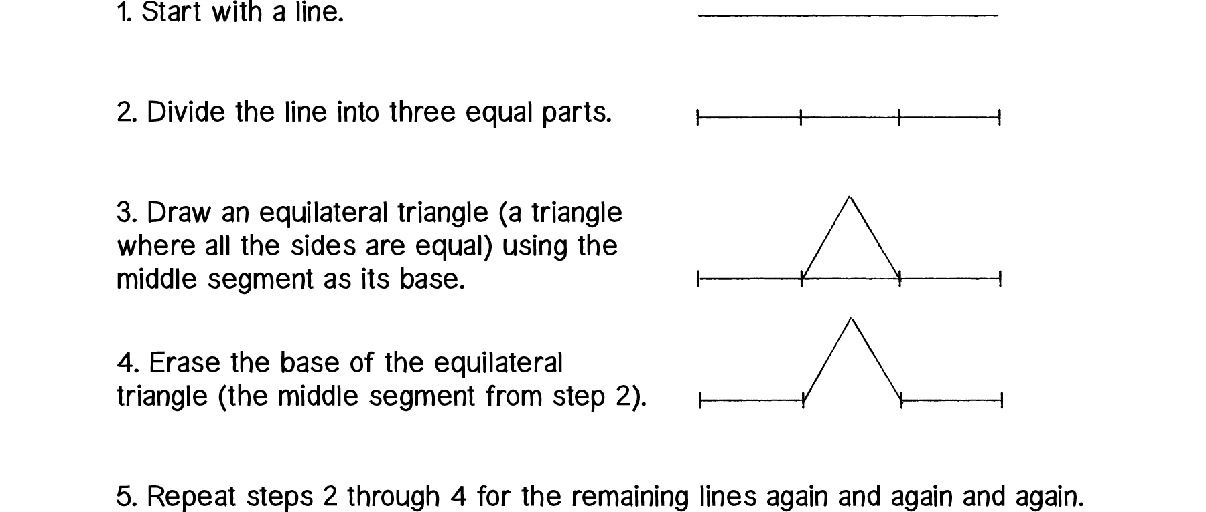
The Koch Curve and the ArrayList Technique

Slide 16
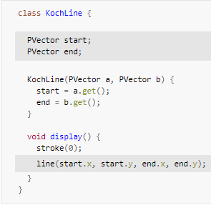
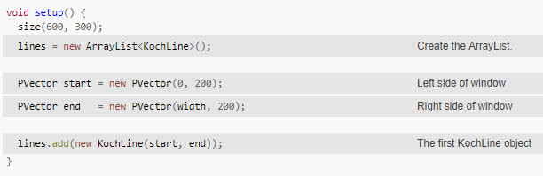
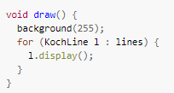

Slide 17
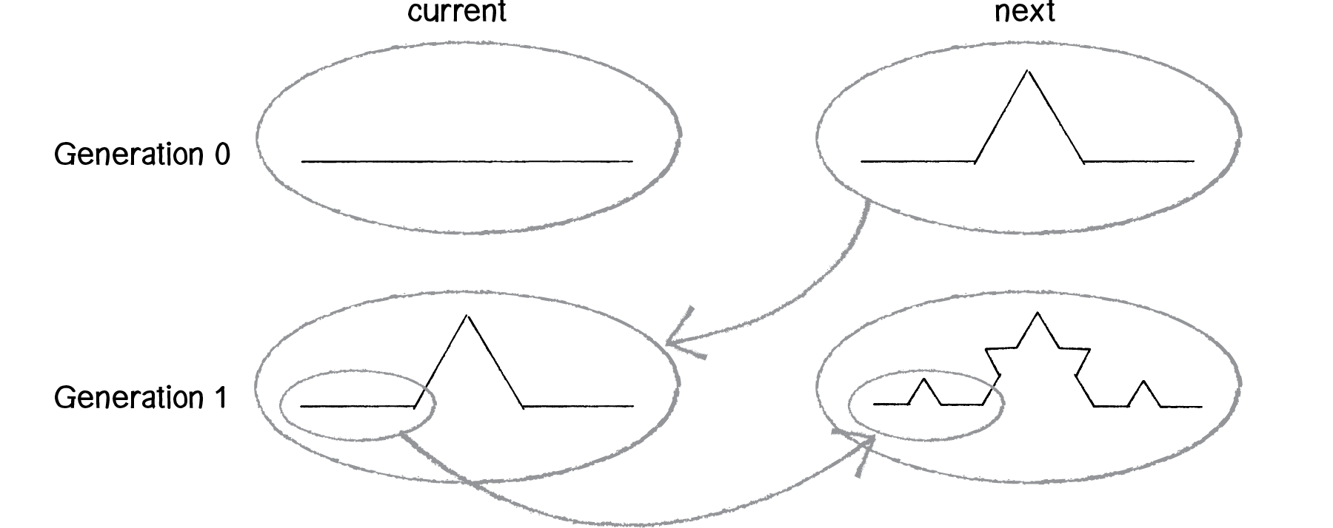

Slide 18
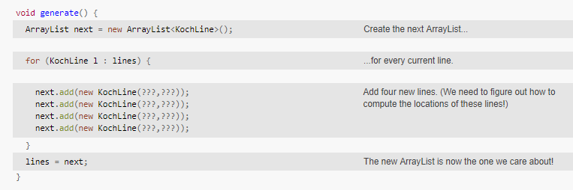
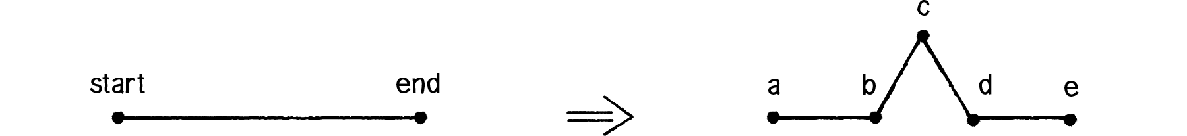

Slide 19
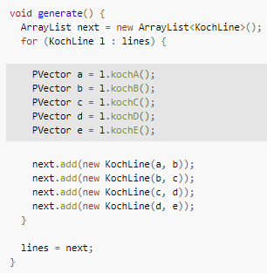

Slide 20
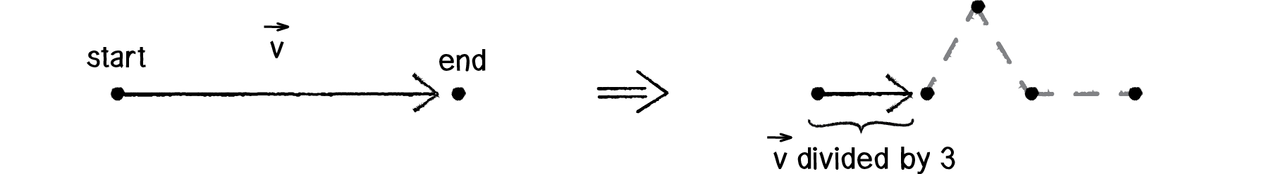
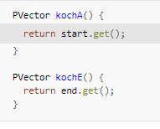
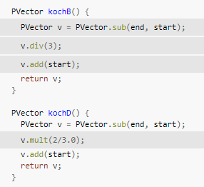

Slide 21
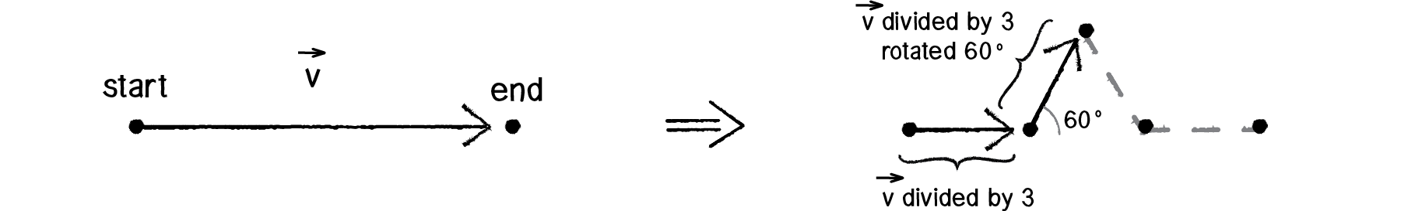
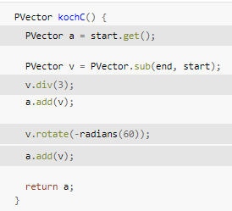

Slide 22
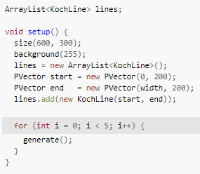
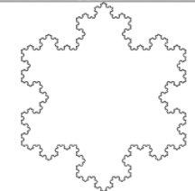
http://natureofcode.com/book/chapter-8-fractals/

