Slide 1
Sound

Slide 2
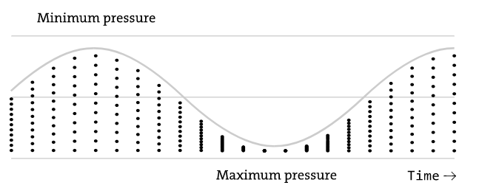
Sound and musical informatics
Simply put, we define sound as a vibration traveling through a medium (typically air) that we can perceive through our sense of hearing. Sound propagates as a longitudinal wave that alternately compresses and decompresses the molecules in the matter (e.g., air) through which it travels. As a result, we typically represent sound as a plot of pressure over time:

Slide 3
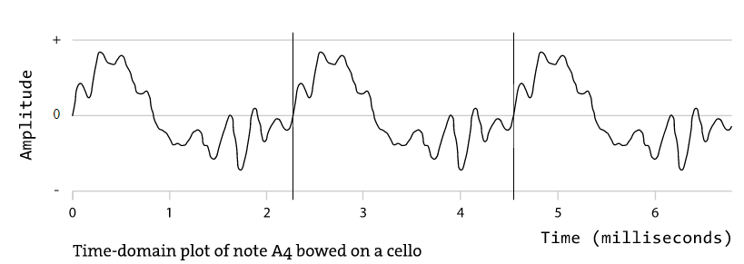
For example
If a sound traveling in a medium at 343 meters per second (the speed of sound in air at room temperature) contains a wave that repeats every half-meter, that sound has a frequency of 686 hertz, or cycles per second. The figure below shows a plot of a cello note sounding at 440 Hz; as a result, the periodic pattern of the waveform (demarcated with vertical lines) repeats every 2.27 ms:

Slide 4
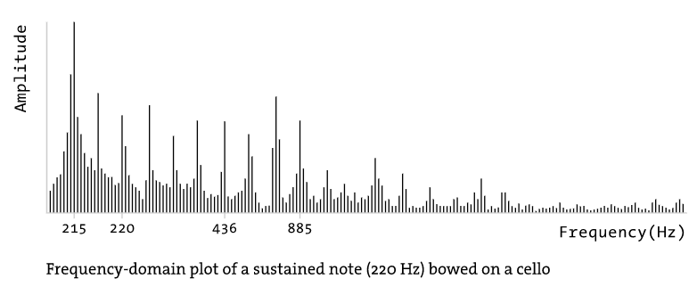
ear
The inner ear contains hair cells that respond to frequencies spaced roughly between 20 and 20,000 hertz, though many of these hairs will gradually become desensitized with age or exposure to loud noise. These cells in turn send electrical signals via your auditory nerve into the auditory cortex of your brain, where they are parsed to create a frequency-domain image of the sound arriving in your ears:

Slide 5
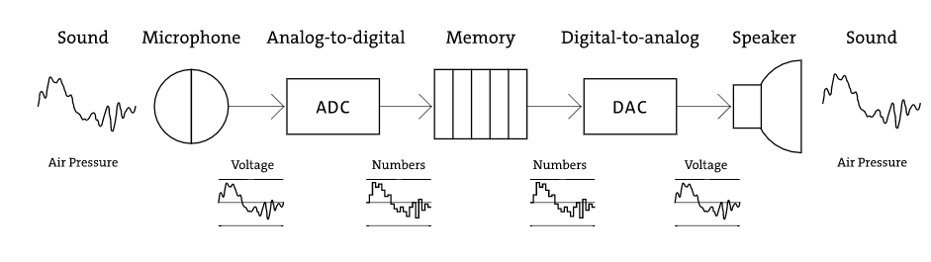
Digital representation of sound and music
Most contemporary digital audio systems (soundcards, etc.) contain both A/D and D/A converters (often more than one of each, for stereo or multichannel sound recording and playback) and can use both simultaneously (so-called full duplex audio). The specific system of encoding and decoding audio using this methodology is called PCM (or pulse-code modulation); developed in 1937 by Alec Reeves, it is by far the most prevalent scheme in use today.

Slide 6
Music as information
Digital representations of music, as opposed to sound, vary widely in scope and character. By far the most common system for representing real-time musical performance data is the Musical Instrument Digital Interface (MIDI) specification, released in 1983 by a consortium of synthesizer manufacturers to encourage interoperability between different brands of digital music equipment. Based on a unidirectional, low-speed serial specification, MIDI represents different categories of musical events (notes, continuous changes, tempo and synchronization information) as abstract numerical values, nearly always with a 7-bit (0–127) numeric resolution.

Slide 7
Audio analysis
A final important area of research, especially in interactive sound environments, is the derivation of information from audio analysis. Speech recognition is perhaps the most obvious application of this, and a variety of paradigms for recognizing speech exist today, largely divided between “trained” systems (which accept a wide vocabulary from a single user) and “untrained” systems (which attempt to understand a small set of words spoken by anyone). Many of the tools implemented in speech recognition systems can be abstracted to derive a wealth of information from virtually any sound source.

Slide 8
Effects processing
In addition to serving as a generator of sound, computers are used increasingly as machines for processing audio. The field of digital audio processing (DAP) is one of the most extensive areas for research in both the academic computer music communities and the commercial music industry. Faster computing speeds and the increased standardization of digital audio processing systems has allowed most techniques for sound processing to happen in real time, either using software algorithms or audio DSP coprocessors such as the Digidesign TDM and T|C Electronics Powercore cards.

Slide 9
Sampling
Many samplers use recordings that have meta-data associated with them to help give the sampler algorithm information that it needs to play back the sound correctly. The base frequency is often one of these pieces of information, as are loop points within the recording that the sampler can safely use to make the sound repeat for longer than the length of the original recording. For example, an orchestral string sample loaded into a commercial sampler may last for only a few seconds, but a record producer or keyboard player may need the sound to last much longer; in this case, the recording is designed so that in the middle of the recording there is a region that can be safely repeated, ad infinitum if need be, to create a sense of a much longer recording.
Rather than using a small waveform in computer memory as an oscillator, we could use a longer piece of recorded audio stored as an AIFF or WAV file on our computer’s hard disk. This sample could then be played back at varying rates, affecting its pitch. For example, playing back a sound at twice the speed at which it was recorded will result in its rising in pitch by an octave. Similarly, playing a sound at half speed will cause it to drop in pitch by an octave.

Slide 10
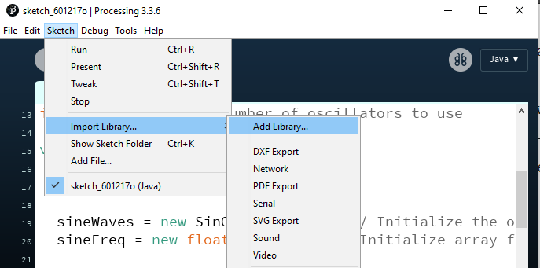
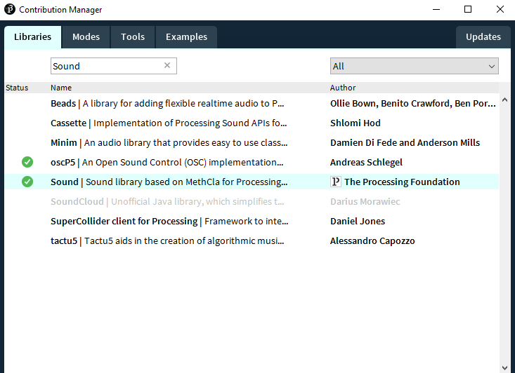

Slide 11
Minim
A Processing library that uses JavaSound API, Tritonus, and MP3SPI to provide an easy to use audio library.
Features:
AudioPlayer: for playback of WAV, AIFF, AU, SND, & MP3 files.
AudioMetaData: for metadata about a file, such as ID3 tags.
AudioSignal: for writing your own sound synthesis
AudioRecorder: for audio recording
AudioEffect: for writing your own audio effects.
FFT: for doing spectrum analysis.
BeatDetect: for doing beat detection.

Slide 12
Music Visualization using Minim
To start using Minim you must first instatiate a Minim object, which you can then use to load audio files or acquire inputs and outputs. Here’s a partial program that demonstrates these things:
void setup()
{
size(100, 100);
minim = new Minim(this);
player = minim.loadFile("song.mp3");
input = minim.getLineIn();
}
import ddf.minim.*;
Minim minim;
AudioPlayer player;
AudioInput input;
http://code.compartmental.net/tools/minim/quickstart/

Slide 13
Playing A File
void setup()
{
size(100, 100);
minim = new Minim(this);
// this loads mysong.wav from the data folder
song = minim.loadFile("mysong.wav");
song.play();
}
import ddf.minim.*;
Minim minim;
AudioPlayer song;
void draw()
{
background(0);
}

Slide 14
If you are using Minim outside of Processing, then the constructor of Minim requires an Object that can handle two important file system operations so that it doesn’t have to worry about details of the current environment. These two methods are:
String sketchPath( String fileName )
InputStream createInput( String fileName )

Slide 15
Retrieving MetaData
Metadata is information about a file, as opposed to the actual contents of the file. You can get the metadata of a file after you have loaded it into an AudioPlayer. The most likely reason you will want to do this is to display ID3 tag information. Here’s a short sketch that does exactly that:
void setup()
{
size(512, 256, P3D);
minim = new Minim(this);
// groove.mp3 would be in the sketches data folder
groove = minim.loadFile("sound.mp3");
meta = groove.getMetaData();

Slide 16
void draw()
{
background(0);
int y = ys;
text("File Name: " + meta.fileName(), 5, y);
text("Length (in milliseconds): " + meta.length(), 5, y+=yi);
text("Title: " + meta.title(), 5, y+=yi);
text("Author: " + meta.author(), 5, y+=yi);
text("Album: " + meta.album(), 5, y+=yi);
text("Date: " + meta.date(), 5, y+=yi);
text("Comment: " + meta.comment(), 5, y+=yi);
text("Track: " + meta.track(), 5, y+=yi);
text("Genre: " + meta.genre(), 5, y+=yi);
text("Copyright: " + meta.copyright(), 5, y+=yi);
text("Disc: " + meta.disc(), 5, y+=yi);
text("Composer: " + meta.composer(), 5, y+=yi);
text("Orchestra: " + meta.orchestra(), 5, y+=yi);
text("Publisher: " + meta.publisher(), 5, y+=yi);
text("Encoded: " + meta.encoded(), 5, y+=yi);
}
Retrieving MetaData

Slide 17
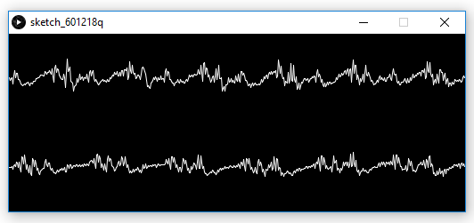
Drawing A Waveform
// we draw the waveform by connecting neighbor values with a line
// we multiply each of the values by 50
// because the values in the buffers are normalized
// this means that they have values between -1 and 1.
// If we don't scale them up our waveform
// will look more or less like a straight line.
void draw()
{
background(0);
stroke(255);
for(int i = 0; i < song.bufferSize() - 1; i++)
{
line(i, 50 + song.left.get(i)*50, i+1, 50 + song.left.get(i+1)*50);
line(i, 150 + song.right.get(i)*50, i+1, 150 + song.right.get(i+1)*50);
}
}

Slide 18
Drawing a Frequency Spectrum
import ddf.minim.*;
import ddf.minim.analysis.*;
Minim minim;
AudioPlayer song;
FFT fft;
// an FFT needs to know how
// long the audio buffers it will be analyzing are
// and also needs to know
// the sample rate of the audio it is analyzing
void setup()
{
size(512, 200);
// always start Minim first!
minim = new Minim(this);
// specify 512 for the length of the sample buffers
// the default buffer size is 1024
song = minim.loadFile("mysong.wav", 512);
song.play();
fft = new FFT(song.bufferSize(), song.sampleRate());
}

Slide 19
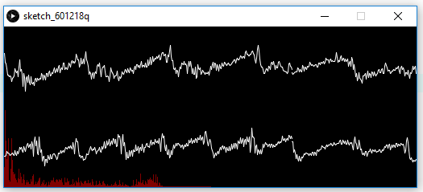
void draw()
{
background(0);
fft.forward(song.mix);
stroke(255, 0, 0, 128);
for(int i = 0; i < fft.specSize(); i++)
{
line(i, height, i, height - fft.getBand(i)*4);
}
// first perform a forward fft on one of song's buffers
// I'm using the mix buffer
// but you can use any one you like
// draw the spectrum as a series of vertical lines
// I multiple the value of getBand by 4
// so that we can see the lines better

Slide 20
Drawing A Waveform
// I draw the waveform by connecting
// neighbor values with a line. I multiply
// each of the values by 50
// because the values in the buffers are normalized
// this means that they have values between -1 and 1.
// If we don't scale them up our waveform
// will look more or less like a straight line.
stroke(255);
for(int i = 0; i < song.left.size() - 1; i++)
{
line(i, 50 + song.left.get(i)*50, i+1, 50 + song.left.get(i+1)*50);
line(i, 150 + song.right.get(i)*50, i+1, 150 + song.right.get(i+1)*50);
}
}

Slide 21
Synthesizing Sound
The first thing you need to do to play synthesized sound is get an AudioOutput. You do this by asking Minim for one:
AudioOutput out = minim.getLineOut();
Calling getLineOut with no arguments will return a stereo line out with a buffer size of 1024 samples that plays 16 bit audio at a 44100 Hz sample rate. It’s mostly those first two things you want to worry about. If you want a mono line out or a different buffer size, you can call getLineOut like this:
AudioOutput out = minim.getLineOut(Minim.MONO);

Slide 22
Synthesizing Sound
// use the getLineOut method of the Minim object to get an AudioOutput object
import ddf.minim.*;
import ddf.minim.ugens.*;
Minim minim;
AudioOutput out;
Oscil wave;
void setup()
{
size(512, 200, P3D);
minim = new Minim(this);
out = minim.getLineOut();
wave = new Oscil( 440, 0.5f, Waves.SINE );
// patch the Oscil to the output
wave.patch( out );
}
// create a sine wave Oscil, set to 440 Hz, at 0.5 amplitude

Slide 23
void draw()
{
background(0);
stroke(255);
strokeWeight(1);
// draw the waveform of the output
for(int i = 0; i < out.bufferSize() - 1; i++)
{
line( i, 50 - out.left.get(i)*50, i+1, 50 - out.left.get(i+1)*50 );
line( i, 150 - out.right.get(i)*50, i+1, 150 - out.right.get(i+1)*50 );
}
// I draw the waveform by connecting
// neighbor values with a line. I multiply
// each of the values by 50
// because the values in the buffers are normalized
// this means that they have values between -1 and 1.
// If we don't scale them up our waveform
// will look more or less like a straight line.

Slide 24
void setup()
{
size(512, 200, P3D);
minim = new Minim(this);
out = minim.getLineOut();
wave = new Oscil( 440, 0.5f, Waves.SINE );
// patch the Oscil to the output
wave.patch( out );
}
// create a sine wave Oscil, set to 440 Hz, at 0.5 amplitude
// draw the waveform we are using in the oscillator
stroke( 128, 0, 0 );
strokeWeight(4);
for( int i = 0; i < width-1; ++i )
{
point( i, height/2 - (height*0.49) * wave.getWaveform().value( (float)i / width ) );
}
}

Slide 25
// usually when setting the amplitude and frequency of an Oscil
// you will want to patch something to the amplitude and frequency inputs
// but this is a quick and easy way to turn the screen into
// an x-y control for them.
void keyPressed()
{
switch( key )
{
case '1':
wave.setWaveform( Waves.SINE );
break;
case '2':
wave.setWaveform( Waves.TRIANGLE );
break;
case '3':
wave.setWaveform( Waves.SAW );
break;
case '4':
wave.setWaveform( Waves.SQUARE );
break;
case '5':
wave.setWaveform( Waves.QUARTERPULSE );
break;
default: break;
}
}
void mouseMoved()
{
float amp = map( mouseY, 0, height, 1, 0 );
wave.setAmplitude( amp );
float freq = map( mouseX, 0, width, 110, 880 );
wave.setFrequency( freq );
}

Slide 26
Refereces
https://processing.org:8443/tutorials/sound/
https://processing.org:8443/reference/libraries/sound/AudioDevice.html
https://processing.org:8443/reference/libraries/sound/SinOsc.html
http://code.compartmental.net/tools/minim/quickstart/
http://ajgo.blogspot.com/2015/01/processing.html
http://artandtech.aalto.fi/wp-content/uploads/2012/06/minim.pdf
https://www.andrew.cmu.edu/course/15-100mns/bn22.pdf
https://github.com/ddf/Minim
https://www.openprocessing.org/sketch/20977#
https://forum.processing.org/two/discussion/4050/music-visualization
http://code.compartmental.net/tools/minim/quickstart/

