Slide 1
A Linked List in Processing

Slide 2
import java.util.*;
https://forum.processing.org/two/discussion/2036/find-5-largest-values-in-a-linked-list-in-processing-java
import java.util.*;
LinkedList<Integer> values;
public void setup()
{
size(800, 300);
values = new LinkedList<Integer>();
HandPosition = new PVector(0, 0); //This is getting x,y values from motion sensor
aCircle = new Circle(); //my class just draws a circle to center of screen
aCircle.draw();
}

Slide 3
draw()
public void draw()
{
if (aCircle.isOut(HandPosition)) /* detects if movement is outside of circle. Would it make more sense for this to be a while loop? I also need to start a timer as soon as this happens but that shouldn't be hard */
{
values.add(aCircle.GetDistance(HandPosition)); //gets how far the hand is from center of circle and adds it to linked list. Allegedly at least, I think this will work.
/*So I need to get the 5 largest value from inside of my linked list here.
I also need to start a timer*/
}
}

Slide 4
class Circle
boolean isOut(PVector Position)
//detects if hand position is outside of circle
{
return mCenter.dist(Position) <= mRadius;
}
float GetDistance(PVector Position)
//detects how far the hand is from the center of circle
{
return mCenter.dist(Position);
}
void draw() {
ellipse(mCenter.x, mCenter.y, mRadius, mRadius);
} }
class Circle {
PVector mCenter;
int mRadius;
Circle()
{
// initialize the center position vector
mCenter = new PVector(0,0);
mRadius = 150;
mCenter.set((width/2),(height/2));
}

Slide 5
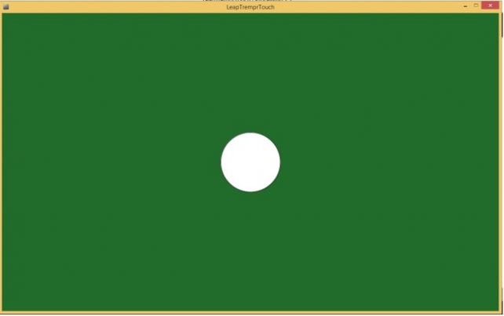

Slide 6
http://www.alan-shapiro.com/virtual-and-physical-geometric-objects-with-processing-by-christos-voutichtis/
Virtual and Physical Geometric Objects with Processing, by Christos Voutichtis
https://github.com/atduskgreg/opencv-processing

Slide 7
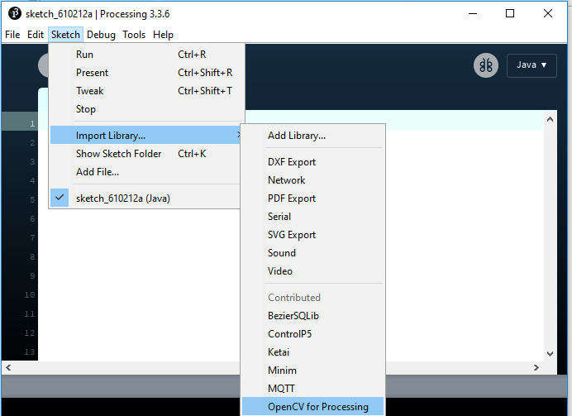
OpenCV library

Slide 8
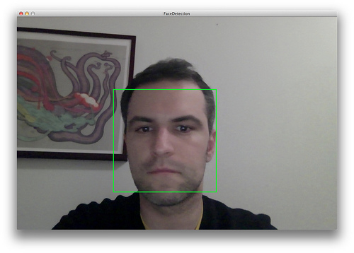
FaceDetection Detect faces in images.

Slide 9

BrightnessContrast Adjust the brightness and contrast of color and gray images.

