Slide 1
Web Programming and Database

Slide 2
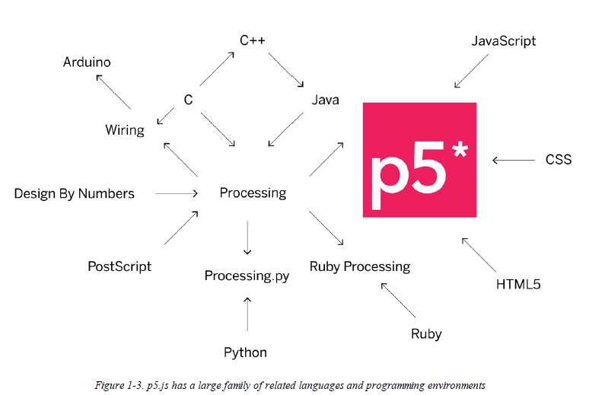
P5.js

Slide 3
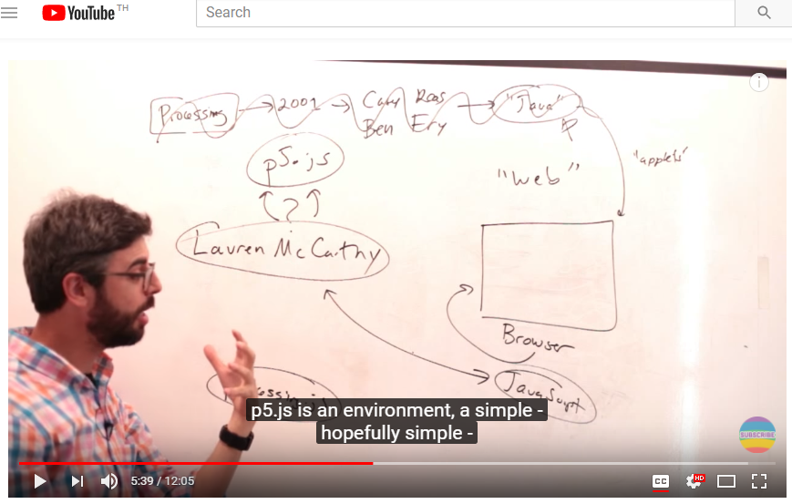
https://www.youtube.com/watch?v=8j0UDiN7my4

Slide 4
Your First Program
If you look at the index.html file, you’ll notice that there is some HTML code there. This file provides the structure for your project, linking together the p5.js library, and another file called sketch.js, which is where you will write your own program.
The code that creates these links look like this:
<script language="javascript" type="text/javascript" src="../p5.js"></script>
<script language="javascript" type="text/javascript" src="sketch.js"></script>

Slide 5
sketch.js
You don’t need to do anything with the HTML file at this point—it’s all set up for you. Next, click sketch.js and take a look at the code:
function setup() {
// put setup code here
}
function draw() {
// put drawing code here
}

Slide 6
The Console
The browser comes with a built-in console that can be very useful for debugging programs. Each browser has a different way to open the console. Here’s how to do it in some of the most common browsers:
To open the console with Chrome, from the top menu select View→Developer→JavaScript Console.
With Firefox, from the top menu select Tools→Web Developer→Web Console.
Using Safari, you’ll need to enable the functionality before you can use it. From the top menu, select Preferences, then click the Advanced tab and check the box next to the text “Show Develop menu in menu bar.” Once you’ve done this, you’ll be able to select Develop→Show Error Console.
In Internet Explorer, open the F12 Developer Tools, then select the Console tool

Slide 7
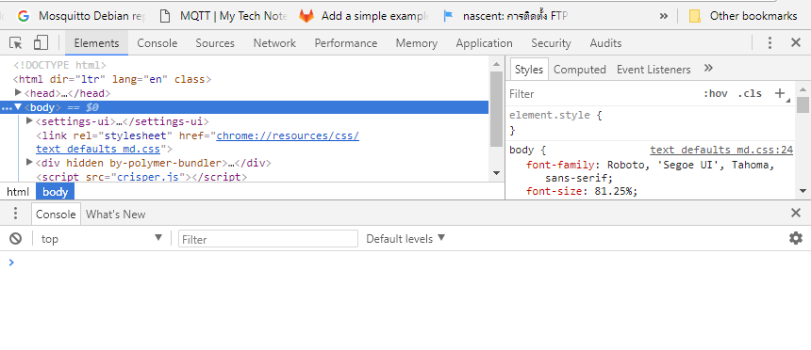
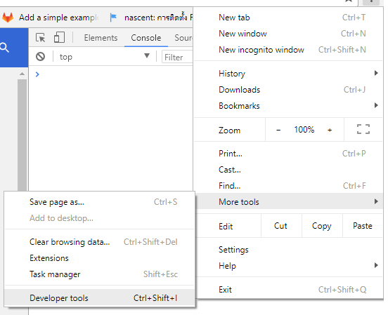
Chrome

Slide 8
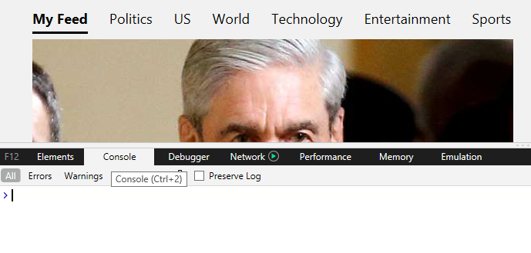
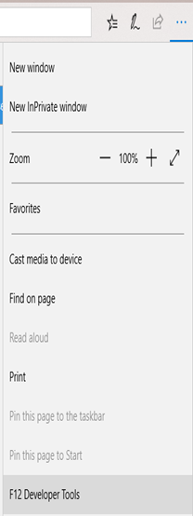
Internet Explorer

Slide 9
Draw
A computer screen is a grid of light elements called pixels. Each pixel has a position within the grid defined by coordinates. When you create a p5.js sketch, you view it with a web browser. Within the window of the browser, p5.js creates a drawing canvas, an area in which graphics are drawn. The canvas may be the same size as the window, or it may have different dimensions. The canvas is usually positioned at the top left of your window, but you can position it in other locations.

Slide 10
When drawing on the canvas
When drawing on the canvas, the x coordinate is the distance from the left edge of the canvas and the y coordinate is the distance from the top edge. We write coordinates of a pixel like this: (x, y). So, if the canvas is 200×200 pixels,
the upper left is (0, 0),
the center is at (100, 100),
and the lower right is (199, 199).
These numbers may seem confusing; why do we go from 0 to 199 instead of 1 to 200? The answer is that in code, we usually count from 0 because it’s easier for calculations that we’ll get into later.
x
0,0 |  |  |  | 0,4
 |  | 2,2
4,0 |  |  |  | 4,4
y

Slide 11
Example 3-1: Create a Canvas
The createCanvas() function has two parameters; the first sets the width of the drawing canvas, and the second sets the height.
To draw a canvas that is 800 pixels wide and 600 pixels high, type:
function setup() {
createCanvas(800, 600);
}
Run this line of code to see the result. Put in different values to see what’s possible. Try very small numbers and numbers larger than your screen.

Slide 12
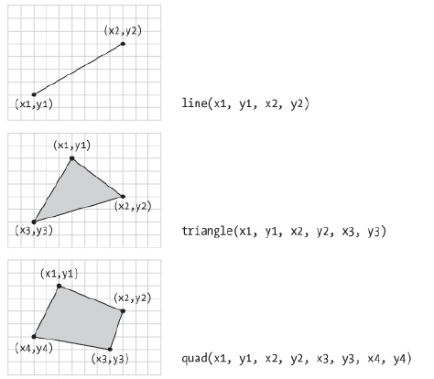
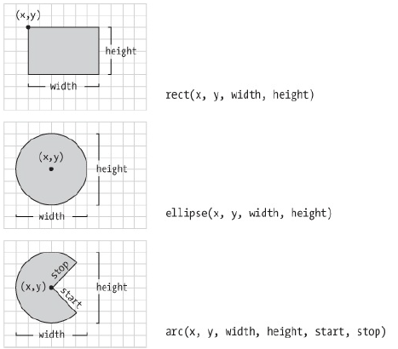
Basic Shapes

Slide 13
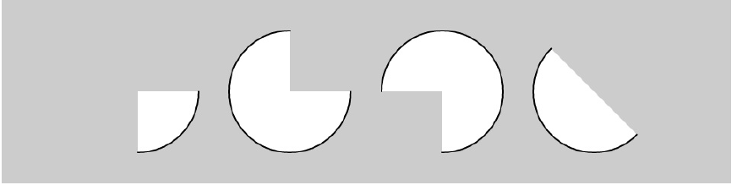
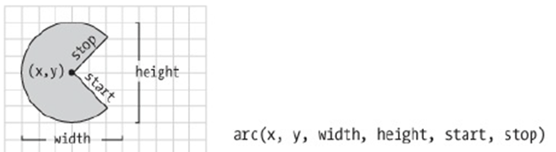
Draw Part of an Ellipse
function setup() {
createCanvas(480, 120);
}
function draw() {
background(204);
arc(90, 60, 80, 80, 0, HALF_PI);
arc(190, 60, 80, 80, 0, PI+HALF_PI);
arc(290, 60, 80, 80, PI, TWO_PI+HALF_PI);
arc(390, 60, 80, 80, QUARTER_PI, PI+QUARTER_PI);
}

Slide 14
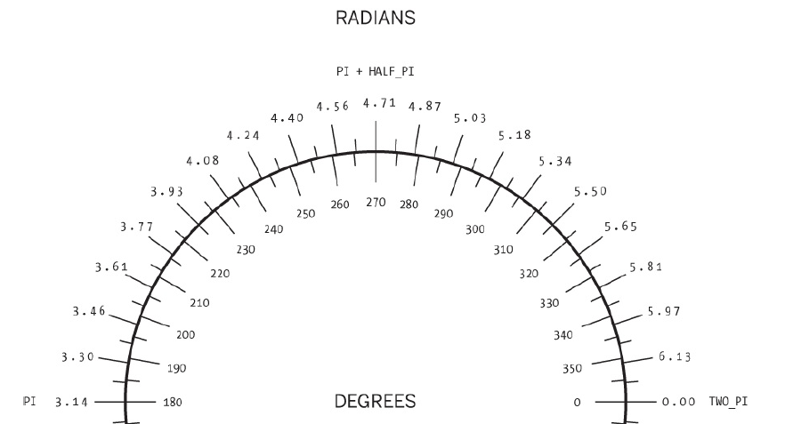
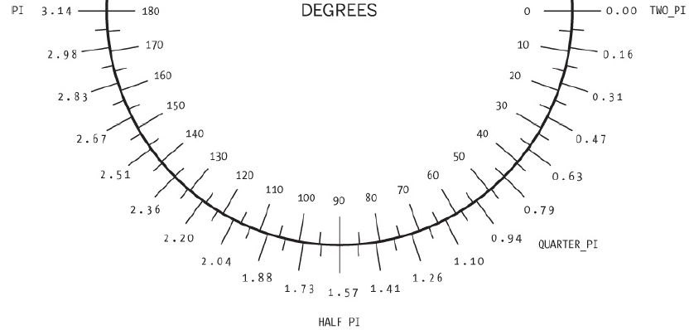

Slide 15
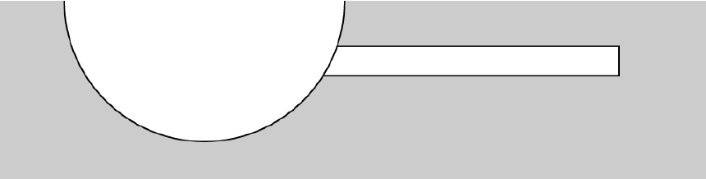
Drawing Order
function setup() {
createCanvas(480, 120);
}
function draw() {
background(204);
rect(160, 30, 260, 20);
// The ellipse draws on top of the rectangle
// because it comes after in the code
ellipse(140, 0, 190, 190);
}

Slide 16
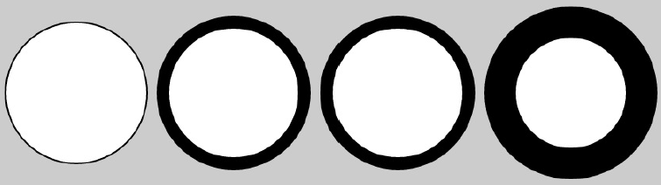
Shape Properties
function setup() {
createCanvas(480, 120);
}
function draw() {
background(204);
ellipse(75, 60, 90, 90);
strokeWeight(8); // Stroke weight to 8 pixels
ellipse(175, 60, 90, 90);
ellipse(279, 60, 90, 90);
strokeWeight(20); // Stroke weight to 20 pixels
ellipse(389, 60, 90, 90);
}
The default stroke weight is a single pixel, but this can be changed with the strokeWeight() function. The single parameter to strokeWeight() sets the width of drawn lines:

Slide 17
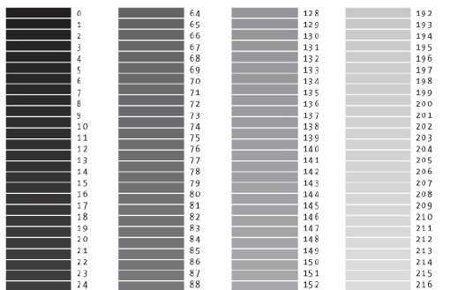
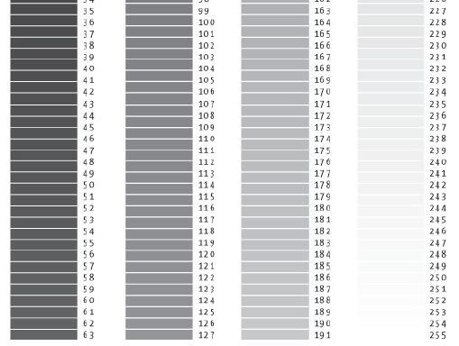
Color
All the shapes so far have been filled white with black outlines. To change this, use the fill() and stroke() functions. The values
of the parameters range from 0 to 255, where 255 is white, 128 is medium gray, and 0 is black

Slide 18
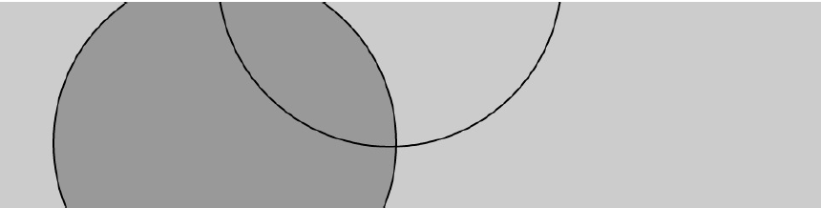
Be careful not to disable the fill and stroke at the same time, as we’ve done in the previous example, because nothing will draw to the screen.
function setup() {
createCanvas(480, 120);
}
function draw() {
background(204);
fill(153); // Medium gray
ellipse(132, 82, 200, 200); // Gray circle
noFill(); // Turn off fill
ellipse(228, -16, 200, 200); // Outline circle
noStroke(); // Turn off stroke
ellipse(268, 118, 200, 200); // Doesn’t draw!
}

Slide 19
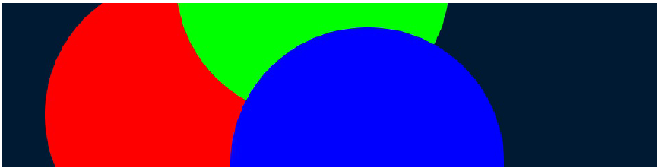
Draw with Color
you use three parameters to specify the red, green, and blue components of a color.
function setup() {
createCanvas(480, 120);
noStroke();
}
function draw() {
background(0, 26, 51); // Dark blue color
fill(255, 0, 0); // Red color
ellipse(132, 82, 200, 200); // Red circle
fill(0, 255, 0); // Green color
ellipse(228, -16, 200, 200); // Green circle
fill(0, 0, 255); // Blue color
ellipse(268, 118, 200, 200); // Blue circle
}

Slide 20
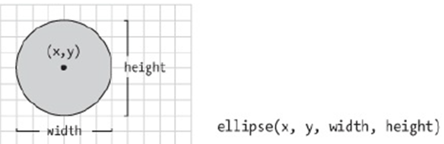
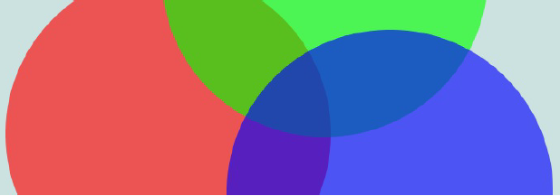
Set Transparency
By adding an optional fourth parameter to fill() or stroke(), you can control the transparency. This fourth parameter is known as the alpha value, and also uses the range 0 to 255 to set the amount of transparency.
The value 0 defines the color as entirely transparent (it won’t display), the value 255 is entirely opaque, and the values between these extremes cause the colors to mix on screen:
function draw() {
background(204, 226, 225); // Light blue color
fill(255, 0, 0, 160); // Red color
ellipse(132, 82, 200, 200); // Red circle
fill(0, 255, 0, 160); // Green color
ellipse(228, -16, 200, 200); // Green circle
fill(0, 0, 255, 160); // Blue color
ellipse(268, 118, 200, 200); // Blue circle
}
function setup() {
createCanvas(480, 120);
noStroke();
}

Slide 21
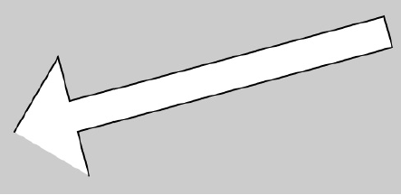
Custom Shapes
The beginShape() function signals the start of a new shape. The vertex() function is used to define each pair of x and y coordinates for the shape.
Finally, endShape() is called to signal that the shape is finished:
function setup() {
createCanvas(480, 120);
}
function draw() {
background(204);
beginShape();
vertex(180, 82);
vertex(207, 36);
vertex(214, 63);
vertex(407, 11);
vertex(412, 30);
vertex(219, 82);
vertex(226, 109);
endShape();
}

Slide 22
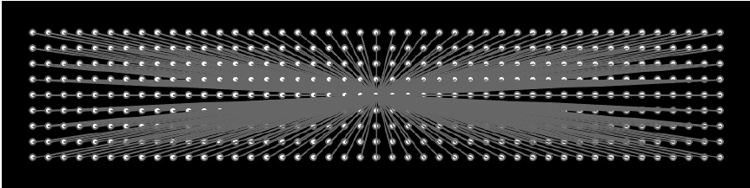
Pins and Lines
function setup() {
createCanvas(480, 120);
fill(255);
stroke(102);
}
function draw() {
background(0);
for (var y = 20; y <= height-20; y += 10) {
for (var x = 20; x <= width-20; x += 10) {
ellipse(x, y, 4, 4);
// Draw a line to the center of the display
line(x, y, 240, 60);
}
}
}

