Slide 1
Web Programming and Database

Slide 2
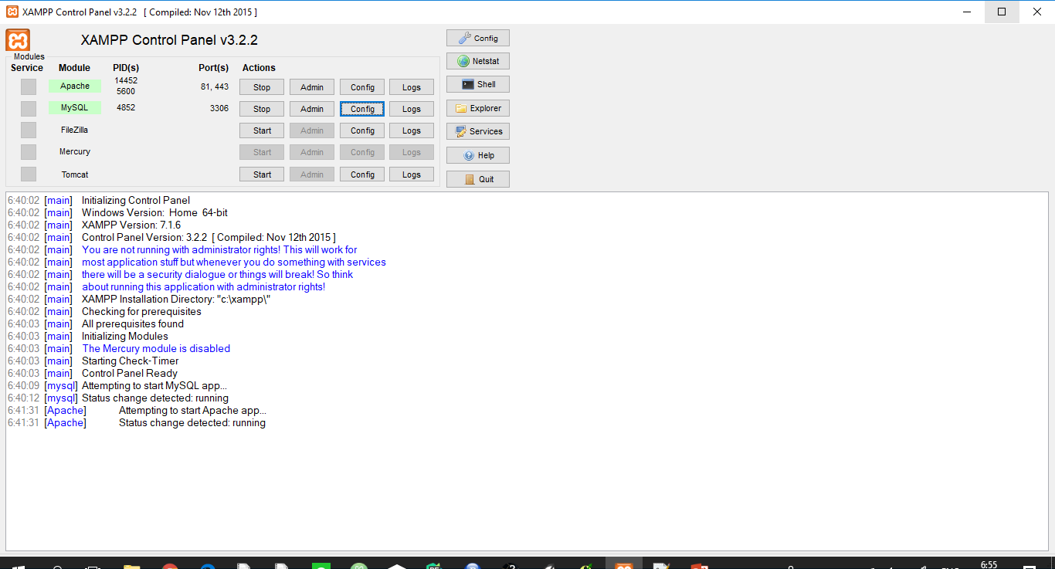
Xampp

Slide 3
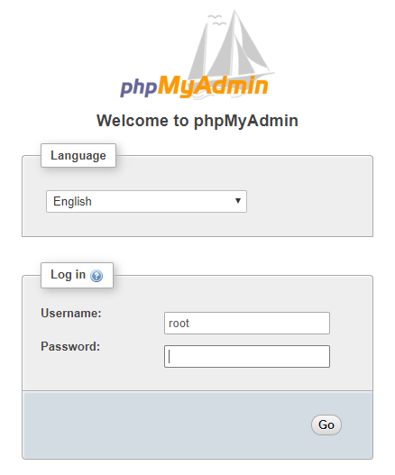
http://localhost:81/phpmyadmin/index.php

Slide 4
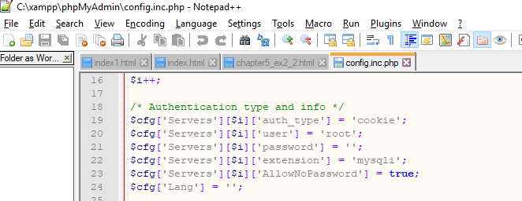
Xampp > phpMyadmin และเลือกไฟล์ config.inc.php

Slide 5
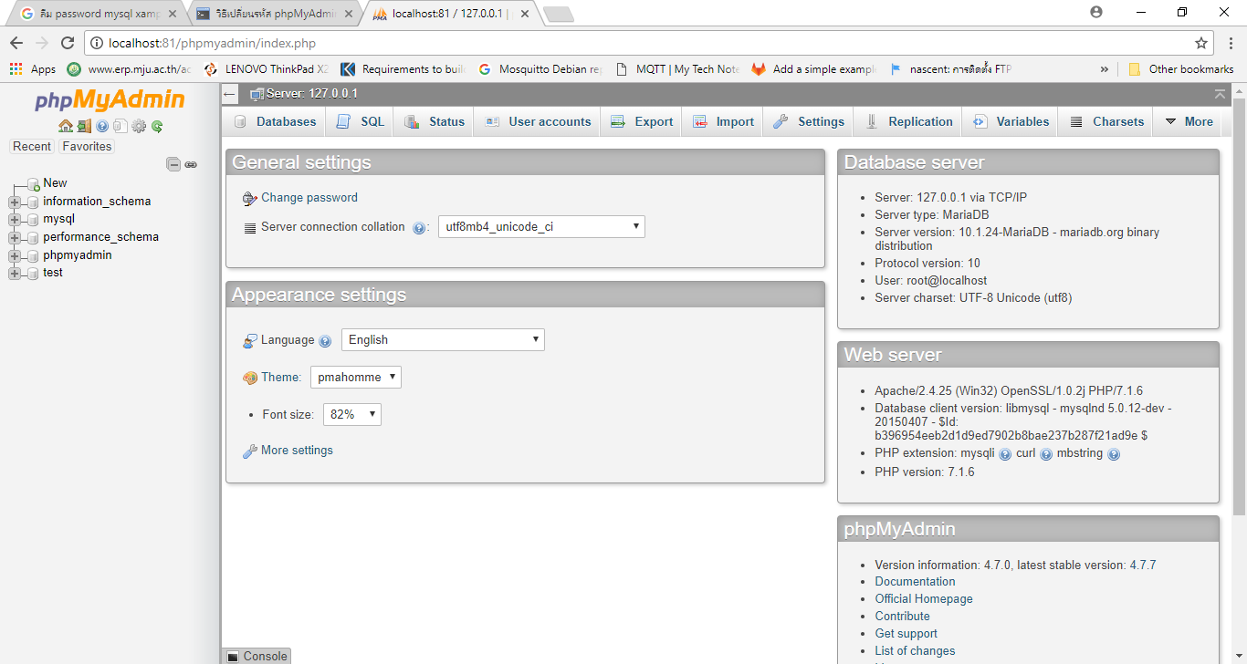
MySQL

Slide 6
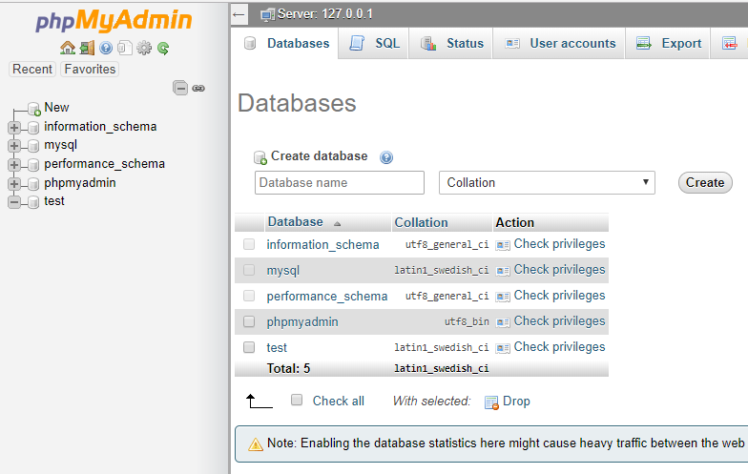
New

Slide 7
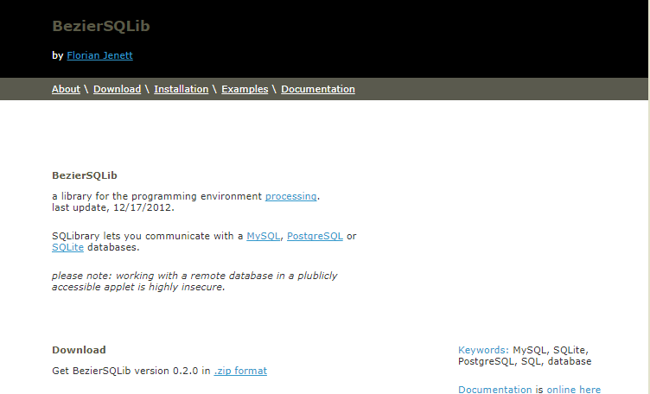
SQL Library

Slide 8
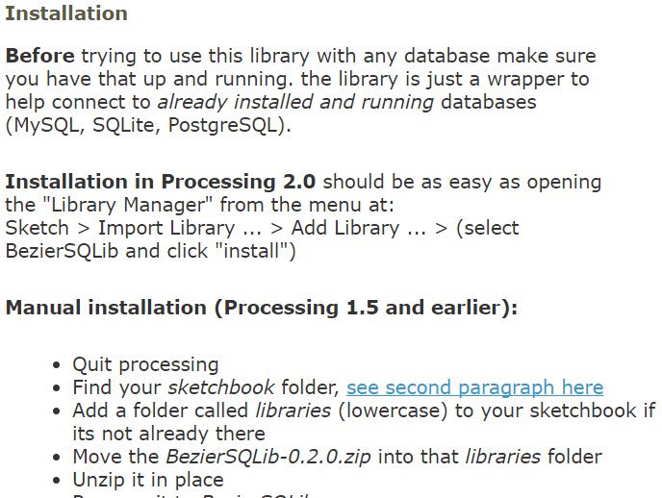

Slide 9
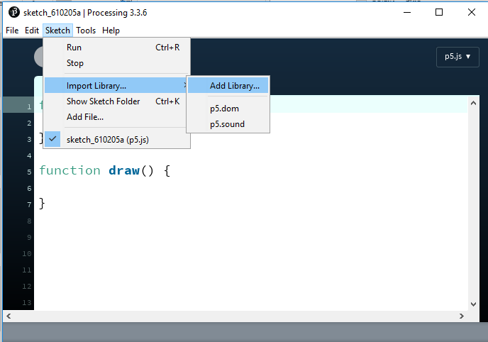
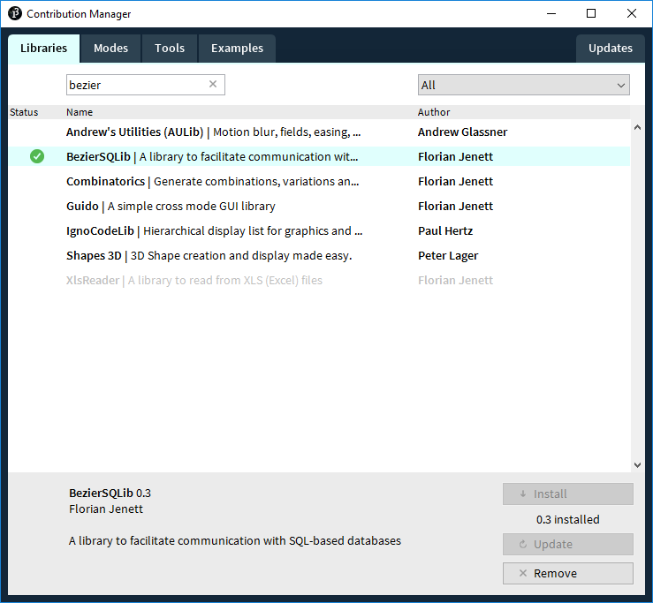
Import Library

Slide 10
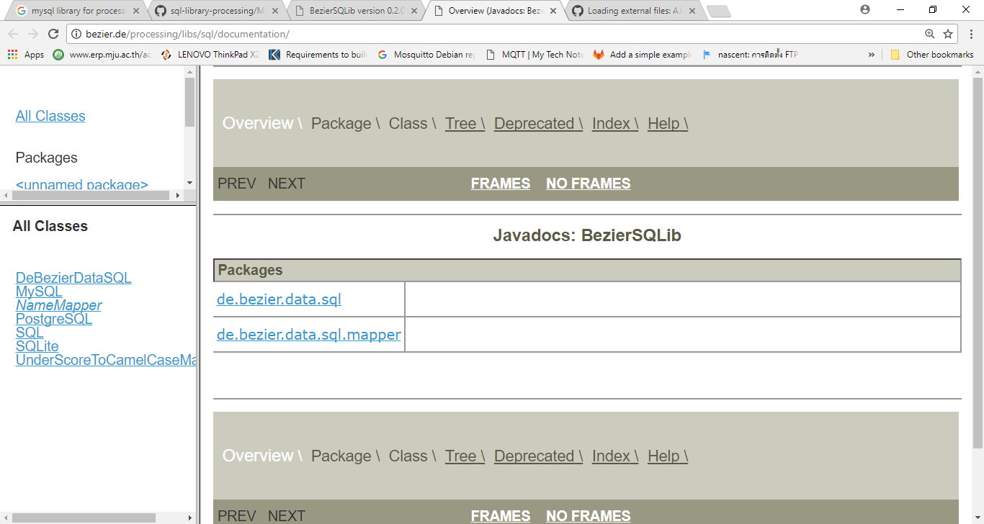

Slide 11
Bellow you will find a copy of the original table: Grade Report
Student_ID | Student_Name | Major | Course_ID | Course_Title | Instructor_Name | Instructor_Location | Grade
168300458 | Williams | IT | ITS420 | Database Imp | Codd | B104 | A
168300458 | Williams | IT | ITP310 | Programming | Parsons | B317 | B
543291073 | Baker | Acctg | ITD320 | Database Imp | Codd | B104 | C
543291073 | Baker | Acctg | Acct201 | Fund Acctg | Miller | H310 | B
543291073 | Baker | Acctg | Mktg300 | Intro Mktg | Bennett | B212 | A

Slide 12
tables can also be shown as such:
Students (Student_ID, Student_Name, Major)
Courses (Course_ID, Course_Title, Instructor_ID)
Foreign key: Instructor_ID to Instructors table
Grades (Student_ID, Course_ID, Grade)
Foreign key: Student_ID to Students table
Foreign key: Course_ID to Courses table
Instructors (Instructor_ID, Instructor_Name, Instructor_Location)

Slide 13
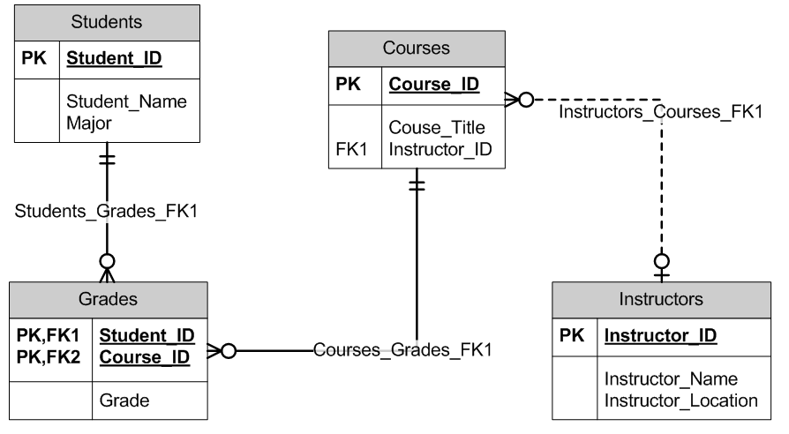
Bellow you will find a Chen’s Model ER diagram of the 3NF tables:These
https://chamblin.wordpress.com/2011/01/26/3-primary-levels-of-database-normalization/

Slide 14
import de.bezier.data.sql.*;
MySQL msql;
void setup()
{
size( 100, 100 );
String user = "sql_user";
String pass = "sql_pass";
String database = "sql_library_test_db";
msql = new MySQL( this, "localhost", database, user, pass );
if ( msql.connect() )
{
msql.query( "SELECT COUNT(*) FROM %s", "example1" );
msql.next();
println( "this table has " + msql.getInt(1) + " number of rows" );
}
else
{
// connection failed !
// - check your login, password
// - check that your server runs on localhost and that the port is set right
// - try connecting through other means (terminal or console / MySQL workbench / ...)
}
}

Slide 15
import de.bezier.data.sql.*;
import de.bezier.data.sql.*;
String dbHost = "localhost"; // if you are using a using a local database, this should be fine
String dbPort = "8889"; // replace with database port, MAMP standard is 8889
String dbUser = "root"; // replace with database username, MAMP standard is "root"
String dbPass = "root"; // replace with database password, MAMP standard is "root"
String dbName = "database_name"; // replace with database name
String tableName = "table_name"; // replace with table name
MySQL msql;
void setup() {
msql = new MySQL( this, dbHost + ":" + dbPort, dbName, dbUser, dbPass );
if (msql.connect()) {
// get number of rows
msql.query("SELECT COUNT(*) FROM " + tableName);
msql.next();
println("Number of rows: " + msql.getInt(1));
println();
// access table
msql.query("SELECT * FROM " + tableName);
while (msql.next()){
// replace "first_name" and "last_name" with column names from your table
String s1 = msql.getString("first_name");
String s2 = msql.getString("last_name");
println(s1 + " " + s2);
}
} else {
println("Yikes, there was an error!");
}
}

