Slide 1

EXTRACTION OF HUMANBODIES FROM SINGLE IMAGES USING MULTILEVEL SEGMENTATION
PROJECT GUIDE K.S.RAGHAVENDRA REDDY
PRESENTED BY
R.GOWRI (1011504905)
P.GOWTHAMI (1011504903)
P.HYNDAVI (1011404009)
M.KIRAN KUMAR NAIK (1011404012)
DEPARTMENT OF ELECTRONICS AND COMMUNICATION ENGINEERING
Y.S.R ENGINEERING COLLEGE OF YOGI VEMANA UNIVERSITY
Proddatur-5163360, Y.S.R (Dt)
ANDHRAPRADESH
2018

Slide 2
CONTENTS
ABSTRACT
INTRODUCTION
OBJECTIVE
EXISTING SYSTEM
PROPOSED SYSTEM
PROPOSED BLOCK DIAGRAM
SIMULATION RESULTS
ADVANTAGES
APPLICATIONS
CONCLUSION

Slide 3
ABSTRACT
Digital image processing and its prominence have increased enormous way in recent times. Digital image processing and associated research fields pave way for the invention of high end applications in medicine, robotics, satellite image processing, genetics etc. Extraction of human bodies from single images from respective digital image has attained attention in recent times and wide range of research is carried on to meet the desired result. The proposed result is classified into five steps, face detection, multi level segmentation, skin detection, upper body segmentation, and lower body segmentation. Finally the simulation results have achieved better performance and high efficiency over traditional state of art methods.

Slide 4
INTRODUCTION
Human body extraction from still image is an extremely difficult problem due to various poses of human body and complicated background environment.
The major contributions of this study address upright and not occluded poses
We propose a novel frame work for automatic segmentation of human bodies in single images.
We combine information gathered from different levels of image segmentation.
Without making any assumptions about the foreground and background, except for the assumptions that sleeves are of similar color to the torso regions.

Slide 5
OBJECTIVE
We presented a novel methodology for extracting human bodies from single images. It is a bottom-up approach that combines information from multiple levels of segmentation in order to discover salient regions with high potential of belonging to the human body.

Slide 6
EXISTING SYSTEM
Most existing methods were used in skin color approach for detecting the faces in still images.
The RGB color model was used to find the skin features. The face of the human has found using the skin color information initially and then applied to other body parts.
Skin color segmentation approach for detecting the faces in still images.
These methods takes a larger time to do.

Slide 7
PROPOSED SYSTEM
we propose a bottom-up approach for human body segmentation in static images.
We decompose the problem into three sequential problems
Face detection
Multilevel segmentation
Skin detection
Upper body extraction
Lower body extraction
Provides a strong indication about the presence of humans in an image.
Reduces the search space for the upper body.
Provides information about skin color.
Determines the dimensions of the rest of the body, according to anthropometric constraints.

Slide 8
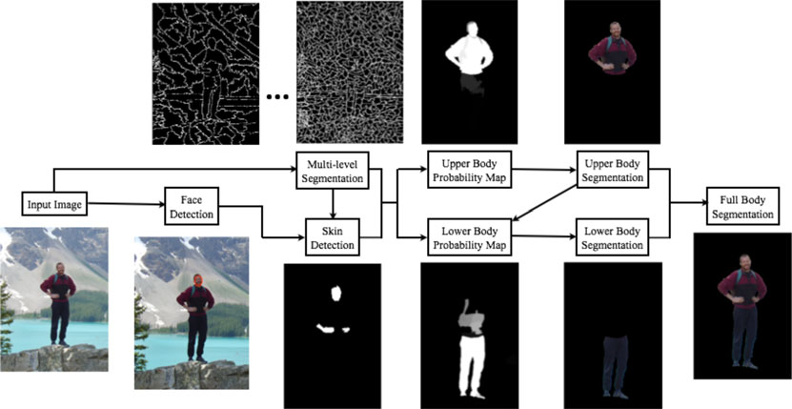
BLOCK DIAGRAM

Slide 9
FACE DETECTION
Viola-Jones face detection algorithm for both front and side views.
Based on facial feature detection and localization using low-level image processing techniques, image segmentation, and graph based verification of the facial structure.
VIOLA-JONES ALGORITHM:
Widely used method for real time object detection.
Detection is fast.
Uses Haar basis feature filters.

Slide 10
MULTILEVEL SEGMENTATION
Segmentation is the process of dividing an image in to different segments.
Multi-level segmentation is the process of dividing an image in to multiple segments that is set of pixels also known as super pixels which is used to easily identify and simplify the representation of image and also which makes it easy to analyze.
In general, super pixels are based on multilevel segmentation like 100 to 500 super pixels depending upon the flexibility. For skin detection, the image is segmented to 500 super pixels in order to differentiate the skin region and skin like regions and to extract only the skin region from an image.

Slide 11
SKIN DETECTION
Skin detection is the process of finding the pixels and regions which are similar to the skin color in an image.
It uses two models:
Adaptive skin model: Allows modelling and detection of the true skin-color pixels with significantly higher accuracy and flexibility.
Global skin model: Global skin model is used to recover the uncertain areas.

Slide 12
UPPER BODY AND LOWER BODY SEGMENTATION
In the case of upper body segmentation, it was the position of the face that aided the estimation of the upper body location.
In the case of lower body segmentation, it is the upper body that aids the estimation of the lower body’s position.
The algorithm for estimating the lower body part, in order to achieve full body segmentation is very similar to the one for upper body extraction.

Slide 13
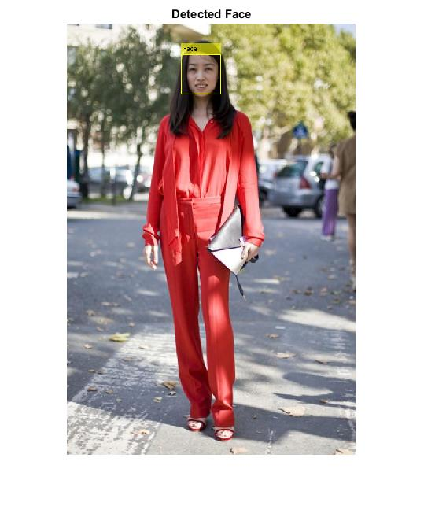
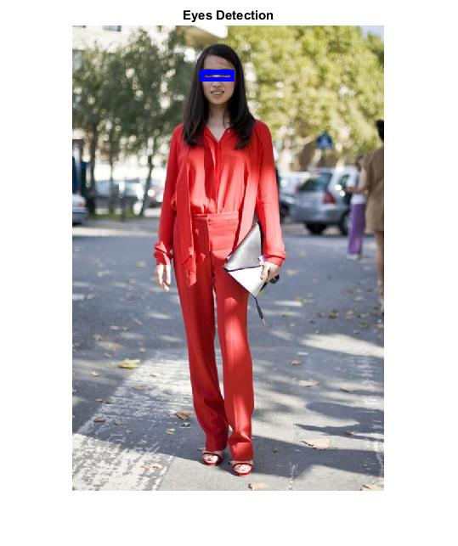


SIMULATON RESULTS
(a) Input image (b) Detected Face (c) Eye Detection (d) Mouth Detection

Slide 14
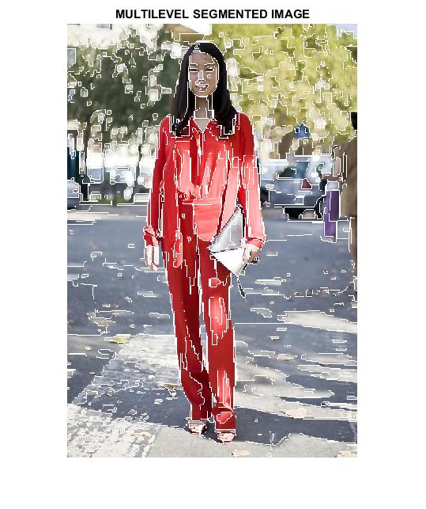
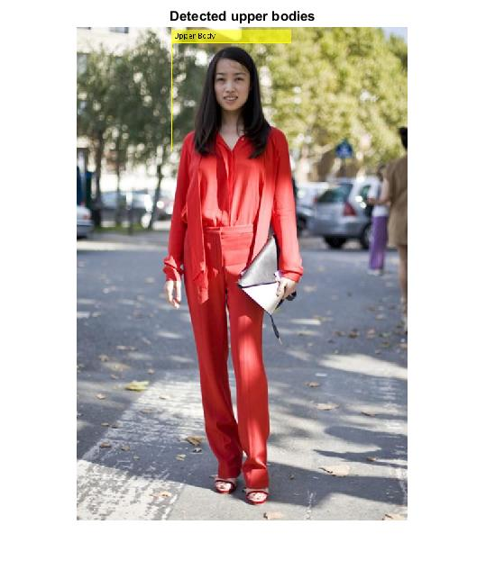
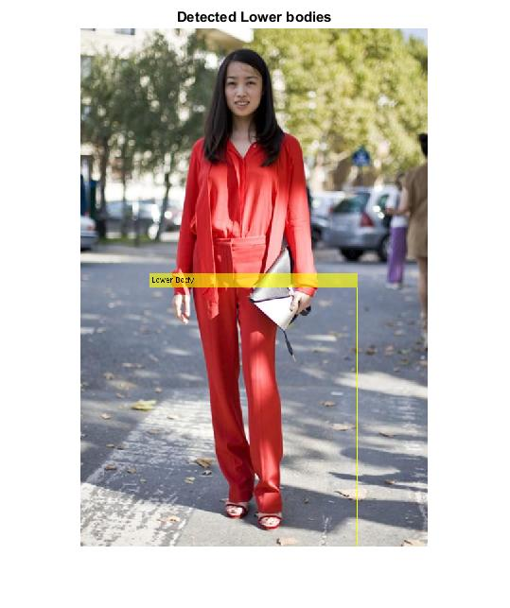
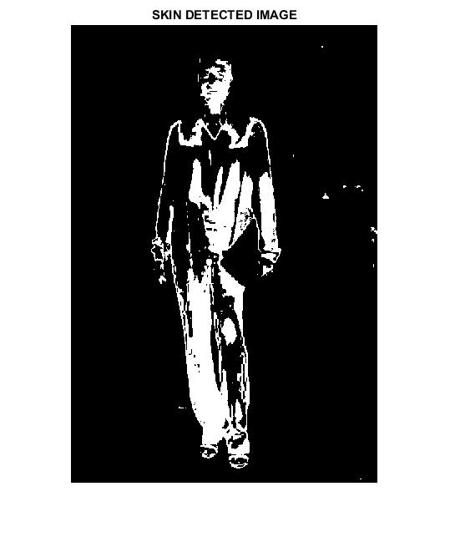
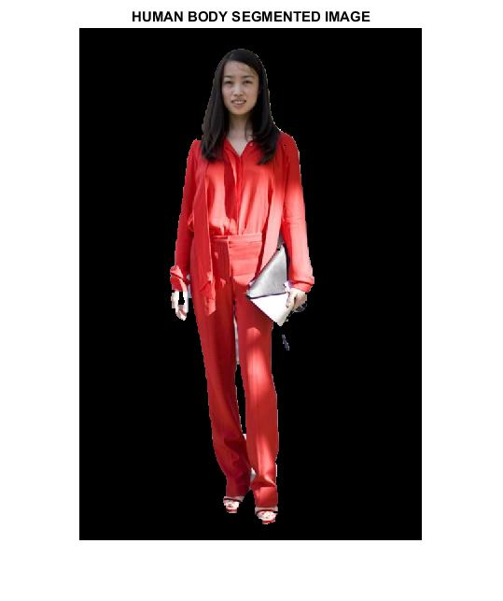
(e) Multilevel
segmented image
(f) Detected Upper body
(g) Lower body
Detection
(h) Skin segmented
image
(i) Human body
segmented image

Slide 15
ADVANTAGES
It can automatically localize and segment the human body.
To find arbitrary salient regions that are comprised by segments that appear strongly inside the (hypothesized) foreground rectangles and weakly outside.
we demonstrate how soft anthropometric constraints can guide and automate the process in many levels, from efficient mask creation and searching to the refinement of the probabilistic map.

Slide 16
APPLICATIONS
Human body localization
Cluttered Environment
Skin color estimation
Shape recognition

Slide 17
CONCLUSION
We presented a novel methodology for extracting human bodies from single images. It is a bottom-up approach that combines information from multiple levels of segmentation in order to discover salient regions with high potential of belonging to the human body.
The main component of the system is the face detection step, where we estimate the rough location of the body, construct a rough anthropometric model, and model the skin’s color. Soft anthropometric constraints guide an efficient search for the most visible body parts, namely the upper and lower body, avoiding the need for strong prior knowledge, such as the pose of the body.

Slide 18
THANK Q

