Slide 1

Spark :: PySpark
Dayoung Kang, Jaehyeon Kim

Slide 2


Team
Dayoung Kang
Jaehyeon Kim
Precision Agriculture
major
Software Engineering
Computer Vision(DL)
Machine Learning
Cloud Computing
DevOps
interest

Slide 3
Table of Contents
1
2
3
Spark
PySpark
ML in Spark
Reference
Spark: Cluster Computing with Working Sets
PySpark: High-performance data processing without learning Scala
MLlib: Machine Learning in Apache Spark
Scalable machine-learning algorithms for big data analytics: a comprehensive review

Slide 4

Emergence of Spark
Large-scale data processing
Map Reduce
For acyclic data flow model

Slide 5
Emergence of Spark
Map Reduce
Step1. Map
Split input data to number of slices
Apply specific function to each to generate intermediate results
Step2. Reduce
Combine the intermediate results to make the final result.

Slide 6
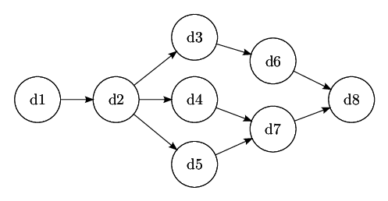
Emergence of Spark
Acyclic data flow model
By representing data processing tasks as a graph
Data can only flow in one direction ---> preventing loops

Slide 7
Emergence of Spark
Not suitable for applications
“reuse datasets through parallel operations”
repeatedly use the same dataset in multiple parallel operations

Slide 8
About Spark
Spark
one variant of Map reduce
introduces the concept of a Resilient Distributed Dataset (RDD)
Resilient Distributed Dataset(RDD)
a collection of read-only objects that are partitioned and stored on multiple computers
if one of the partitions is lost, it can be rebuilt

Slide 9
About Spark - RDD
Resilient Distributed Dataset(RDD)
in Spark, each RDD is represented by a Scala object
Methods
Generated from the file – from Shared file systems
Parallelizing Scala collections – split number of slices ---> nodes
Transformation RDD – convert type of component
Changing persistence – Cache & Save
* Cache: keep RDD in memory and make them reusable * Save: computes RDD and saves to distributed file system
---> making available to subsequent operations

Slide 10
About Spark - RDD
Resilient Distributed Dataset(RDD)
RDD performs a variety of parallel tasks
Works
Reduce – combine elements of dataset using operation ---> to produce result in driver program
Collect – send all the elements to driver program
Foreach – asses each element through user-supplied function

Slide 11
About Spark
Spark
Spark supports two types of shared variables
Variables
broadcast – cache values in memory on all nodes
accumulator – only added to (such as counter & sum)

Slide 12
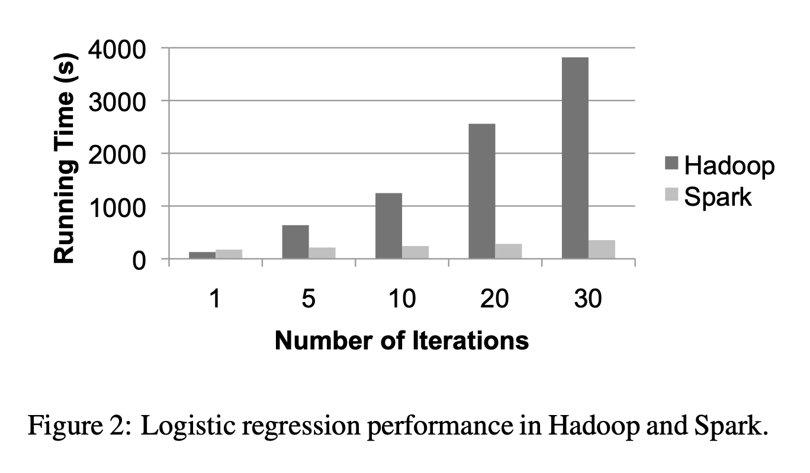
Spark vs Hadoop
Spark vs Hadoop : Logistic regression
when comparing the performance of logistic regression,
Spark ran up to 10 times faster than Hadoop.
reuse cached data
shared variables
parallel processing
recovery function

Slide 13
About PySpark
PySpark
The python API for Apache Spark (library)
PySpark or pandas
PySpark
pandas
Large datasets
Easy to analyze data in local
Limitations for very large datasets

Slide 14
About PySpark
PySpark with pandas
PySpark to aggregate and transform data and pull the results into a DataFrame in pandas for further analysis in local environment
“an effective approach to processing and analyzing large amounts of data”
The key point is that PySpark will not necessarily replace the pandas

Slide 15

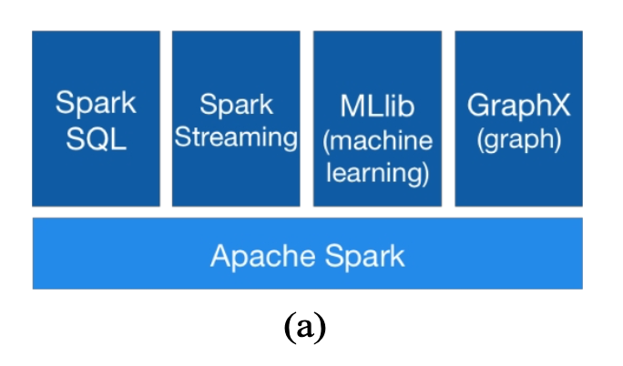
Machine Learning in spark
MLlib: Machine Learning in Apache Spark
Spark’s distributed machine learing library, and the largest such library
Targets large-scale learning settings that benefit from data-parallelism or model-parallelism

Slide 16
Machine Learning in spark
MLlib: Algorithms
MLlib provides fast, distributed implementations of common learning algorithms.
Learning
Classification
Regression
Clustering
Recommendation

Slide 17
MLlib: Algorithms
MLlib: Classification Algorithms
Algorithms
Logistic Regression with SGD
Logistic Regression with LBFGS
SVM with SGD
Naïve Bayes
Decision Tree
Gradient Boosted Trees

Slide 18
MLlib: Algorithms
MLlib: Regression Algorithms
Algorithms
Linear Regression with SGD
Ridge Regression with SGD
Lasso with SGD
Elastic Net Regression
Isotonic Regression
Gradient Boosted Trees
Random Forest

Slide 19
MLlib: Algorithms
MLlib: Clustering Algorithms
Algorithms
K-means
Streaming K-Means
Gaussian Mixture
LDA
Power Iteration Clustering

Slide 20
MLlib: Algorithms
MLlib: Recommendation Algorithms
Algorithms
ALS

Slide 21
MLlib: Cases
MLlib: Algorithmic Optimization
MLlib includes many optimizations to support efficient distributed learning and prediction
JVM GC
Reduce Communication Costs
Parallelize Learning within Trees

Slide 22
Thank you

