Slide 1
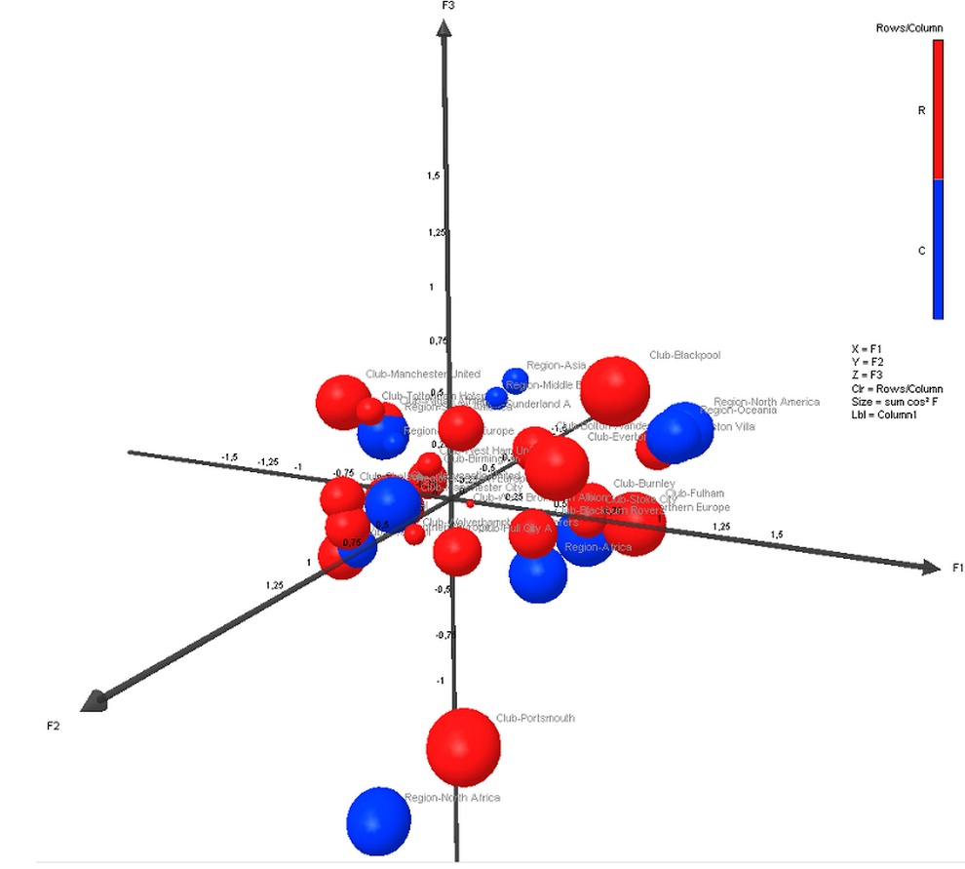
Processing
UniDic
Multi-regression
Analysis
Speech
Corpora
Internal
Specification
Results
Morphological
Analyzer-MeCab
Feature
Extraction
Transcriptions
Scores of
3 scales
0.32, -0.55, -0.78
…
Training
Data
300 words
Rating
Multi-regression
Analysis
UniDic
Input
Output
Input texts
(Sentences)
Results
Analysis
Model
Morphological
Analyzer-MeCab
Scores of
3 scales
0.32, -0.55, -0.78
Visualization
Key Statistics
Info
Misc Info

Slide 2
Internal Specification of An Analysis System of Texts on speaking style
Input
  Input texts(Sentences): A text (several sentences or paragraphs) given by system users
  Morphological Analyzer-Mecab: Part-of-Speech and Morphological Analyzer MeCab
  UniDic: a multi-purpose electronic dictionary for morphological analyzers Mecab
  Results: morphological analyzed results of Input texts
  Key Statistics: some basic statistics of Input texts, such as word count, sentence count, etc.
  Info: results of key statistics of Input texts
Processing
  Speech Corpora: consist of speeches with diverse speaking style
  Transcriptions: Transcriptions of speeches from Speech Corpora
    One talk as one sample
    Transcription of the middle one minute of one talk
  Morphological Analyzer-Mecab: Part-of-Speech and Morphological Analyzer MeCab
  UniDic: a multi-purpose electronic dictionary for morphological analyzers Mecab
  Rating: impression rating experiment based on the scale of speaking style by Eskenazi, M.(1993)
    intelligibility-oriented
    familiarity
    social strata
  Results: morphological analyzed results of Transcriptions
  Scores of 3 scales: average rates of Rating as 3-Dimensions Coordinates (e.g.: 0.32, -0.55, -0.78)
Multi-regression Analysis
  Feature Extraction: features that help to specify speaking style extracted from results, such as rate of Part-of-Speech, rate of the language description, inflection, etc
  Training Data: average rating results of Transcriptions on the scale of speaking style by Eskenazi, M. as training data for Analysis Model
  Multi-regression Analysis : to build analysis models for 3 scales
  Analysis Model: a model that specifies speaking style of given texts
Output
  Scores of 3 scales: Regression results of Input texts on speaking style in a 3-Dimensions Coordinate form (e.g.: 0.32, -0.55, -0.78)
  Misc: a transfromed text of Info
  Visualization: visualize the analysis results of texts given by system users on speaking style using Scores of 3 scales and Misc in a 3-Dimensions figure

Slide 3
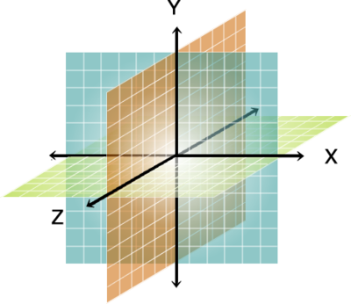

External
Specification
From speaking style
From speaking style
Results:
return
return
Top
speaking style | Name | Remarks | Info Link | Samples
Public Speech | Corpus of Spontaneous Japanese | 日本語話し言葉コーパス（CSJ） | http://www.ninjal.ac.jp/products-k/Katsudo/seika/corpus/ | Sample 1 Sample 2 Sample 3 …
...
…
Collation
Database
Discrimination and Recommendation
Of Speech Corpora
Based on speaking style
From speaking style
Or
From Speech Corpora
Or
From Transcriptions
From Known Speech Corpora
A list of speech corpora
From Known Speech Corpora
Results:
speaking style: Public Speech
Remarks: Speeches that were addressed publicly
return
return
Top
Name
Remarks
Info Link
Corpus of Spontaneous Japanese
日本語話し言葉コーパス(CSJ)
http://www.ninjal.ac.jp/products-k/Katsudo/seika/corpus/
…
…
…
…
From Transcriptions
From Transcriptions
Results:
speaking style: Public Speech
Remarks: Speeches that were addressed publicly
return
return
Top
Please Input transcriptions here:
Analysis
Model
submit

Slide 4
UniDic
Speech
Corpora
Results
Morphological
Analyzer-MeCab
Feature
Extraction
Transcriptions
Multi-
regression
Analysis
3 scales
0.32, -0.55, -20.78
…
Training
Data
300 words
Rating

Slide 5
From Transcriptions
return
Input
Input texts
(Sentences)
Please Input transcriptions here:
submit
Prior
Process
Count
Etc.
UniDic
Morphological
Analyzer-MeCab
Pattern
Matching
Morph
Patterns
From Transcriptions
return
Top
Misc
Results
MA
Results
Count:
…….
Analysis
Output
lm
Model
Scores of
3 scales
0.32, -0.55, -0.78

