Slide 1
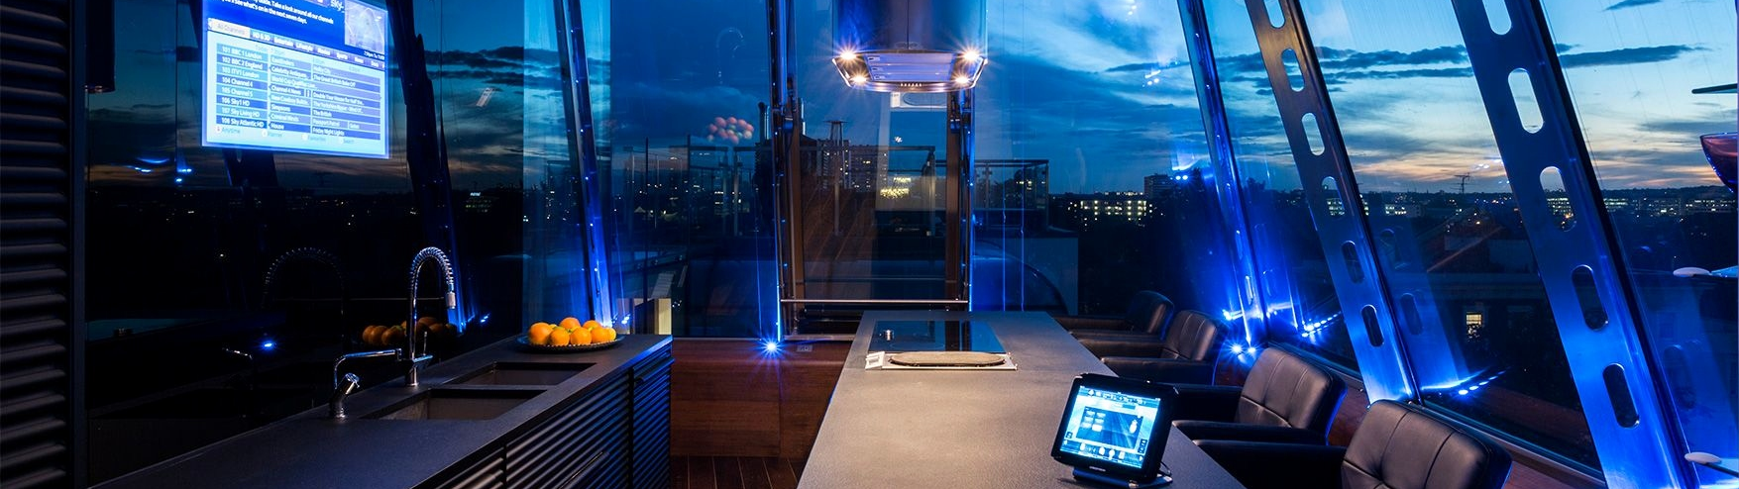
DATA ANALYSIS | FORECAST | DASHBOARD
FOCUS ON THE WHY

Slide 2
INDEX
1.INTRODUCTION
2.PRE-PROCESS
3.ANALYSIS
4.FORECASTS
5.DASHBOARD
6.SUGGESTIONS
Pages 03 - 04
Pages 05 - 09
Pages 10 - 13
Pages 14 - 17
Pages 18 - 19
Pages 20 - 21

Slide 3


1.
INTRODUCTION

Slide 4
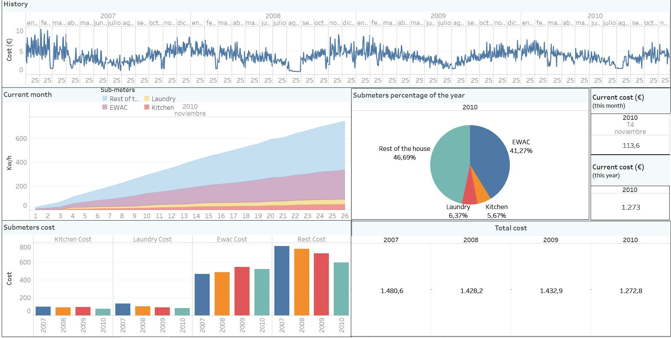
DASHBOARD

Slide 5

2.
PRE-PROCESS

Slide 6
What we did?
DATA COLLECTION
RAW ANALYSIS
PRE-PROCESSING
FORECASTING
1
2
3
4

Slide 7
Causes problems with the analysis / forecasting
MISSING VALUES
Solution
Replaced by the mean

Slide 8
MEASURES
Transform all measures into Kw/h
Keep global power and sub-meters

Slide 9
PRICES
Assign night/day prices concerning the rates
(night from 10.30pm – 6.30am & day 6.30am – 10.30pm)
Calculate cost per minute for total power, each sub-meter and the rest of the house (Total power – sub-meters)

Slide 10
SAVING TIME
Taking into consideration summer/winter timeshift
(Summer -> March to October | Winter -> October to March)

Slide 11
3.
ANALYSIS

Slide 12
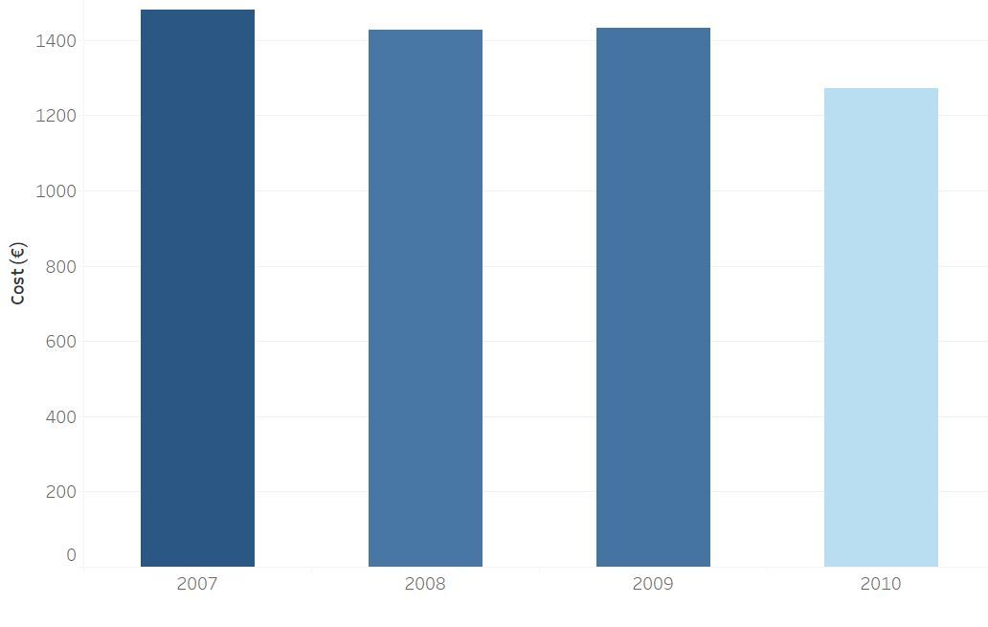
AMOUNT SPENT OVER THE YEARS

Slide 13
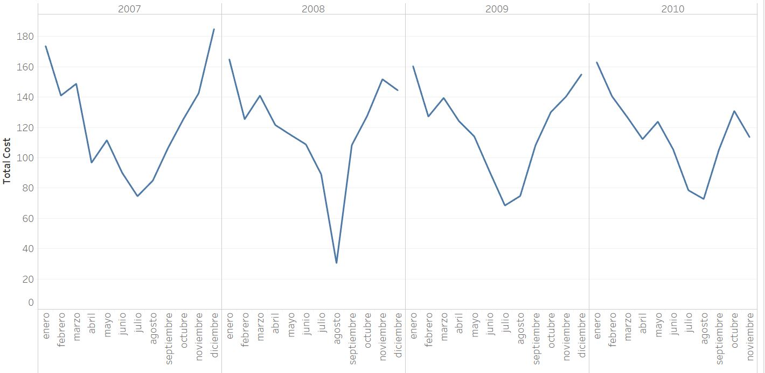
AMOUNT SPENT OVER THE MONTHS

Slide 14
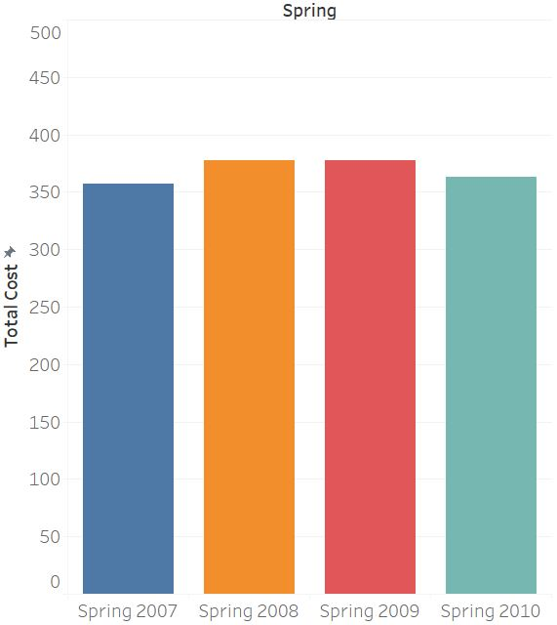
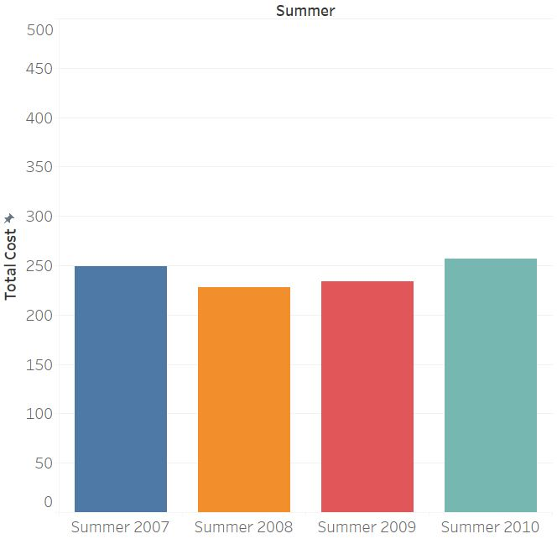
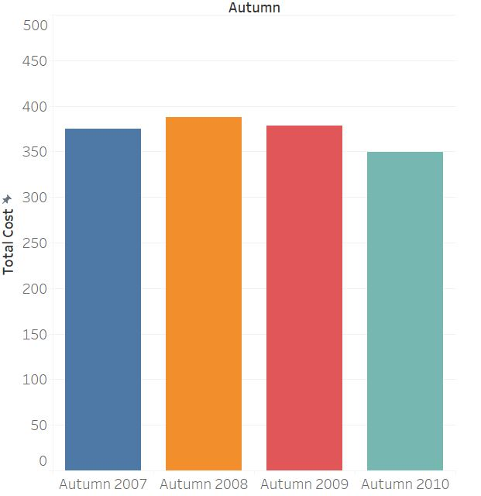
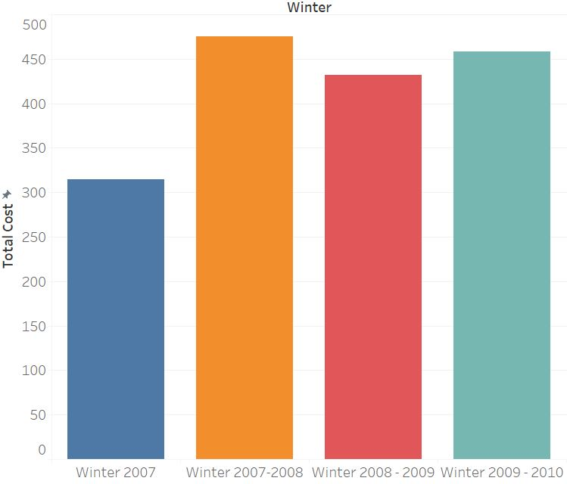
AMOUNT SPENT OVER THE SEASONS

Slide 15

4.
FORECASTS

Slide 16
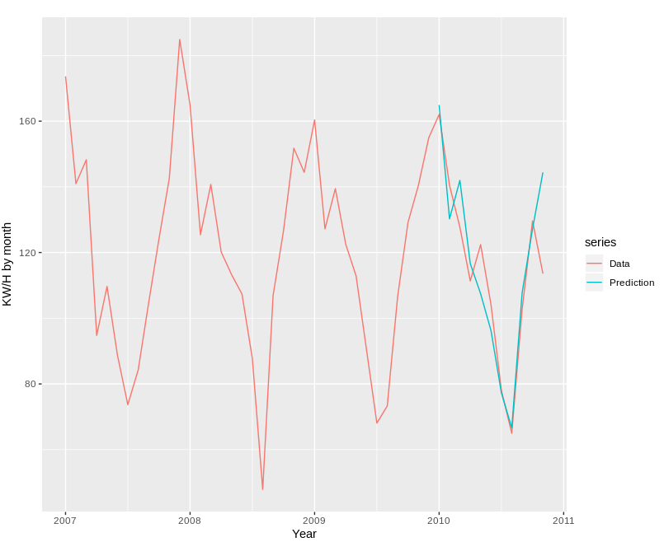
PRICES FORECAST
Accuracy percentage of the forecast: 7,4%

Slide 17
2010 prices (and forecast)
PRICES FORECAST
Jan | Feb | Mar | Apr | Mai | Jun | Jul | Aug | Sep | Oct | Nov | Dec
162,04 | 140,49 | 127,70 | 111,34 | 122,42 | 104,12 | 78,05 | 64,96 | 102,71 | 129,64 | 141.19 | 160,38

Slide 18
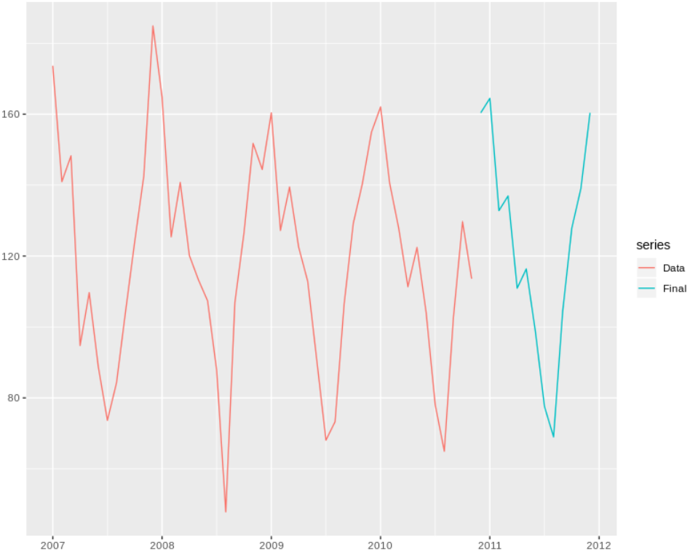
2011 price forecasts
PRICES FORECAST

Slide 19

5.
DASHBOARD

Slide 20
DASHBOARD

Slide 21

6.
SUGGESTIONS

Slide 22
Develop the dashboard in an app
SUGGESTIONS
Add sub-meters by each device
Make different aggrupation

Slide 23
01
HEADQUARTERS
Av. Diagonal 597, 5th floor
08012 Barcelona, Spain
Phone: 934572282
WE ARE HERE
Glad to hearing
from you
02
E-MAIL ADDRESSES
Infor: info@kvalue.com
Sales: sales@kvalue.com
Support: support@kvalue.com
03
SOCIAL MEDIA

Slide 24
APPENDIX
FOCUS ON THE WHY

Slide 25
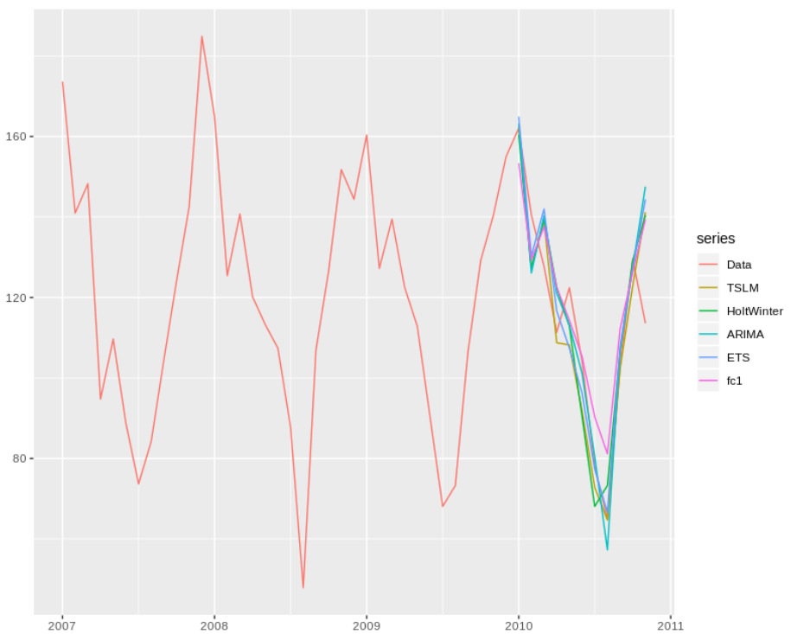
All forecasts
FORECAST
MODEL | MAPE
TSLM | 7,40%
HOLTWINTER | 9,45%
ARIMA | 8,22%
ETS | 7,47%
FC1 (hmodel) | 10,36%

