Slide 1
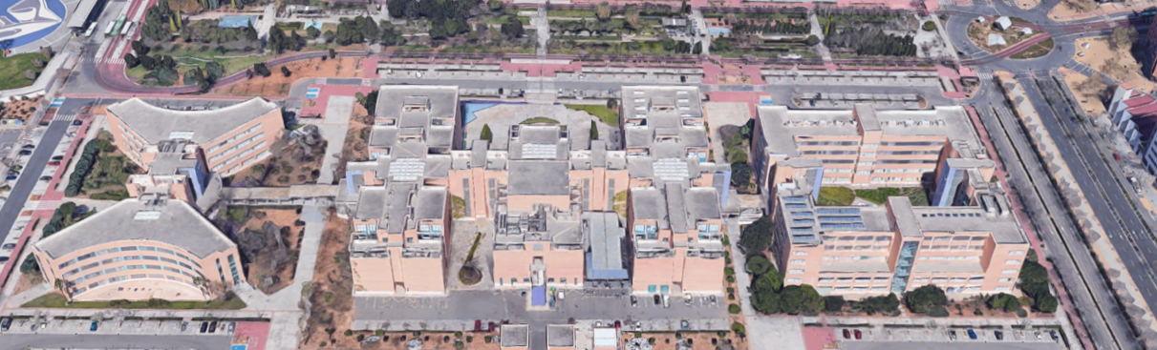
JAUME I UNIVERSITY, SPAIN.
WIFI LOCATION BASED ON FINGERPRINTING
A MACHINE LEARNING PROJECT
Valerian Virmaux & Kiko Sánchez

Slide 2
INDEX
1.INTRODUCTION
2.PRE-PROCESS
3.MODELLING
4.RECOMMENDATIONS
Pages 03 - 09
Pages 10 - 13
Pages 14 - 35
Pages 36 - 38

Slide 3
1.
INTRODUCTION

Slide 4
Insert Image
GENERAL VIEW
INTRODUCTION
Training set with 19937 samples in 933 fixed points.
2 DATA SETS
Validation set with 1111 random points.

Slide 5
Insert Image
GENERAL VIEW
529 FEATURES
INTRODUCTION
COLUMN NUMBERS | FEATURE
001 – 520 | RSSI signals
521 -523 | Real world coordinates of the sample points
524 | Building ID
525 | Space ID
526 | Realtive position to respect Space ID
527 | User ID
528 | Phone ID
529 | Timestamp

Slide 6
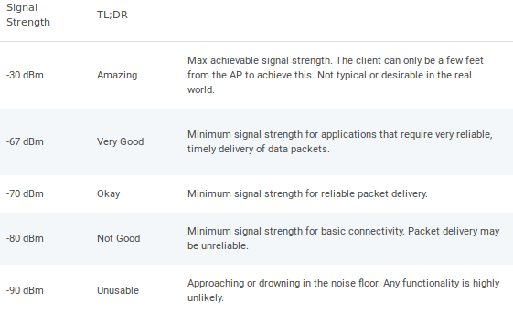
Insert Image
GENERAL VIEW
520 WAPS (giving RSSI signal to the phones)
INTRODUCTION

Slide 7
Insert Image
GENERAL VIEW
Distribution of the data set
INTRODUCTION
 | FLOOR 0 | FLOOR 1 | FLOOR 2 | FLOOR 3 | FLOOR 4 | TOTAL
BUILDING 0 | 5% | 6.8% | 7.2% | 6.9% | - | 26%
BUILDING 1 | 6.8% | 7.4% | 7% | 4.7% | - | 26%
BUILDING 2 | 9.7% | 10.8% | 7.9% | 13.6% | 5.5% | 47%
TOTAL | 21.9% | 25% | 22% | 25% | 5.5% | 100%

Slide 8
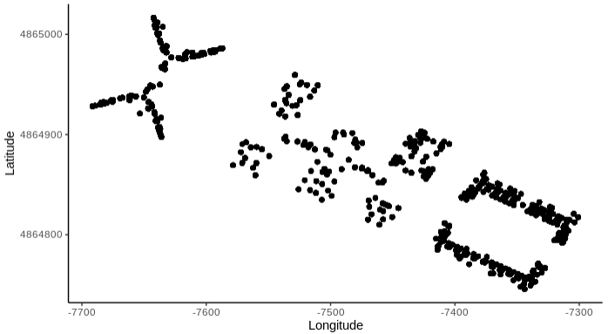
Insert Image
GENERAL VIEW
Distribution of the samples in longitude and latitude
INTRODUCTION

Slide 9
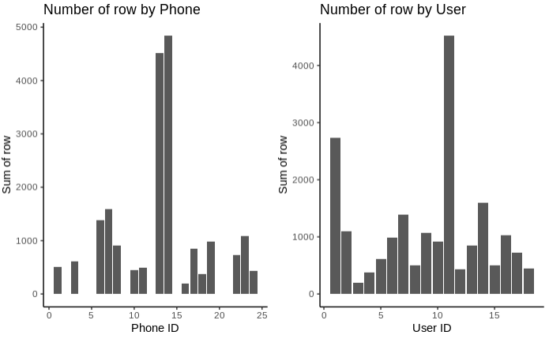
Insert Image
GENERAL VIEW
Distribution of user and phones
INTRODUCTION

Slide 10
2.
PRE-PROCESS

Slide 11
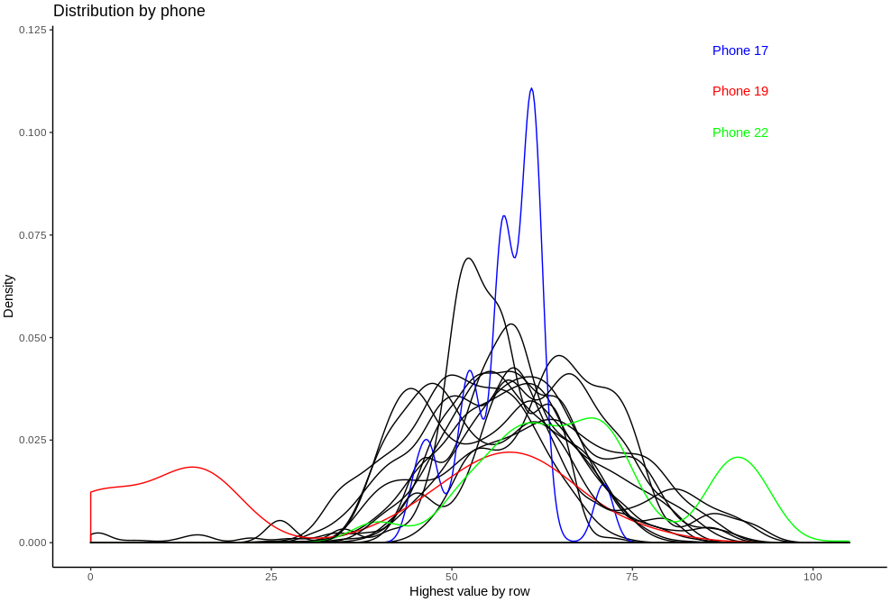
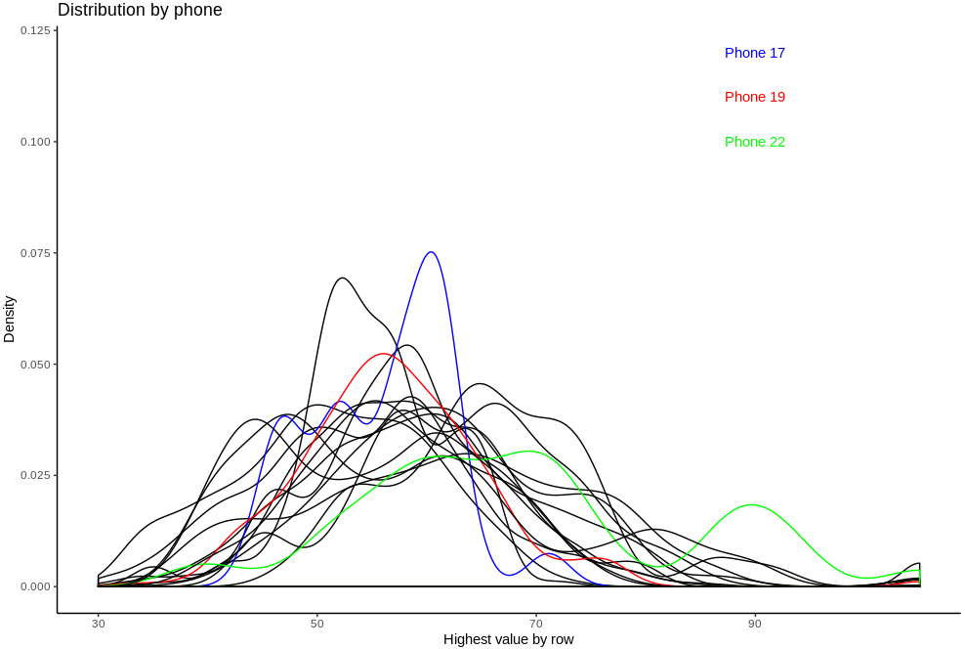
Insert Image
PRE-PROCESS
Removed outliers (<30 & >90)
Users: 18
PRE-PROCESS

Slide 12
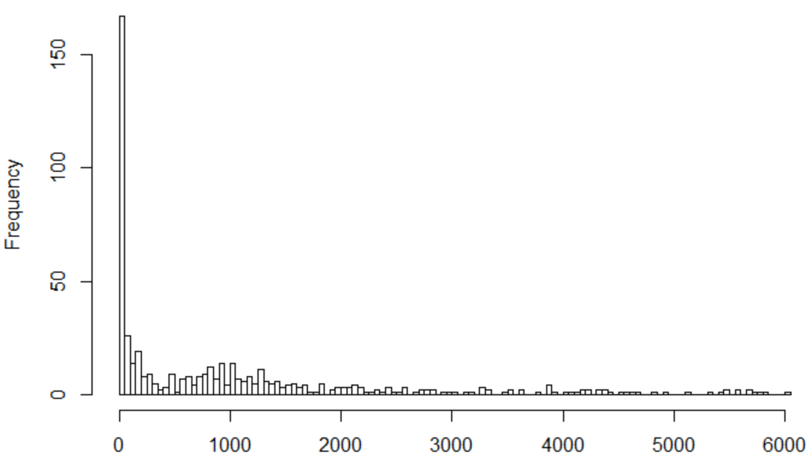
Insert Image
PRE-PROCESS
Removing near zero variance of the waps (columns)
PRE-PROCESS

Slide 13
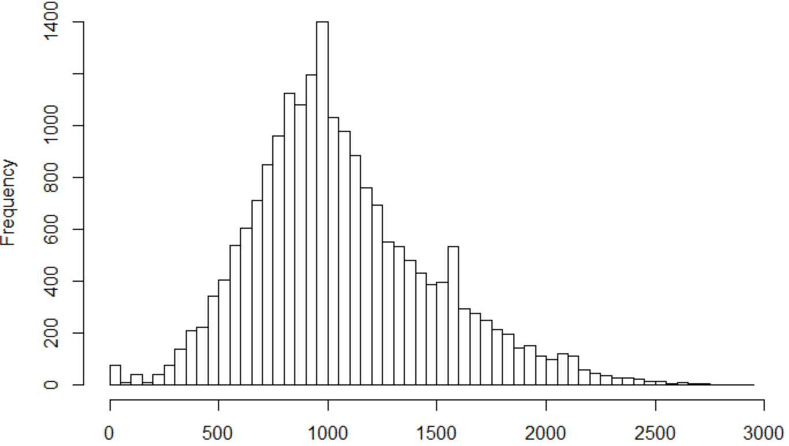
Insert Image
PRE-PROCESS
Removing near zero variance of the checkpoints (rows)
PRE-PROCESS

Slide 14
3.
MODELS

Slide 15
Features selection for modelling
Insert Image
MODELS
1
464 WAPS (from a total of 520)
2
DEPENDENT VARIABLES (Building, Floor, Latitude/longitude
3
SPACE ID
4
RELATIVE POSITION
5
USER ID
6
PHONE
7
TIMESTAMP

Slide 16
Semi-waterfall modeling approach
Insert Image
464 WAPS
BUILDING PREDICTION
MODELS
205 waps
212 waps
218 waps
Building 0
Building 1
Building 2
FLOOR
LATITUDE
LONGITUDE
FLOOR
LATITUDE
LONGITUDE
FLOOR
LATITUDE
LONGITUDE

Slide 17
Used models
Insert Image
MODELS
1
2
3
RANDOM FOREST
SUPPORT VECTOR MACHINE
K-NEAREST NEIGHBOURS

Slide 18
Insert Image
Building metrics of the models
MODELS
MODELS | Accuracy | Kappa
Random forest | 0.997 | 0.996
SVM | 0.480 | 0.275
KNN | 0.993 | 0.990

Slide 19
Insert Image
Prediction building metrics of the best model
RANDOM FOREST
MODELS
CONFUSION MATRIX | Real B0 | Real B1 | Real B2
Predicted B0 | 535 | 0 | 0
Predicted B1 | 0 | 306 | 1
Predicted B2 | 1 | 1 | 267

Slide 20
Insert Image
Floor metrics of the models
BUILDINGS | Random forest | SVM | KNN
Building 0 (536 samples) | Ac. 0.97 | Ac. 0.84 | Ac. 0.97
 | K. 0.96 | K. 0.78 | K. 0.96
Building 1 (307 samples) | Ac. 0.79 | Ac. 0.80 | Ac. 0.76
 | K. 0.69 | K. 0.72 | K. 0.66
Building 2 (268 samples | Ac. 0.93 | Ac. 0.87 | Ac. 0.95
 | K. 0.91 | K. 0.82 | K. 0.94
MODELS

Slide 21
Insert Image
Prediction floor metrics of the best model
BUILDING 0 - RANDOM FOREST
CONFUSION MATRIX:
MODELS
CONFUSION MATRIX | Real F0 | Real F2 | Real F2 | Real F3
Predicted F0 | 72 | 1 | 0 | 0
Predicted F1 | 3 | 205 | 3 | 0
Predicted F2 | 3 | 1 | 161 | 2
Predicted F3 | 0 | 0 | 1 | 83

Slide 22
Insert Image
Prediction floor metrics of the best model
BUILDING 1 - SVM
CONFUSION MATRIX:
MODELS
CONFUSION MATRIX | Real F0 | Real F1 | Real F2 | Real F3
Predicted F0 | 20 | 3 | 0 | 0
Predicted F1 | 4 | 93 | 2 | 0
Predicted F2 | 6 | 44 | 77 | 2
Predicted F3 | 0 | 2 | 9 | 45

Slide 23
Insert Image
Prediction floor metrics of the best model
BUILDING 2 - KNN
CONFUSION MATRIX:
MODELS
CONFUSION MATRIX | Real F0 | Real F1 | Real F2 | Real F3 | Real F4
Predicted F0 | 22 | 1 | 0 | 0 | 0
Predicted F1 | 2 | 108 | 0 | 0 | 1
Predicted F2 | 0 | 4 | 54 | 0 | 0
Predicted F3 | 0 | 0 | 0 | 39 | 3
Predicted F4 | 0 | 0 | 0 | 1 | 34

Slide 24
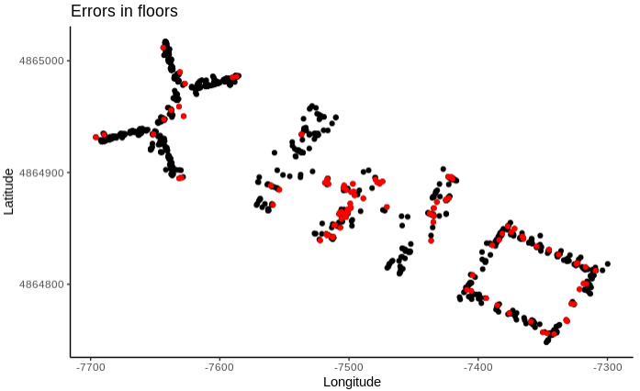
Insert Image
Errors in floor predictions
MODELS

Slide 25
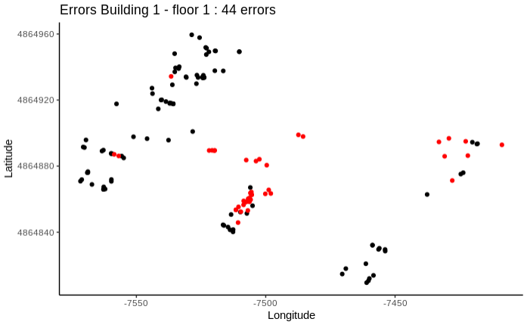
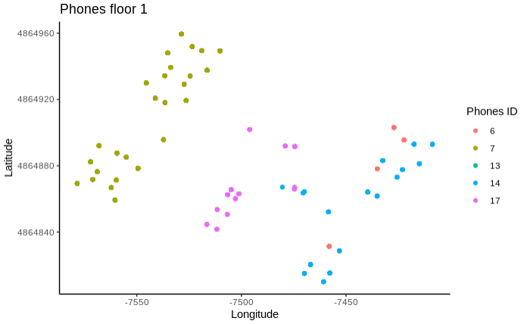
Insert Image
Building 1 – Floor 1
40% of the errors are here
MODELS

Slide 26
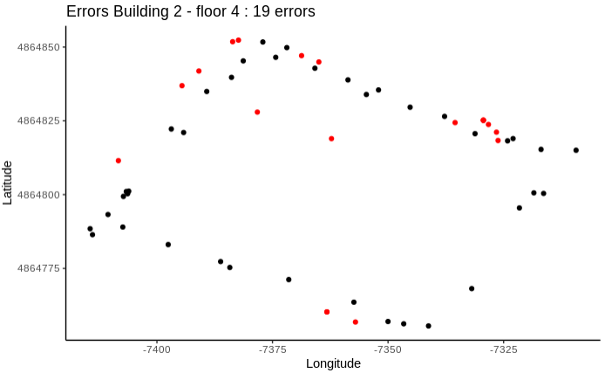
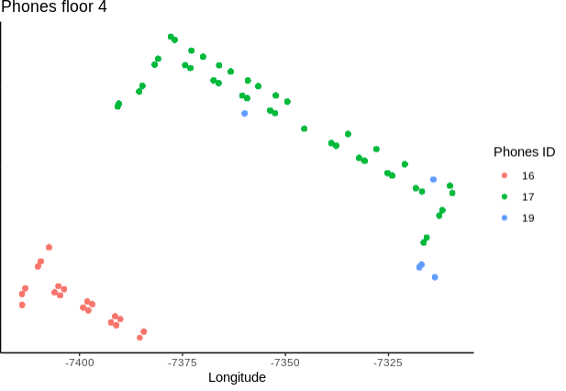
Insert Image
Building 2 – Floor 4
18% of the errors are here
MODELS

Slide 27
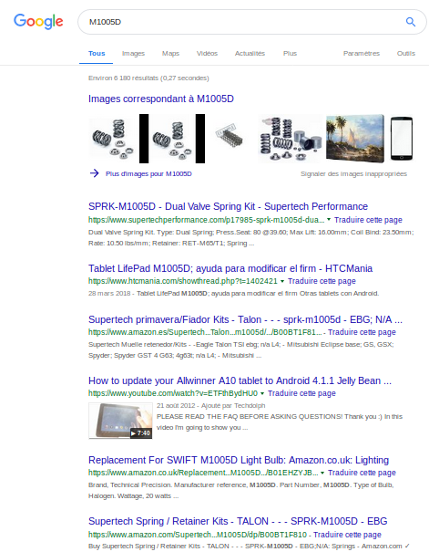
Insert Image
PHONE 17 : M1005D
MODELS

Slide 28
Insert Image
Longitude / Latitude metrics
LONGITUDE | Random Forest |  |  | SVM |  |  | KNN
 | MAE | RMSE | R2 | MAE | RMSE | R2 | MAE | RMSE | R2
Building 0 | 4.51 | 6.57 | 0.94 | 7.89 | 13.18 | 0.75 | 3.74 | 5.92 | 0.95
Building 1 | 6.73 | 10.32 | 0.95 | 11.46 | 17.41 | 0.86 | 6.64 | 10.59 | 0.94
Building 2 | 9.39 | 20.58 | 0.67 | 12.94 | 23.87 | 0.56 | 8.46 | 20.71 | 0.66
Longitude MAE mean |  |  |  |  |  |  | 5.68
MODELS
LATITUDE | Random Forest |  |  | SVM |  |  | KNN
 | MAE | RMSE | R2 | MAE | RMSE | R2 | MAE | RMSE | R2
Building 0 | 3.83 | 5.54 | 0.97 | 10.13 | 16.14 | 0.75 | 3.23 | 5.04 | 0.97
Building 1 | 7.56 | 10.72 | 0.90 | 8.63 | 12.40 | 0.88 | 7.19 | 11.70 | 0.89
Building 2 | 8.36 | 17.30 | 0.69 | 9.58 | 16.56 | 0.71 | 6.74 | 14.23 | 0.79
Latitude MAE mean |  |  |  |  |  |  | 5.21

Slide 29
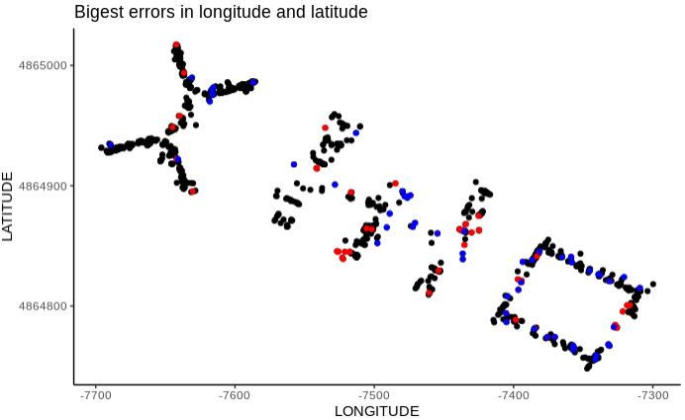
Insert Image
Errors with MAE > 20
MODELS
Longitude
Latitude

Slide 30

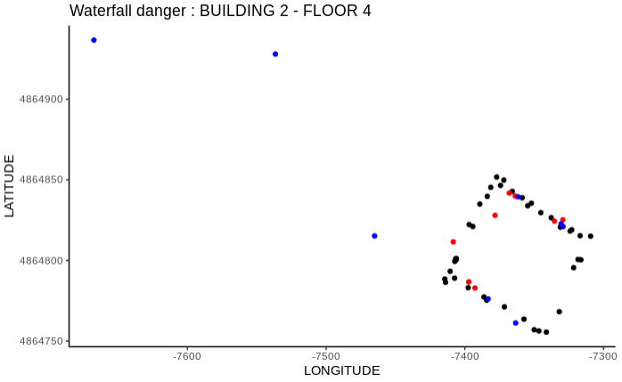
Insert Image
Danger of waterfall modelling – Outliers error
MODELS

Slide 31
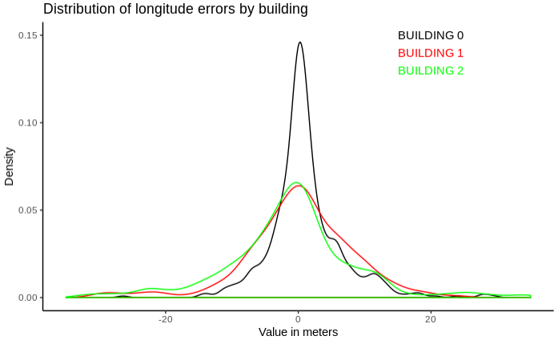
Insert Image
Distribution of the errors
LONGITUDE
MODELS

Slide 32
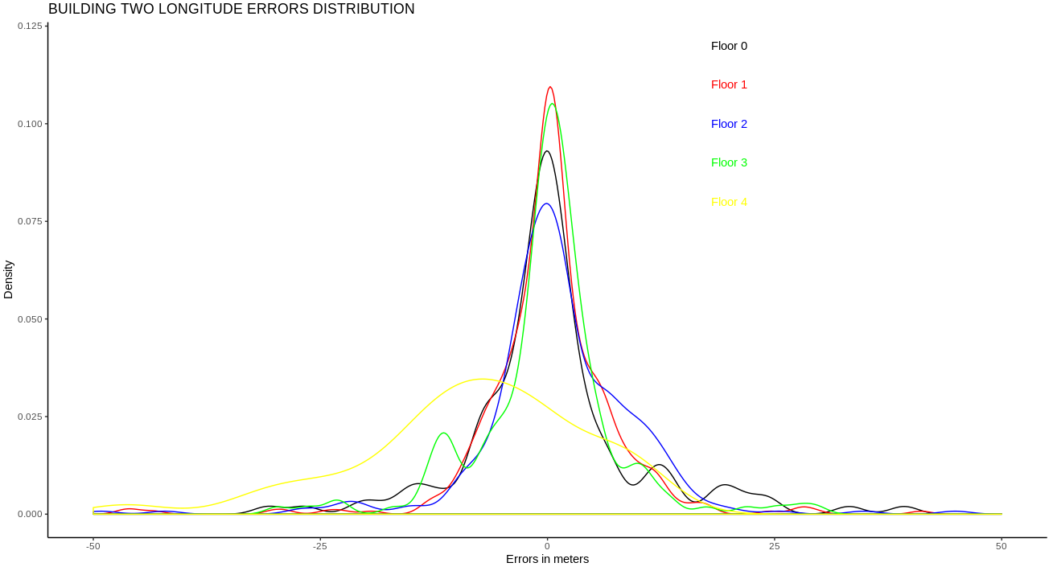
Insert Image
Distribution of the errors in building 2
LONGITUDE
MODELS

Slide 33
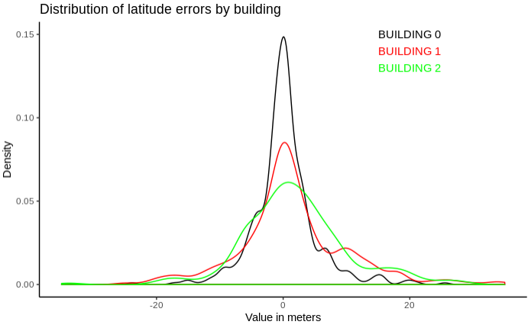
Insert Image
Distribution of the errors
LATITUDE
MODELS

Slide 34
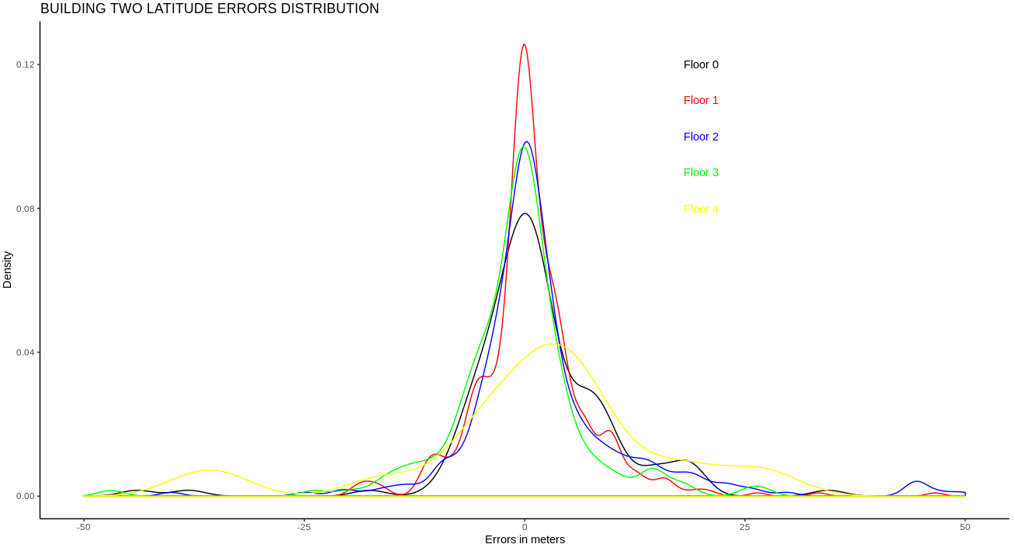
Insert Image
Distribution of the errors in building 2
LATITUDE
MODELS

Slide 35
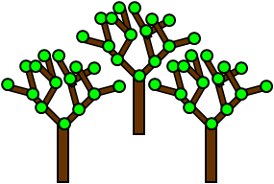

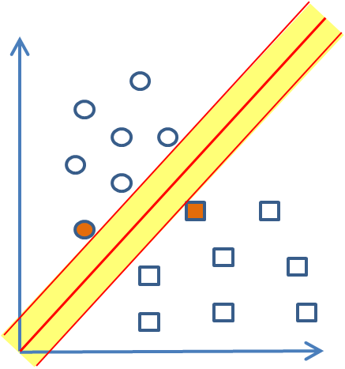
Semi-waterfall modeling approach
Insert Image
464 WAPS
BUILDING PREDICTION
MODELS
205 waps
212 waps
218 waps
Building 0
Building 1
Building 2
FLOOR
LATITUDE
LONGITUDE
FLOOR
LATITUDE
LONGITUDE
FLOOR
LATITUDE
LONGITUDE

Slide 36
4.
RECCOMENDATIONS

Slide 37
Insert Image
Conclusions
MODELS
WE CAN PREDICT THE INDOOR POSITION OF A USER WITH AN ACCURACY OF 3/8 METERS
NO CORRELATION BETWEEN ERRORS AND PHONE ID OF VALIFATION DATA SET
UNRELIABLE PHONE ARE THE BIGGEST ISSUE WE FACED TO BUILDING THE MODEL
COMPUTATIONAL POWER IS IMPORTANT FOR PRODUCTIVITY

Slide 38
Insert Image
General recommendations
WE COULD CROSS BUILDING PREDICTION AND LONG / LAT PREDICTION
MODELS
POINTS IN TRAINING SHALL HAVE BEEN TAKEN BY AS MUCH PHONE AS POSSIBLE
GET INDOOR COORDINATES OF THE BUILDINGS TO FIX THE ERRORS THAT APPEARS OUTSIDE THE BUILDINGS AND PUT THEM INSIDE (THE COLSEST ONE)
TRANSFORM UTM COORDINATES INTO DECIMAL DEGREES LATITUDE AND LONGITUDE IN ORDER TO USE THEM WITH GOOGLE MAPS. IN THAT WAY WE COULD CREATE AN INDOOR NAVIGATION INSIDE THE BUILDINGS USING GOOGLE API

Slide 39
JAUME I UNIVERSITY, SPAIN.
THANK YOU!
A MACHINE LEARNING PROJECT
Valerian Virmaux & Kiko Sánchez

