Slide 1
Relational Databases (RDBMS) by MARWA KILANI

Slide 2
MySQL
MYSQL is an open source SQL relational database management system developed and supported by Oracle.
MySQL was originally released in 1995. Since then it has gone through a few changes in ownership and management, before ending up at Oracle Corporation in 2010. While Oracle is in charge now, MySQL is still open source software . , which means you can use and modify it freely.

Slide 3
PostgreSQL
PostgreSQL is a powerful, open source object-relational database system with over 30 years of active development that has earned it a strong reputation for reliability, feature robustness, and performance.
PostgreSQL has earned a strong reputation for its proven architecture, reliability, data integrity, robust feature set, extensibility, and the dedication of the open source community behind the software to consistently deliver performant and innovative solutions.

Slide 4
Microsoft SQL server
Microsoft SQL Server is a RDBMS (relational database management system) created by Microsoft. It is used as a central location to save and obtain data needed for applications. It uses SQL (structured query language) for queries that store or retrieve data
Microsoft SQL Server also allows user-defined composite types (UDTs) to be defined and used. It also makes server statistics available as virtual tables and views (called Dynamic Management Views or DMVs). In addition to tables, a database can also contain other objects including views, stored procedures, indexes and constraints, along with a transaction log.

Slide 5
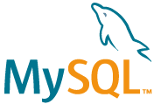
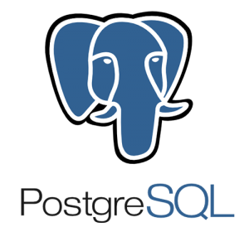
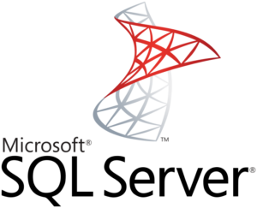
Differences between RDBMS
What are the differences between MySQL vs PostgreSQL vs MS SQL server
The choice between SQL and non-SQL databases usually boils down to differences in the structure. However, when we are looking into several SQL solutions, the criteria are a lot more distorted. Now will consider the aspects more precisely and analyze the underlying functionality. We’ll be taking a look at the three most popular relational databases: MySQL vs Postgresql vs SQL server.

Slide 6
 | MySQL | PostgreSQL | MS SQL server
Price | developed by Oracle and has additional paid tools; the core functionality can be accessed for free. | open-source | the database has a free edition for developers and small businesses but only supports 1 processor and 1GB of memory.
Language | C++ | C | C++
Defragmentation | offers several approaches to defragmentation – during backup, index creation, and with an OPTIMIZE Table command | allows scanning the entire tables of a data layer to find empty rows and delete the unnecessary elements. | offers an efficient garbage collector that doesn’t create more than 15-20% of overhead.

Slide 7
 | MySQL | PostgreSQL | MS SQL server
Data queries | offers a scalable buffer pool – developers can set up the size of the cache according to the workload. | isolates processes even further than MySQL by treating them as a separate OS process. | also uses a buffer pool, and just like in MySQL, it can be limited or increased according to processing needs.
Temporary Tables | offers limited functionality for temporary tables. Developers cannot set variables or create global templates. | offers a lot more functionality when it comes to temporary content. You divide temporary tables into local and global and configure them with flexible variables. | offers rich functionality for temporary table management. You can create local and global temporary tables, as well as oversee and create variables.

Slide 8
 | MySQL | PostgreSQL | MS SQL server
Indexes | organized indexes in tables and clusters. Developers can automatically locate and update indexes in their databases. | supports index-based table organization, but the early versions don’t include automated index updates | offers rich automated functionality for index management. They can organize in clusters and maintain the correct row order without manual involvement.
JSON Support | supports JSON files but doesn’t allow indexing them. | supports JSON files, as well as their indexing and partial updates. | provides full support of JSON documents

Slide 9
 | MySQL | PostgreSQL | MS SQL server
Partitioning | allows partitioning databases with hashing functions in order to distribute data among several nodes. | allows making LIST and RANGE partitions where the index of a partition is created manually. | provides access to RANGE partitioning, where the partition is assigned to all values that fall into a particular range.
Used by companies | Google , Udemy, Netflix, AirBnb, Amazon … | Apple, Skype, Cisco … | BankOfAmerica, UPS …

Slide 10
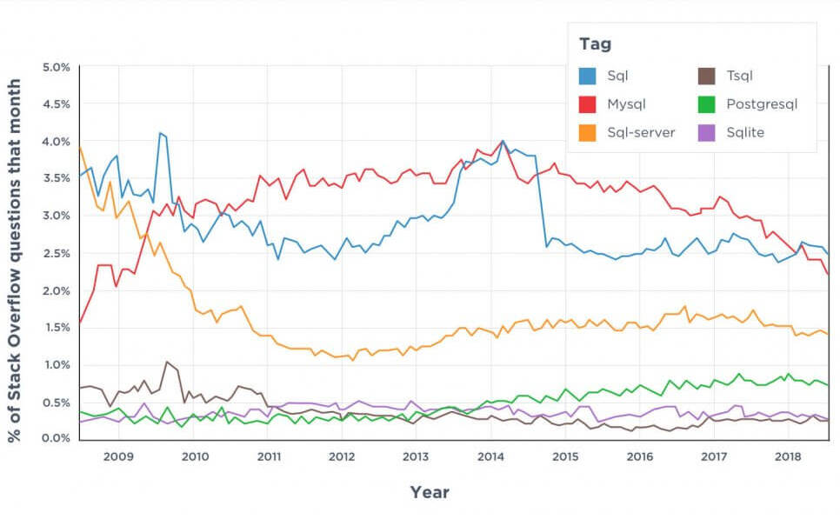

Slide 11
Conclusion
The choice between the three most popular databases ultimately boils down to the comparison of the functionality, use cases, and ecosystems. Companies that prioritize flexibility, cost-efficiency, and innovation usually choose open-source solutions. They can be integrated with multiple free add-ons, have active user communities, and are continuously updated.

