Slide 1



Predicting Head and Neck Cancer Radiotherapy Replanning using Machine Learning

Slide 2

About Me
My name is Srishti Ahlawat
A Computer science student with specialisation in AI/ML from India
Working with professor John Kildea as a MITACS Globalink Research Intern
Previously worked at Amazon as a Software Development Intern and at Monash University as a research intern

Slide 3
Project Background and Previous Work
Head-neck cancer patients who undergo radiotherapy often experience anatomical changes.
These anatomical changes in turn can render the treatment plan invalid, requiring replanning, which if performed suddenly, can be disruptive for the treatment planning team
In this research project we are working on predicting if and when a Head-neck cancer patient will require replanning using machine learning

Slide 4
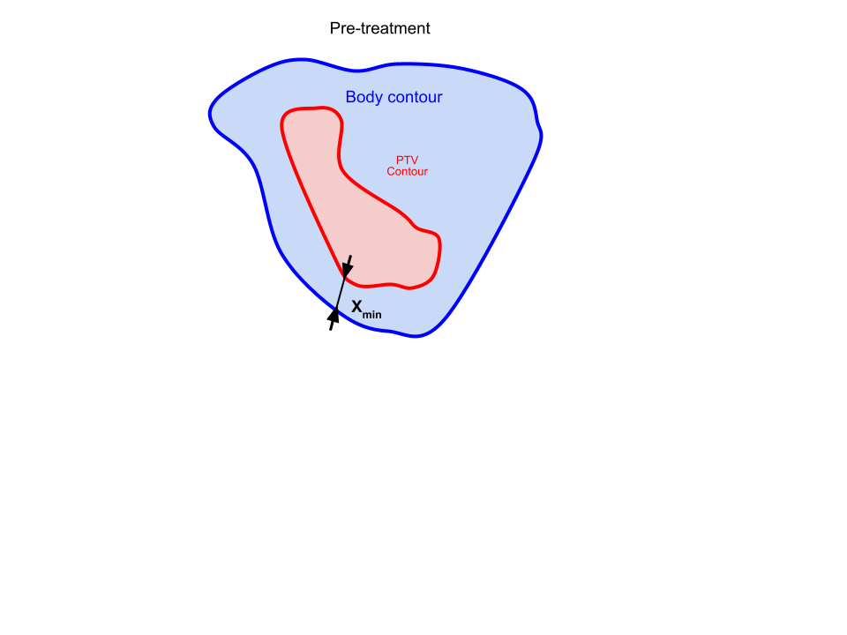
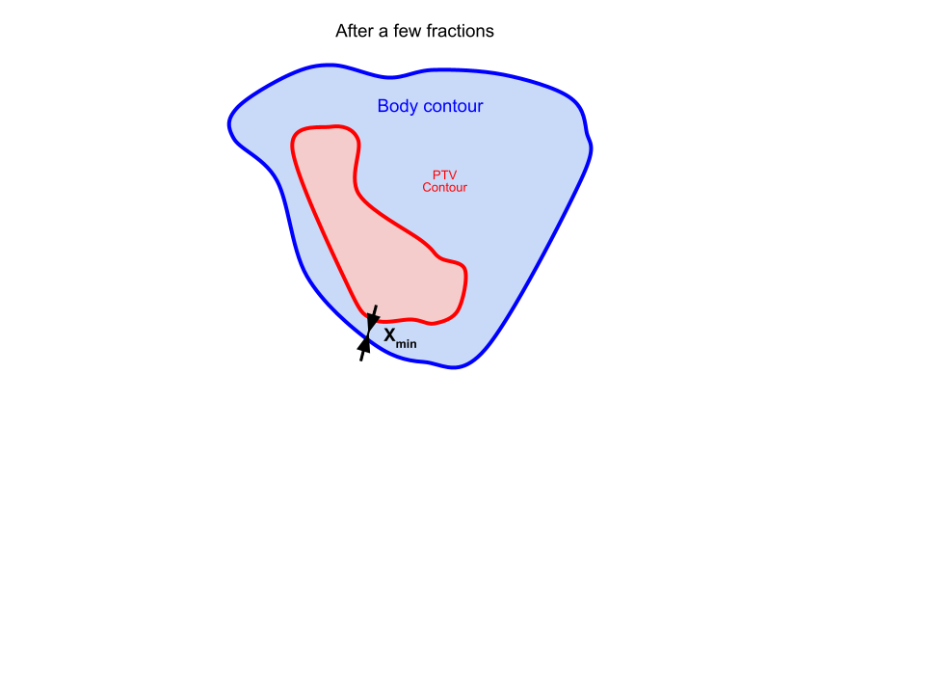

Project Background and Previous Work
PTV: Planning Target Volume
Xmin : Minimum distance between PTV and the body
Research by previous students James and Axia showed the most important factors that influence replanning are:
Xmin
Weight Loss

Slide 5
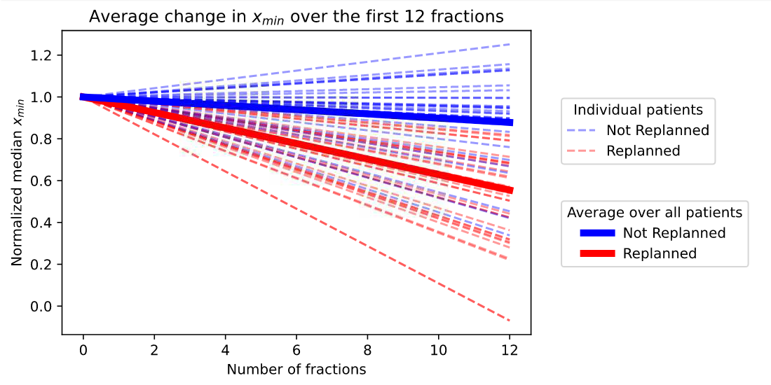
Project Background and Previous Work

Slide 6
Project Stages
1. Data Concatenation
2. Exploratory Data Analysis
3. Data Preprocessing
Classification
(if)
4. Developing Machine Learning Models
5. Model Evaluation
Regression
(When)

Slide 7
Stage 1: Data Concatenation
Demographic Data
Input
Output
Xmin Data
CODE
MASTER TABLE
Weight Loss Data
…………

Slide 8
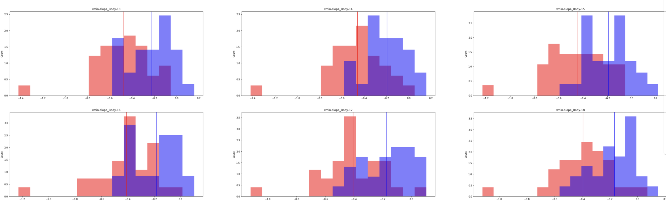
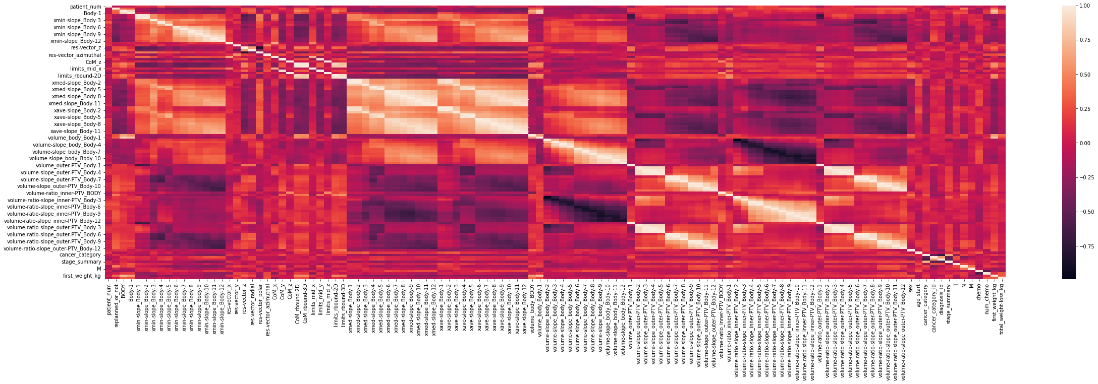
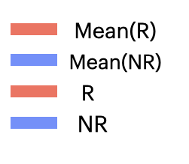
Stage 2: Exploratory Data Analysis
Developed a script to create histograms for all the numerical columns of the master table
Created a heatmap to find correlating attributes

Slide 9
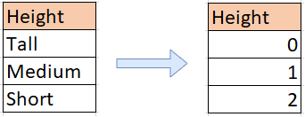
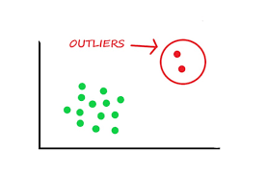
Stage 3: Data preprocessing
Example: Patient Id
Removal of unwanted observations
Encoding categorical data
Handling missing data
Managing Outliers
N/A
?

Slide 10
Stage 4: Building Machine Learning Models
Classification
Y
Classification is a supervised machine learning algorithm which predicts the labels(classes) of new data based on the training it previously got from labelled training data
Class A
Class B
In this project classification is used to predict whether a patient would require replanning or not based on their data collected for first 12 fractions
I used 15 different classification models and compared their results.
X

Slide 11
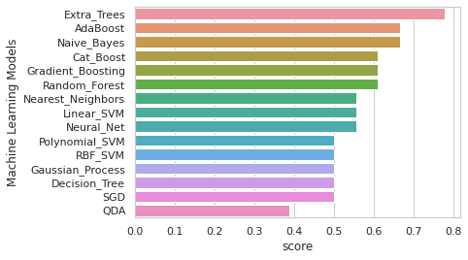
Stage 4: Building Machine Learning Models
Extra Trees model performed the best with 0.778 Accuracy score
The formula to calculate the score:
Number of correct predictions /
Total predictions

Slide 12
Stage 4: Machine Learning
Classification - Extra Trees
Extremely randomized trees classifier
Training dataset
Ensemble learning technique which aggregates the results of multiple de-correlated decision trees collected in a “forest” to output it’s classification result.
Decision trees
Combined Decision

Slide 13
Summary of Results
Successfully combined several types of data files together
Developed a classification model that can predict whether a patient would require replanning or not based on the data collected in the early stages of the treatment
The model developed has 77% accuracy rate

Slide 14
Future Work
Collecting and using more patient data
Fine tuning the machine learning models to get more accurate results
Finding more attributes that influence replanning

Slide 15
Thank You

