Slide 1
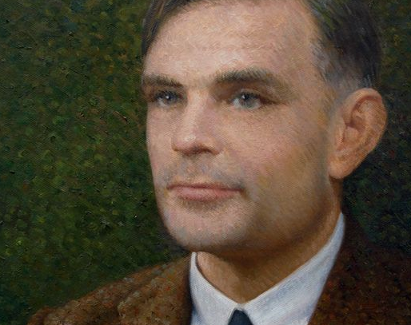
Formal Methods
JD Kilgallin
CPSC:480
10/03/22
Photo: Alan Turing, Fellowship of the Royal Society
Known for: Turing Machines, Halting Problem, Cryptanalysis of Axis Enigma Machines, Turing Test thought experiment, theory of computing, computational biology, conviction and post-humous pardon under British indecency law.

Slide 2
Formal Methods
JD Kilgallin
CPSC:480
10/03/22

Slide 3
Notes
Average on quiz 4 was a bit lower than others.
Remember, a functional requirement is anything the software does, and a non-functional requirement is a constraint on how. Any requirement needs to be phrased in a way that someone can determine if it's been met.
Review definitions of terms like "traceability", "cohesion", "coupling"
Project 2 checkpoint feedback is up. Most missed points were:
Failure to follow instructions; read them over before submission.
Failure to capture all requirements in class and behavioral models.
14 grades 95-100, 9 90-95, 5 85-90, 2 < 85. Good work!
Midterm course review is open on learn.uakron.edu/evaluation; link on Brightspace? Please submit any feedback you have.
Office hours/extended review after class today; exam Wednesday.
Mid-term grades: 35% exam, 5% ea Ex, 20% ea Pr, 10% Qz, no drops

Slide 4
Learning objectives
Formal methods concepts
Purpose of formal specification and verification
Methods of formal modeling
Temporal Logic of Actions system
Only next three slides are examinable; you do not need to learn TLA.

Slide 5
Formal methods
Formal Methods is a class of techniques for assessing correctness of a system by modelling that system in a mathematical language.
A software system is modeled in a formal logic with a finite state machine (or similar), and the specification is a set of logical formulas describing requirements of the system.
Formal verification or model-checking: Given state machine M along with specification h, algorithmically determine whether or not the behavior of M meets the terms of h.
Determining whether the formal specification captures the intended requirements is called "pleasantness" and is outside the scope of formal methods.
Pre-dates software, back to Turing Machines modeling computation.

Slide 6
Benefits of formal verification
Formal specifications can be model-checked programmatically to verify that they meet certain properties. Enables automation.
Increases confidence in software reliability.
Rigor of formal spec necessitates precise design, which helps catch design flaws and ambiguities.
Gives a machine-readable reference for the system's behavior.
Test cases and some documentation can be automatically extracted from a model - and can be updated automatically on program change.
Some form of formal verification required for some certifications.

Slide 7
Drawbacks of formal verification
Cumbersome due to advanced math, and harder to write than English + code, and is inaccessible to much of the team.
Limited compatibility matrix of programming languages, formal specification languages, and model-checking tools compounds complexity and learning requirements.
Some E-type systems cannot be effectively modeled.
Specifications of systems of any complexity quickly become impossible to model or comprehend.
Errors (or just excessive abstraction) in the model may lead to false expectations about the product.
No guarantee of providing actionable proof or finding errors that wouldn't have been found otherwise.

Slide 8
Temporal Logic of Actions (TLA)
One popular model-checking language and developer suite built for concurrent, hybrid (discrete + realtime), reactive, distributed systems.
Specs can be written in PlusCal, an algorithm-definition language very similar to program code
Rich IDE with TLA/PlusCal editor, PlusCal->TLA translator, LaTeX pretty-printer for TLA, TLA syntax checker, TLC model-checker
Developed and maintained by Leslie Lamport from Microsoft Research, and major reason for his 2013 Turing Award.

Slide 9
TLA definitions
A "state" is an assignment of values to all variables defined.
A transition between states is a change in value of some variables (possibly none - called a stuttering step).
State predicates describe individual states (e.g. "f == x < 0 /\ y > 0")
Actions define transitions between states, using the "in the next time step" operator, " ` ". (e.g. " g == x' = x+1 /\ y'=y " describes the transition where x is incremented by one and y is unchanged).
[] operator "always" – "[]P" = "P is true in every time step".
<> operator "eventually" – "<>P" = "P is true now or at some future point"
"<>P" is equivalent to "~[]~P" (~ = "not")
[]<>P "At every point, P will eventually be true again" "P is infinitely often true"
<>[]P "At some point, P will become true and then remain true forever"

Slide 10
Formal specification of "compose email" form
The recipient line, subject line, and body are initially blank.
The user may set the cursor into any of the three control fields.
Typing a character will increment the length of the contents of the selected field.
Pressing backspace will decrement the length until empty.
The subject line cannot be more than 255 characters long.
A message cannot be sent unless it has a recipient, subject, and body.
Can model cursor position, field length, and constraints.

Slide 11
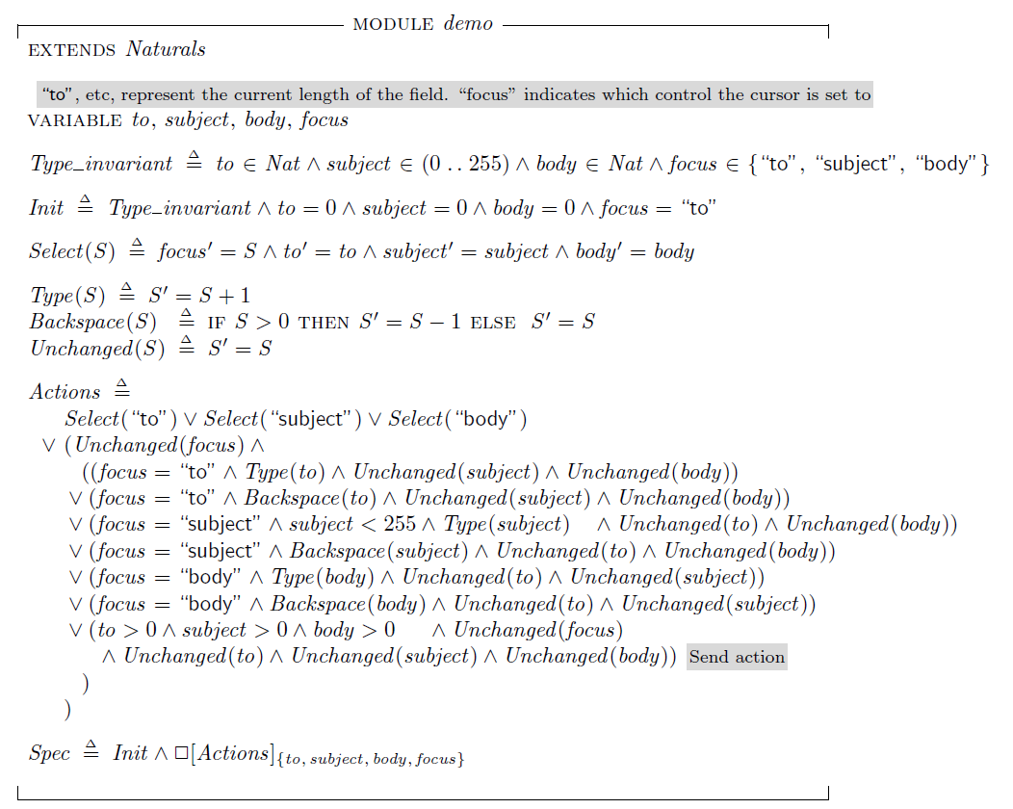

Slide 12
References
Alan Turing: the enigma. Andrew Hodges. 2012. Princeton
Specifying Systems. Leslie Lamport. 2002. Pearson.
The Beginning of Model-Checking: A Personal Perspective. Allen Emerson. 2008. Springer.
Formal Verification by Model-Checking. Natasha Sharygina. 2009. Carnegie Mellon University.
Formal Methods + TLA. Jonathan Kilgallin. 2010. Microsoft.

