Slide 1
Project Planning
JD Kilgallin
CPSC:480
09/19/22
Pressman Ch 6, 25
"I have not failed. I’ve just found 10,000 ways that won’t work." –Thomas A. Edison

Slide 2
Project 1
Submissions for project 1 are now closed, but I will still review anyone's resume any time, on request, outside of the assignment.
Per syllabus, late work is not accepted without a documented, excusable reason
For project 1, "late" means past the final cutoff today, half an hour ago.
This is a 400-level class; customers/coworkers in the real world won't be satisfied if work is late because you didn't start till the last day and then felt sick.
Portfolios should make it easy for the reader to understand what they're looking at. A description in the README about what the software does, how to build/install/run it, and how to use it is helpful.
Linking your GitHub portfolio in your resume is strongly encouraged.
Resumes should order work/school experience with most recent first.
You may want to remove phone numbers/email addresses and give alternate instructions to contact you, such as LinkedIn.

Slide 3
Notes
Great job on quiz 3, ex 1, and project 1; average was ~95% on each!!
You may delete or hide the exercise 1 repos if you are done with them. Do not delete the project 1 repo!
See Brightspace for top issues. #1 is merge conflicts in Ex 1.
Project 2 & exercise 2 (Wed) draft posted. Exercise 2 has two options.
Group requests for initial team project assignments due tomorrow. Keep in mind teams may shift between (or during) projects at my discretion. So far I have 1 full team and 2 partial team requests.
I've drafted tentative teams from survey responses regarding areas of interest, languages known, and balance in experience level.

Slide 4


Slide 5
Learning objectives
Project planning concepts
Estimating effort required
Measuring progress according to project plan

Slide 6
Planning
Aims to optimize cost and schedule of a project to meet requirements and make best use of resources. Primary concern is estimating effort.
Happens to some degree in conjunction with requirements engineering and product design.
Requirements must be known in order to build a plan, but a plan is needed to assess cost/timeline and whether the project is feasible at all.
Some design is needed to build a plan, but design work should be planned.
Iterative process with rough task outline and estimates for the whole project, gradually refined and broken down to sprint plans.
Some aspects unique to software vs other engineering disciplines (lack of reference, difficulty capturing requirements, scope/complexity).

Slide 7
Types of plan
Plans occur at many levels: overall product roadmap (indefinite), version release (months-year), individual sprint (weeks-month)
Initial high-level project plan may only have a rough outline with "t-shirt size" effort estimates (classify requirements as XS/S/M/L/XL)
Plans for a particular sprint must specify much greater detail on work to be done in that sprint and more precise, granular estimates.
Amount of detail in a plan at any level varies significantly.
More detailed plans take longer and thus risk delaying the release (and may still need to be rewritten due to changing requirements)
less detailed plans risk failing to identify challenges ahead of time and make progress harder to measure.

Slide 8
Elements of a plan
Tasks to be done – Decomposing requirements into work tasks
Effort – Estimating amount of work required to complete each task.
Dependencies between tasks – "Task network" model.
Risks & Unknowns – Anticipated technical or management challenges.
Work products – Defined artifacts (eg designs, prototypes, tests, docs)
Schedule & milestones – Measurable intermediate goals & timeline.
Responsibilities – Who will participate in tasks to be done.
Not all plans (especially early plans) include all elements. "A good plan today is better than a perfect plan tomorrow."

Slide 9
Estimation challenges
Earlier estimates risk being inaccurate, later estimates not actionable.
Requirement changes – Alter scope, invalidate old designs/code
Refactoring, untracked tech debt, disagreement about implemented code
Failure to account for architecture/setup, tests, bug fixes, documentation
Dependency scheduling – Unidentified or delayed task prerequisites
Difficult integrating changes across a large team
Technology availability – Hardware/software needed to complete work
Developer availability – Rarely long-term, but high impact short-term
Unforeseen technical challenges – "The first 90% of a project takes 90% of the scheduled time. The last 10% takes another 90% of scheduled time."

Slide 10
Time vs effort
Attempts to accelerate product release schedule requires exponential increase in effort and the number of personnel needed to complete that effort, so available resources must be considered carefully.
Additional communication/management overhead grows quadratically.
Additional complexity integrating changes; more incompatibilities introduced.
More code rewrites needed to maintain project integrity ("too many cooks")
Harder to have all developers productive all the time (training, blocked work)
Requirement changes and dependency delays affect more people.
Effort is frequently measured in person-months, but more person-months are required for faster projects.
Putnam-Norden-Rayleigh (PNR) curve suggests effort is proportional to (Lines of Code)³/(Time)⁴. Delivering 10% faster requires 50% more staff; 25% faster => ~4x the staff. Impossible to go much beyond this.

Slide 11
Velocity
Tracking the amount of estimated work done in each sprint or development cycle across the team.
Gives insight into estimate accuracy and sources of misestimation.
Shows team capacity - Amount of estimated work a team can do in a set time. This is crucial information for future project planning.
May start slowly in a given cycle as developers ramp up on tasks but will approach a relatively constant value once completed items start rolling in.
Individual contribution rates can be analyzed and can factor into managers' review of your performance and value to the organization.
Can compute in lines of code as well as development hours.
A Burndown chart visualizes velocity, ideal velocity, work remaining over time, projected completion date, and status (ahead/behind schedule).

Slide 12
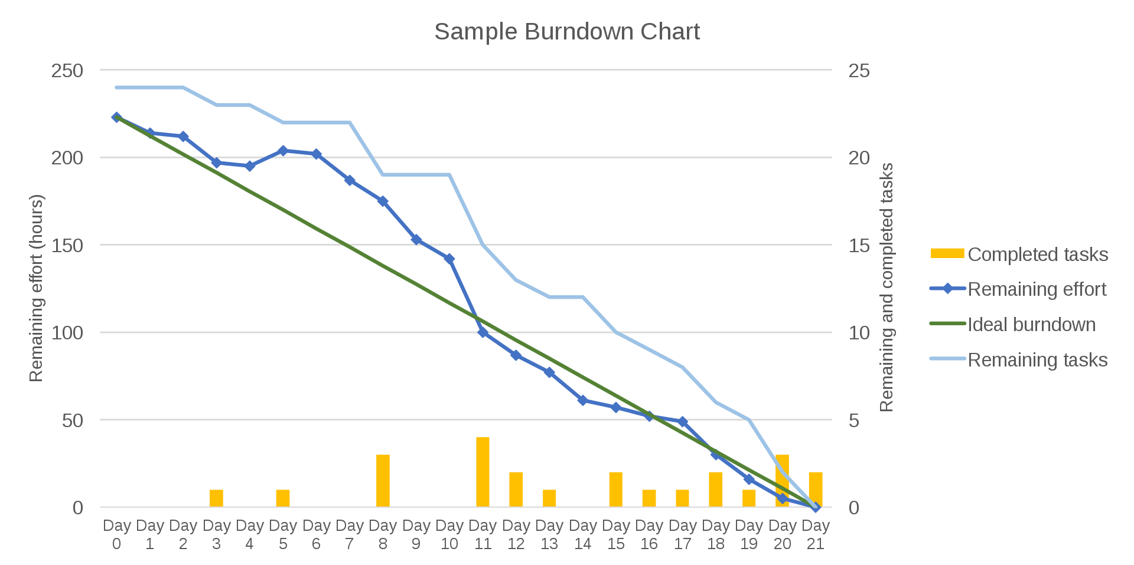

Slide 13
References
The mythical man-month : essays on software engineering. Frederick Brooks. 1975; 1995. Addison-Wesley Publishing.
This is the classic textbook on software engineering project planning and project management. Widely referenced. Highly recommended.
Software Project Planning. JavaTpoint. 2021.
Subpage: Putnam Resource Allocation Model.
Burndown Chart. Wikipedia.
Agile Burndown Charts. Erica Chapell. Feb 2020. Clickup.
Reading for next lecture: Project 2 and exercise 2a/2b on GitHub

