Slide 1

Named Entity Recognition for German Legal Documents
NLP – Group 18: Sentimental Analysis

Slide 2
Task & Dataset Overview
Goal: Extract PER and ORG entities
Dataset: GerParCor - German Language Parliamentary Records in XMI format
Preprocessing: implemented an XMI parser to parse XMI/GZIP, extracting sofaString and ground truth annotations
Raw XMI
XMI Parser
Plain Text & List[entity]
Notes:
Sara
-goal is to extract persons and organizations from the gerparcor german language parliamentary records
-preprocessing includes parsing the raw xmi documents, extracting the sofaString ,
-then iterating thought the specified namespaced tags to find entities,
-also extracting the start and end characters
-so the parser returns a clean dictionary containing the raw text with a list of entity spans

Slide 3
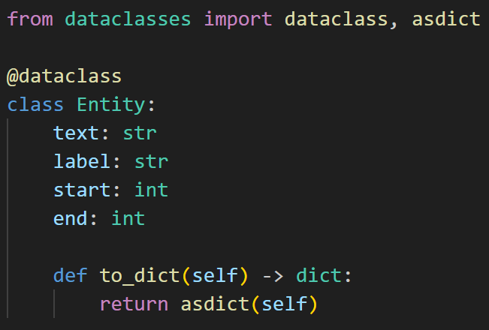
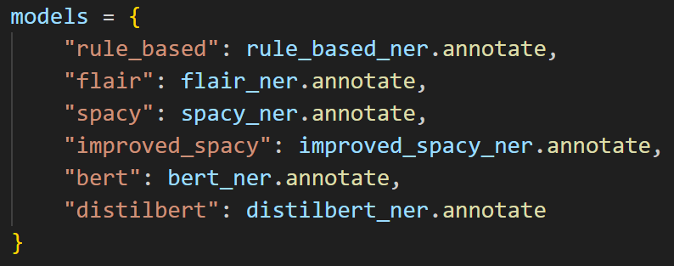
Pipeline Architecture
ner_pipeline.py allowing easy model swapping
All models output a unified Entity data class: text, label, start, & end points
Models:
Rule-based
SpaCy
Flair
BERT & distilBERT
Notes:
-our pipeline imports all our model wrappers together into one workflow
-it initializes the xmi parser to handle the data reading
-and organizes the models into a dictionary that maps each model name to its specific annotate method
-the script iterates through the files and extracts the raw text and the ground truth entities
-then passes this text to each model

Slide 4
BERT & DistilBERT
BERT: Bidirectional Encoder Representations from Transformers
Large (~110M params), high accuracy, but computationally heavy
DistilBERT: 40% smaller, 60% faster, retains ~97% of performance
Ideal for large corpora
Sub-word tokenization handled with hugging face
Uses chunking with overlap (requires offset calculation)
Notes:
Sara -BERT models typically have a 512-token limit
-implemented a chunking process so we don’t process the whole text at once
-splits the text into 2000 char blocks with a 100 character overlap to make sure we don’t cut an entity in half
-The pipeline predicts entities within each chunk, and the code filters these results to retain only those categorized as persons or organizations
-it also calculates the start and end points relative to the original document and makes sure that there are no duplicate entities from the overlap

Slide 5
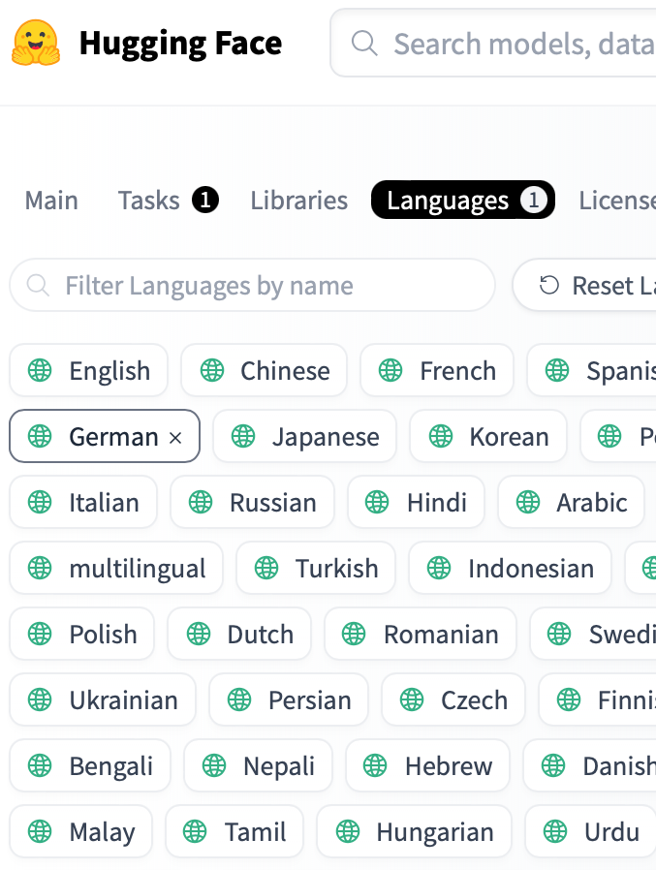
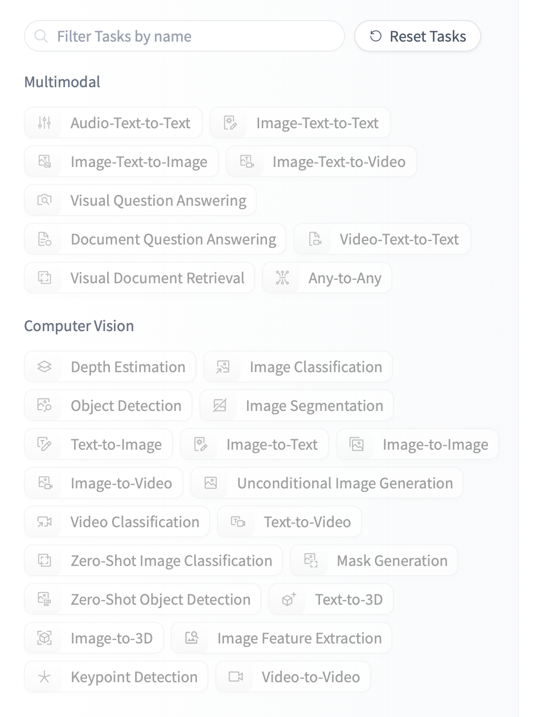
Flair
Flair model hosted on hugging face
flair/ner-german-large
Predicts token-level NER tags across entire text
Filters for entity types PER and ORG
Notes:
Valentina

Slide 6
Rule-Based
Built a deterministic system using SpaCy’s EntityRuler combined with dynamic and static gazetteers
A script fetches the current list of MPs live from the Austrian Parliament API to ensure up-to-date Person recognition
Implemented a _non_overlapping_spans function to strictly enforce that longer matches (e.g., full ministry names) take priority
Static lists were hardcoded for stable organizations
Notes:
Kilian

Slide 7
SpaCy
de_core_news_md – trained on German news articles
Iterate over all entities found and extract PER and ORG
Best numeric results achieved (because GerParCor uses SpaCy as the “ground truth”)
Notes:
Julia

Slide 8
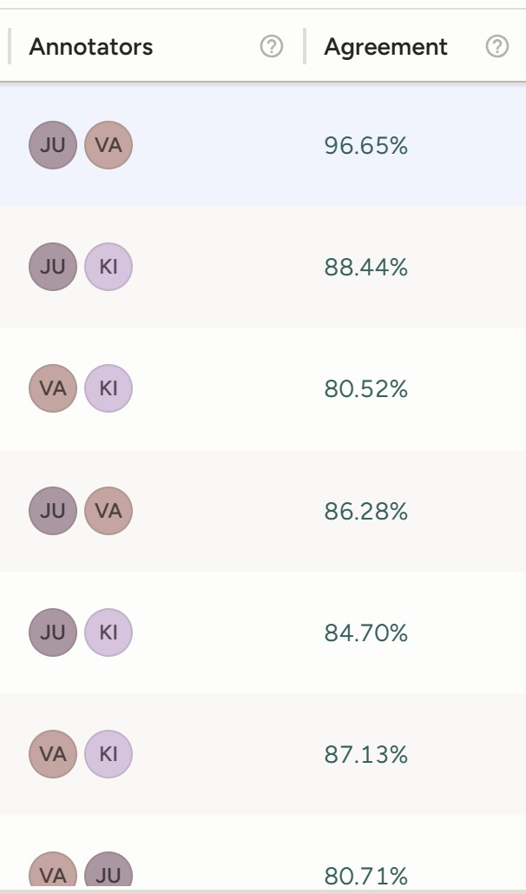
Manual Annotation
~15 hours per person
110 documents
Label studio
Process
Annotation of first 40 files with two people per file
Consistent agreement of at least 80% → continued individually
Notes:
Valentina

Slide 9
Manual Annotation Challenges
Bundesrat is both a building and an organization
Is Bundespräsident an entity?
Is Minister an entity?
Weird emphasis puts space in names (Heinz Bude -> Heinz B u d e)
Ambiguity of names (Max Mustermann – example or entity?)
Documents partially out of order (linebreaks in a word, pages mixed up)
Notes:
Julia

Slide 10

Evaluation
Precision, Recall, F1, Macro-F1 Score
Exact span matching: an entity is TP if start, end, and label match the ground truth perfectly
A custom script (evaluate_results.py) compares the JSON output of each model against the parsed XMI gold standard file
Penalizes even partial matches, ensuring our models are precise on exact entity boundaries
Notes:
Kilian

Slide 11
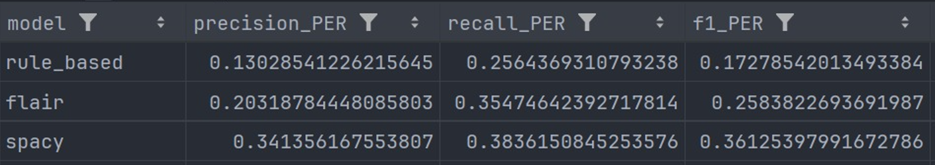
Results – PER
Notes:
Valentina

Slide 12
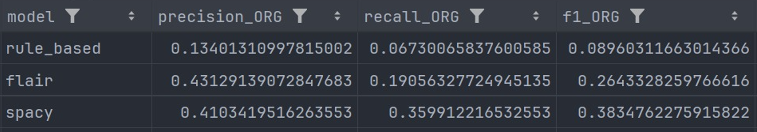
Results – ORG
Notes:
Valentina

Slide 13
Future Work
Evaluate entity sets in addition to exact occurrences
Running all models on all files using ground truth from manually annotations
Notes:
Julia

