Slide 1
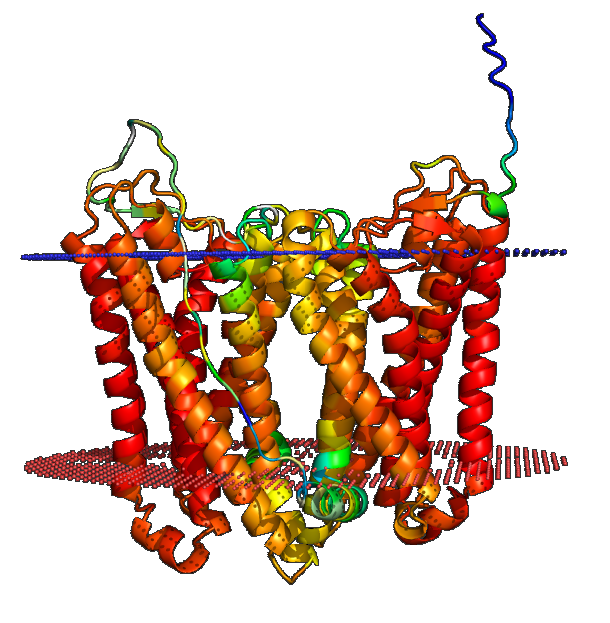
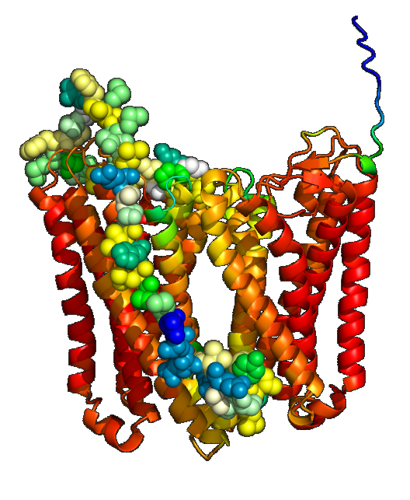
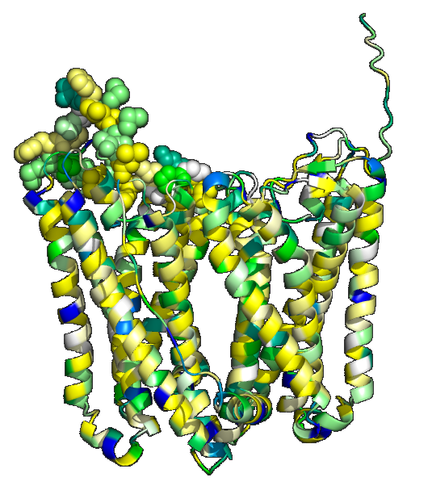
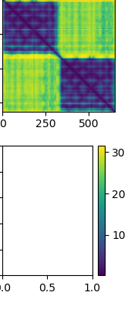
A
C
D
B
E
Kessel&Ben-Tal scale most hydrophobic [20,15]-residue window
1
650
1
AF2 predicted aligned error values
LLFSSYEAEVEERMPLHISAELTMLMFNGSVFMPSMLTLVGIPGLK
312 322 332 342 352
650
Hessa et al. scale most hydrophobic [20,15] residue window

Slide 2
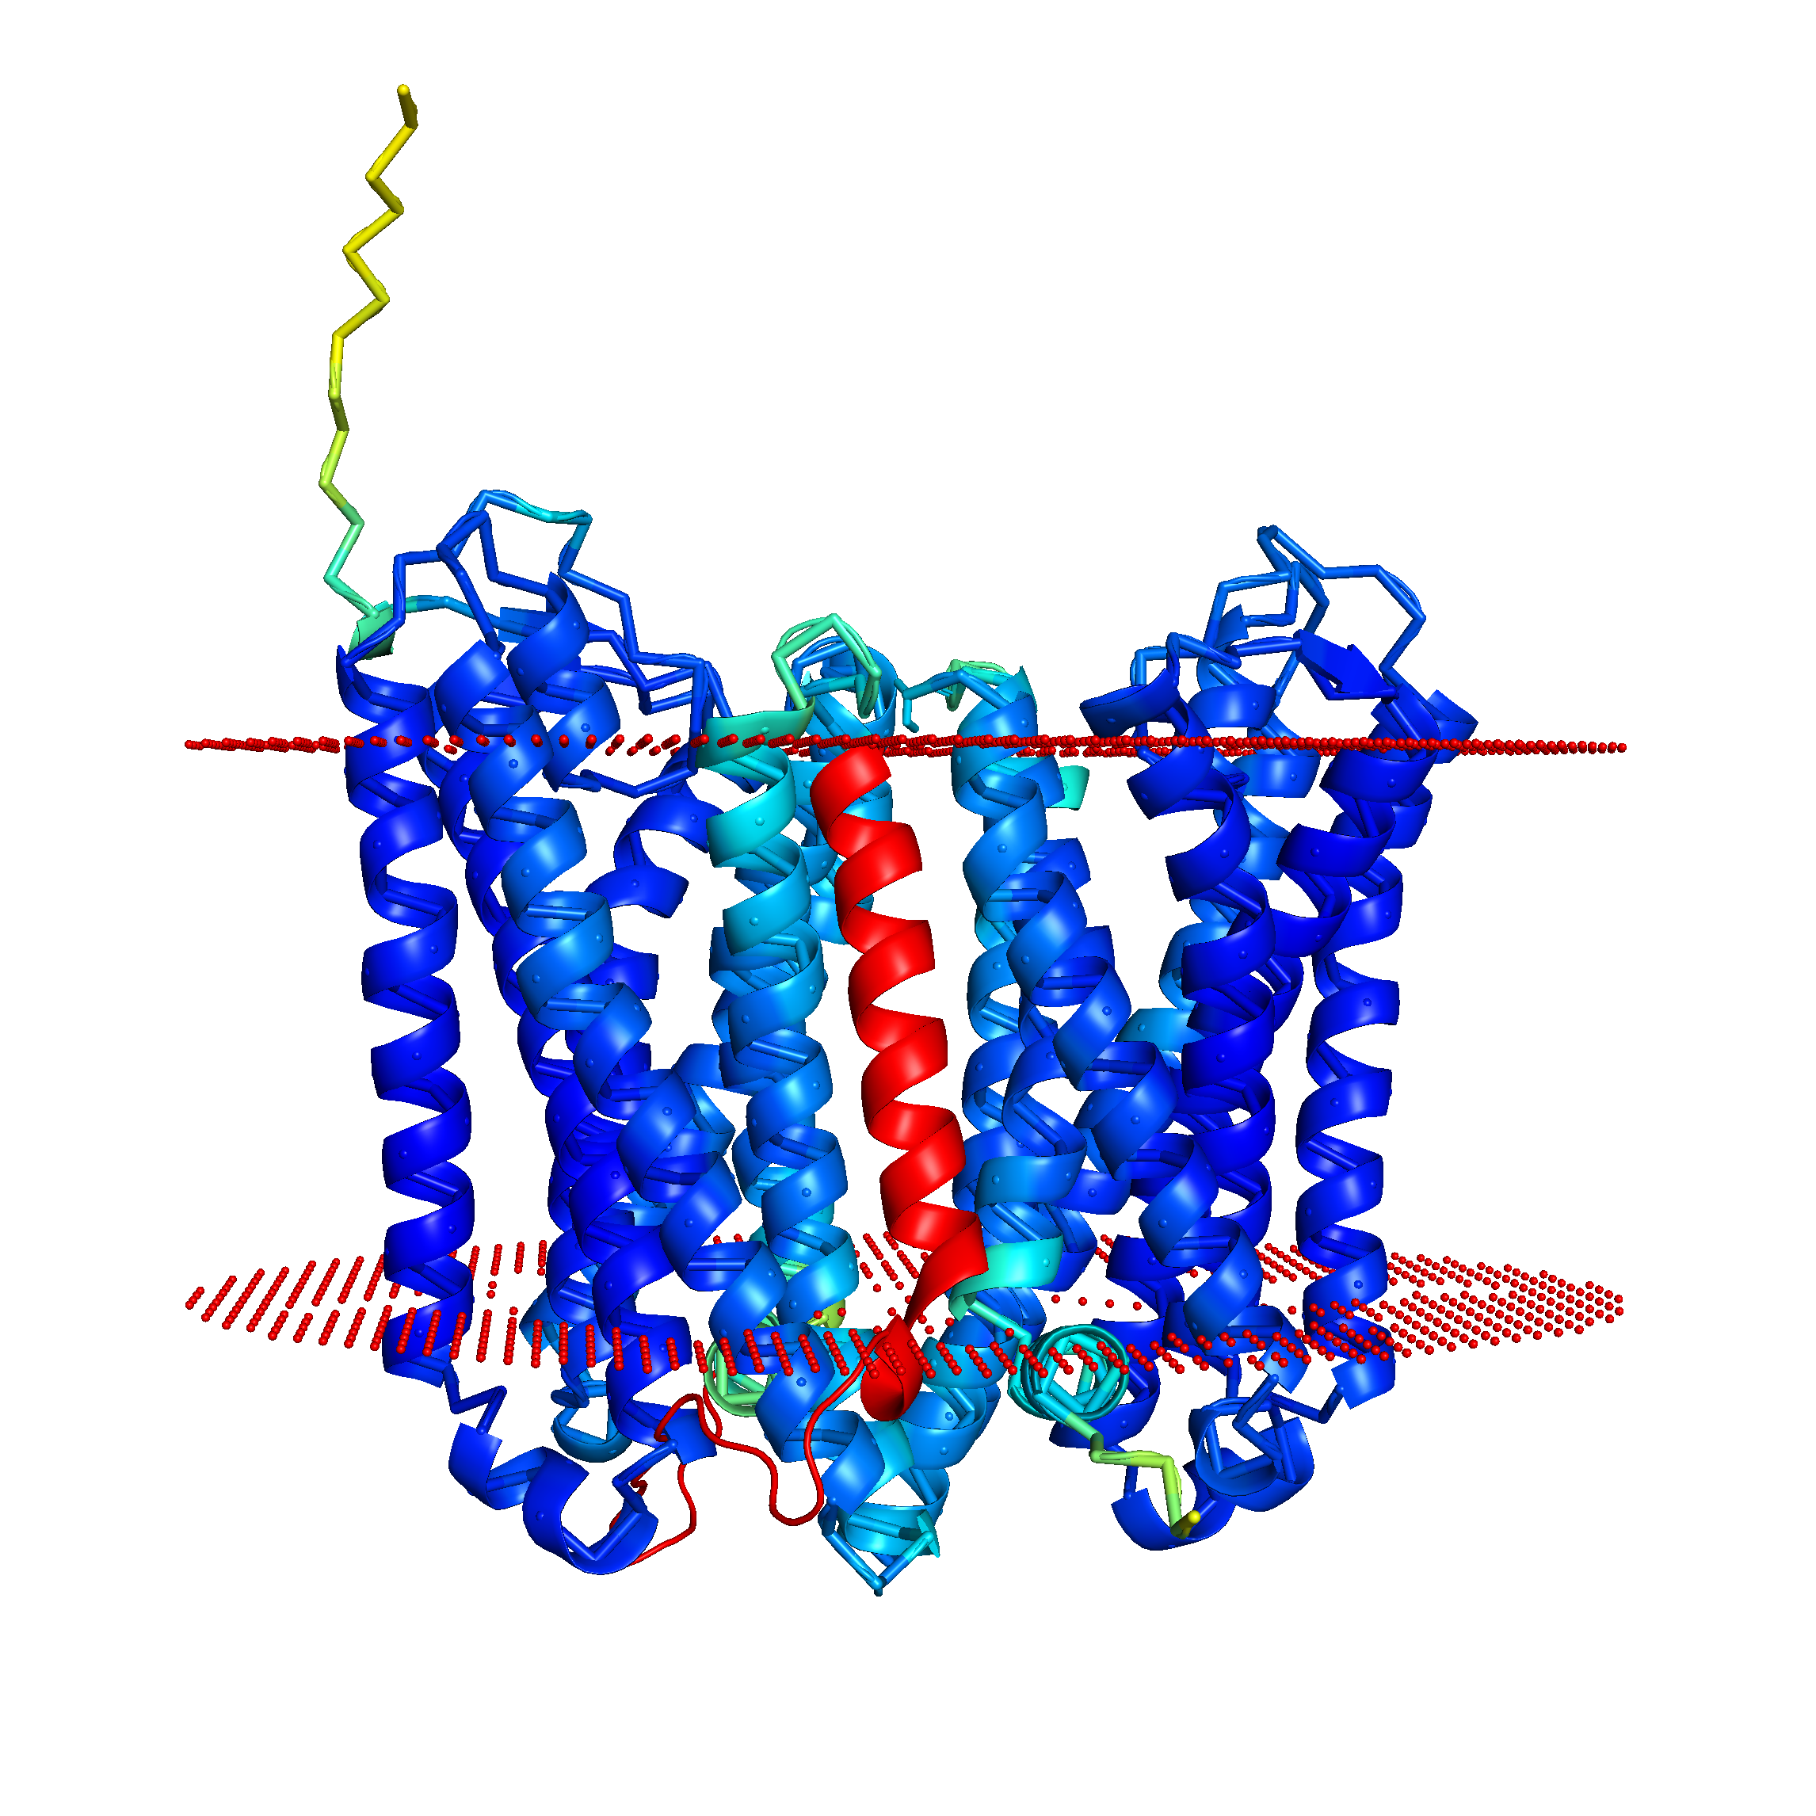
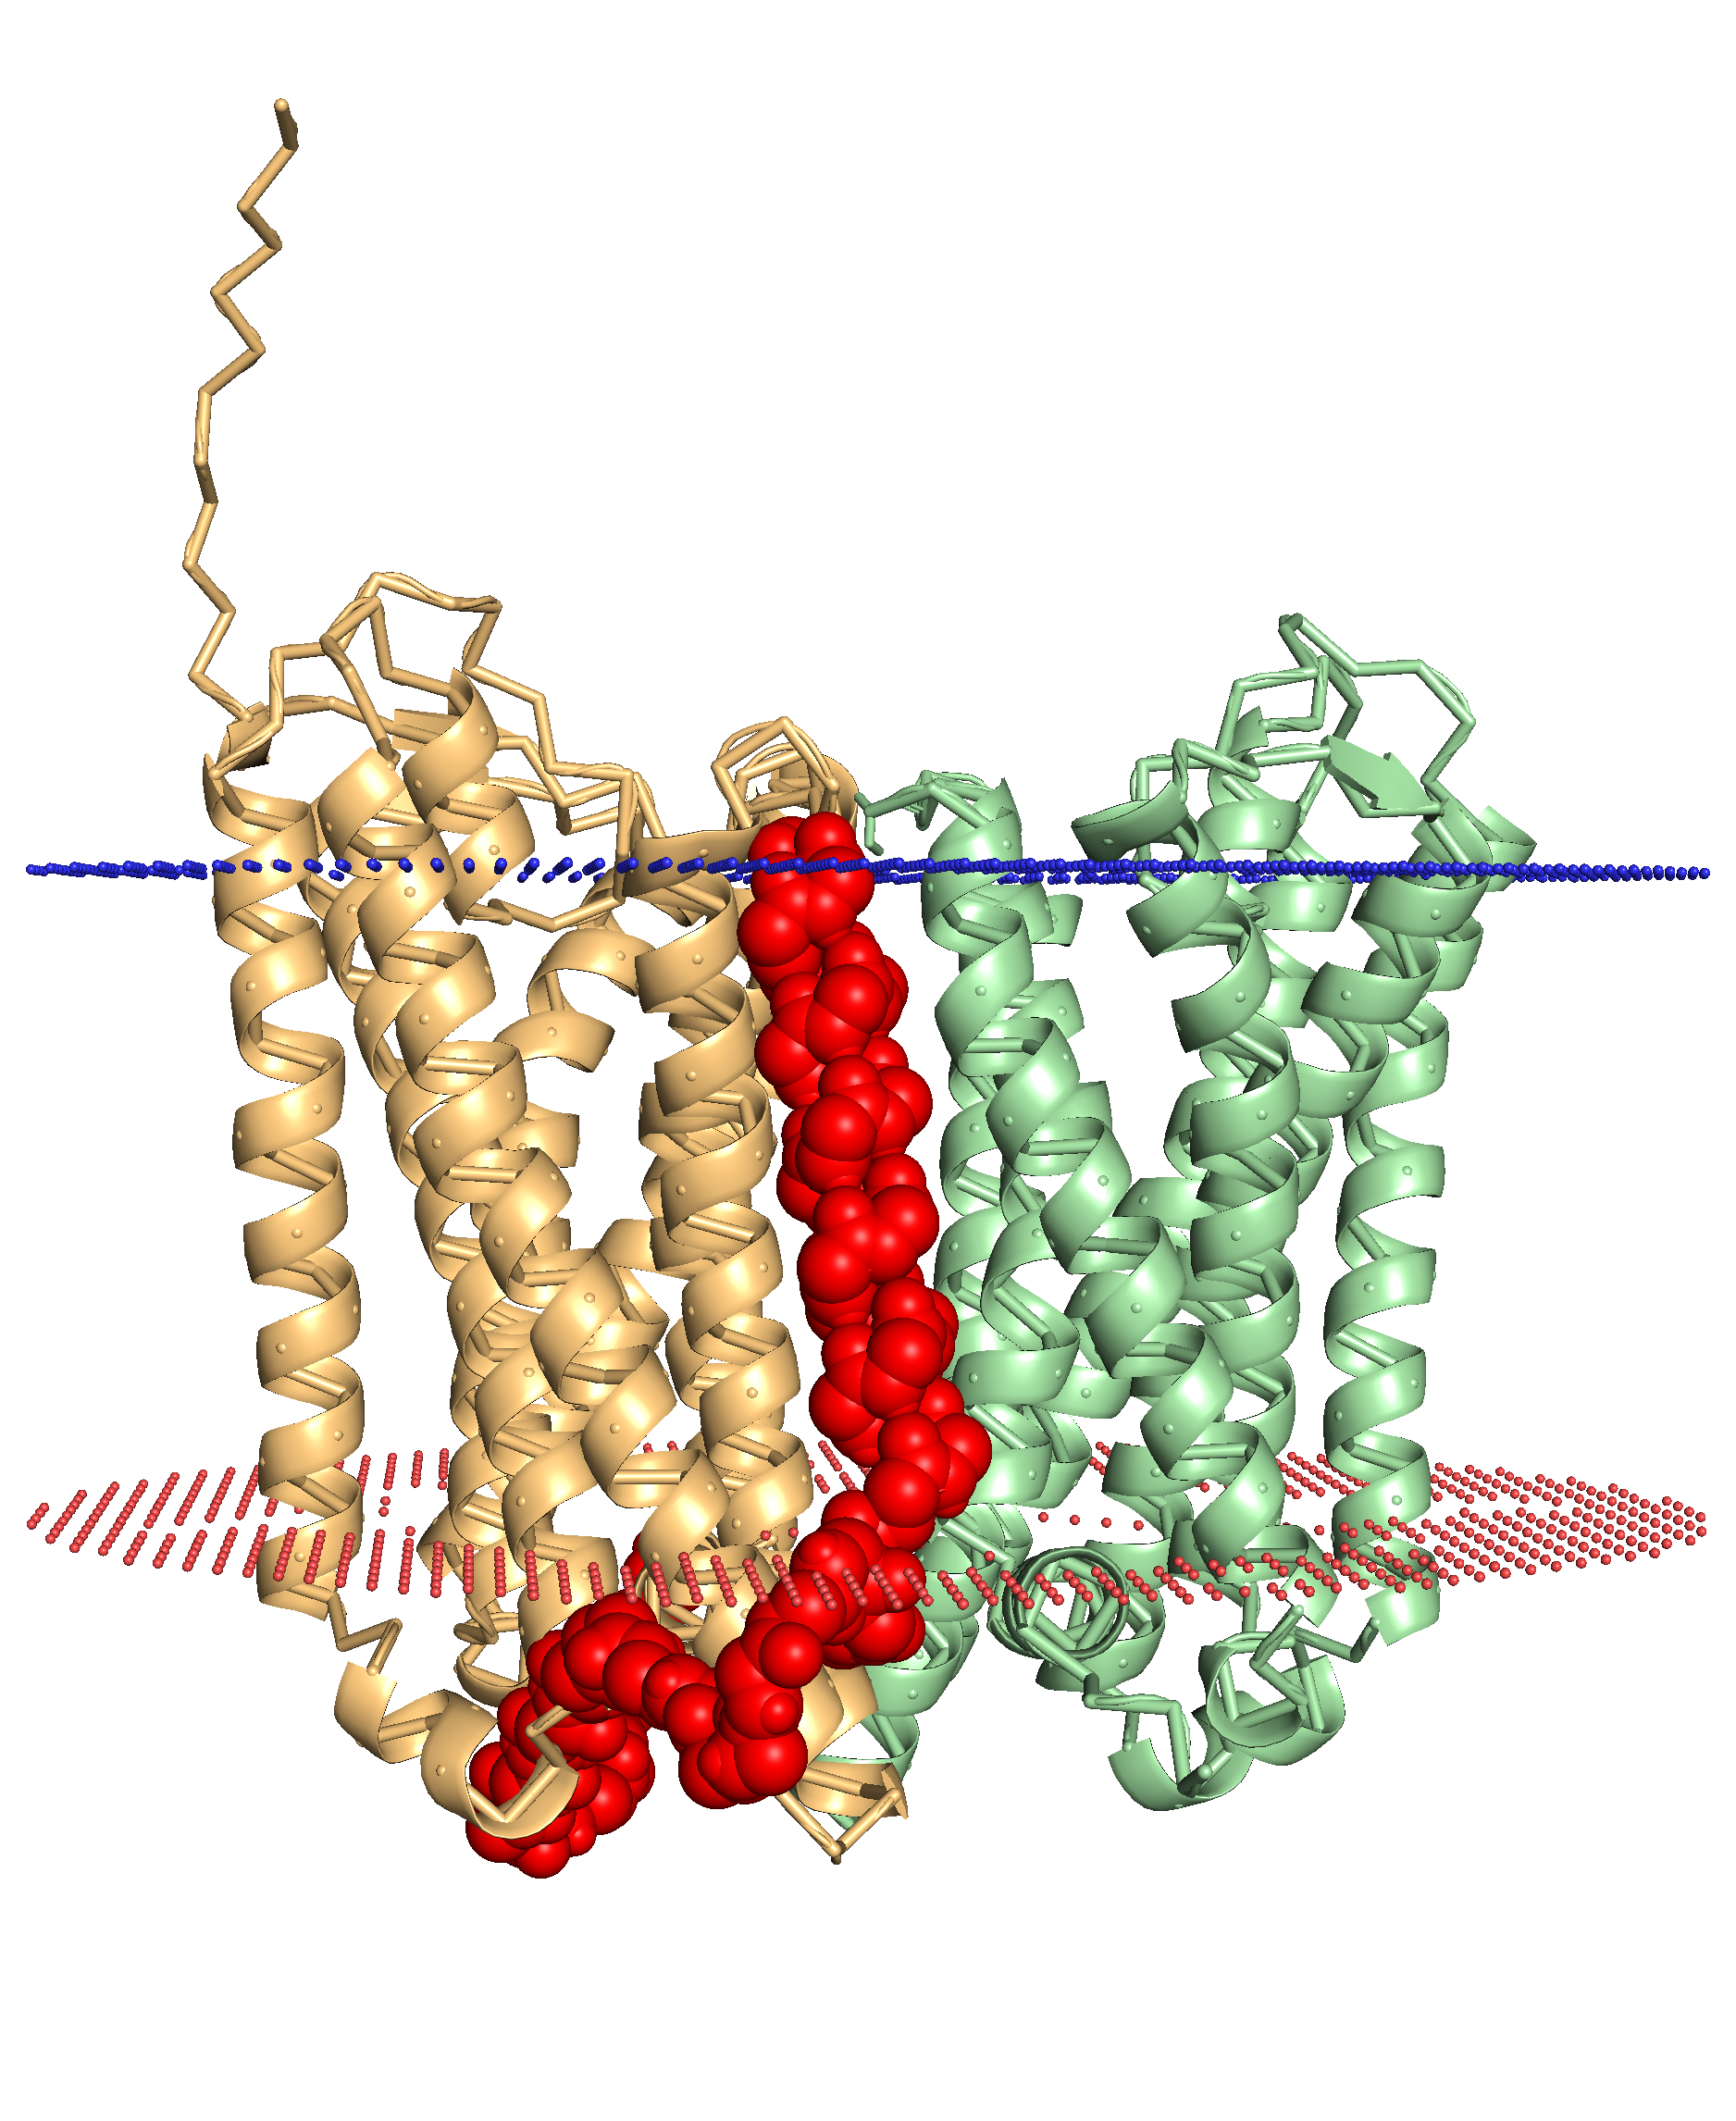
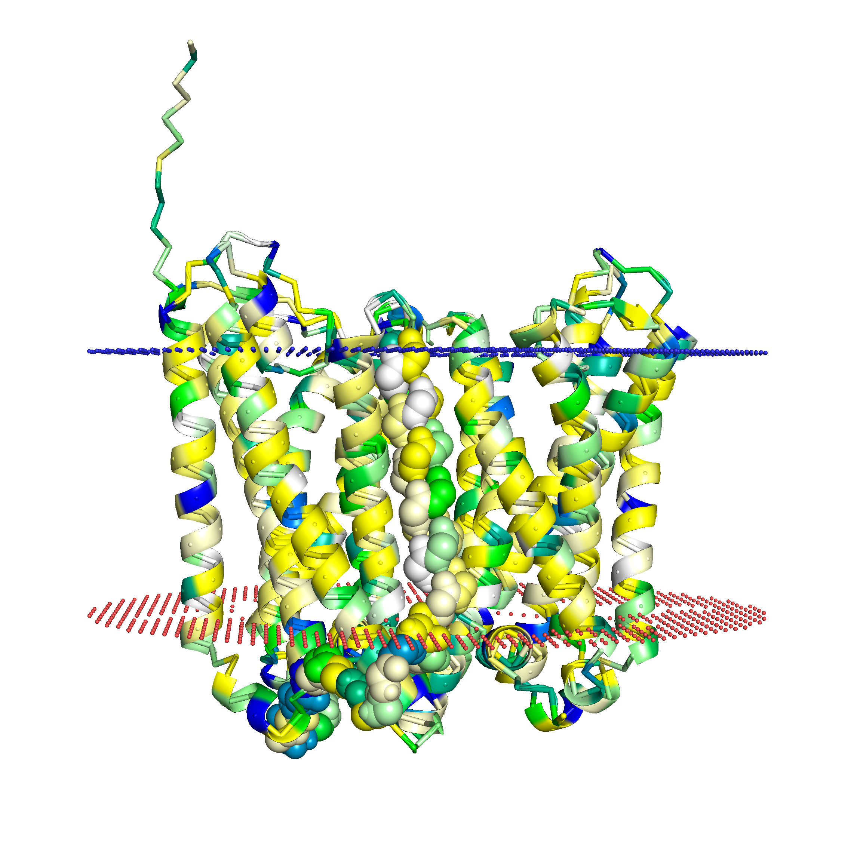
A
B
1
650
hydrophobic 20-residue window
1
AF2 predicted aligned error values
LLFSSYEAEVEERMPLHISAELTMLMFNGSVFMPSMLTLVGIPGLK
312 322 332 342 352
hydrophobic 15-residue window
650
C
D
E

Slide 3
A
B
hydrophobic 20-residue window
1
650
1
AF2 predicted aligned error values
LLFSSYEAEVEERMPLHISAELTMLMFNGSVFMPSMLTLVGIPGLK
312 322 332 342 352
hydrophobic 15-residue window
650
C
D
E

