Slide 1
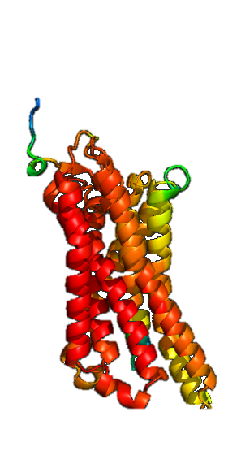


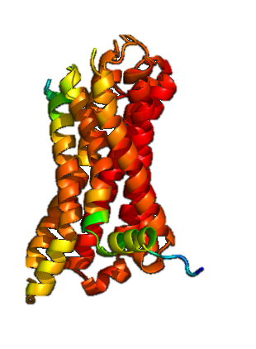
out
out
Cell Membrane
Cell Membrane
in
in
G
G
G
Internal
Organelle

Slide 2
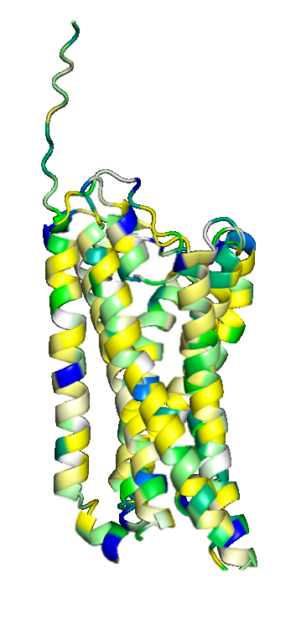
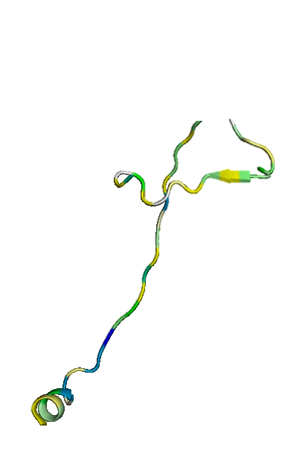
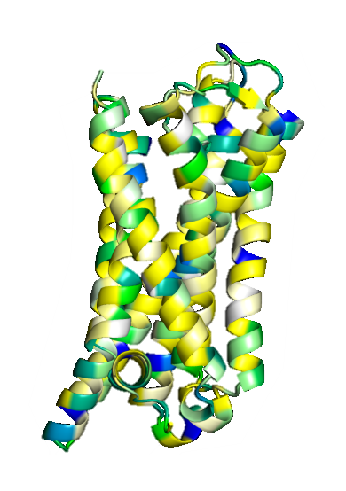
out
out
Cell Membrane
Cell Membrane
in
in
G
G
G
Internal
Organelle

Slide 3
out
Cell Membrane
in
G

Slide 4
out
Cell Membrane
in
G
G
Internal
Organelle

