Slide 1
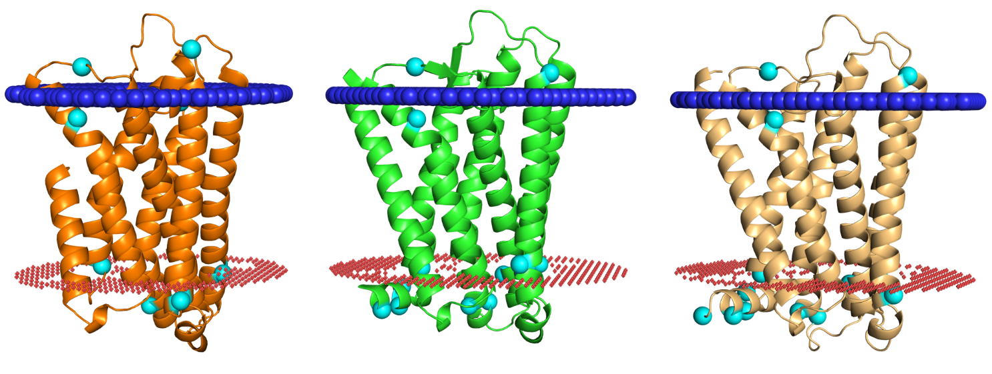
EC loops
EC loops
EC loops
N’
N’
N’
C’
C’
C’
IC loops
IC loops
IC loops
1st domain
2nd domain
3rd domain

Slide 2
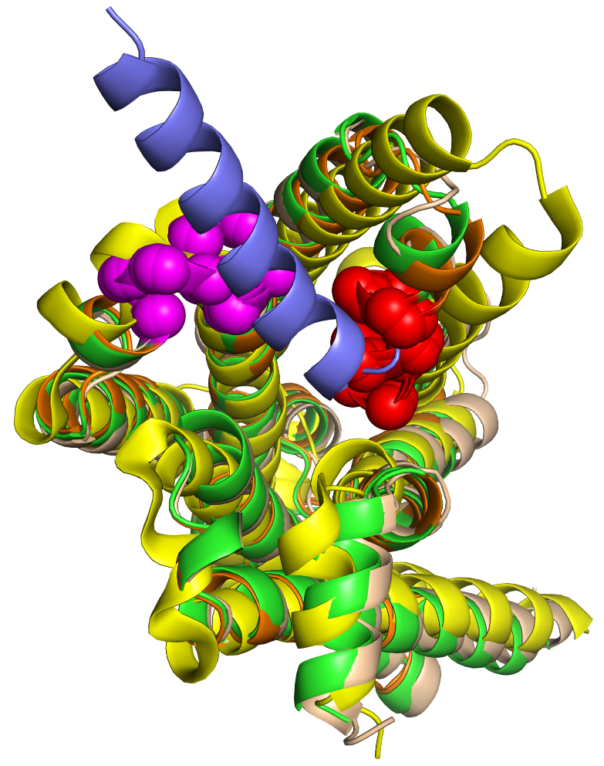
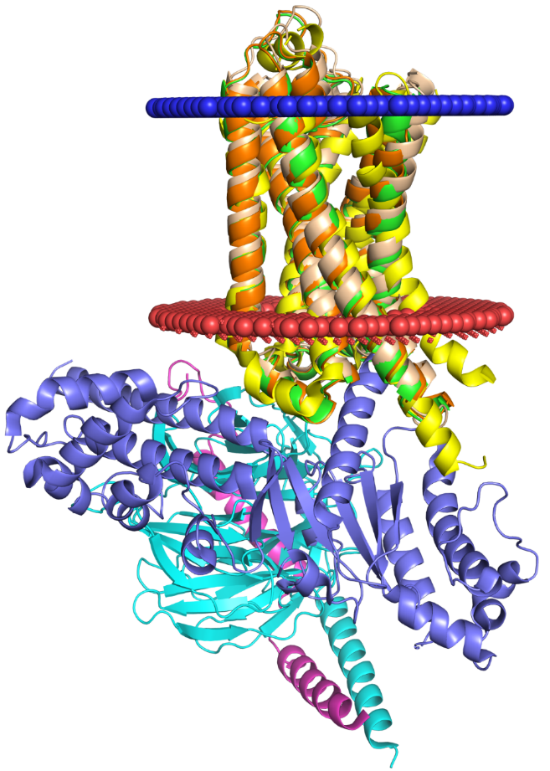
Extracellular side
90 °
Intracellular side
G protein

Slide 3
A
1st domain
2nd domain
3rd domain
EC loops
EC loops
EC loops
N’
N’
N’
C’
C’
C’
IC loops
IC loops
IC loops
B
Extracellular side
90 °
Intracellular side
G protein

Slide 4
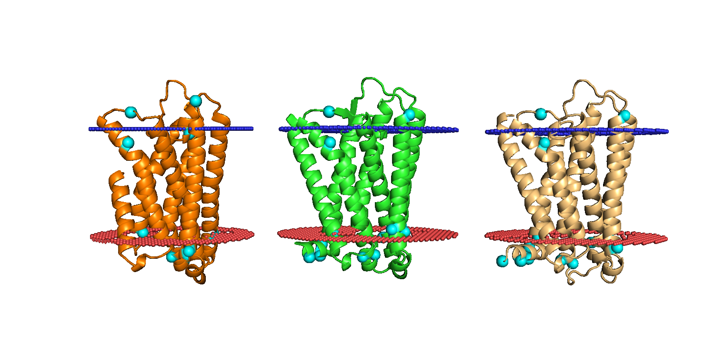
A
1st domain
2nd domain
3rd domain
EC loops
EC loops
EC loops
N’
N’
N’
C’
C’
C’
IC loops
IC loops
IC loops
B
Extracellular side
90 °
Intracellular side
G protein

