Slide 1
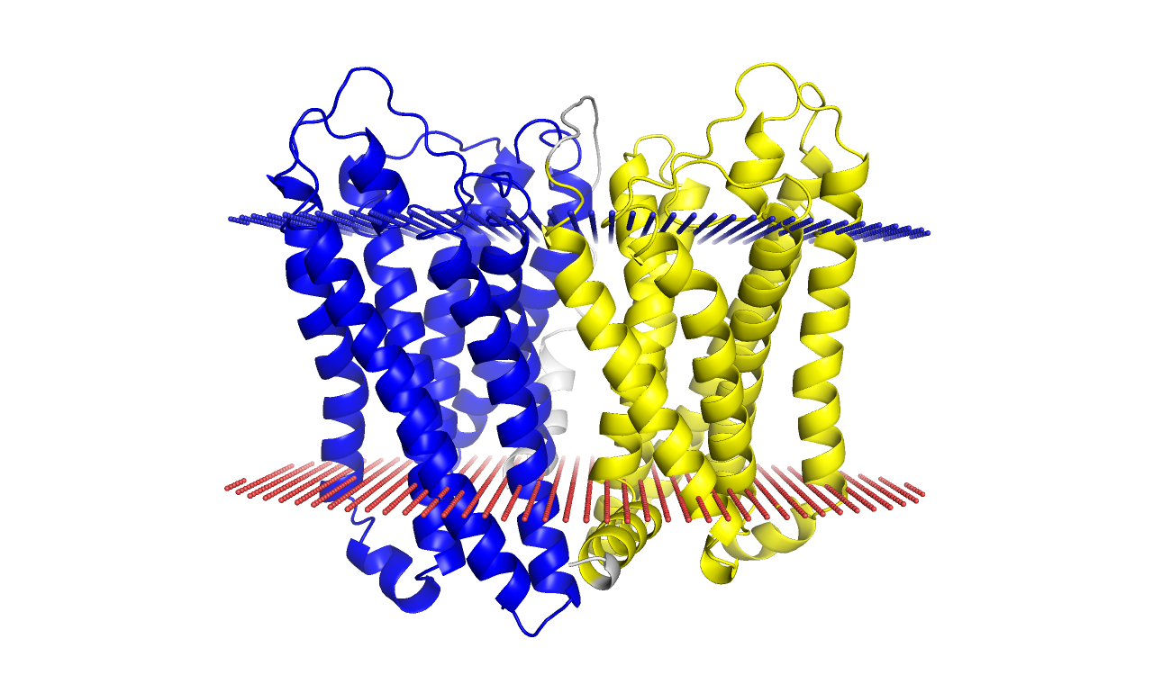
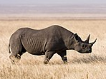

Slide 2















(A)
(B)
(C)
N-terminus
N-terminus
N-terminus
out
in
G
G
G
G
Internal
organelle

Slide 3
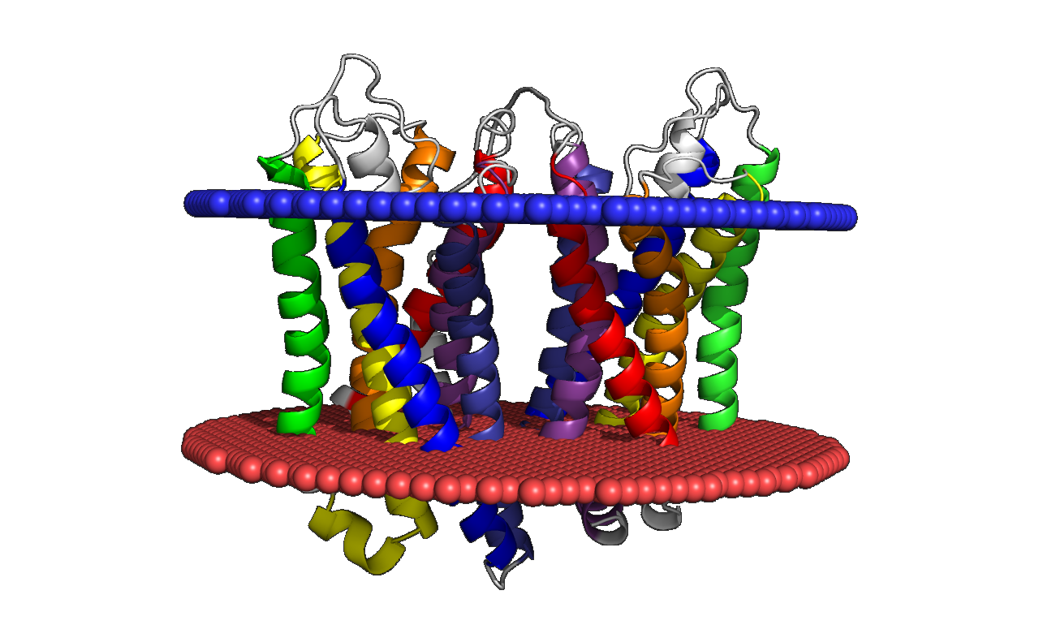

Slide 4
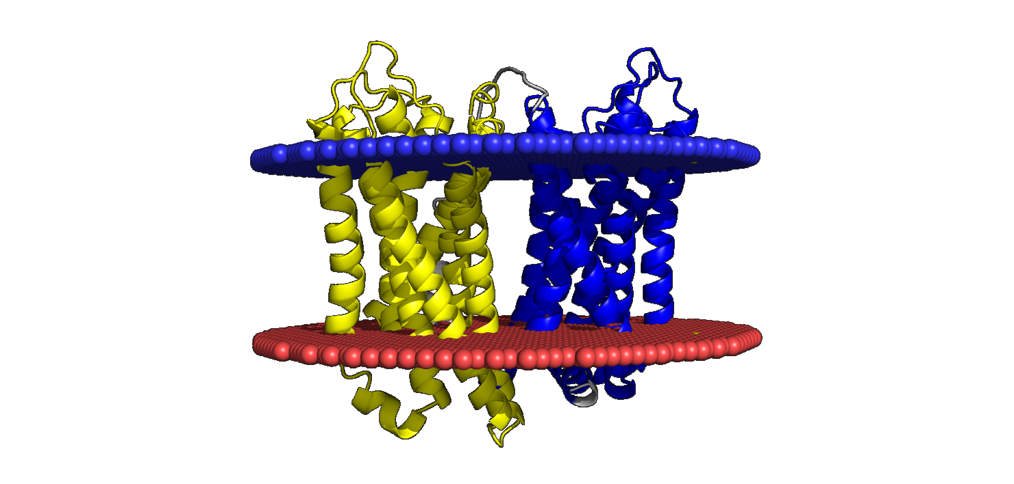

Slide 5
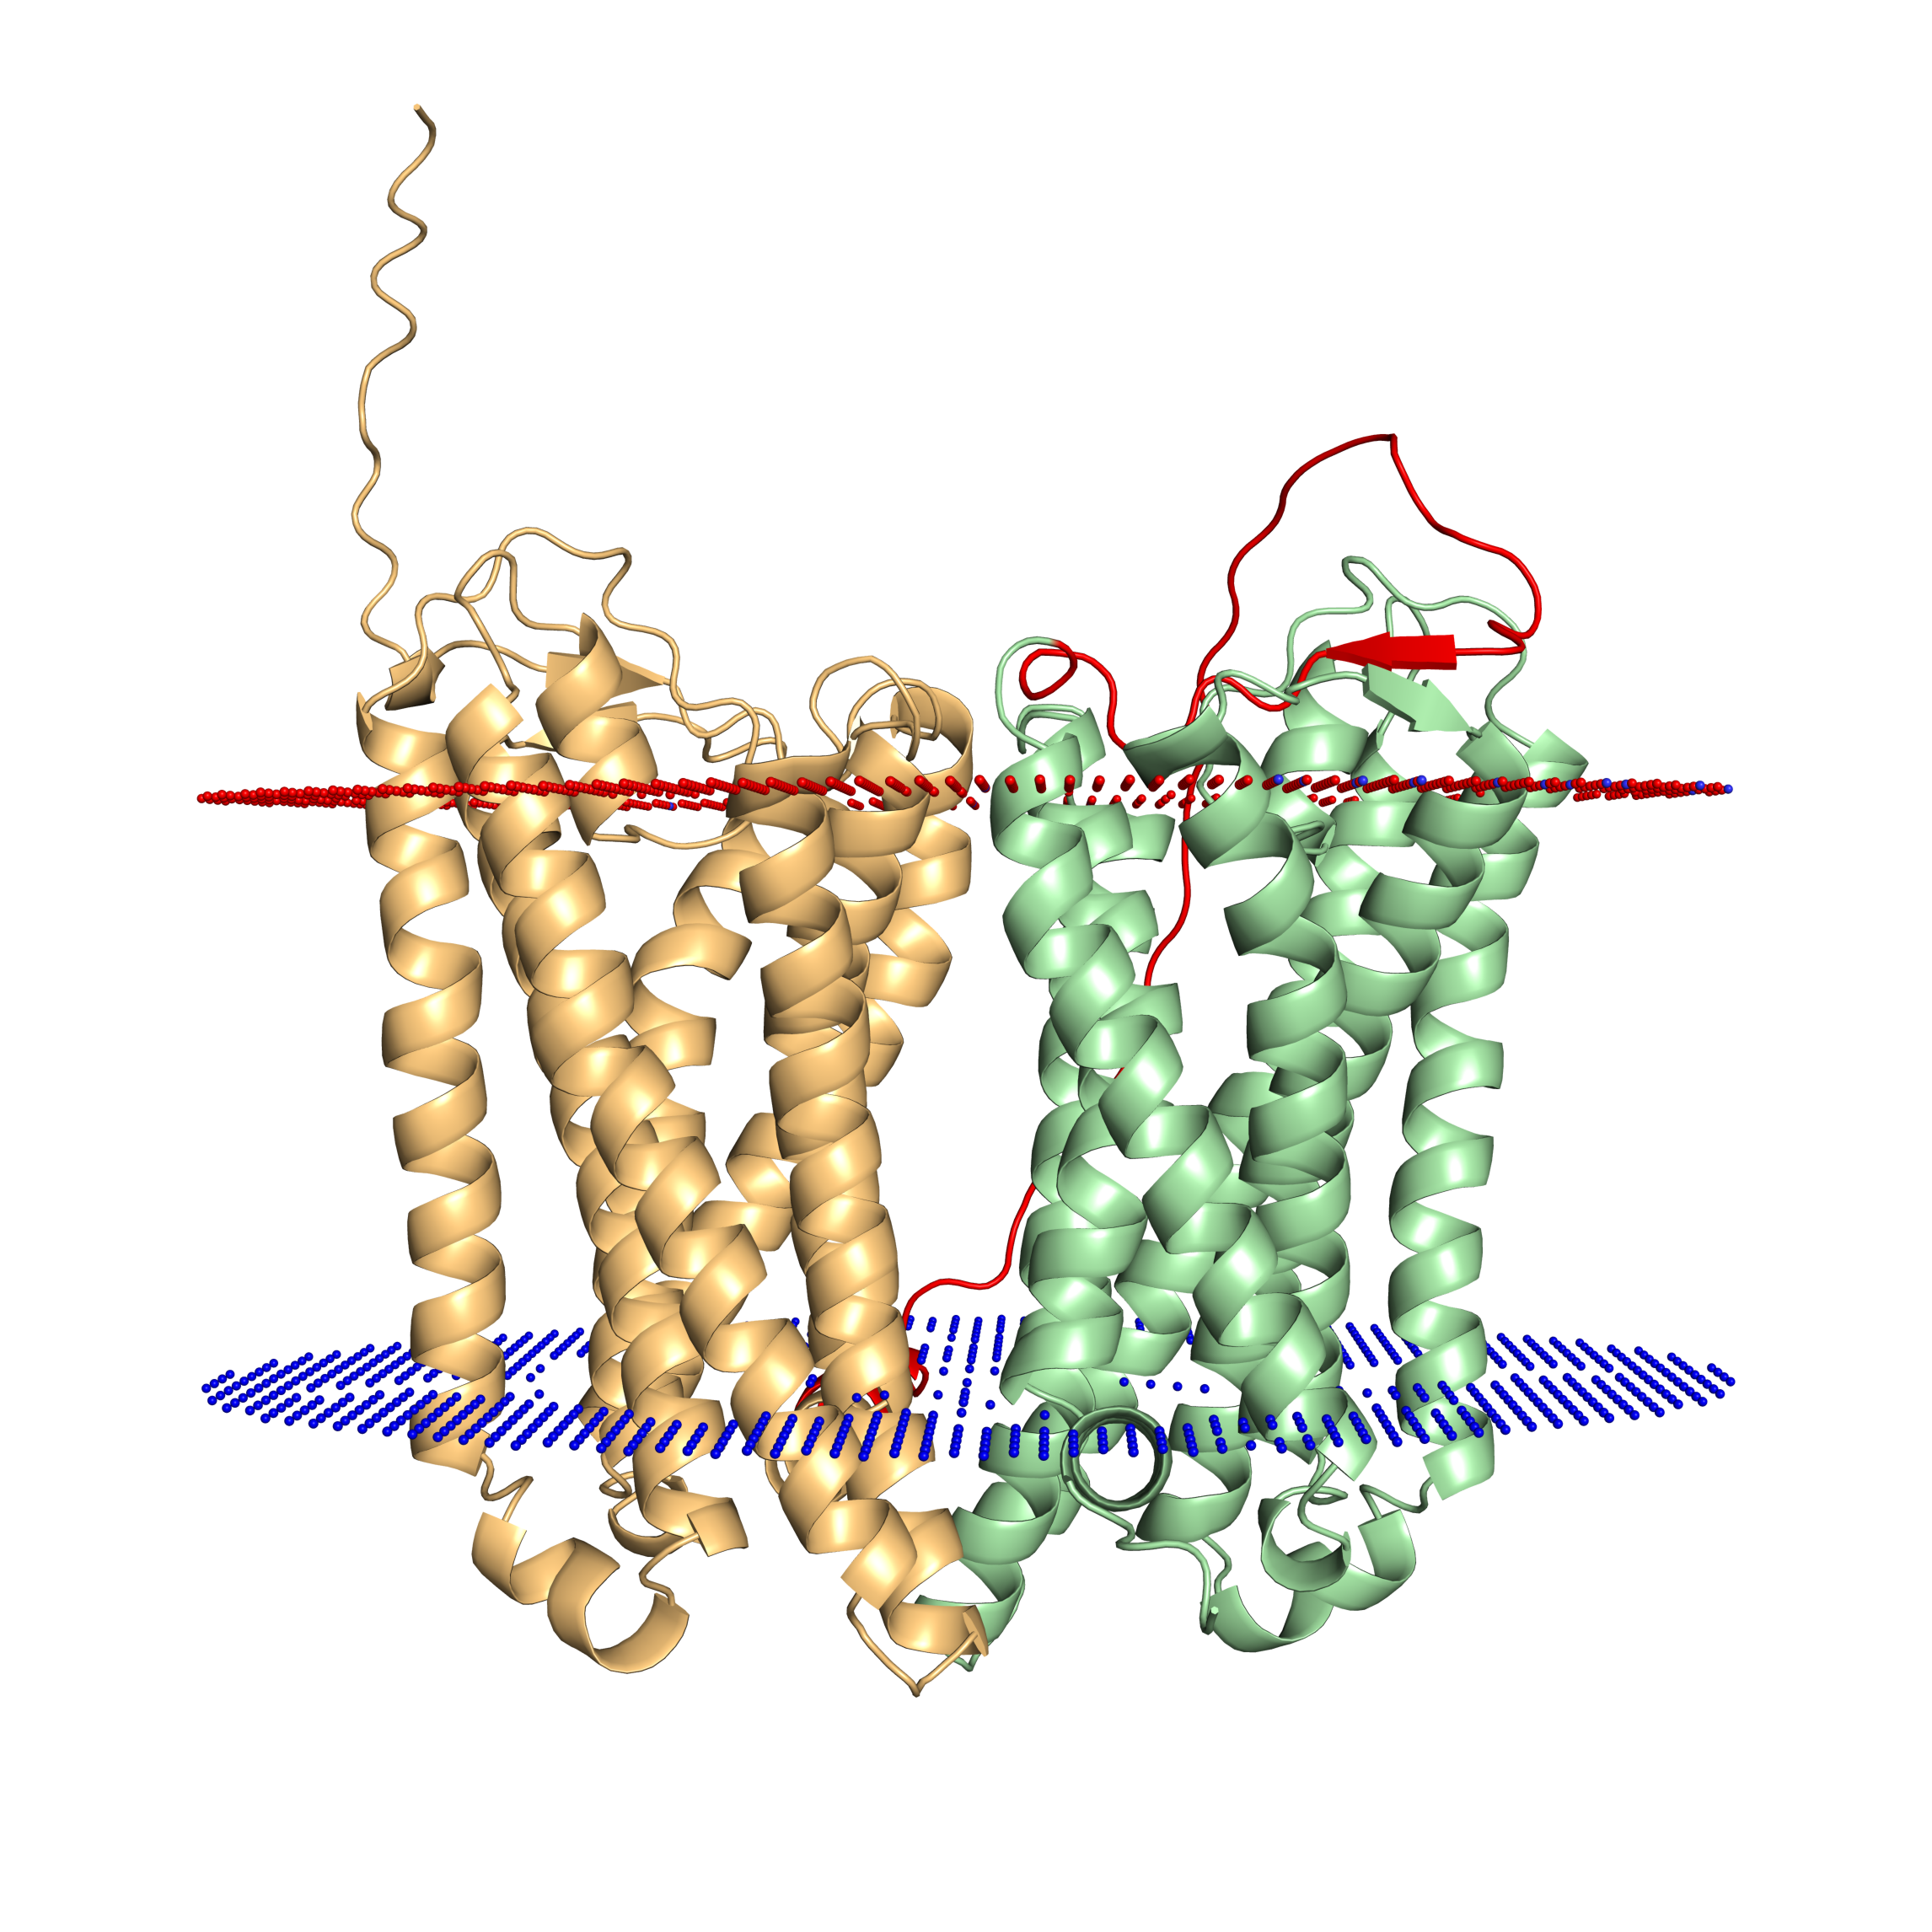
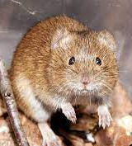

Slide 6
(A)
(B)
(C)
out
in
G
G
G
G
Internal
organelle

Slide 7
(A)
(B)
(C)
out
in
G
G
G
Internal
organelle
G

Slide 8
N
(A)
(B)
(C)
C
out
in
G
G
G
N
(A)
Internal
organelle
G

Slide 9
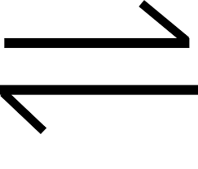
(A)
(B)
(C)
N
N
N
C
out
out
out
in
in
in
G
G
G
out
C
in
C
C
Internal
organelle
G
G
N

