Slide 1
Proteins with multiple G protein-coupled receptor domains
Kılıçali Işıldayancan, Amit Kessel, Ron Solan
Tel Aviv University, Faculty of Life Sciences
Rachel Kolodny
University of Haifa, Department of Computer Science
Notes:
Gram-negative outer membrane proteins with multiple β-barrel domains
On the evolution of outer membrane β-barrel proteins

Slide 2
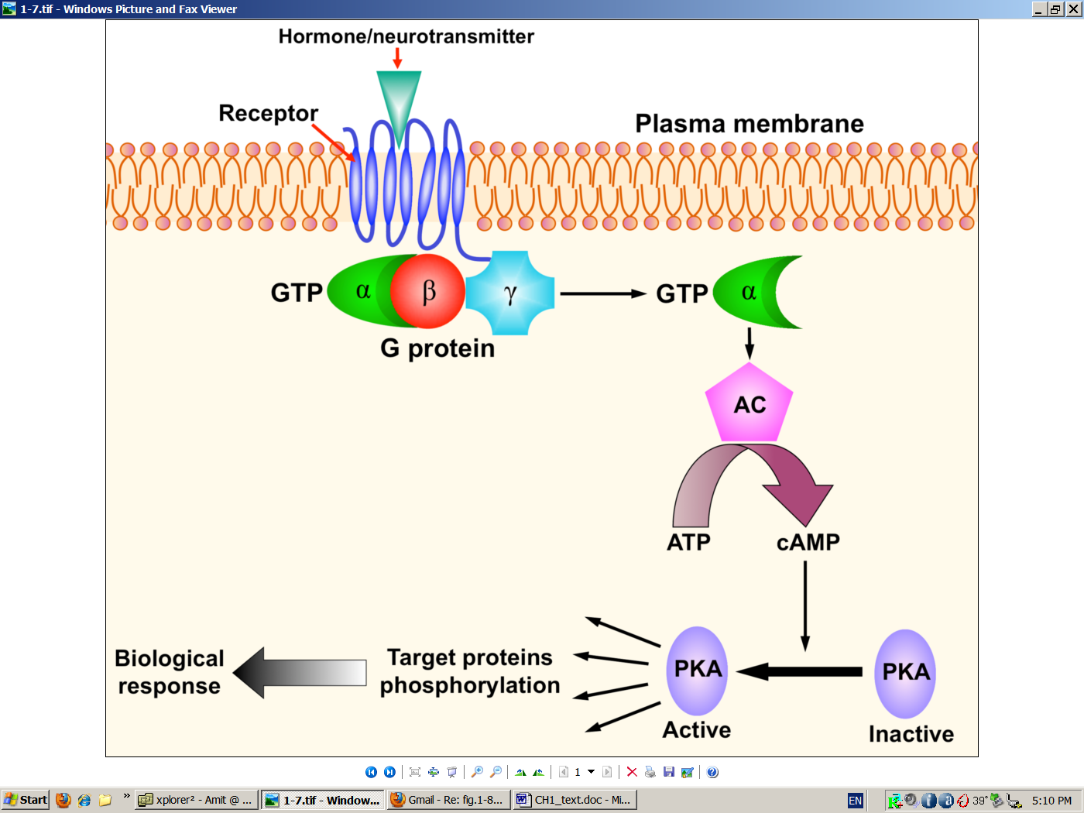
GPCR signaling
Kessel & Ben-Tal. Introduction to Proteins: Structure, Function, and Motion 2nd Edition (2018)
Notes:
Figure 7.31. The main players in a typical signal transduction cascade. (b) The cAMP-PKA cascade. Binding of an external chemical messenger (hormone, neurotransmitter, etc.) to a membrane-bound protein receptor induces the activation of an enzyme called a G-protein, which acts as a transducer. The activation of the G-protein leads to the activation of adenylyl cyclase (AC), which catalyzes the conversion of ATP into cyclic AMP. The latter acts as an intracellular messenger. It binds to and activates the enzyme amplifier PKA, which, in turn, phosphorylates a large set of cytoplasmic proteins. The phosphorylated proteins may activate other cellular components, or perform a certain function (that is, they may act as sensors and/or effectors). In any case, this signal transduction eventually leads to changes in the cell's behavior, i.e., to a biological response.

Slide 3
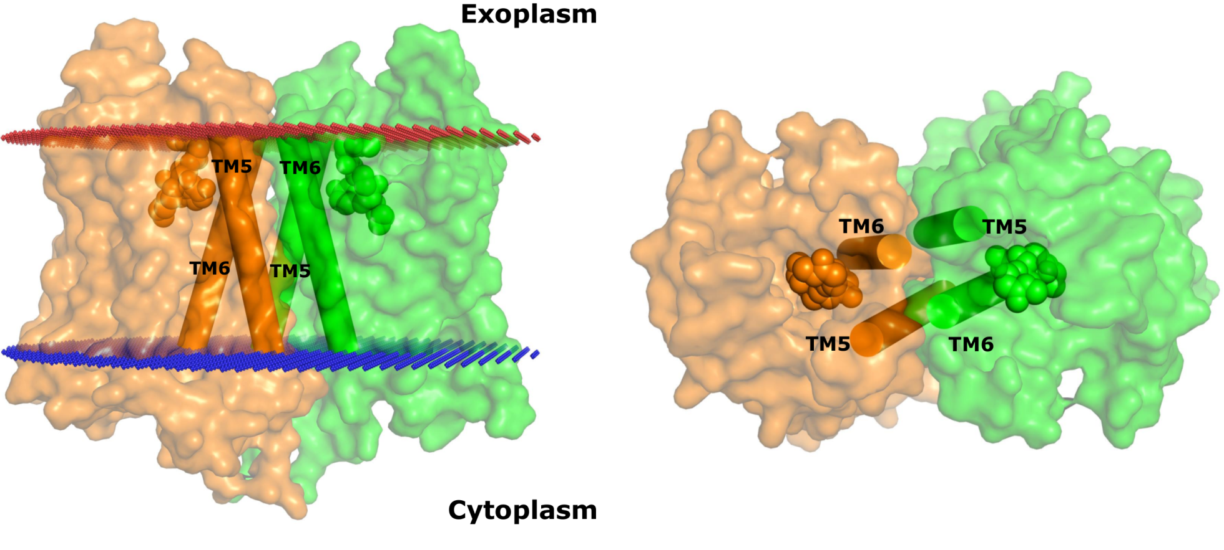
Many GPCRs form homo- or hetero-dimers
Class A – mostly regulation (cooperativity, crosstalk)
Class C – each chain may have different roles
μ-opioid receptor:
Kessel & Ben-Tal. Introduction to Proteins: Structure, Function, and Motion 2nd Edition (2018)
Notes:
Another feature that may be different between the classes is the effect of dimerization/oligomerization: in class A GPCRs both monomeric and homo-dimeric (or oligomeric) forms are active, and the role of dimerization/oligomerization is mostly regulatory (cooperativity, crosstalk).
In class C GPCRs only the hetero-dimer is active, and each chain may have a different role. For example, in the GABA_{B} receptor one polypeptide chain binds the ligand whereas the other binds the G-protein ^{[393]}, and is also needed for bringing the entire receptor to the cell surface.
Figure 7.35. A two-fold symmetric dimer formed by the μ-opioid receptor. The receptor (PDB entry 4dkl) is shown in a surface representation from the side (a) and top (extracellular) (b). Each monomer is colored differently. The two bound ligands (one in each monomer) are shown as spheres. The red and blue lines mark the predicted boundaries of the membrane (the OPM database [135]). The dimerization is mediated by a four-helix bundle motif, formed by TM5 and TM6 (shown as cylinders). On their opposite side TMs 5 and 6 line the ligand-binding sites, which may be related to the role of dimerization in regulating receptor activity.

Slide 4
Many GPCRs form homo- or hetero-dimers
Are there receptors with two-GPCR domains within the same protein chain?
Kessel & Ben-Tal. Introduction to Proteins: Structure, Function, and Motion 2nd Edition (2018)
Notes:
Another feature that may be different between the classes is the effect of dimerization/oligomerization: in class A GPCRs both monomeric and homo-dimeric (or oligomeric) forms are active, and the role of dimerization/oligomerization is mostly regulatory (cooperativity, crosstalk).
In class C GPCRs only the hetero-dimer is active, and each chain may have a different role. For example, in the GABA_{B} receptor one polypeptide chain binds the ligand whereas the other binds the G-protein ^{[393]}, and is also needed for bringing the entire receptor to the cell surface.
Figure 7.35. A two-fold symmetric dimer formed by the μ-opioid receptor. The receptor (PDB entry 4dkl) is shown in a surface representation from the side (a) and top (extracellular) (b). Each monomer is colored differently. The two bound ligands (one in each monomer) are shown as spheres. The red and blue lines mark the predicted boundaries of the membrane (the OPM database [135]). The dimerization is mediated by a four-helix bundle motif, formed by TM5 and TM6 (shown as cylinders). On their opposite side TMs 5 and 6 line the ligand-binding sites, which may be related to the role of dimerization in regulating receptor activity.

Slide 5
Finding proteins with multi-GPCR domains
Constructed HMMER profiles for all 92 GPCR domains in the (99% NR) ECOD database
Searched UniRef90 for proteins with non-overlapping multiple GPCR domains
Clustered the hits using CD-HIT: found 1395 clusters
Selected the 16 clusters with >5 hits and identical number of domains: 57 proteins in total
Mapped them to representative genomes
Isildayancan, Kessel, Solan, Kolody, Ben-Tal. BioRxiv.
Notes:
Figure 1: The number of ECOD GPCR HMMs aligned to each position in the nine representatives of clusters with multi-GPCRs. In each one, we can see stretches that are longer than 200 residues with multiple matches. Also, we mark (with black vertical lines), the partitioning of each sequence when considering which GPCRs are aligned to that sequence segment (see Fig. 2).

Slide 6
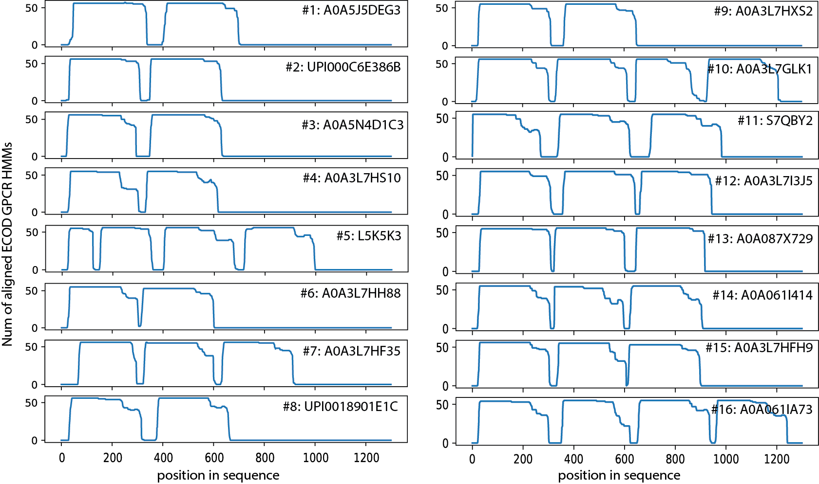
The number of ECOD GPCR HMMs aligned to each position in the sixteen clusters
Isildayancan, Kessel, Solan, Kolody, Ben-Tal. BioRxiv.
Notes:
Figure S1: The number of ECOD GPCR HMMs aligned to each position in sixteen representatives of clusters with multi-GPCRs. In each one, we can see stretches that are longer than 200 residues with multiple matches. For each panel, the number of cluster and the representative protein is listed. In each one we see multiple stretches that are candidates for GPCR segments. Notice that in some of these proteins there are long stretches that are shorter than a full GPCR (e.g., in cluster #5), as described in the text.

Slide 7
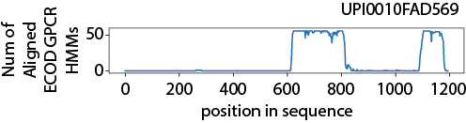
UPI0010FAD569 was filtered out because it has only one full GPCR domain
Isildayancan, Kessel, Solan, Kolody, Ben-Tal. BioRxiv.
Notes:
Figure S2: The sequence UPI0010FAD569 was filtered out because there was only a single sufficiently-long segment along the sequence that matches to the ECOD GPCR HMMs (between residues 610-837). The stretch between residues 1086-1184 is not long enough. Thus, we removed this sequence, and 33 additional (shorter) sequences that were in its CD-HIT cluster.

Slide 8
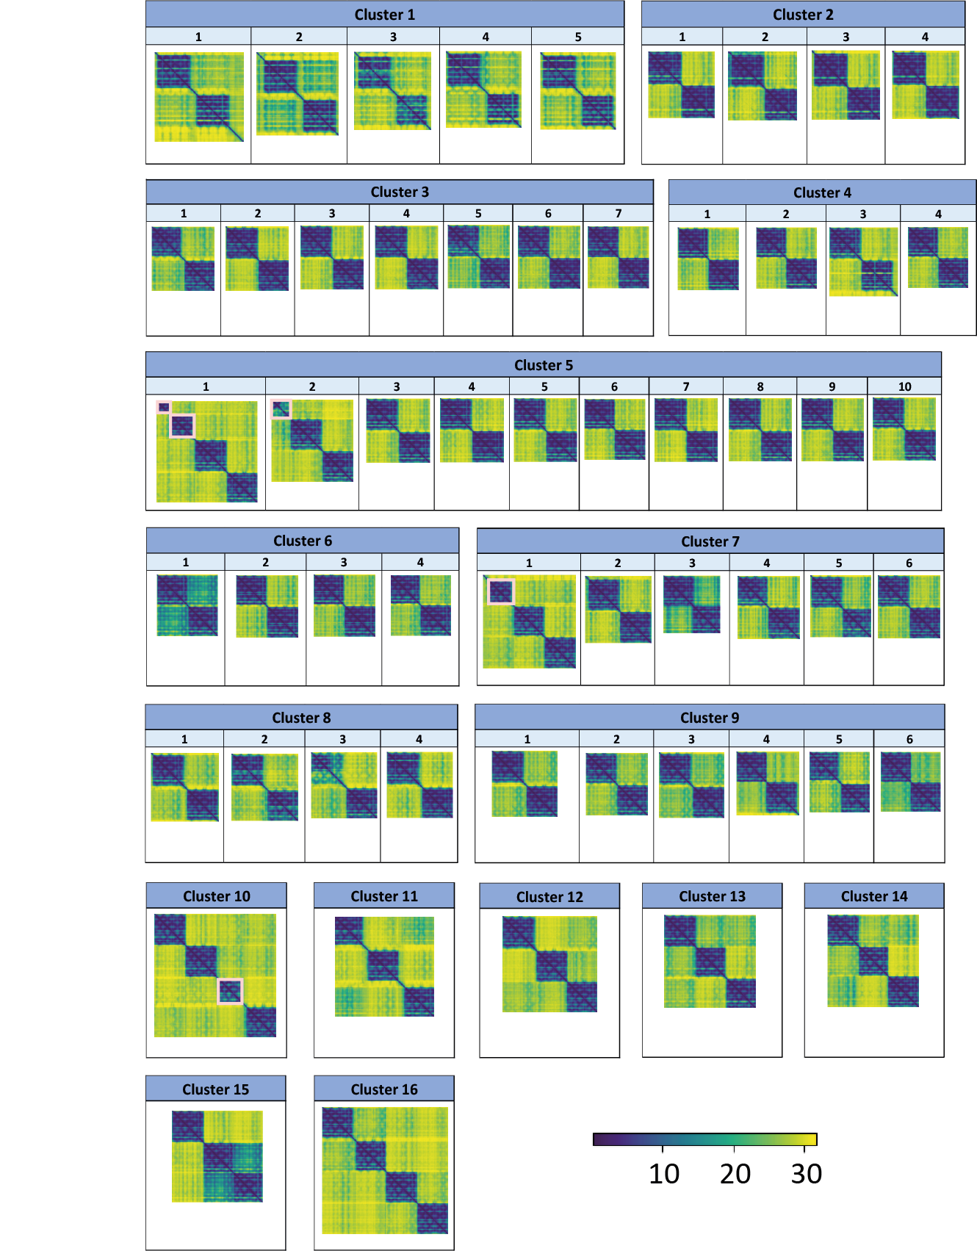
AlphaFold predicted pairwise aligned errors for the 57 multi-GPCR proteins
Isildayancan, Kessel, Solan, Kolody, Ben-Tal. BioRxiv.
Notes:
Figure 1: AlphaFold predicted aligned errors for the 57 multi-GPCR proteins. The estimated accuracy of the relative positions of the predicted structures are shown as colormaps of the n×n matrix of predicted aligned errors. For each protein of n residues, the color at (x, y) indicates AlphaFold’s expected position error at residue x if the predicted and true structures were aligned on residue y. AlphaFold assigns high confidence to relative amino acid positions within the individual GPCR domains (blue shades), and low confidence to the relative orientation of the domains with respect to each other (yellow shades). The colormaps are grouped by their clusters. The pink rectangles mark the four cases (first two multi-GPCRs in cluster #5, first multi-GPCR in cluster #7, and first multi-GPCR in cluster #10) with segments that have fewer than seven helices.

Slide 9
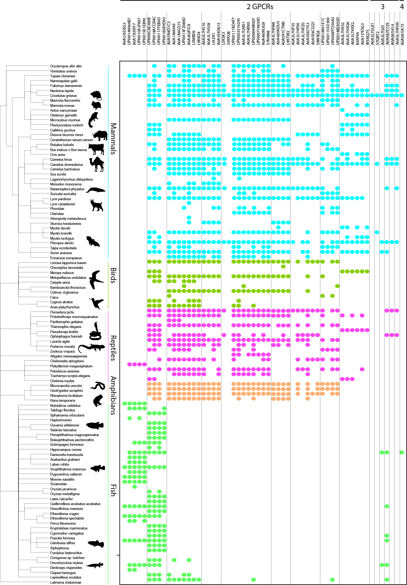
Tree of life distribution of homologues of the 57 multi-GPCR proteins
Single-domain GPCRs are broadly distributed in eukaryotes: primitive yeast and choanoflagellate → animals, but multi-GPCRs only in Chordata species
Multi-GPCR domains are only homologous to muscarinic acetylcholine receptor M3, adenosine receptor, rhodopsin, and orexin receptor type 2/ chemokine receptor type 4.
By homology, most are olfactory receptors, and some are chemokine receptors
Isildayancan, Kessel, Solan, Kolody, Ben-Tal. BioRxiv.
Notes:
Figure 2: Tree of life distribution of homologues of the 57 multi-GPCR proteins. The proteins are plotted along the x-axis (first two-GPCR domains, then three-GPCR domains, then the four-GPCR domains), ordered as in Table 1. Vertical lines indicate cluster boundaries. Homologues were identified in 106 species, and are shown as leaves of a phylogenetic tree along the y-axis. Colored dots mark the species found with a homologue of a protein: cyan for mammals, green for birds, pink for reptiles, orange for amphibians, and light green for fish.
Cluster 1: Based on these, almost all the multi-GPCR proteins for which we found a functional annotation are olfactory receptors. The only exceptions are the chemokine receptors of cluster #1, which are almost entirely restricted to fish.

Slide 10
But proper GPCR function requires an N-terminal out topology…
As in homo- or hetero-dimers
Kessel & Ben-Tal. Introduction to Proteins: Structure, Function, and Motion 2nd Edition (2018)
Notes:
Another feature that may be different between the classes is the effect of dimerization/oligomerization: in class A GPCRs both monomeric and homo-dimeric (or oligomeric) forms are active, and the role of dimerization/oligomerization is mostly regulatory (cooperativity, crosstalk).
In class C GPCRs only the hetero-dimer is active, and each chain may have a different role. For example, in the GABA_{B} receptor one polypeptide chain binds the ligand whereas the other binds the G-protein ^{[393]}, and is also needed for bringing the entire receptor to the cell surface.
Figure 7.35. A two-fold symmetric dimer formed by the μ-opioid receptor. The receptor (PDB entry 4dkl) is shown in a surface representation from the side (a) and top (extracellular) (b). Each monomer is colored differently. The two bound ligands (one in each monomer) are shown as spheres. The red and blue lines mark the predicted boundaries of the membrane (the OPM database [135]). The dimerization is mediated by a four-helix bundle motif, formed by TM5 and TM6 (shown as cylinders). On their opposite side TMs 5 and 6 line the ligand-binding sites, which may be related to the role of dimerization in regulating receptor activity.

Slide 11
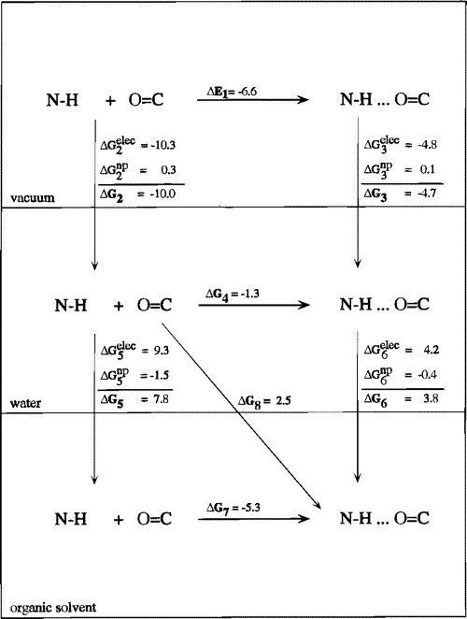
Unsatisfied backbone hydrogen bonds in the membrane are energetically costly
The linkers connecting the GPCR domains should be hydrophobic TM helices
But most linkers are not sufficiently long and hydrophobic…
Ben-Tal, Sitkoff, Topol, Yang, Burt, Honig (1997) J Phys Chem B

Slide 12
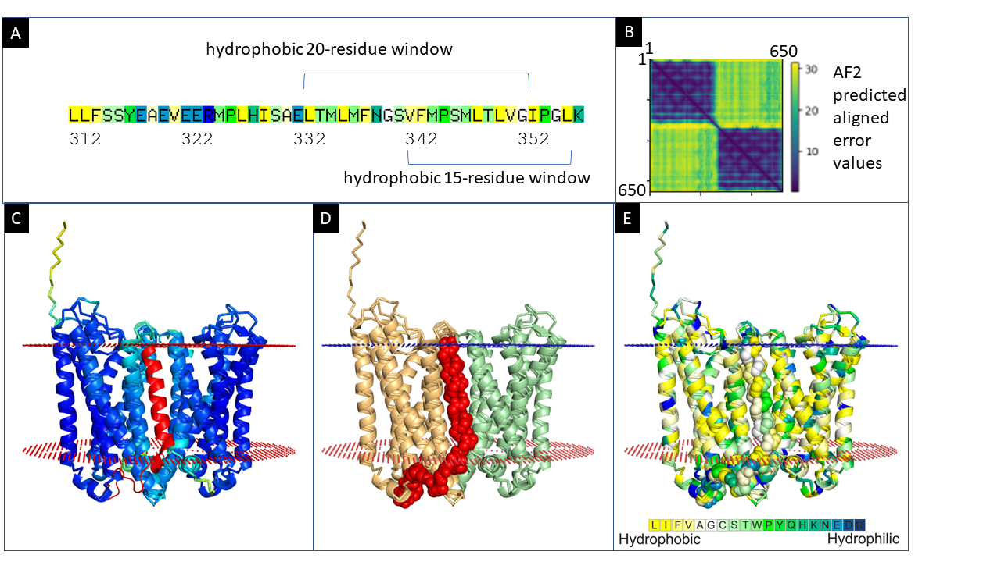
Predicted structure of two-GPCR-domain A0A3L7HXX2 (from rodent)
Isildayancan, Kessel, Solan, Kolody, Ben-Tal. BioRxiv.
Notes:
Figure 3: Predicted structure of two-GPCR-domain A0A3L7HXX2. (A) Kessel & Ben-Tal scale hydrophobicity scores of the linker region. The most hydrophobic 20-residue and 15-residue windows within the linker are indicated. (B) Heatmap visualization of the predicted errors in the pairwise positioning of the residues in A0A3L7HXX2 in the structure predicted by AlphaFold. The positioning of residues within each of the GPCR domains is predicted to be accurate, whereas the relative positioning of the two domains and the linker structure are not. (C) The most confident model (pTM 81.5) from AlphaFold, colored by the pLDDT confidence measure with the linker, residues 312-358 (red), modeled manually. The first 20 positions of the linker, which contain many polar and charged amino acids, are organized as a random coil mostly outside the membrane, and the remaining mostly hydrophobic 25 amino acids form an alpha-helix that crosses the membrane, placing both GPCRs in the same orientation. The extracellular (small blue spheres) and intracellular (small red spheres) boundaries of the membrane are also shown (predicted by the OPM web server). (D) Model as in panel C with the two GPCR domains colored wheat and pale green and the linker region colored red with atoms shown as spheres. (E) Model as in panel C with the structure colored by the Kessel & Ben-Tal hydrophobicity scale scores.

Slide 13
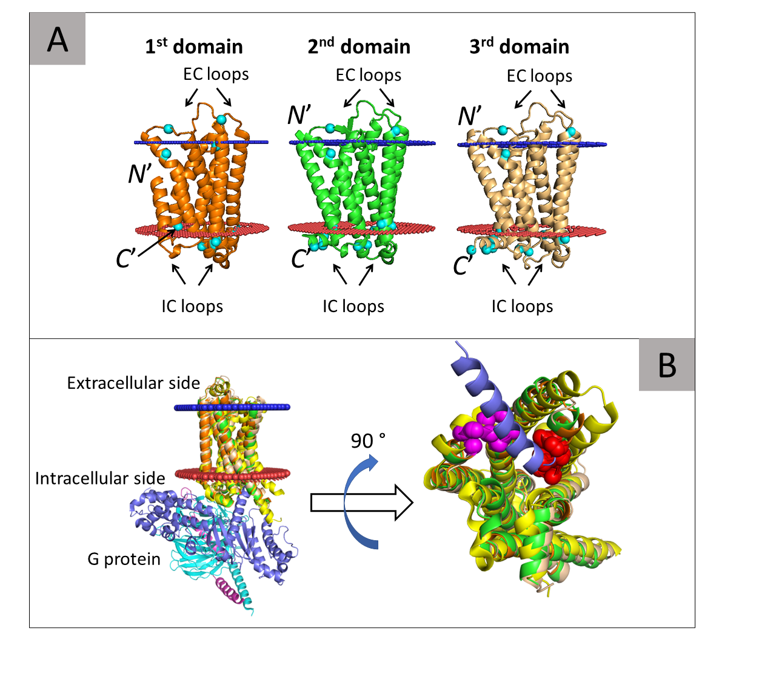
Predicted structure of three-GPCR-domain S7QBY2
The β₂-AR receptor (yellow) in complex with G protein.
α (blue), β (cyan), and γ (magenta)
The VAICxPLxY (pink) and KAFSTCASH (red) motifs
Isildayancan, Kessel, Solan, Kolody, Ben-Tal. BioRxiv.
Notes:
molecular switches and locks motifs
Figure 4: Predicted structure of three-GPCR-domain S7QBY2 (from bat). (A) Predicted model with the first, second, and third successive GPCR domains of the protein colored orange, green, and wheat, respectively. The inferred extracellular and intracellular membrane boundaries are also shown (calculated by the PPM web server[36]), as blue and red spheres, respectively. The membrane topologies of the domains are shown by noting their N- and C-termini and the intracellular (IC) and extracellular (CE) loops. The arginine and lysine residues (cyan spheres) are asymmetrically distributed in keeping with the positive-inside rule [29]. (B) Left: Side view of the structure with the three GPCR domains superimposed onto the structure of the G protein-bound (activated) β2-adrenergic receptor (β₂-AR, PDB ID: 3sn6). The β₂-AR receptor is colored yellow and the α, β, and γ subunits of the G protein are colored blue, cyan, and magenta. Right: An enlarged view of the G protein-binding site. The β₂-AR and superimposed domains of S7QBY2 are rotated 90° to show the binding site. For clarity, only the α5 helix of the G protein is shown; this region directly interacts with the GPCR. The image clearly shows that all three domains of S7QBY2 contain a cavity that corresponds to the G protein-binding site of the β₂-AR. Moreover, all domains contain the VAICxPLxY and KAFSTCASH motifs (pink and red spheres, respectively), which directly interact with the α5 helix of the G protein.

Slide 14
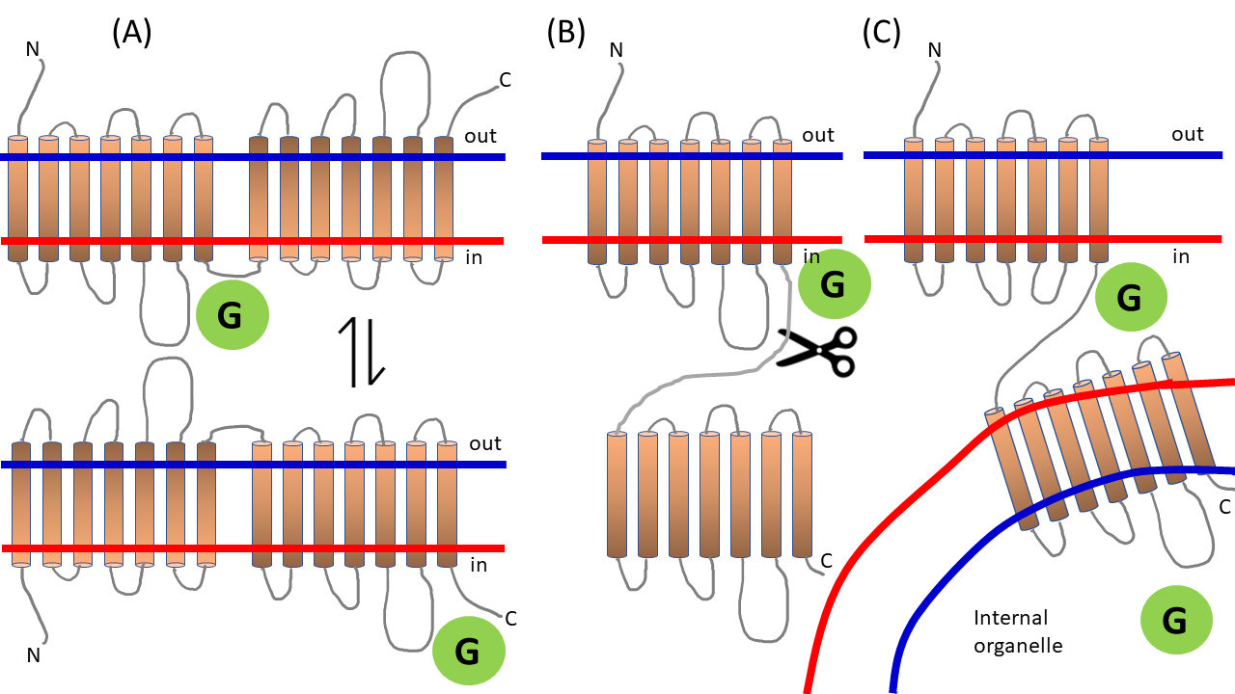
Speculative scenarios for a two-GPCR protein with a linker that is too polar to cross the membrane
Isildayancan, Kessel, Solan, Kolody, Ben-Tal. BioRxiv.
Notes:
Figure 5: Speculative scenarios for a two-GPCR protein with a linker that is too polar to cross the membrane. (A, top) The first 7TM GPCR domain has its N terminus on the outer side, in the conventional membrane topology. We indicated the correct orientation with the color gradient. The second 7TM GPCR domain, on the other hand, is oriented in the opposite direction. Here, only the first domain is functional, and if the orientation of the protein in the membrane is reversed (A, bottom), only the second domain would be functional. (B) A (yet to be discovered) enzyme may cleave the chain. (C) The first 7TM GPCR domain may be oriented properly in the membrane, while the second is in the membrane of a nearby internal organelle.

Slide 15
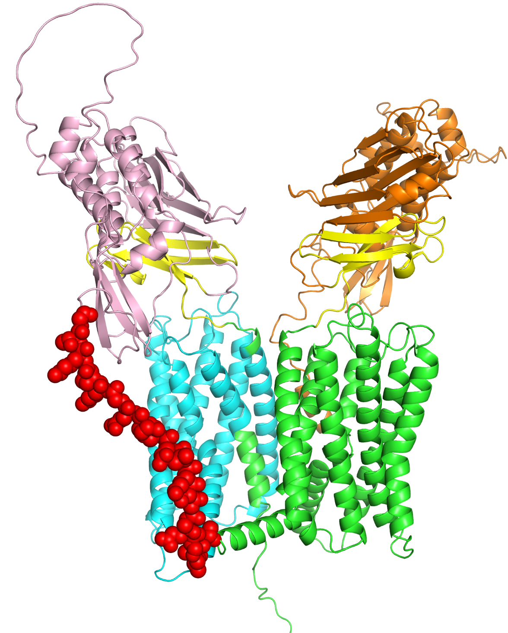
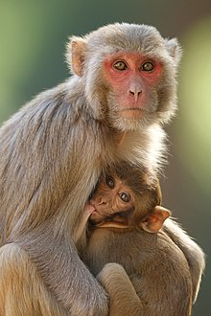
Adhesion GPCR F4 from Rhesus Macaque
Gene: ADGRF4
UniProt: A0A1D5QNK2
EC domain 1
EC domain 2
GPS domain 2
GPS domain 1
TM domain 2
TM domain 1
Linker
Notes:
The two GPS domains (yellow) separate between the extracellular (orange and pink) and GPCR (green and cyan) domains. The linker is shown as red spheres.
Adhesion G protein-coupled receptors (adhesion GPCRs) are a class of 33 human protein receptors with a broad distribution in embryonic and larval cells, cells of the reproductive tract, neurons, leukocytes, and a variety of tumours.^{[1]} Adhesion GPCRs are found throughout metazoans and are also found in single-celled colony forming choanoflagellates such as Monosiga brevicollis and unicellular organisms such as Filasterea. The defining feature of adhesion GPCRs that distinguishes them from other GPCRs is their hybrid molecular structure. The extracellular region of adhesion GPCRs can be exceptionally long and contain a variety of structural domains that are known for the ability to facilitate cell and matrix interactions. Their extracellular region contains the membrane proximal GAIN (GPCR-Autoproteolsis INducing) domain. Crystallographic and experimental data has shown this structurally conserved domain to mediate autocatalytic processing at a GPCR-proteolytic site (GPS) proximal to the first transmembrane helix. Autocatalytic processing gives rise to an extracellular (α) and a membrane-spanning (β) subunit, which are associated non-covalently, resulting in expression of a heterodimeric receptor at the cell surface.^{[2][3]} Ligand profiles and in vitro studies have indicated a role for adhesion GPCRs in cell adhesion and migration.^{[4]} Work utilizing genetic models confined this concept by demonstrating that the primary function of adhesion GPCRs may relate to the proper positioning of cells in a variety of organ systems. Moreover, growing evidence implies a role of adhesion GPCRs in tumour cell metastasis.^{[5]} Formal G protein-coupled signalling has been demonstrated for a number for adhesion GPCRs,^{[6][7]} however, the orphan receptor status of many of the receptors still hampers full characterisation of potential signal transduction pathways. In 2011, the adhesion GPCR consortium was established to facilitate research of the physiological and pathological functions of adhesion GPCRs.

Slide 16
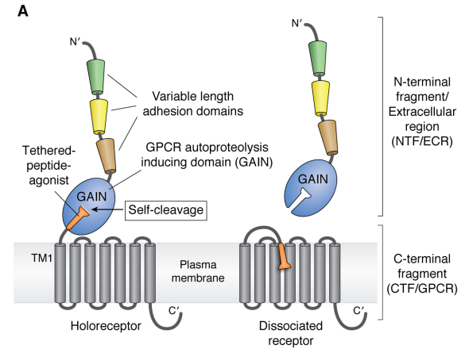
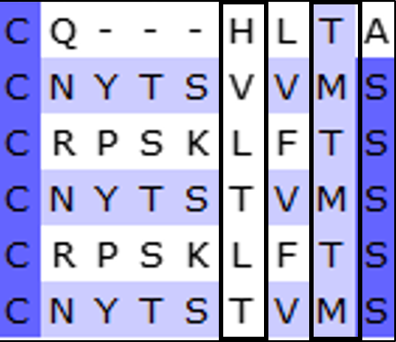
Adhesion GPCR F4 from Rhesus Macaque
HLS/T motif
*
Human AGRF3
Human AGRF4
A0A1D5QNK2_1
A0A1D5QNK2_2
F7ELW9_1
F7ELW9_2
*
Auto-proteolysed
Vizurraga, A. et al. (2020) J Biol Chem. 295: 14065-14083
Notes:
Left: the domains arrangement of adhesion proteins.
Right: sequence alignment of the GPS self-cleavage motifs in:
Human AGRF3 – adhesion GPCR known to be proteolysed.
Human AGRF4 – adhesion GPCR which is not proteolysed.
A0A1D5QNK2 and F7ELW9 – two multi-GPCRs from Macaca mulatta (in each, _1 is the 1st GPCR domain and _2 is the 2nd GPCR domain.
The first and second catalytic residues in each protein are marked by the rectangles. Adhesion GPCRs that self-proteolyzed contain a basic residue in the first positon of the motif and a polar residue in the last positon.

Slide 17
Summary and outlook
Many putative proteins with multi-GPCR domains
From fish to mammals
Up to monkeys
Annotated mostly as olfactory receptors; few chemokine receptors
None of them prevail, so probably not indispensable
What is their unique contribution?
What is their membrane topology?
Mechanisms?
Multi-barrel and multi-GPCR domains… What other multi-domain membrane proteins are there?

Slide 18






Acknowledgments
The Ben-Tal lab: https://www.bentalab.com/
University of Haifa
Rachel Kolodny
Kilicali Isildayancan
Amit Kessel
Ron Solan
Funding:

Slide 19
Notes:
Figure S3: (A) Distribution of sequence identify/similarity among the different GPCR domains within the same chain.
(B) Distribution of the number of residues in the linker regions between the different GPCR domains in the same chain.

Slide 20
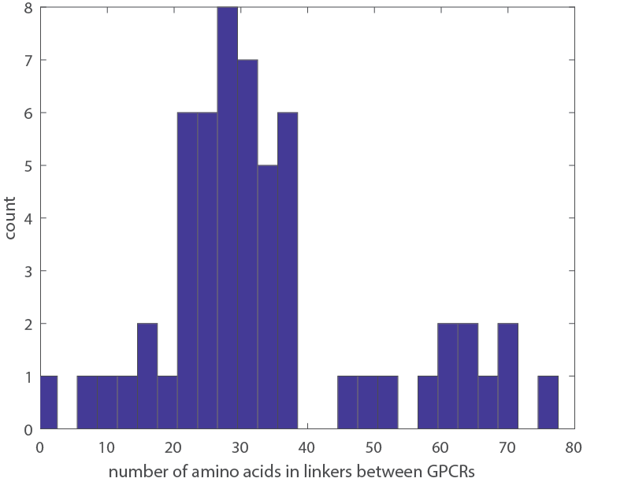
Distribution of the number of residues in the linker regions between the different GPCR domains in the same chain
Isildayancan, Kessel, Solan, Kolody, Ben-Tal. BioRxiv.
Notes:
Figure S3: (A) Distribution of sequence identify/similarity among the different GPCR domains within the same chain.
(B) Distribution of the number of residues in the linker regions between the different GPCR domains in the same chain.

Slide 21
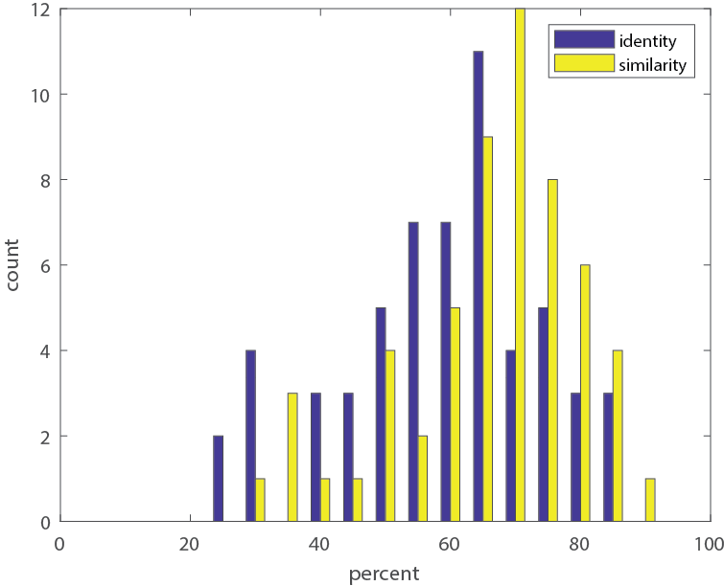
Distribution of sequence identify/similarity among the different GPCR domains within the same chain
Isildayancan, Kessel, Solan, Kolody, Ben-Tal. BioRxiv.
Notes:
Figure S3: (A) Distribution of sequence identify/similarity among the different GPCR domains within the same chain.
(B) Distribution of the number of residues in the linker regions between the different GPCR domains in the same chain.

