Slide 1
Proteins with multiple G protein-coupled receptor domains
Kılıçali Işıldayancan, Amit Kessel, Ron Solan
Tel Aviv University, Faculty of Life Sciences
Rachel Kolodny
University of Haifa, Department of Computer Science

Slide 2
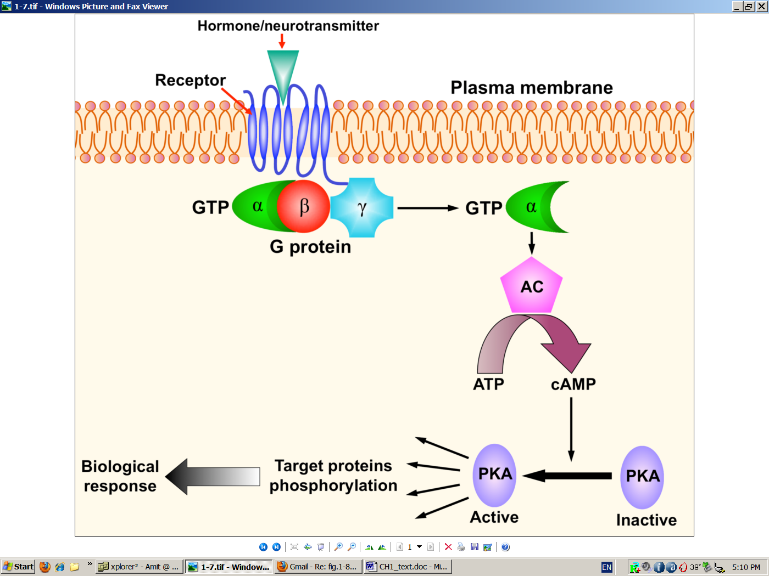
GPCR signaling
Kessel & Ben-Tal. Introduction to Proteins: Structure, Function, and Motion 2nd Edition (2018)
Notes:
Figure 7.31. The main players in a typical signal transduction cascade. (b) The cAMP-PKA cascade. Binding of an external chemical messenger (hormone, neurotransmitter, etc.) to a membrane-bound protein receptor induces the activation of an enzyme called a G-protein, which acts as a transducer. The activation of the G-protein leads to the activation of adenylyl cyclase (AC), which catalyzes the conversion of ATP into cyclic AMP. The latter acts as an intracellular messenger. It binds to and activates the enzyme amplifier PKA, which, in turn, phosphorylates a large set of cytoplasmic proteins. The phosphorylated proteins may activate other cellular components, or perform a certain function (that is, they may act as sensors and/or effectors). In any case, this signal transduction eventually leads to changes in the cell's behavior, i.e., to a biological response.

Slide 3
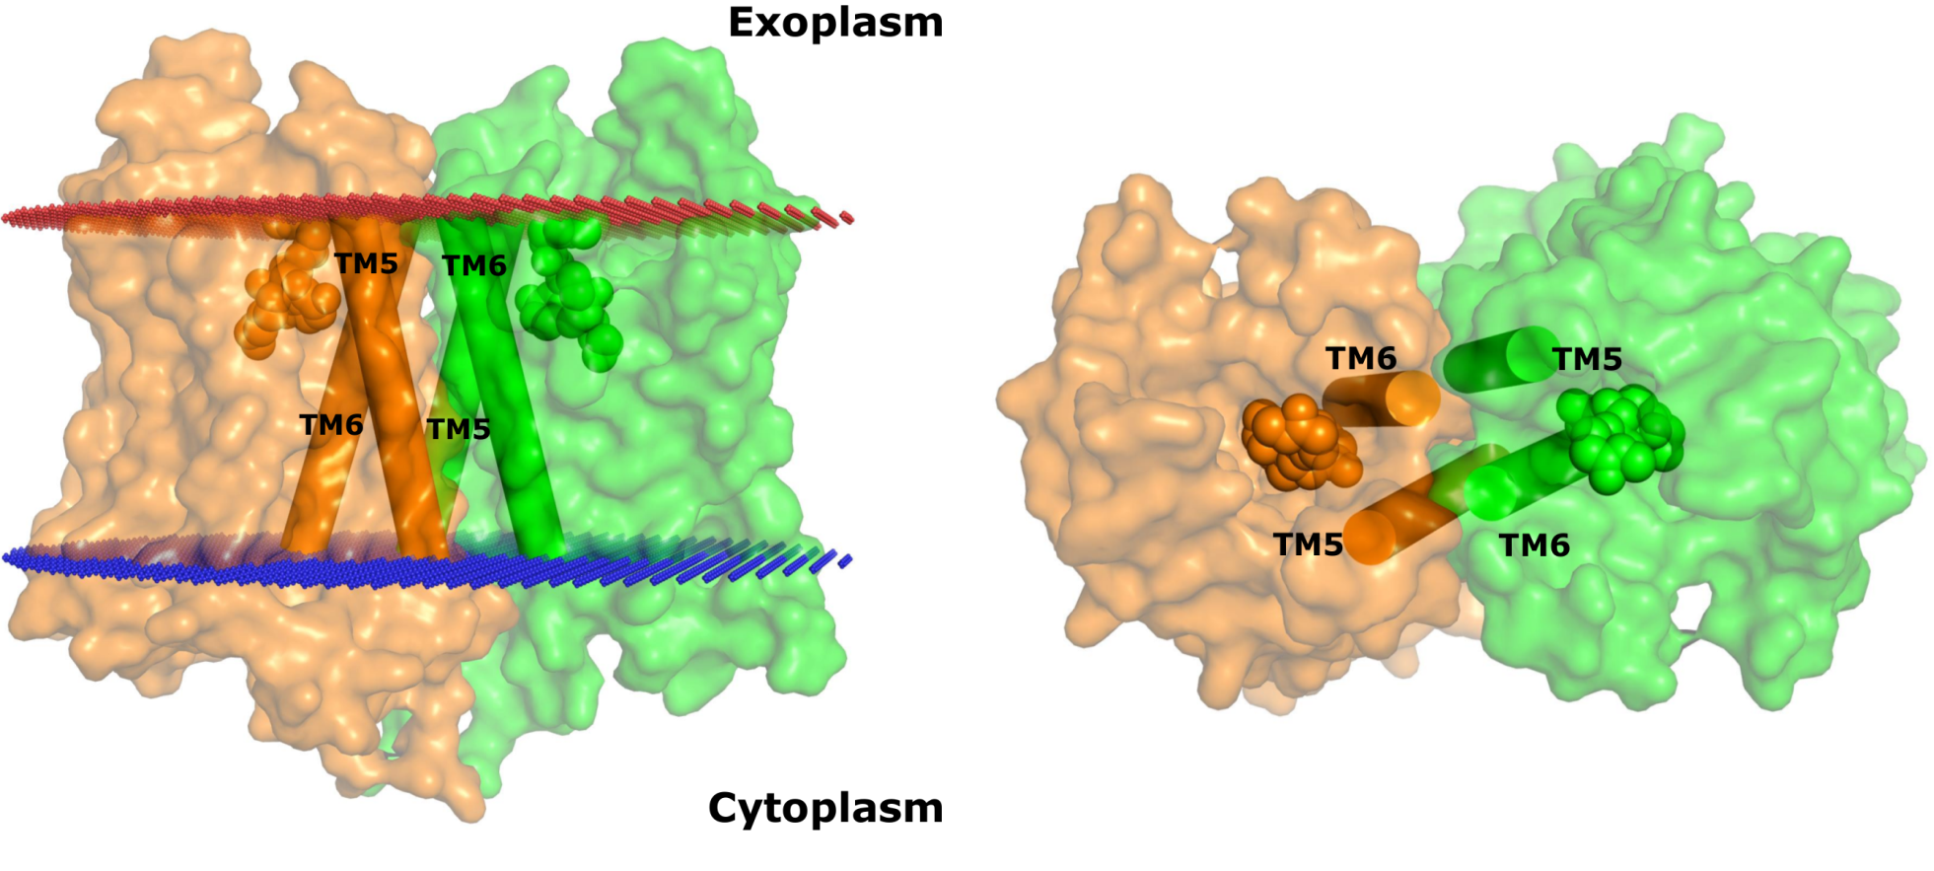
Many GPCRs form homo- or hetero-dimers
Class A – mostly regulation (cooperativity, crosstalk)
Class C – each chain may have different roles
μ-opioid receptor:
Kessel & Ben-Tal. Introduction to Proteins: Structure, Function, and Motion 2nd Edition (2018)
Notes:
Another feature that may be different between the classes is the effect of dimerization/oligomerization: in class A GPCRs both monomeric and homo-dimeric (or oligomeric) forms are active, and the role of dimerization/oligomerization is mostly regulatory (cooperativity, crosstalk).
In class C GPCRs only the hetero-dimer is active, and each chain may have a different role. For example, in the GABA_{B} receptor one polypeptide chain binds the ligand whereas the other binds the G-protein ^{[393]}, and is also needed for bringing the entire receptor to the cell surface.
Figure 7.35. A two-fold symmetric dimer formed by the μ-opioid receptor. The receptor (PDB entry 4dkl) is shown in a surface representation from the side (a) and top (extracellular) (b). Each monomer is colored differently. The two bound ligands (one in each monomer) are shown as spheres. The red and blue lines mark the predicted boundaries of the membrane (the OPM database [135]). The dimerization is mediated by a four-helix bundle motif, formed by TM5 and TM6 (shown as cylinders). On their opposite side TMs 5 and 6 line the ligand-binding sites, which may be related to the role of dimerization in regulating receptor activity.

Slide 4
Many GPCRs form homo- or hetero-dimers
Are there receptors with two-GPCR domains within the same protein chain?
Kessel & Ben-Tal. Introduction to Proteins: Structure, Function, and Motion 2nd Edition (2018)
Notes:
Another feature that may be different between the classes is the effect of dimerization/oligomerization: in class A GPCRs both monomeric and homo-dimeric (or oligomeric) forms are active, and the role of dimerization/oligomerization is mostly regulatory (cooperativity, crosstalk).
In class C GPCRs only the hetero-dimer is active, and each chain may have a different role. For example, in the GABA_{B} receptor one polypeptide chain binds the ligand whereas the other binds the G-protein ^{[393]}, and is also needed for bringing the entire receptor to the cell surface.
Figure 7.35. A two-fold symmetric dimer formed by the μ-opioid receptor. The receptor (PDB entry 4dkl) is shown in a surface representation from the side (a) and top (extracellular) (b). Each monomer is colored differently. The two bound ligands (one in each monomer) are shown as spheres. The red and blue lines mark the predicted boundaries of the membrane (the OPM database [135]). The dimerization is mediated by a four-helix bundle motif, formed by TM5 and TM6 (shown as cylinders). On their opposite side TMs 5 and 6 line the ligand-binding sites, which may be related to the role of dimerization in regulating receptor activity.

Slide 5
Finding proteins with multi-GPCR domains
Constructed HMMER profiles for all 92 GPCR domains in the (99% NR) ECOD database
Searched UniRef90 for proteins with non-overlapping multiple GPCR domains
Clustered the hits using CD-HIT: found 1395 clusters
Selected the 16 clusters with >5 hits and identical number of domains: 57 proteins in total
Mapped them to representative genomes
Isildayancan, Kessel, Solan, Kolody, Ben-Tal. BioRxiv.

Slide 6
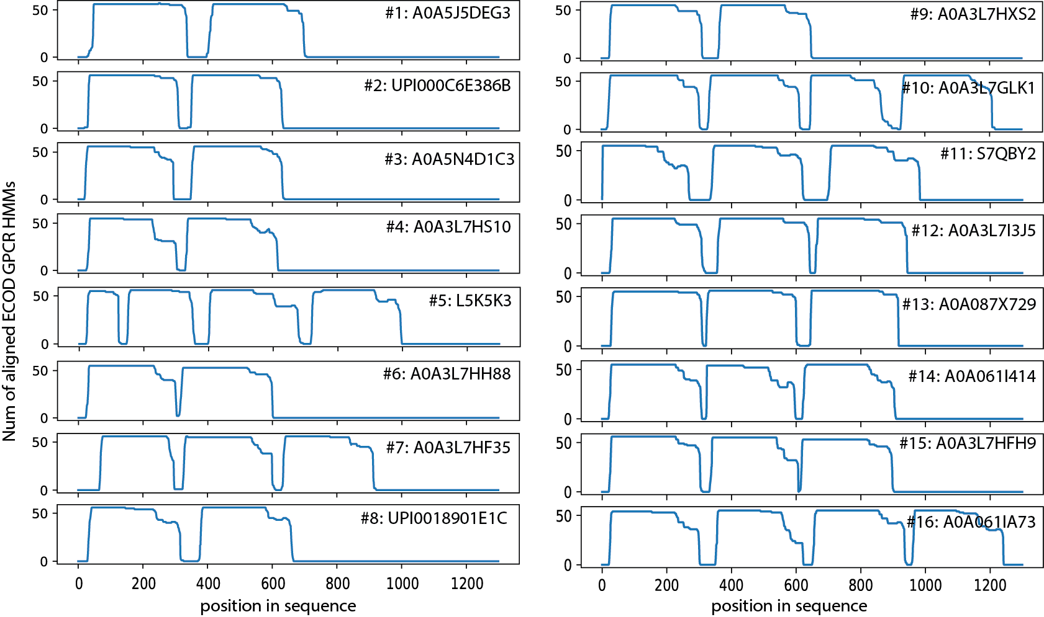
The number of ECOD GPCR HMMs aligned to each position in the sixteen clusters
Isildayancan, Kessel, Solan, Kolody, Ben-Tal. BioRxiv.
Notes:
Figure S1: The number of ECOD GPCR HMMs aligned to each position in sixteen representatives of clusters with multi-GPCRs. In each one, we can see stretches that are longer than 200 residues with multiple matches. For each panel, the number of cluster and the representative protein is listed. In each one we see multiple stretches that are candidates for GPCR segments. Notice that in some of these proteins there are long stretches that are shorter than a full GPCR (e.g., in cluster #5), as described in the text.

Slide 7
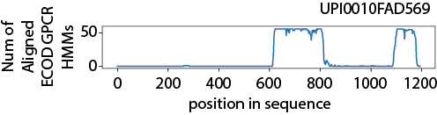
UPI0010FAD569 was filtered out because it has only one full GPCR domain
Isildayancan, Kessel, Solan, Kolody, Ben-Tal. BioRxiv.
Notes:
Figure S2: The sequence UPI0010FAD569 was filtered out because there was only a single sufficiently-long segment along the sequence that matches to the ECOD GPCR HMMs (between residues 610-837). The stretch between residues 1086-1184 is not long enough. Thus, we removed this sequence, and 33 additional (shorter) sequences that were in its CD-HIT cluster.

Slide 8
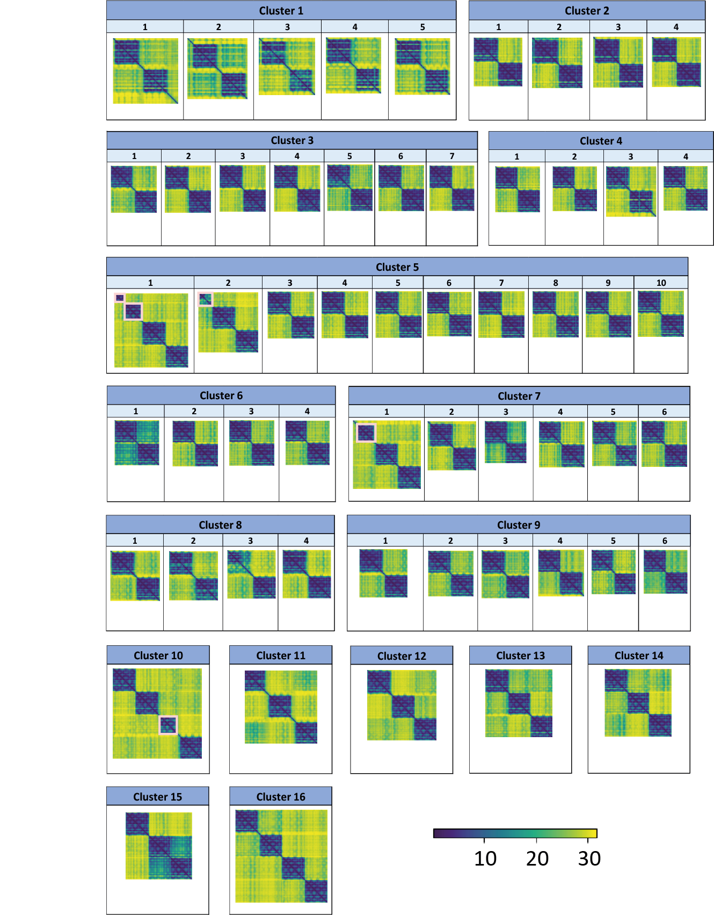
AlphaFold predicted pairwise aligned errors for the 57 multi-GPCR proteins
Isildayancan, Kessel, Solan, Kolody, Ben-Tal. BioRxiv.
Notes:
Figure 1: AlphaFold predicted aligned errors for the 57 multi-GPCR proteins. The estimated accuracy of the relative positions of the predicted structures are shown as colormaps of the n×n matrix of predicted aligned errors. For each protein of n residues, the color at (x, y) indicates AlphaFold’s expected position error at residue x if the predicted and true structures were aligned on residue y. AlphaFold assigns high confidence to relative amino acid positions within the individual GPCR domains (blue shades), and low confidence to the relative orientation of the domains with respect to each other (yellow shades). The colormaps are grouped by their clusters. The pink rectangles mark the four cases (first two multi-GPCRs in cluster #5, first multi-GPCR in cluster #7, and first multi-GPCR in cluster #10) with segments that have fewer than seven helices.

Slide 9
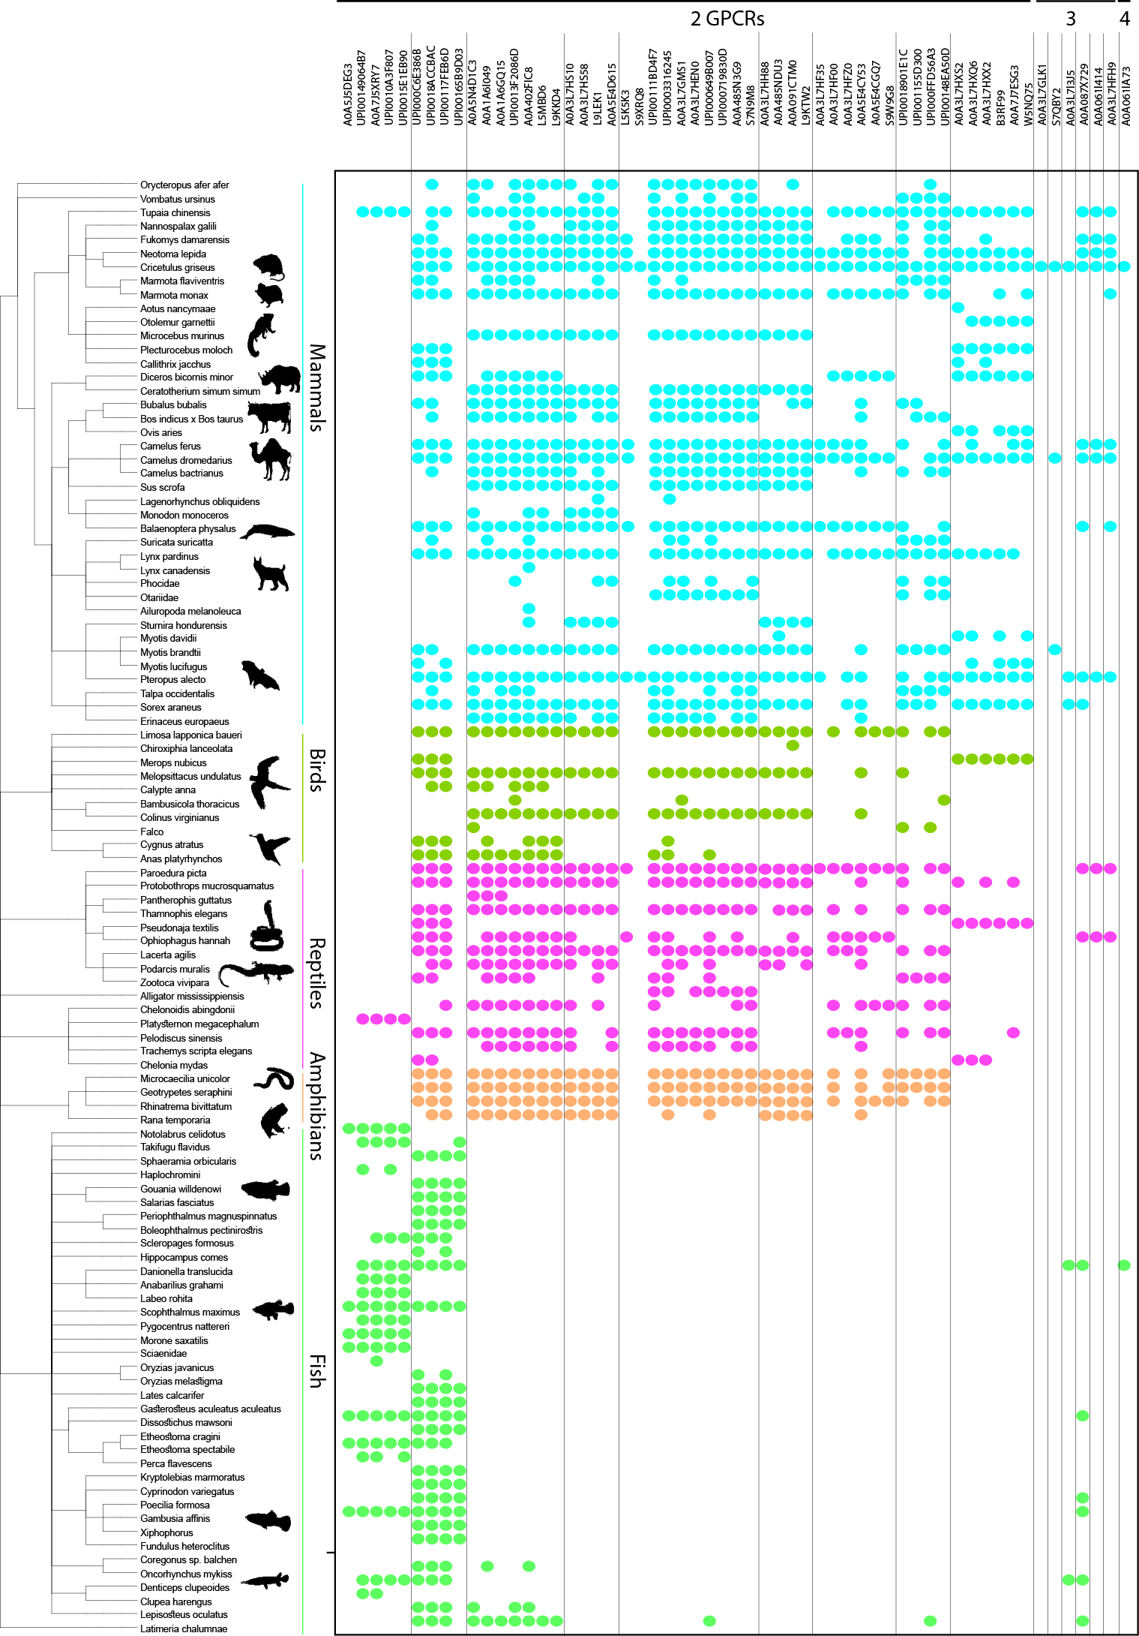
Tree of life distribution of homologues of the 57 multi-GPCR proteins
Single-domain GPCRs are broadly distributed in eukaryotes: primitive yeast and choanoflagellate → animals, but multi-GPCRs only in Chordata species
Multi-GPCR domains are only homologous to muscarinic acetylcholine receptor M3, adenosine receptor, rhodopsin, and orexin receptor type 2/ chemokine receptor type 4.
By homology, most are olfactory receptors, and some are chemokine receptors
Isildayancan, Kessel, Solan, Kolody, Ben-Tal. BioRxiv.
Notes:
Figure 2: Tree of life distribution of homologues of the 57 multi-GPCR proteins. The proteins are plotted along the x-axis (first two-GPCR domains, then three-GPCR domains, then the four-GPCR domains), ordered as in Table 1. Vertical lines indicate cluster boundaries. Homologues were identified in 106 species, and are shown as leaves of a phylogenetic tree along the y-axis. Colored dots mark the species found with a homologue of a protein: cyan for mammals, green for birds, pink for reptiles, orange for amphibians, and light green for fish.
Cluster 1: Based on these, almost all the multi-GPCR proteins for which we found a functional annotation are olfactory receptors. The only exceptions are the chemokine receptors of cluster #1, which are almost entirely restricted to fish.

Slide 10
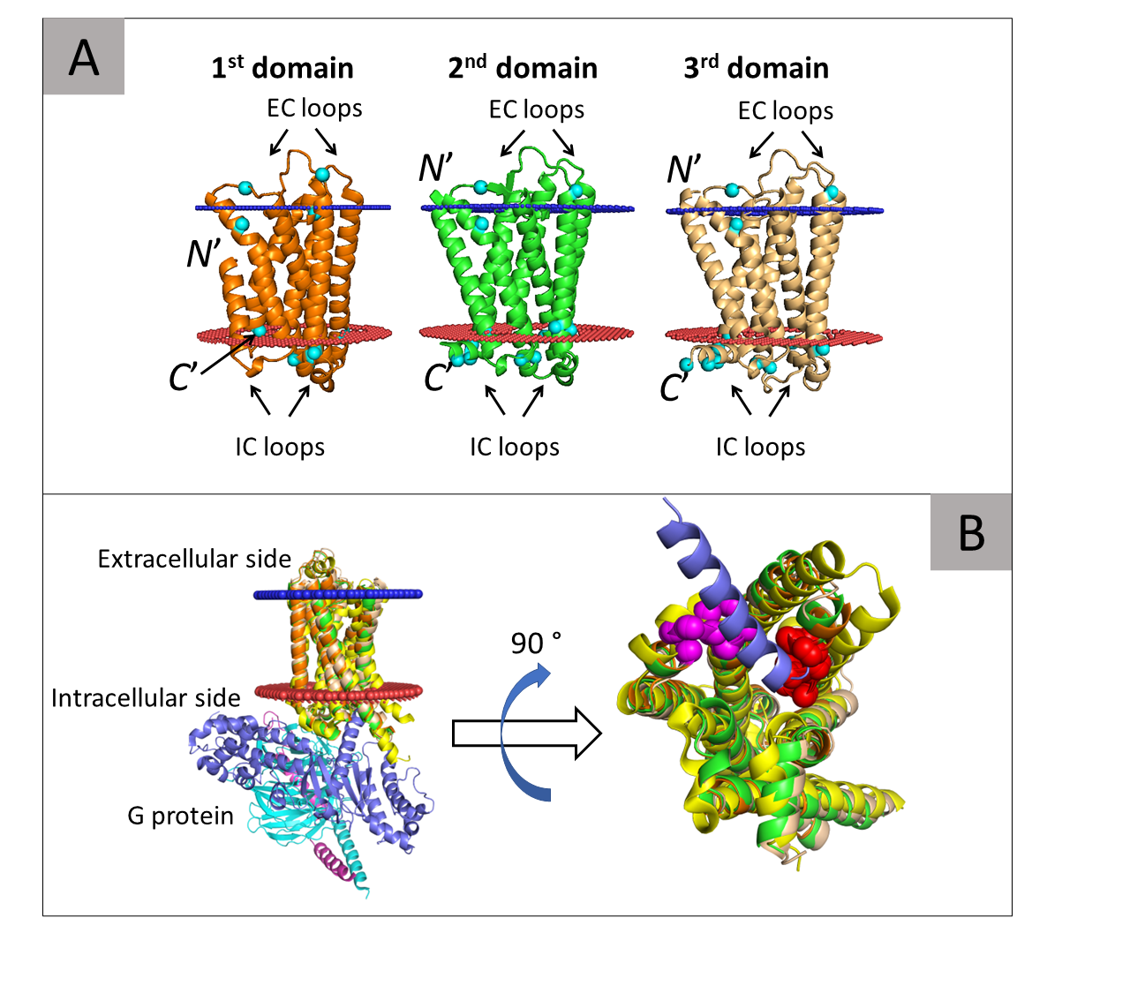
AlphaFold model of tri-GPCR-domain S7QBY2
The β₂-AR receptor (yellow) in complex with G protein.
α (blue), β (cyan), and γ (magenta)
The VAICxPLxY (pink) and KAFSTCASH (red) motifs
Isildayancan, Kessel, Solan, Kolody, Ben-Tal. BioRxiv.
Notes:
molecular switches and locks motifs
Figure 4: Predicted structure of three-GPCR-domain S7QBY2 (from bat). (A) Predicted model with the first, second, and third successive GPCR domains of the protein colored orange, green, and wheat, respectively. The inferred extracellular and intracellular membrane boundaries are also shown (calculated by the OPM web server[36]), as blue and red spheres, respectively. The membrane topologies of the domains are shown by noting their N- and C-termini and the intracellular (IC) and extracellular (CE) loops. The arginine and lysine residues (cyan spheres) are asymmetrically distributed in keeping with the positive-inside rule [29]. (B) Left: Side view of the structure with the three GPCR domains superimposed onto the structure of the G protein-bound (activated) β2-adrenergic receptor (β₂-AR, PDB ID: 3sn6). The β₂-AR receptor is colored yellow and the α, β, and γ subunits of the G protein are colored blue, cyan, and magenta. Right: An enlarged view of the G protein-binding site. The β₂-AR and superimposed domains of S7QBY2 are rotated 90° to show the binding site. For clarity, only the α5 helix of the G protein is shown; this region directly interacts with the GPCR. The image clearly shows that all three domains of S7QBY2 contain a cavity that corresponds to the G protein-binding site of the β₂-AR. Moreover, all domains contain the VAICxPLxY and KAFSTCASH motifs (pink and red spheres, respectively), which directly interact with the α5 helix of the G protein.

Slide 11
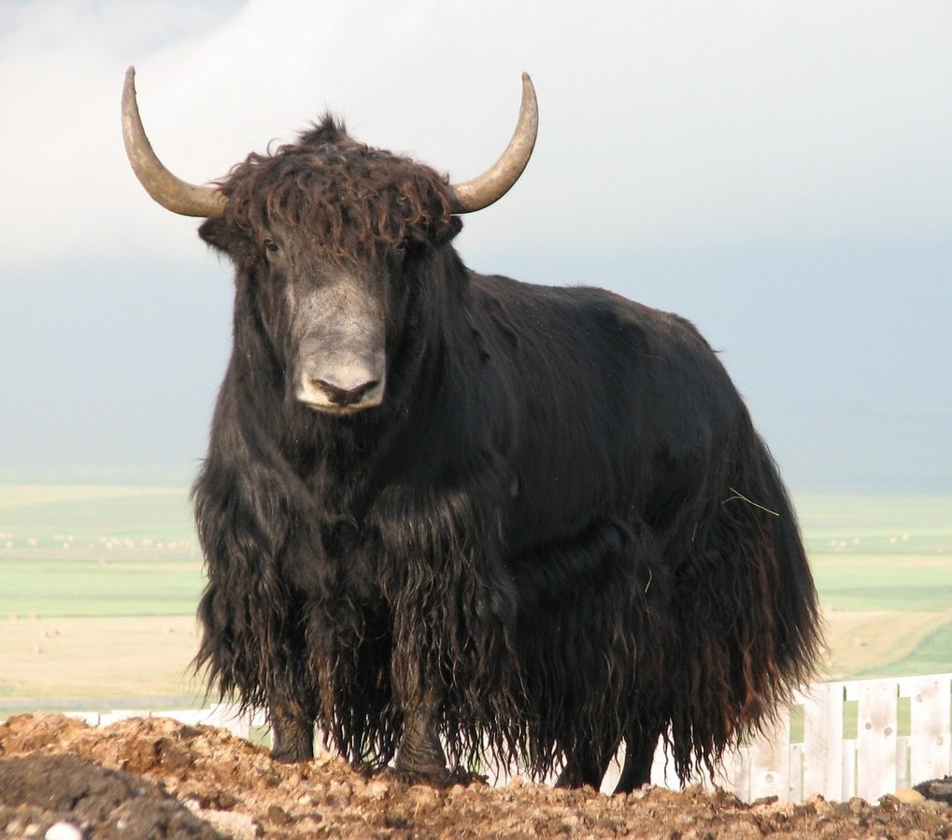
The A0A6B0S3N8 bi-GPCR from Bos mutus (Wild Yak): A chemokine receptor?
N-term domain is closest to C-C Chemokine Receptor 2: 84% seq identity, 100% coverage
C-term domain is closest to C-C Chemokine Receptor 5: 99.6% seq identity, 100% coverage
Notes:
–best homology–
Homology was detected using PSI-Blast from NCBI.
First domain: CCR2 from Macaca mulatta with 84% identity and 100% coverage.
Second domain: CCR5 from Bos taurus with 99.6% identity and 100% coverage.
Note: first domain also has high-scoring homologies with CCR5 receptors, they seem to be relatively similar to each other.

Slide 12
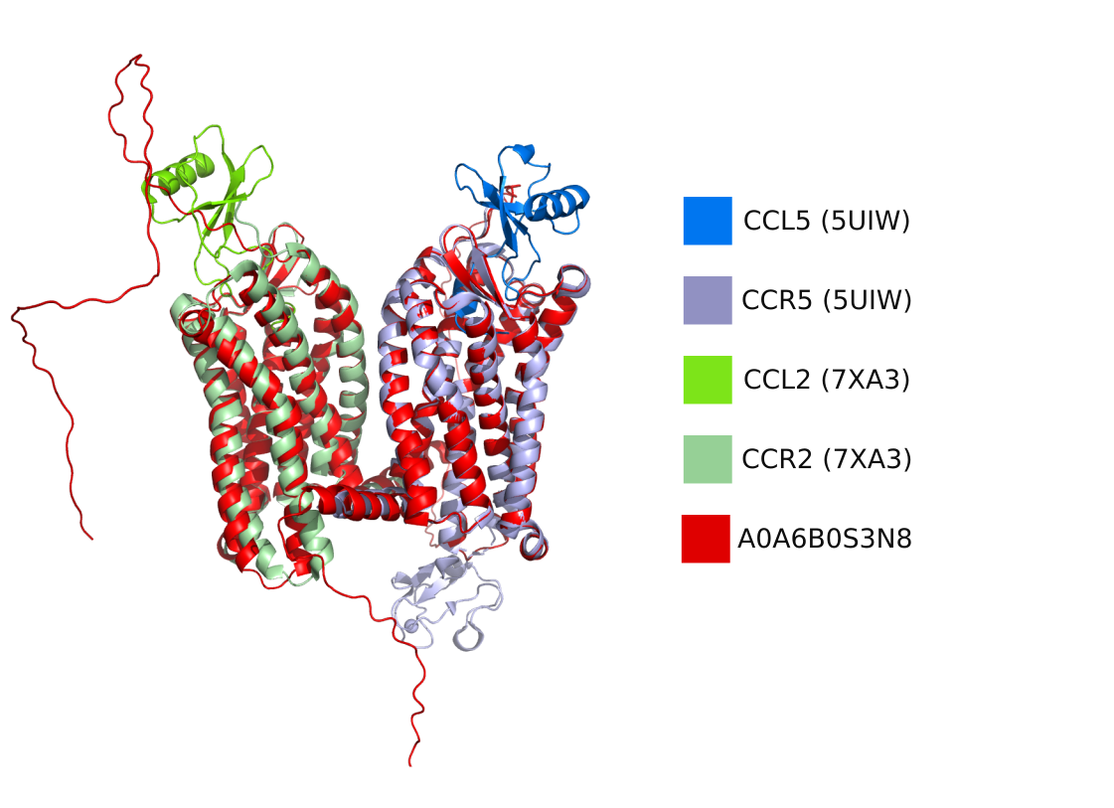
Tentative complex of A0A6B0S3N8 with chemokine ligands
Superimposition of the AlphaFold model of A0A6B0S3N8 and two PDB structures: CCR2-CCL2 (7XA3; RMSD=1.4 Å) and CCR5-CCL5 (5UIW, RMSD=0.5 Å) complexes
Notes:
The structure is predicted by AlphaFold2, which is depicted in red. PDB structures with their bound native ligands of the best homologues (CCR2 (7XA3) and CCR5 (5UIW) respectively). The ligands were docked by superimposing the PDB receptor with the mGPCR receptor domains. RMSD’s between receptors, and AF2 predicted structures:
CCR2 – first domain: 1.391
CCR5 – second domain: 0.506

Slide 13
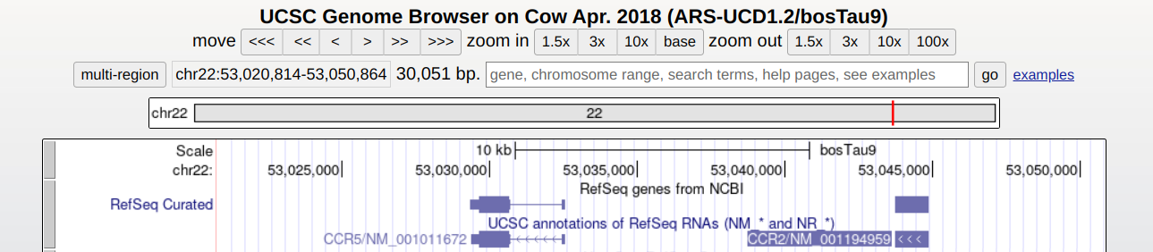
The two chemokine receptors are near one another in the Cow genome
~10k bp distance
Notes:
This is the view of the cow genome (chromosome 22) where the two chemokine receptors are located.
This presents a few possibilities:
There is also alternative splicing that might produce this di-chemokine GPCR in cows as well.
These two genes somehow evolved elsewhere to be multi-GPCRs (i.e. not present in cows but in wild yak)
There is misannotation in the multi-GPCR that we found, probably due to them being this close in the genome.
There is another unknown reason for them to be together in the genome across multiple species

Slide 14
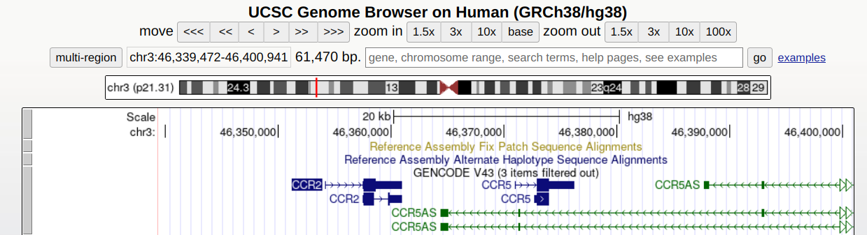
The two chemokine receptors are near one another in the Human genome
~10k bp distance
Notes:
This is the view of the human genome (this time chromosome 3) where the two chemokine receptors are located.
This presents the same possibilities mentioned in the slide before.

Slide 15
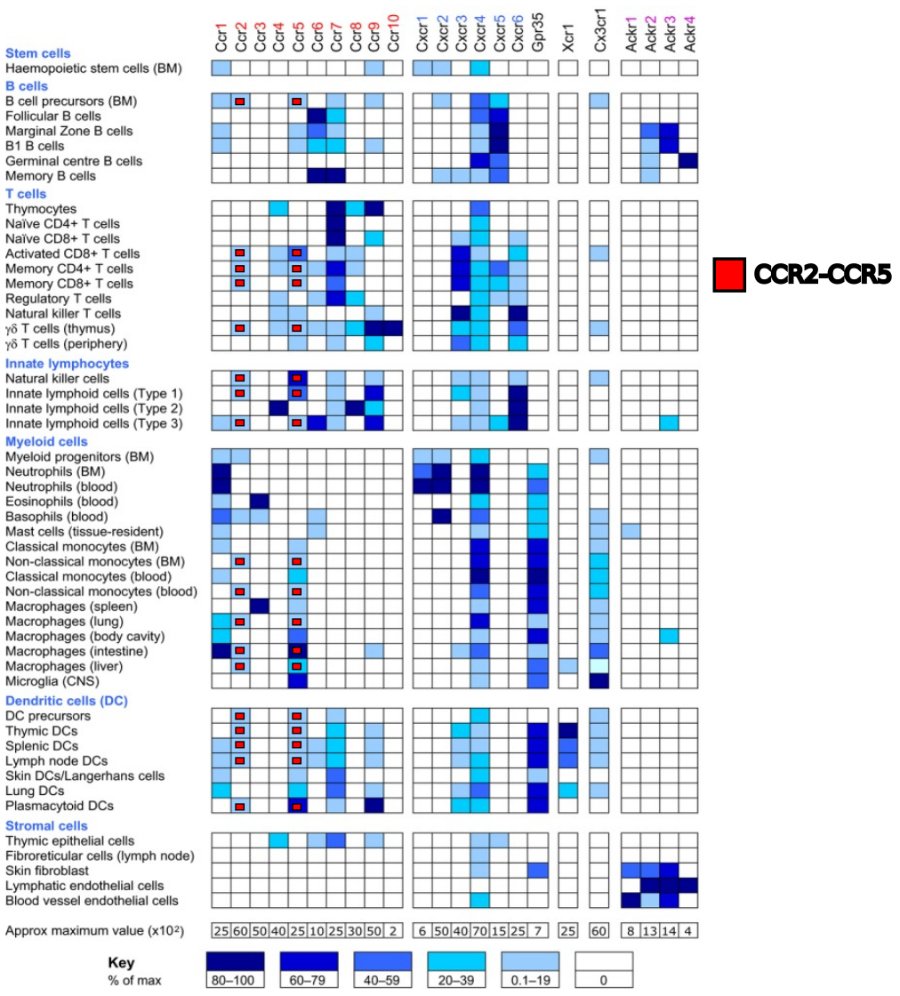
CCR2 and CCR5 co-express in the human immune system
Adapted from Hughes CE, Nibbs RJB. A guide to chemokines and their receptors. FEBS J. 2018 Aug;285(16):2944-2971.
Notes:
Coming from the argumentation from the genomes: that the two chemokine receptor genes are “too close” to be always separate, these are the tissue expressions of the chemokine receptors. The authors that made the original figure used transcript data from https://www.immgen.org/, and made this figure. The chemokine receptors that are close together and express in the same tissue are noted in different colors.
On the y-axis, there are different immune-related cell types (e.g. B cell precursors, T cells, etc.). On the x-axis there are the different chemokine receptors. White means not expressed (or not detected in this analysis), and darker blues mean more expression. Some of them are marked with red, green, or magenta. These are the ones where chemokine receptors are simultaneously expressed and are proximal in the genome. I believe that if we are to find bi-chemokine receptors, these tissues are the ones to look at where alternative splicing is a good possibility for the production of multi-GPCRs.

Slide 16
But proper GPCR function requires an N-terminal out topology…
As in homo- or hetero-dimers
Kessel & Ben-Tal. Introduction to Proteins: Structure, Function, and Motion 2nd Edition (2018)
Notes:
Another feature that may be different between the classes is the effect of dimerization/oligomerization: in class A GPCRs both monomeric and homo-dimeric (or oligomeric) forms are active, and the role of dimerization/oligomerization is mostly regulatory (cooperativity, crosstalk).
In class C GPCRs only the hetero-dimer is active, and each chain may have a different role. For example, in the GABA_{B} receptor one polypeptide chain binds the ligand whereas the other binds the G-protein ^{[393]}, and is also needed for bringing the entire receptor to the cell surface.
Figure 7.35. A two-fold symmetric dimer formed by the μ-opioid receptor. The receptor (PDB entry 4dkl) is shown in a surface representation from the side (a) and top (extracellular) (b). Each monomer is colored differently. The two bound ligands (one in each monomer) are shown as spheres. The red and blue lines mark the predicted boundaries of the membrane (the OPM database [135]). The dimerization is mediated by a four-helix bundle motif, formed by TM5 and TM6 (shown as cylinders). On their opposite side TMs 5 and 6 line the ligand-binding sites, which may be related to the role of dimerization in regulating receptor activity.

Slide 17
Membrane topology and the positive-inside rule
K, R
The β₂-AR receptor (yellow) in complex with G protein.
α (blue), β (cyan), and γ (magenta)
The VAICxPLxY (pink) and KAFSTCASH (red) motifs
Isildayancan, Kessel, Solan, Kolody, Ben-Tal. BioRxiv.
Notes:
molecular switches and locks motifs
Figure 4: Predicted structure of three-GPCR-domain S7QBY2 (from bat). (A) Predicted model with the first, second, and third successive GPCR domains of the protein colored orange, green, and wheat, respectively. The inferred extracellular and intracellular membrane boundaries are also shown (calculated by the OPM web server[36]), as blue and red spheres, respectively. The membrane topologies of the domains are shown by noting their N- and C-termini and the intracellular (IC) and extracellular (CE) loops. The arginine and lysine residues (cyan spheres) are asymmetrically distributed in keeping with the positive-inside rule [29]. (B) Left: Side view of the structure with the three GPCR domains superimposed onto the structure of the G protein-bound (activated) β2-adrenergic receptor (β₂-AR, PDB ID: 3sn6). The β₂-AR receptor is colored yellow and the α, β, and γ subunits of the G protein are colored blue, cyan, and magenta. Right: An enlarged view of the G protein-binding site. The β₂-AR and superimposed domains of S7QBY2 are rotated 90° to show the binding site. For clarity, only the α5 helix of the G protein is shown; this region directly interacts with the GPCR. The image clearly shows that all three domains of S7QBY2 contain a cavity that corresponds to the G protein-binding site of the β₂-AR. Moreover, all domains contain the VAICxPLxY and KAFSTCASH motifs (pink and red spheres, respectively), which directly interact with the α5 helix of the G protein.

Slide 18
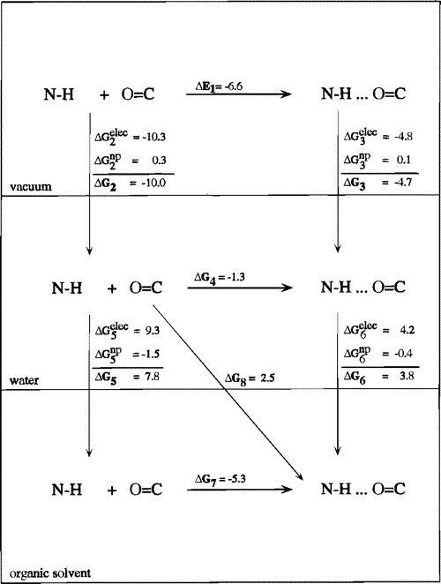
Unsatisfied backbone hydrogen bonds in the membrane are energetically costly
The linkers connecting the GPCR domains should be hydrophobic TM helices
But most linkers are not sufficiently long and hydrophobic…
Ben-Tal, Sitkoff, Topol, Yang, Burt, Honig (1997) J Phys Chem B

Slide 19
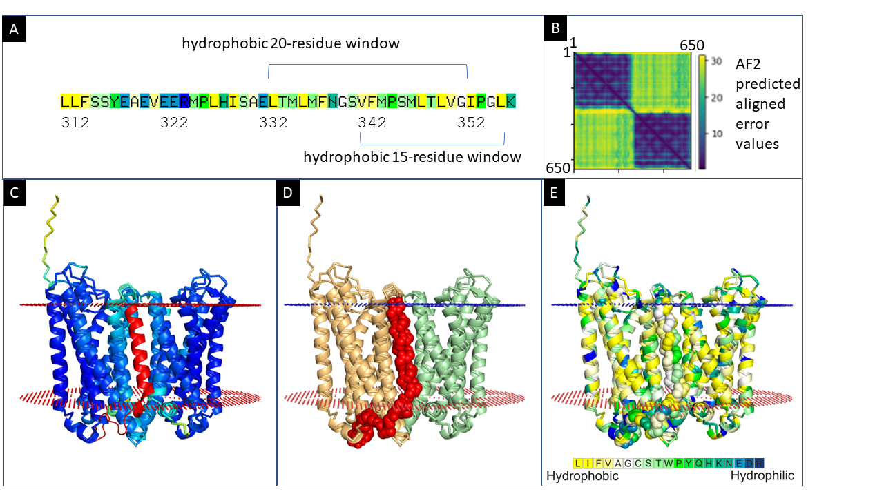
Predicted structure of two-GPCR-domain A0A3L7HXX2 (from rodent)
Isildayancan, Kessel, Solan, Kolody, Ben-Tal. BioRxiv.
Notes:
Figure 3: Predicted structure of two-GPCR-domain A0A3L7HXX2. (A) Kessel & Ben-Tal scale hydrophobicity scores of the linker region. The most hydrophobic 20-residue and 15-residue windows within the linker are indicated. (B) Heatmap visualization of the predicted errors in the pairwise positioning of the residues in A0A3L7HXX2 in the structure predicted by AlphaFold. The positioning of residues within each of the GPCR domains is predicted to be accurate, whereas the relative positioning of the two domains and the linker structure are not. (C) The most confident model (pTM 81.5) from AlphaFold, colored by the pLDDT confidence measure with the linker, residues 312-358 (red), modeled manually. The first 20 positions of the linker, which contain many polar and charged amino acids, are organized as a random coil mostly outside the membrane, and the remaining mostly hydrophobic 25 amino acids form an alpha-helix that crosses the membrane, placing both GPCRs in the same orientation. The extracellular (small blue spheres) and intracellular (small red spheres) boundaries of the membrane are also shown (predicted by the OPM web server). (D) Model as in panel C with the two GPCR domains colored wheat and pale green and the linker region colored red with atoms shown as spheres. (E) Model as in panel C with the structure colored by the Kessel & Ben-Tal hydrophobicity scale scores.

Slide 20
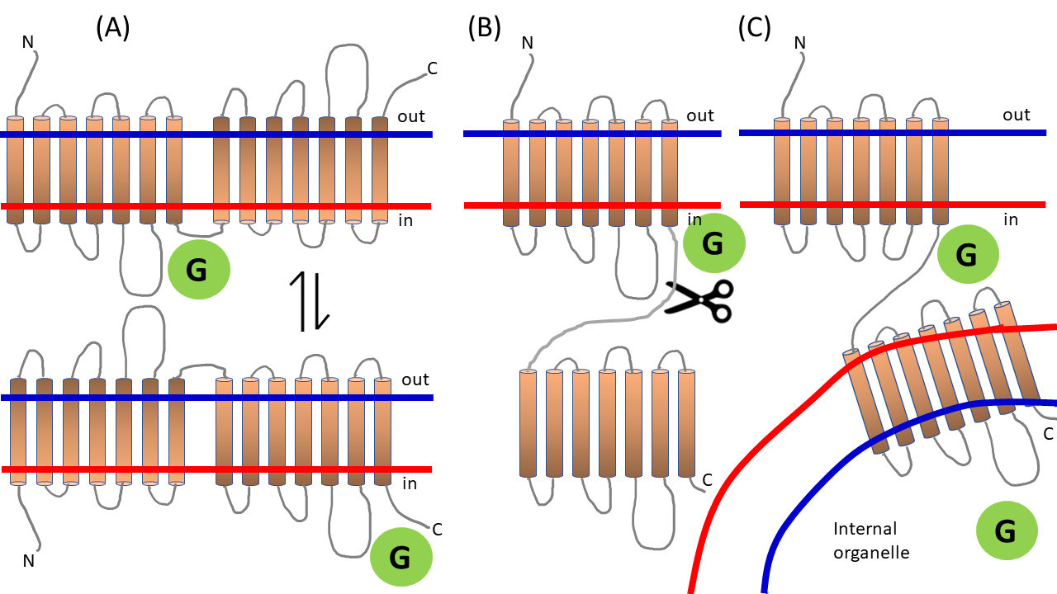
Speculative scenarios for a two-GPCR protein with a linker that is too polar to cross the membrane
Isildayancan, Kessel, Solan, Kolody, Ben-Tal. BioRxiv.
Notes:
Figure 5: Speculative scenarios for a two-GPCR protein with a linker that is too polar to cross the membrane. (A, top) The first 7TM GPCR domain has its N terminus on the outer side, in the conventional membrane topology. We indicated the correct orientation with the color gradient. The second 7TM GPCR domain, on the other hand, is oriented in the opposite direction. Here, only the first domain is functional, and if the orientation of the protein in the membrane is reversed (A, bottom), only the second domain would be functional. (B) A (yet to be discovered) enzyme may cleave the chain. (C) The first 7TM GPCR domain may be oriented properly in the membrane, while the second is in the membrane of a nearby internal organelle.

Slide 21
Summary and outlook
Many putative proteins with multi-GPCR domains
From fish to mammals
Up to monkeys
Annotated mostly as olfactory receptors; few chemokine receptors
None of them prevail, so probably not indispensable
What is their unique contribution?
What is their membrane topology?
Mechanisms?
Fragmented GPCR domains?
Multi-barrel and multi-GPCR domains… What other multi-domain membrane proteins are there?

Slide 22






Acknowledgments
The Ben-Tal lab: https://www.bentalab.com/
University of Haifa
Rachel Kolodny
Kilicali Isildayancan
Amit Kessel
Ron Solan
Funding:

Slide 23
Notes:
Figure S3: (A) Distribution of sequence identify/similarity among the different GPCR domains within the same chain.
(B) Distribution of the number of residues in the linker regions between the different GPCR domains in the same chain.

Slide 24
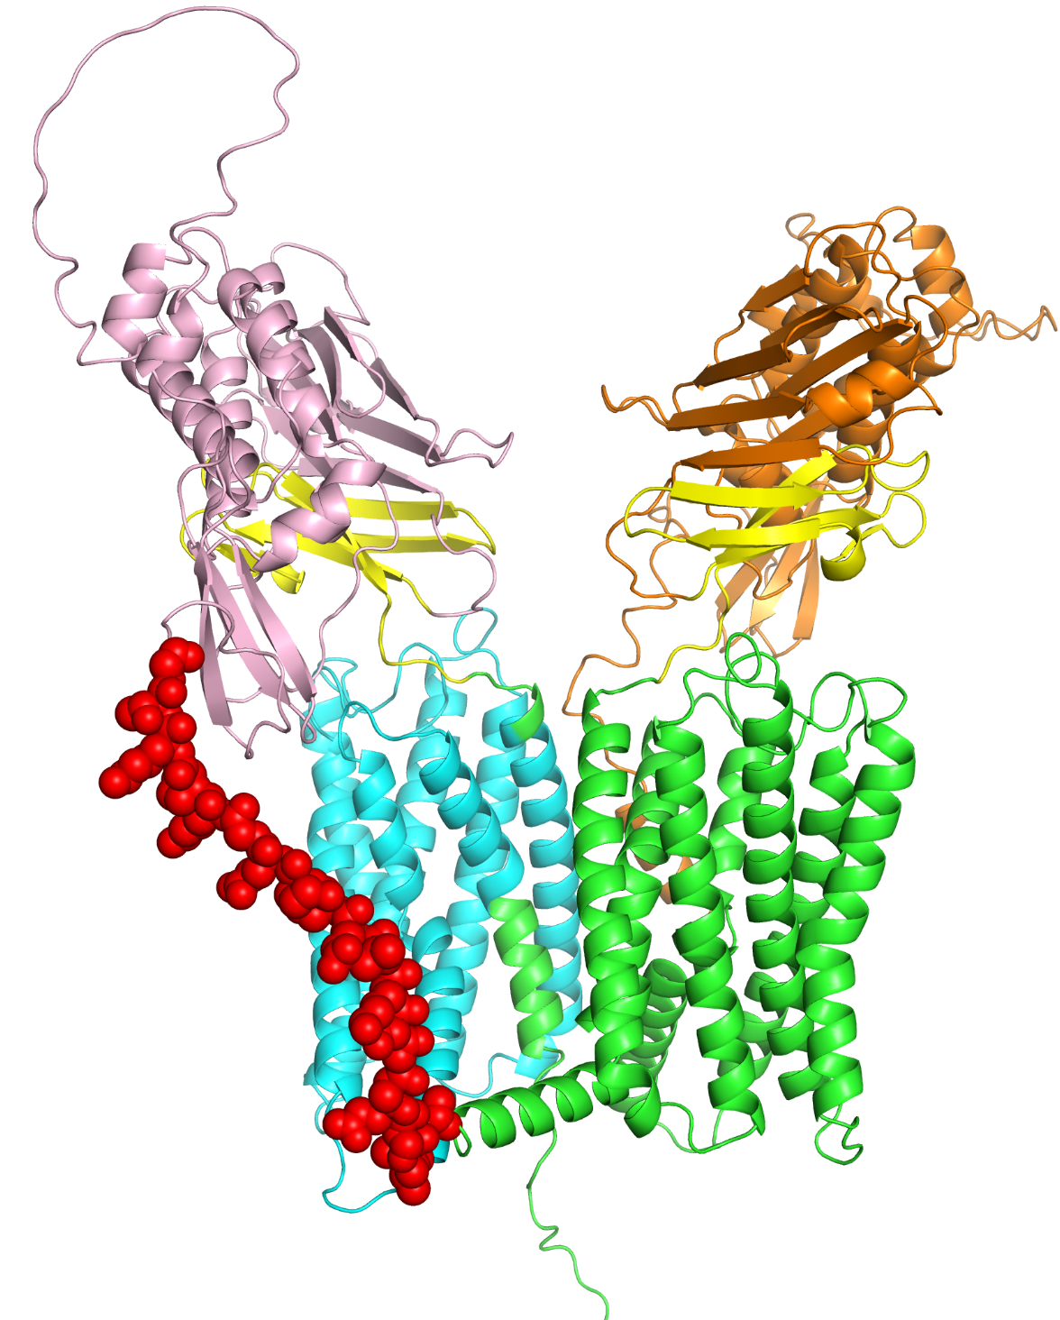
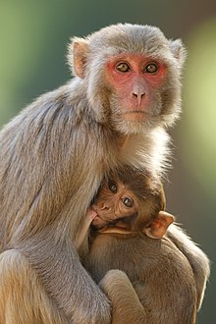
Adhesion GPCR F4 from Rhesus Macaque
Gene: ADGRF4
UniProt: A0A1D5QNK2
EC domain 1
EC domain 2
GPS domain 2
GPS domain 1
TM domain 2
TM domain 1
Linker
Notes:
The two GPS domains (yellow) separate between the extracellular (orange and pink) and GPCR (green and cyan) domains. The linker is shown as red spheres.
Adhesion G protein-coupled receptors (adhesion GPCRs) are a class of 33 human protein receptors with a broad distribution in embryonic and larval cells, cells of the reproductive tract, neurons, leukocytes, and a variety of tumours.^{[1]} Adhesion GPCRs are found throughout metazoans and are also found in single-celled colony forming choanoflagellates such as Monosiga brevicollis and unicellular organisms such as Filasterea. The defining feature of adhesion GPCRs that distinguishes them from other GPCRs is their hybrid molecular structure. The extracellular region of adhesion GPCRs can be exceptionally long and contain a variety of structural domains that are known for the ability to facilitate cell and matrix interactions. Their extracellular region contains the membrane proximal GAIN (GPCR-Autoproteolsis INducing) domain. Crystallographic and experimental data has shown this structurally conserved domain to mediate autocatalytic processing at a GPCR-proteolytic site (GPS) proximal to the first transmembrane helix. Autocatalytic processing gives rise to an extracellular (α) and a membrane-spanning (β) subunit, which are associated non-covalently, resulting in expression of a heterodimeric receptor at the cell surface.^{[2][3]} Ligand profiles and in vitro studies have indicated a role for adhesion GPCRs in cell adhesion and migration.^{[4]} Work utilizing genetic models confined this concept by demonstrating that the primary function of adhesion GPCRs may relate to the proper positioning of cells in a variety of organ systems. Moreover, growing evidence implies a role of adhesion GPCRs in tumour cell metastasis.^{[5]} Formal G protein-coupled signalling has been demonstrated for a number for adhesion GPCRs,^{[6][7]} however, the orphan receptor status of many of the receptors still hampers full characterisation of potential signal transduction pathways. In 2011, the adhesion GPCR consortium was established to facilitate research of the physiological and pathological functions of adhesion GPCRs.

Slide 25
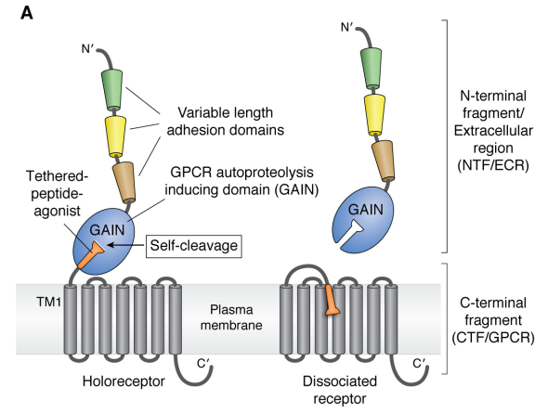
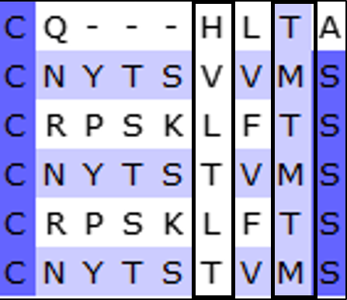
Adhesion GPCR F4 from Rhesus Macaque
HLS/T motif
*
Human AGRF3
Human AGRF4
A0A1D5QNK2_1
A0A1D5QNK2_2
F7ELW9_1
F7ELW9_2
*
Auto-proteolysed
Vizurraga, A. et al. (2020) J Biol Chem. 295: 14065-14083
Notes:
Left: the domains arrangement of adhesion proteins.
Right: sequence alignment of the GPS self-cleavage motifs in:
Human AGRF3 – adhesion GPCR known to be proteolysed.
Human AGRF4 – adhesion GPCR which is not proteolysed.
A0A1D5QNK2 and F7ELW9 – two multi-GPCRs from Macaca mulatta (in each, _1 is the 1st GPCR domain and _2 is the 2nd GPCR domain.
The first and second catalytic residues in each protein are marked by the rectangles. Adhesion GPCRs that self-proteolyzed contain a basic residue in the first positon of the motif and a polar residue in the last positon.

Slide 26
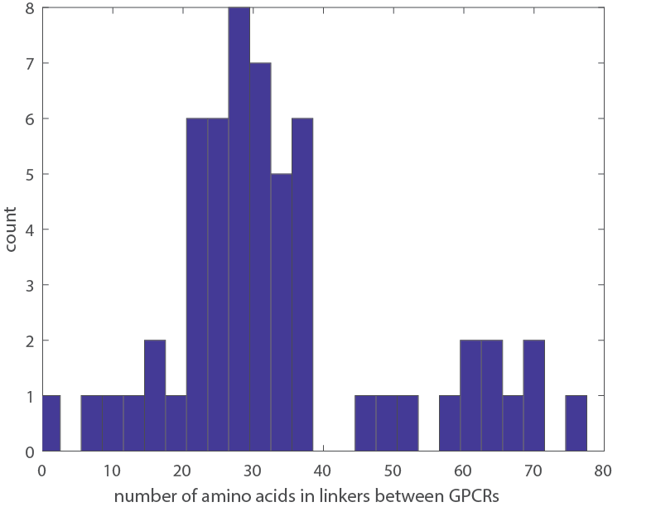
Distribution of the number of residues in the linker regions between the different GPCR domains in the same chain
Isildayancan, Kessel, Solan, Kolody, Ben-Tal. BioRxiv.
Notes:
Figure S3: (A) Distribution of sequence identify/similarity among the different GPCR domains within the same chain.
(B) Distribution of the number of residues in the linker regions between the different GPCR domains in the same chain.

Slide 27
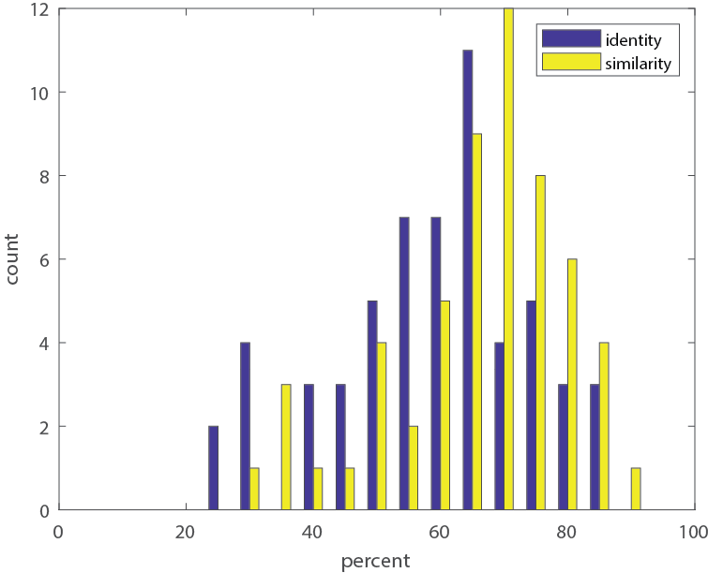
Distribution of sequence identify/similarity among the different GPCR domains within the same chain
Isildayancan, Kessel, Solan, Kolody, Ben-Tal. BioRxiv.
Notes:
Figure S3: (A) Distribution of sequence identify/similarity among the different GPCR domains within the same chain.
(B) Distribution of the number of residues in the linker regions between the different GPCR domains in the same chain.

