Slide 1
Programing VS
Author: Kilik White
Major: Computer Science
Advisor: Dr. Hayes

Slide 2

Statement of Purpose
So programing competitions are a major event for programers to show off their skills
But there is not mauch in group practice methods for those programers to improve traditionally
This is what this program is meant to solve
That is because the practicing competitors can use this program to practice at any time and any place.
It functions similarly to HackerRank but there is an online aspect of the program

Slide 3

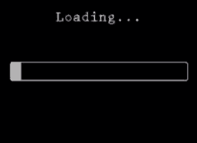
Demo the program
Give me just a moment… to start up this program…

Slide 4

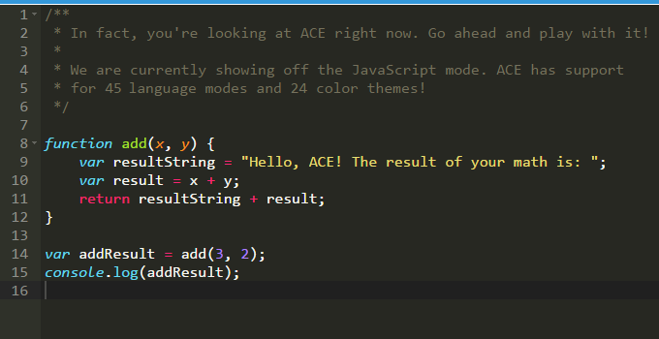
Research and Background
Background and process during presentation
Packages Researched and later used:
Meteor JS(at First)
React JS
Socket-io
NPM packages:
React-ace
Sandbox
react-time-hook
.

Slide 5

Testing
As to how it was tested I followed the test cases that was made
Example: “Check the response on pressing the Practice Button”
I recommend looking at the docs section to see the charts.
I tested it myself using my Desktop computer and I got my mom to test the program to see if there are any errors that are in there.
The results is the program passed 85% of the tests

Slide 6

Challenges
One of the Challenges that I had to overcome is to restart development as a result of Meteor.js
I could not figure out how to get Ace.editor to work with Meteor.Js
It was an issue because Ace.editor is the most important part of the program
Executing the JavaScript code that the competitor create with the hidden test cases.
Was initially going to use eval()
Handling the security concerns with executing the competitors JavaScript.

Slide 7
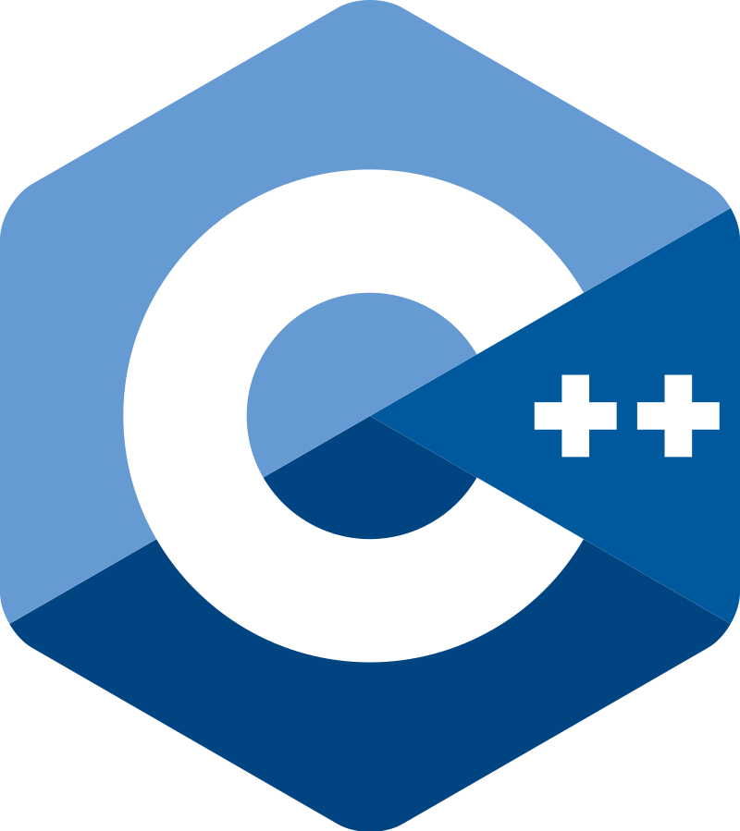

Future Enhancements?
One of the plans was to possibly add more questions instead of it being just one
Another plan was to add other languages down the line since I was thinking of adding C++ and python into the program for the questions
Finally I wanted to make some small improvements like some towards the online feature of the project down the line.

Slide 8

Thank You for Listening to This presentation
Here is the Link to my github repository: https://github.com/kilikwhite/CSU-Senior-Project
Any Questions???

Slide 9
Project Languages Hardware and Software
The Project Language of this Project is JavaScript.
The Software that I used to program this project is Visual Studio Code.
The Hardware that I used to program this project is my home computer and My Laptop.

