Slide 1
DioNiSio
By
Gerardo García Peña
<gerardo@kung-foo.dhs.org>

Slide 2
DNS Introduction (I)
DNS is a key point of Internet Architecture.
Hierarchical and distributed database.
  keys are not unique
  have several values associated to one key
  each key have associated a list of resource records.
  static schema and finite tables (IN, CHAOS, HS)
Examples
  example.com
  example.org
  foo.example.com & bar.example.com

Slide 3
DNS Introduction (II)
Essentially it makes possible to convert between names and addresses
Process of converting names to addresses is named “resolution”
And there are two resolution algorithms:
  iterative resolution
  recursive resolution – oh yeah

Slide 4
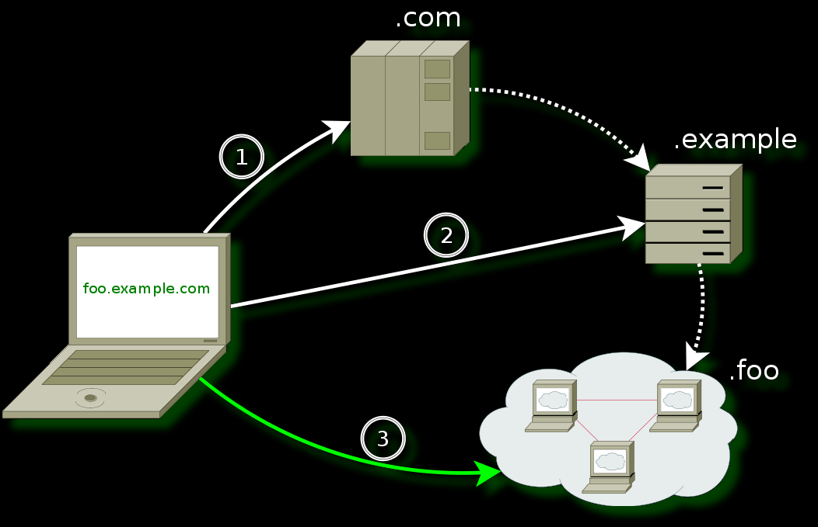
DNS Introduction (III)
Iterative resolution

Slide 5
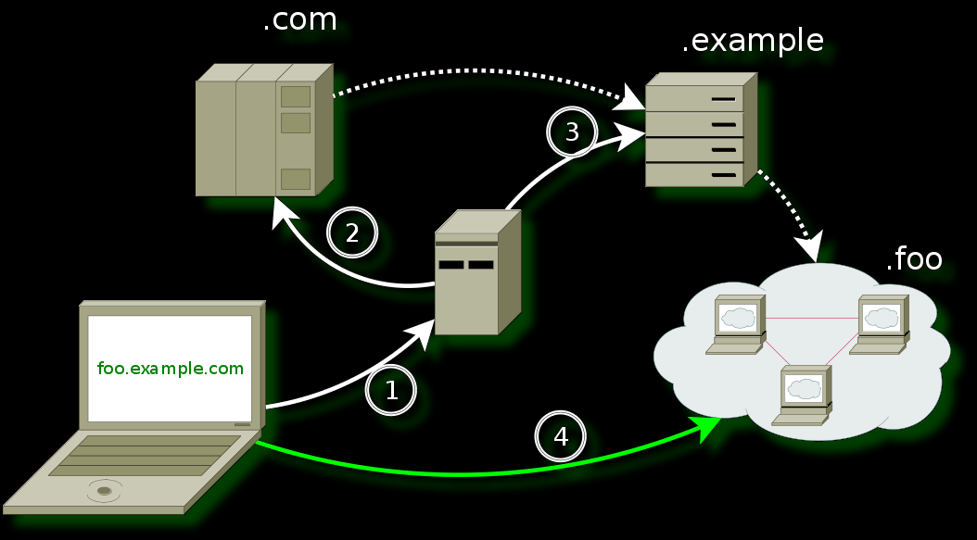
DNS Introduction (IV)
Recursive resolution

Slide 6
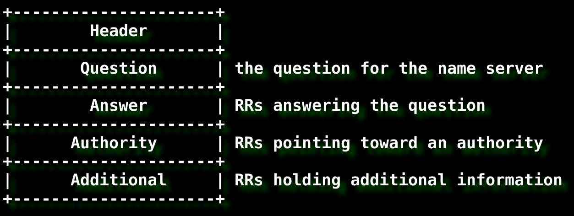
DNS Protocol (I)
DNS message

Slide 7
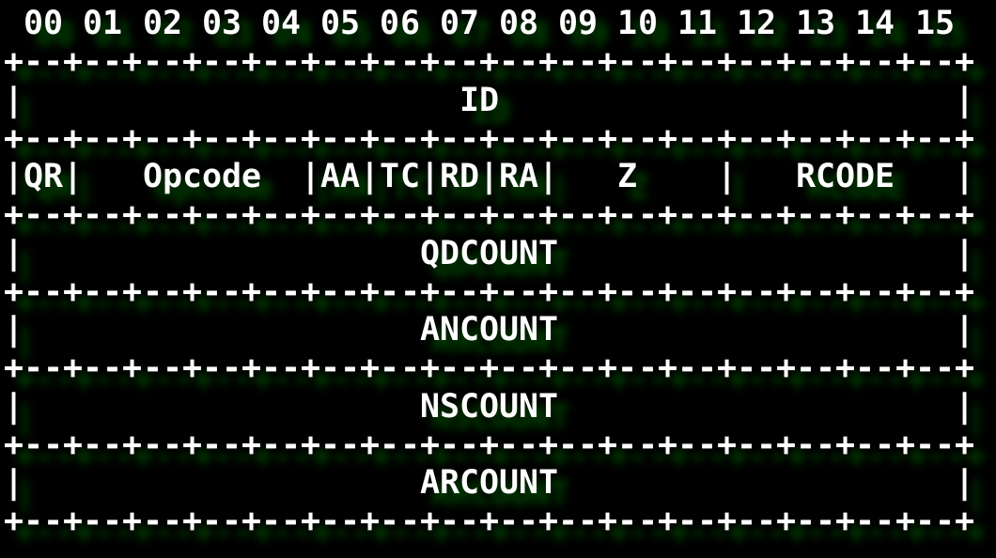
DNS Protocol (II)
DNS header

Slide 8
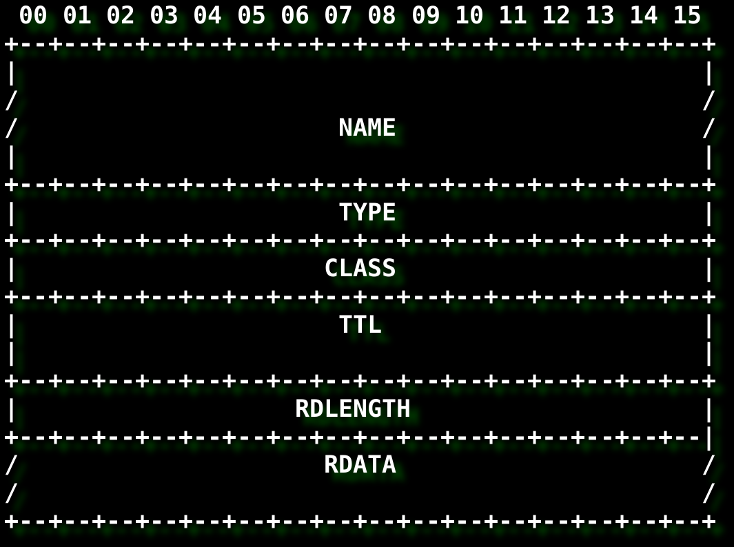
DNS Protocol (III)
An RR

Slide 9
DNS Protocol (IV)
Types of RR
      A = IPv4 address
      AAAA = IPv6 address
      MX = Mail eXchange
      NS = Name Server
      SOA = Start Of Authority
      CNAME = Canonical Name
      PTR = Pointer (reverse address lookup)
      ... up to 2¹⁶ possible, but about 50
Classes (IN, CHAOS and HS)
  IN usually is the only interesting
  HS only in Unix environments – about users

Slide 10
Attacks and vectors
In next slides we present interesting attacks vectors and ideas:
  Dictionary Attacks
  Massive Reverse Lookup Attacks
  Recursivity
  DNS is an old protocol
  Zone Transfers
Mix with care and drink cold.

Slide 11
Dictionary Attacks (I)
DNS was designed to ease the memorization of computer and network addresses; so names usually
  are common words
  describe the use or purpose
Due to hierarchical organization is possible to scan an entire domain brute forcing on names.
Information discovered can be used to repeat the attack on subdomains or related domains.

Slide 12
Dictionary Attacks (II)
Some nice features:
  It is funny.
  Give good results (sometimes surprising): people usually choose dictionary names.
  Always works.
But it has some problems:
  Results not 100% accurate
  It is really f*cking slow
  It is easy to detect :'(
  Analysis can fall into a black hole (wildcard) giving zillions of not-at-all-false positives x”D

Slide 13
Massive Destruction Reverse Address Lookup Weapons (I)
It is easy to know an organization's IP netblocks
  whois (AfriNIC, APNIC, ARIN, LACNIC & RIPE NCC)
DNS provides with 'reverse address lookups'
  so is possible to convert 'addresses' to 'names'
Usually administrators allow to reverse lookup any address so...
  blocks of addresses can be converted to blocks of names

Slide 14
Massive Destruction Reverse Address Lookup Weapons (II)
Good:
  This attack is very popular because give a lot of info about a target with minimal efforts.
  Can be used to make an internal names map of an organization that answers internal addresses.
  Simple implementation: similar to dictionary attacks.
Bad:
  It only works well with IPv4 networks.
  Some administrators only accept reverse lookups for some servers (MX and NS servers).
  It is also easy to detect.

Slide 15
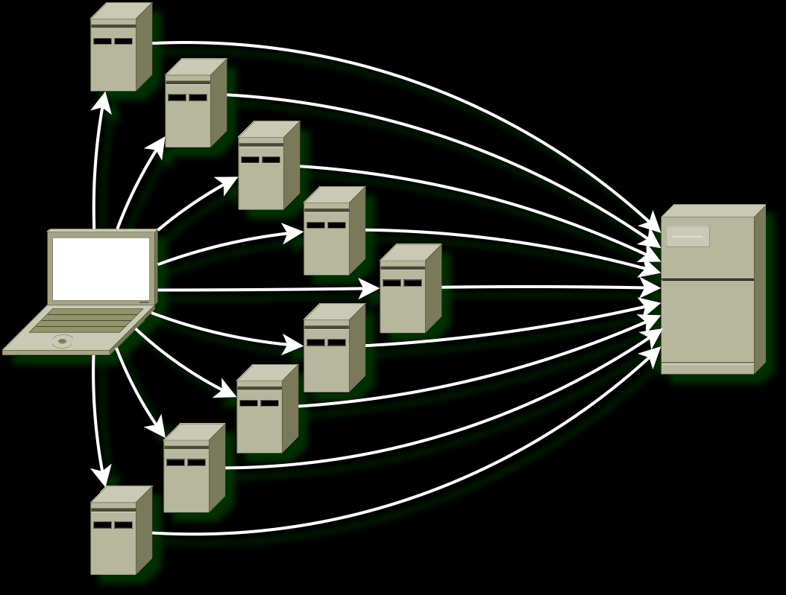
Recursivity, Our Best Friend
or how I fell in love with distributed attacks

Slide 16
DNS is a rich protocol
There are a lot of Resource Records and they usually provide a lot of info
    about the domain (SOA, PTR)
    about hosts (A, AAAA, A6)
    about basic servers (MX, NS, MD, MF)
    about services (WKS, SRV)
    aliases and sometimes dangerous bugs (CNAME)
    extra information (TXT, HINFO, GPOS, LOC)
    WTF?!?! (SINK, RP, AFSDB)
You can use all this information to “surf the namespace” :D

Slide 17
Recursive Zone Transfers
And of course you can always try “hardcore” things.
  like a zone transfer from domain nameservers
But it usually fails...
    but we were studying “in deep” the target
    so is possible that we discovered backup NS, no official NS or even subdomain NS that have a copy of the main database :D
    and they are interesting targets to be AXFR'd
It is detectable and there is not a workaround – but I think it is worthless.

Slide 18
Putting everything together
At this point, if we mix in the same application...
  ...the three described attacks.
  ...analysis techniques that take advantage of richness of DNS protocol.
  ...a pool of recursive DNS servers.
    also called Open Resolvers
    and there are a lot of lists of Open Resolvers :)
  ...recursive zone transfers.
  ...and algorithm that chooses the best analysis for each RR.
we can obtain a powerful DNS analysis tool.

Slide 19
DioNiSio, a pentest tool
But it is not enough
  we are hardcore penetration testers x”D
      we can 0wn a remote machine into the target network
      so the application must be really portable – we don't know what we can find there outside (Unix, Windows, Linux, BSD*, z/OS, AmigaOS, C64 Basic...).
      no dependency on external libraries or tools.
  no need for nice trendy GUI's
      IT SHOULD RUN REMOTELY ;)
  it must economize memory, CPU and be reliable.
  Output easy to analyze and reuse
      currently support CSV and TXT output.
      it can also save communications for later analysis.

Slide 20
DioNiSio Help
Syntax:
dionisio -d [options] <target_domain> [...]
dionisio -r [options] <ip_range> [...]
dionisio -x [options] <target_domain> [...]
dionisio -u [options] <dump_file>
Options:
-c, --comments add comments to output.
-d, --dictionary dictionary scanner [SCANNER
MODE].
-D, --domain-test do a domain analysis on
discovered domains.
-e, --memorize memorize not found names
(speedup and memory eater)
-f, --max-fail max fails per nameserver.
-g, --debug debug mode (all possible
messages).
-h, --help this help.
-H, --host-test do a host analysis on each
new HOST found.
-l, --ns-list path to nslist.txt file
(list of nameservers).
-m, --mode set scanner mode.
1 = recursive zone transfer
2 = dictionary analysis
3 = reverse lookup network
4 = read dump
-M, --follow-mode how to follow new discovered
domains.
0 = follow only subdomains
1 = follow any domain
-n, --names path to dictionary file
-o, --output output format
0 = TXT output
1 = Comma Separated Value
-q, --quiet quiet mode (only errors).
-r, --reverse reverse lookup scanner
[SCANNER MODE].
-R, --reverse-test do reverse lookup on each
new IP found.
-u, --read-dump read dump [SCANNER MODE].
-U, --dump-file dumps sent/recvd DNS packets
for debugging.
-x, --axfr perform a recursive zone
transfer [SCANNER MODE].
-X, --axfr-test do a zone transfer on each
new NS found.
-v, --verbosity[=level]
set verbosity level.

Slide 21
Live Examples
Dictionary Attack against upc.edu
    dionisio -c -e -d upc.edu
Reverse Network Block Lookup
    dig terra.com // whois 208.70.188.151
    dionisio -U reverse.dump -r 208.70.188.0-255
Load dump and generate output in CSV format
    dionisio -o 1 -u reverse.dump
Recursive AXFR
    today not – but try yourself ;) [dionisio -x target.domain]

Slide 22
That's all
  Questions?

Slide 23
Are you Sarah Connor?
Who am I:
      gerardo@kung-foo.dhs.org
      http://kung-foo.dhs.org/killabyte/
Where can I find DioNiSio?
  Home page:
      http://dionisio.sourceforge.net/
  DioNiSio's source forge site:
      http://sourceforge.net/projects/dionisio/
  Mailing list:
      https://lists.sourceforge.net/lists/listinfo/dionisio-general

