Slide 1
SocGholish/FakeUpdates with NetSupport
By: Killam, Jason R

Slide 2
Background
User visits legitimate website and is redirected to a fake browser update in the form of a JavaScript loader.
SocGholish in it’s current form has been around since about April 2018.
The name “SocGholish” is due to the attack relying on Social Engineering tactics of trying to trick the user.
Previous versions predate it though under other names and slightly different premises, such as “HoeflerText” and “EITEST”
NOTE: Domains that have brackets around the “.” character like example[.]com are either Indicators of Compromise or compromised sites.
Notes:
References:
https://www.malware-traffic-analysis.net/2019/08/26/index.html
https://isc.sans.edu/forums/diary/Fake+Updates+campaign+still+active+in+2019/24640/
https://blog.malwarebytes.com/threat-analysis/2018/04/fakeupdates-campaign-leverages-multiple-website-platforms/

Slide 3
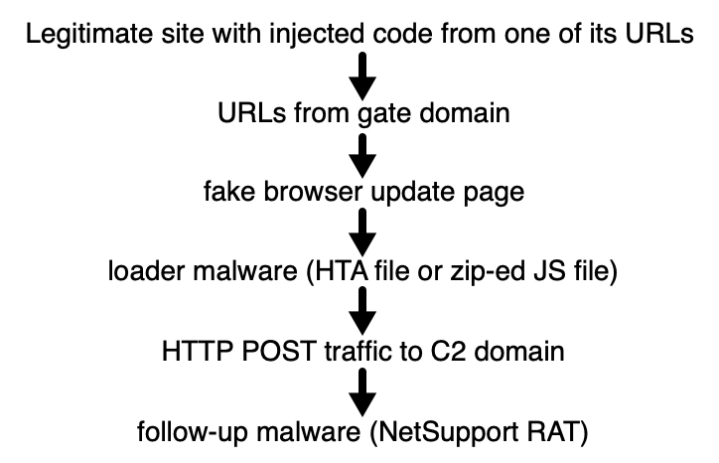
Infection Chain
Notes:
Infection chain outlined by the Brad Duncan at the internet storm center
Reference:
https://isc.sans.edu/forums/diary/Fake+browser+update+pages+are+still+a+thing/25774/

Slide 4
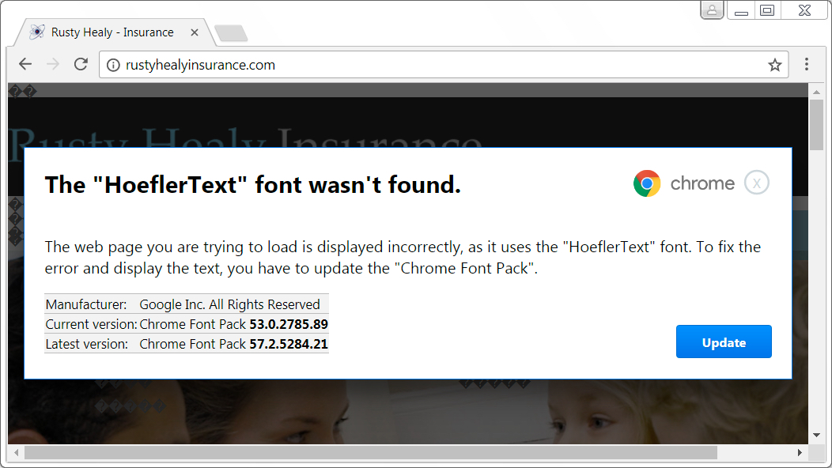
Old Version: HoeflerText Premise
Notes:
It’s hard to see in the background, but in this version, the text on the compromised site is altered to seem corrupt and the “update” window appears over the site content.
In this older version the downloaded file was usually an executable file using a name suchas “Font_Update.exe”

Slide 5
Visual Example (GIF)
Notes:
This image is a gif, if you’re viewing this in a non-presentation mode it will not move
Important Note: The URL the user is on does not change! This probably goes a long way in fooling the user into believing the “update” is actually from the browser and not a redirect
Due to the way this content change occurs it’s not considered a “popup” in the traditional sense, so a popup blocker will not block this
Also of note: the prompted file to download is a javascript file, whereas in the next example the script is contained within a zip file, which helps with bypassing antivirus scanning as files are downloaded or decoded onto the enpoint
Reference Image:
https://blog.malwarebytes.com/threat-analysis/2018/04/fakeupdates-campaign-leverages-multiple-website-platforms/

Slide 6
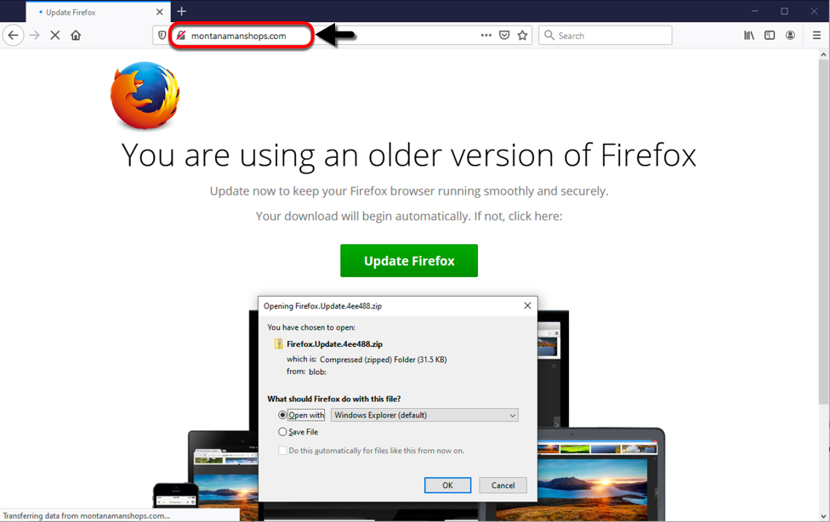
Fake Update Page (Static)
Notes:
Example download prompt for a compromised site
Note again: domain does not change when showing the update page
Also of note: while parts of the filename remain the same, the string at the end varies with each download
Older version of this campaign used other filenames and filetypes
Examples
Chrome.hta, Firefox.hta
Chrome_Update.exe, Font_Update.exe, Update_Font.exe etc
Reference:
http://malware-traffic-analysis.net/2020/02/04/index.html

Slide 7
PCAP Exercise (Lab 1 Part 1)
Open the “2020-02-04-socgholish-traffic-example” pcap
Try the following wireshark filter “http.request || ssl.handshake.type”
From the pcap what domains / urls look suspicious?
What certificate authority (CA) does pixel[.]adsprofitnetwork[.]com use?
Do any other domains use that same CA?
Notes:
Certificate Authority: Let’s Encrypt
Drill down into one of the packets with the certificate info and look for printableString: Let's Encrypt Authority X3 right-click on the CA and choose “apply as filter” > selected
Should become a filter like x509sat.printableString == "Let's Encrypt"
Ref: https://unit42.paloaltonetworks.com/using-wireshark-display-filter-expressions/

Slide 8
Exercise/Demonstration
Site contains link to “pixel[.]adsprofitnetwork[.]com” with a URL to a legitimate image file and sends the information about the user’s session, such as resolution and referrer.
The site will return either the image and no redirect if there’s no referrer, or a screen resolution common to a virtual machine.
Filtering users in this manner is known in the infosec community as a “Gate Domain” and is often used by malicious redirects for Exploit Kits
Example compromised site, dearart[.]net
https://urlscan.io/result/83a75174-01a7-4655-958e-a77a6dff321b/#transactions
Notes:
If accessible, navigate to the urlscan page to show what html site code looks like, there is is no risk of being infected by this site, as this site doesn’t actually run/render the HTML code
The first URL is a capture of the compromised site, and you can look through the pieces of injected javascript.
On urlscan look for javascript entry under “Newspaper/js” (it’s in several other javascript entries as well)
Ctrl + f search for the above domain and look at how the url is generated and all the values sent to the site
Reference on how Gate Domains work: https://unit42.paloaltonetworks.com/unit42-understanding-angler-exploit-kit-part-1-exploit-kit-fundamentals/
Values sent by the url
ti=encodeURIComponent(document.title) – Page Title (URL encoded)
sw=encodeURIComponent(screen.width) – Screen Width
sh=encodeURIComponent(screen.height) – Screen Height
c=encodeURIComponent('1360’) - Static String (different from montanamanshops, site identifier/affiliate id?)
cd=encodeURIComponent(screen.colorDepth) = screen color depth
re=encodeURIComponent(document.referrer) – Referrer
r=Math.random() – random number
Sites are likely compromised through third-party wordpress plugins
If someone is remediating a compromised site, they should remove any “sketchy” 3rd party or other wordpress packages from less-than reputable sources.
Properly secure admin pages for WordPress installations

Slide 9
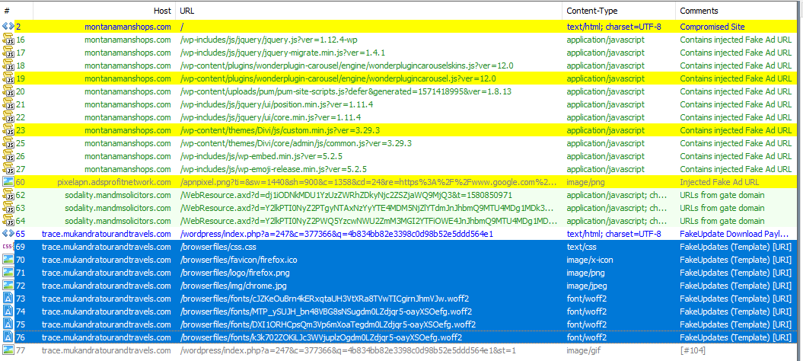
Example of Traffic with Redirects (Fiddler)
Referrer URL
Contains the encoded downloader
Notes:
Traffic in this screenshot is pulled from a web traffic capture tool called Fiddler, with traffic automatically marked up using “EKFiddle” a tool used to help identify exploit kit activity in fiddler captures
https://github.com/malwareinfosec/EKFiddle
Example traffic capture is pulled from the below malware traffic analysis post, and altered to remove and compact the traffic to the relevant sections
http://malware-traffic-analysis.net/2020/02/04/index.html

Slide 10
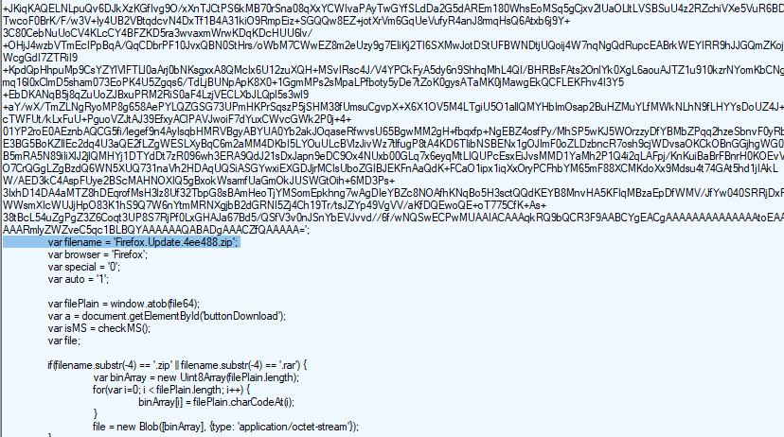
Payload Downloaded as Zip File
Notes:
This is a screenshot from content delivered by the URL ending in “/wordpress/index.php?a=…” on the previous slide
Note the “filename” entry with the base64 encoded data above, which is what the browser prompts to the user to open.
Reference:
http://malware-traffic-analysis.net/2020/02/04/index.html

Slide 11
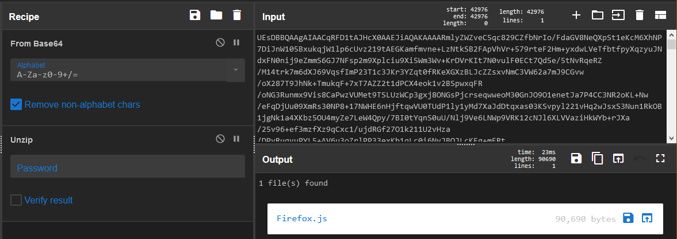
Decoded Payload {Browser.js}
Notes:
In this example from montanamanshops, the payload is “Firefox.js” but depending on the browser it can be “Chrome.js” or “Edge.js”
It’s next to impossible to decode this javascript easily, so there are no screenshots that would be useful of the js file.
Decoded payload is pulled from extracted traffic with the base64 section isolated and put into cyberchef with the options above.
https://gchq.github.io/CyberChef/

Slide 12
PCAP Exercise (Lab 1 Part 2)
Open the “2020-02-05-socgholish-JS-file-sends-NetSupport-RAT” pcap
Try the following wireshark filter “http.request || dns”
Why does this filter work better for this pcap than the previous one we used?
What can be discerned from the traffic with the “codingbit” domain?
What information can be obtained from the traffic to “geo.netsupportsoftware.com”?
What application generated the traffic to “81.17.21.98”
Notes:
There is no TLS traffic present in this pcap, including dns traffic reveals domains from the malware that were not active when the traffic was captured.
From the stream content it appears to be hex encoded data, although attempts to decode the contents will not reveal anything. But from the context and timing we can probably assume this is the next stage of the payload being sent by malware.
The user’s probable geographic coordinates
NetSupport Manager Client

Slide 13
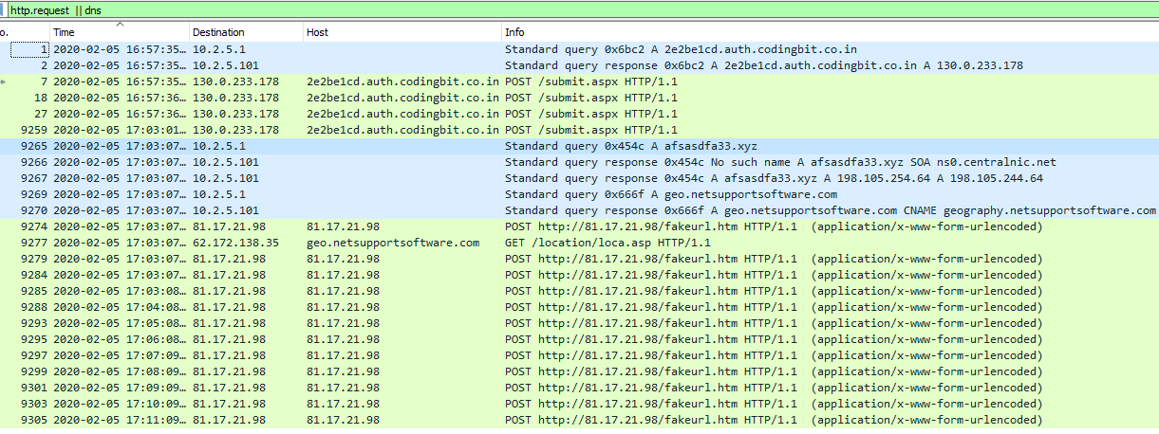
Pcap Traffic from Infection
Notes:
The connection to the domain codingbit, has recently changed to edge[.]wholesalerandy[.]com, but contains the same random subdomain characteristic
Connections to the xyz domain are configured by the NetSupport config ini file
The HTTP POST URLs in the screenshot are used for sending encoded data from the host, presumably basic host information, such as hostname, process list, users, etc.
Reference pcap from:
http://malware-traffic-analysis.net/2020/02/04/index.html

Slide 14
What to Watch Out For? (Network)
Hits to known redirect domains - these do not change often and are easy to block
Hits to “auth[.]codingbit.co[.]in” with a random subdomain - this initial domain changes semiregularly as well
DNS requests to “.xyz” Top Level Domains (TLD) or other sketchy TLDs
HTTP requests to “NetSupport” related domains - this was the RAT payload in this case, which could be other malware like Cobalt Strike.
There are a few good SNORT and Suricata signature urls
All named “Js.Trojan.FakeUpdate”
Notes:
Ways to Identify SocGholish from network monitoring:
Suricata/Snort alerts from the listed rule
Domain-based IOCs hits in http traffic
edge[.]wholesalerandy[.]com, auth.codingbit[.]co[.]in
These domains do change somewhat regularly but not often enough to be too ephemeral
IOCs specific to the NetSupport RAT payload
DNS requests logs connections to netsupport infrastructure
The geo.netsupport[.]com Subdomain seems to be embedded in the netsupport binary so while an actor could remove it, it would no longer be signed
It’s generally a good idea to block/alert on a subset of certain TLDs such as xyz
Some other example TLDs to alert on .ru, .su (Russia) .bazar, .bitcoin, (crypto-currency domains hosted on blockchain, tor accessible)
IOCs for domains for the part using authcoding can be difficult if you can’t IOC parent domains
also this domain is a legitimate training site so just IOCing it might be a bad idea.
HTTP “POST” URLs to ip addresses with “fakeurl.htm”
Ref: https://www.fireeye.com/blog/threat-research/2019/10/head-fake-tackling-disruptive-ransomware-attacks.html
https://snort.org/search?query=fakeupdate&submit_search=

Slide 15
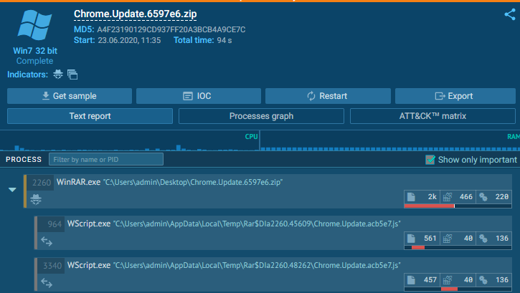
Host Execution
Notes:
The WScript instance in this screenshot are connecting to the auth.codingbit[.]co[.]in domain, but no additional content was delivered (probably detected the sandbox)

Slide 16
Host Analysis Exercise (Lab 2)
Open the “Users” zip file and unzip the contents with the password “infected”
This zip file has had it’s user AppData populated with some legit data, what folder stands out as suspicious? (don’t look too deep).
Of the two executables in this folder, does there appear to be any deception going on?
Why don’t these files trigger antivirus?
If this file is “legitimate” what makes this of use to an attacker?
Notes:
There are no files in this archive that will trigger AV, and no risk of infecting yourself since I’ve neutered the payload
The folder you’re looking for is in Roaming, a randomly named folder called “PTOVTYJC”
One of the binaries is named “taskhost1.exe” and the internal filename is “client32” and was originally named this and not taskhost
The binary is actually a legitimate remote administration tool called “NetSupport Manager” and is actually signed by the company that sells the tool.
The Client32.ini file contains a network address for the server that allows the actor to control the host. (The c2 has been replaced with the ip for “iscaliforniaonfire.com” a legit site.

Slide 17
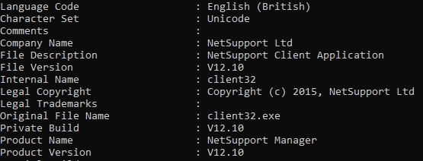
“taskhost” Metadata
Notes:
This information is displayed using the tool exiftool, a useful tool for displaying metadata about files.

Slide 18
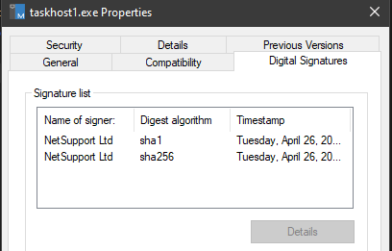
Taskhost Signed
Notes:
The binary is signed by “NetSupport Ltd” NetSupport is a legitimate remote administration tool being abused by actors in this case.
Some interesting information can be found on the entry for the executable on virustotal:
https://www.virustotal.com/gui/file/49a568f8ac11173e3a0d76cff6bc1d4b9bdf2c35c6d8570177422f142dcfdbe3/details
Notice AV labels that flag it call it things like “Remote Admin”
The details section for this executable has even more entries of interest
History timestamps can be useful for establishing a timeline
Names show many odd/suspect file paths
The debug path is also interesting and could be something a host analyst could target across several files on a host.

Slide 19
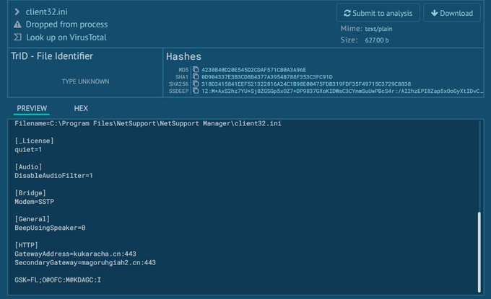
NetSupport Client INI File Contents
Notes:
In the example above the malicious instance of Net Support was actually installed in the program files folder, which is where it would normally reside if installed under legitimate circumstances
The INI file will contain both the primary and backup domains for communications, which would be of interest to a network analyst to identify all IOCs, and if c2 was established

Slide 20
What to Watch Out For? (Host)
Wscript.exe process reaching out to external network addresses
Wscript command lines with “Chrome.Update” or “Firefox.Update”
Wscript creating/executing binaries in appdata
For NetSupport payloads: executables using “client32” internal name running from appdata folders
Cobalt Strike payloads reside in memory, so look for evil usage of the recon tools like PowerView, or preparation of ransomware activities such as disabling shadow copies.
Ref: https://symantec-enterprise-blogs.security.com/blogs/threat-intelligence/wastedlocker-ransomware-us
Notes:
Events Local to host
Zipped JavaScript files in users directory
Suspiciously named binaries within the user’s AppData folder
The presence of a “client32.ini” file with some others in the folder of the executable (can be renamed from client32.exe to something else)
AutoRuns – Persistence is most likely using the registry key from HKCU\SOFTWARE\Microsoft\Windows\CurrentVersion\Run
Event Logs:
PowerShell logs – PowerShell commands with large encoding entries
Security Logs – EventID 4688 Browser > WScript
System Logs – EventIDs related to service creation
Events Seen in system logs at a SIEM level
Event Logs (See Above)
Sysmon Events
Event ID 11: FileCreate – files being written to appdata from wscript
Event ID 13: RegistryEvent (Value Set) – ID events related to run keys
Event ID 19: WmiEvent (WmiEventFilter activity detected) – the actor will frequently use WMI for enumeration and commands
Event ID 22: DNSEvent (DNS query) – DNS querys to domains with suspect TLDs or names
Ref: https://docs.microsoft.com/en-us/sysinternals/downloads/sysmon
Identifying the usage of Penetration Testing Frameworks can be very difficult
Verify with local network admins what tools that are in use for remote administration
In this threat verify things like the following:
Using WMIC to Create User accounts
Deleting shadow copies
Usage of PSEXEC
PowerView, AdFind

Slide 21
Reported Payloads
NetSupport (Remote Admin Tool) – due to it’s simplicity, we only cover how this threat works.
Cobalt Strike > WastedLocker Ransomware
Dridex (Banking Trojan)
Empire (Penetration Testing Framework)
Chthonic (Banking Trojan)
Notes:
The final payload delivered to a user varies based on what the initial socgholish loader finds
What malware is pushed to a host is dependent on the conditions the actor chooses
Guesses:
Joined to a domain? Send cobalt strike to begin lateral movement and recon ops
Not joined to a domain? Send NetSupport RAT or a banking trojan
These other example payloads could probably have their own set of dedicated presentations and are not covered further in this presentation
Refs
https://www.bleepingcomputer.com/news/security/new-wastedlocker-ransomware-distributed-via-fake-program-updates/
https://www.malware-traffic-analysis.net/2019/04/05/index.html

Slide 22
Mitigation Recommendations
Block known redirect gate domains, and compromised sites proactively.
If in control of the affected site, evaluate wordpress plugins for issues, and ensure admin sections are properly secured.
Set “Open With” option for javascript, hta files to use a text editor by default. These file types are not usually directly executed by a user and users who need to will usually know how to open legit script.
Since this chain requires user action for execution, user education regarding the activity is highly recommended.

Slide 23
Summary
Malware threats like SocGholish are constantly evolving to bypass content filters and evade being identified.
Malware campaigns like this one, while on the surface seem completely different from malspam campaigns, still rely on tricking the user.
Good web filtering can block threats like this, but host monitoring can help a lot when tactics change enough to get around these.
Malware can often take the form of legitimate tools used in a malicious manner. So verify remote admin tools usage even if it seems legitimate.

Slide 24
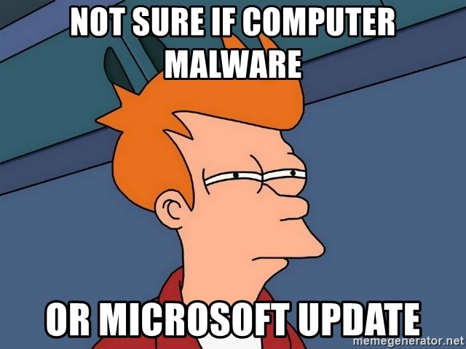
Questions?

