Slide 1
Analysis Of High Energy Physics Theory Citation Network
Anil Kumar :-20BCS015
Ashwini Kumar :- 20BCS023
Harsh Rawat :-20BCS050
Jayant Kumawat :- 20BCS064
Karthik Bhamare :- 20BCS066

Slide 2
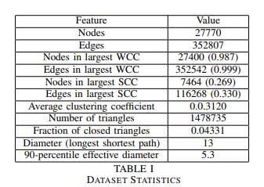
DATASET
https://snap.stanford.edu/data/cit-HepTh.html

Slide 3
ALGORITHMS USED
PageRank
Connected Components

Slide 4
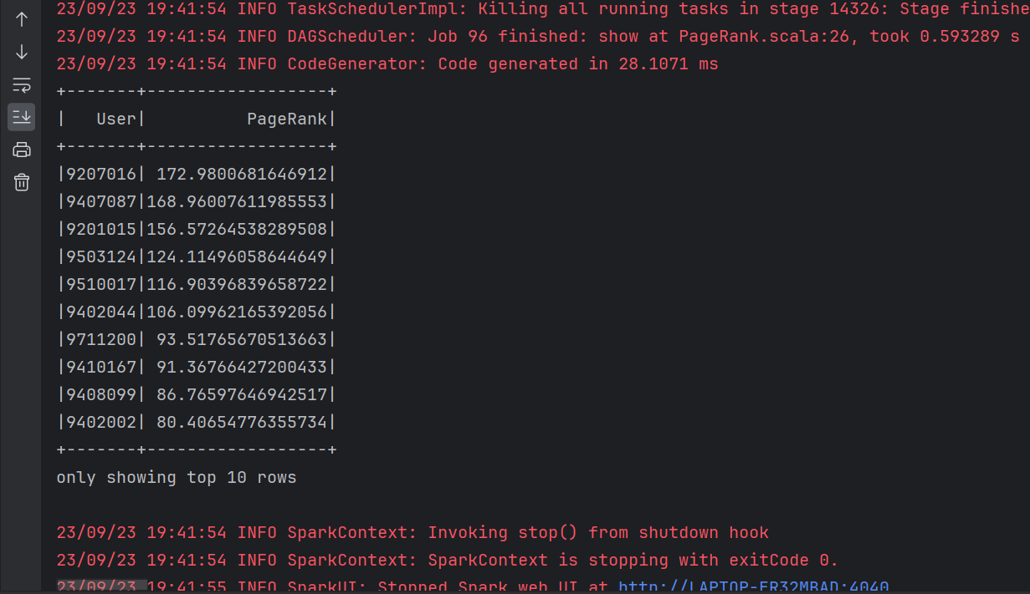
PAGE RANK
We can see the list top 10 reference paper that referenced most by the research papers.

Slide 5
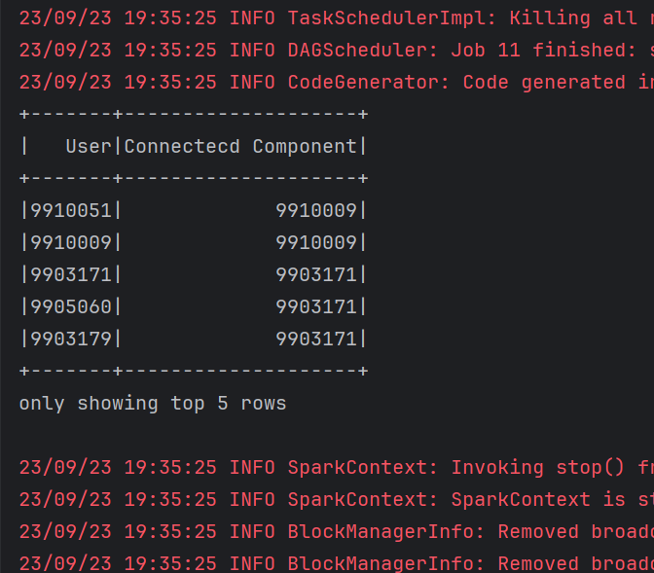
CONNECTED COMPONENTS

Slide 6
REFERENCES
J. Leskovec, J. Kleinberg and C. Faloutsos. Graphs over Time: Densification Laws, Shrinking Diameters and Possible Explanations. ACM SIGKDD International Conference on Knowledge Discovery and Data Mining (KDD), 2005.
J. Gehrke, P. Ginsparg, J. M. Kleinberg. Overview of the 2003 KDD Cup. SIGKDD Explorations 5(2): 149-151, 2003.
https://snap.stanford.edu/data/cit-HepTh.html

Slide 7
Thank you
Please feel free to ask any questions.

