Slide 1
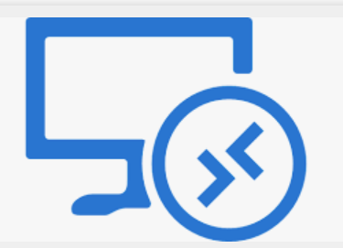
Azure Virtual Desktop

Slide 2
Topics
Shared image gallery Deep dive on FSlogix WVD Host pool, application group and workspace WVD monitoring Brief on Azure Landing zone concept Brief AVD calculator

Slide 3
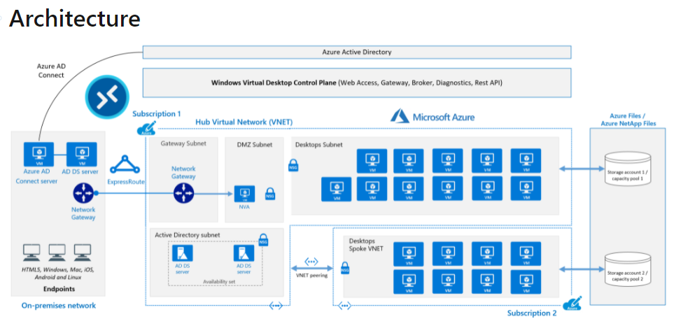
Azure Virtual Desktop

Slide 4
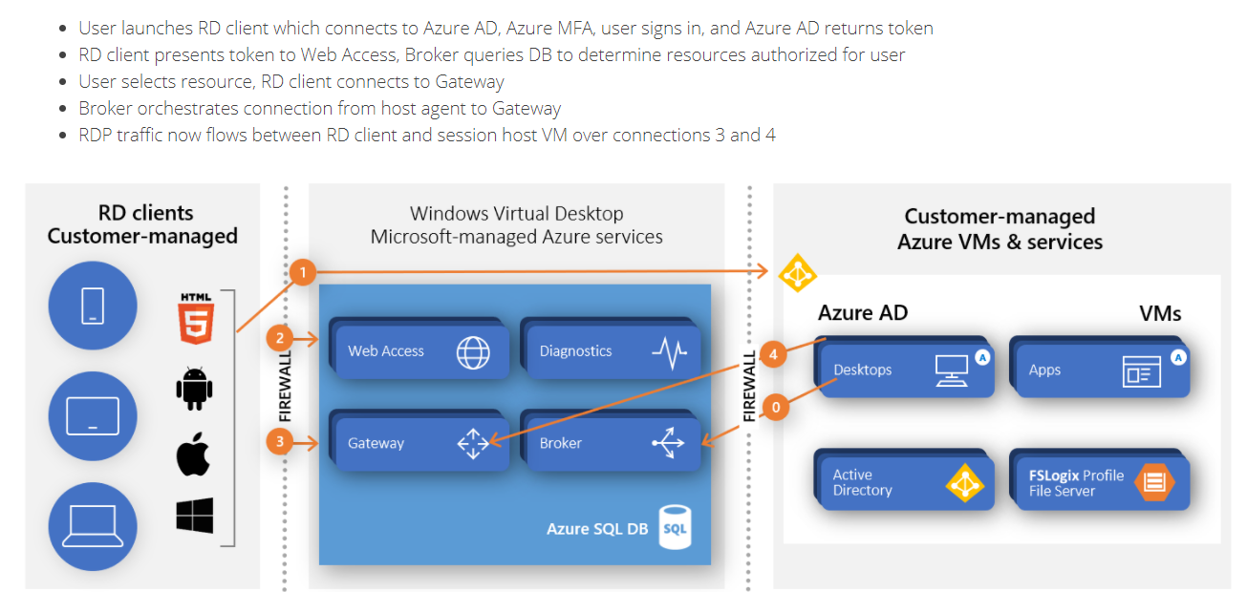

Slide 5
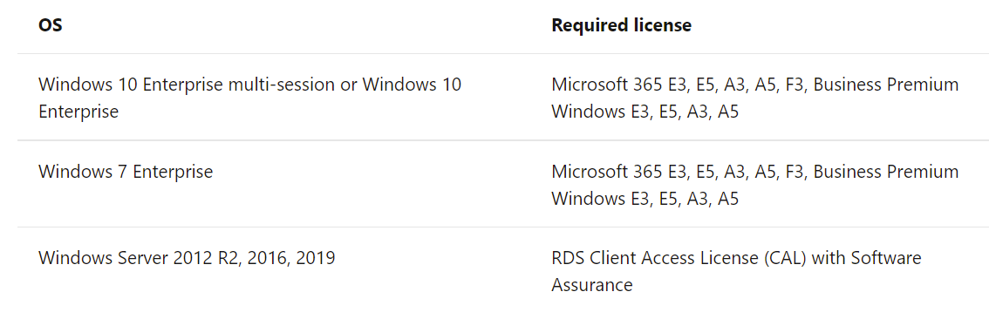
Requirements
License
An Azure Active Directory.’
A Windows Server AD in sync with Azure Active Directory. User is sourced from Windows Server AD and the Azure Virtual Desktop VM is joined to Windows Server AD domain.
An Azure AD Domain Services domain
An Azure subscription,

Slide 6
Components
Components Microsoft manages
Microsoft manages the following Azure Virtual Desktop services, as part of Azure:
Web Access: The Web Access service within Window Virtual Desktop lets users access virtual desktops and remote apps through an HTML5-compatible web browser as they would with a local PC, from anywhere on any device. You can secure Web Access using multifactor authentication in Azure Active Directory.
Gateway: The Remote Connection Gateway service connects remote users to Azure Virtual Desktop apps and desktops from any internet-connected device that can run an Azure Virtual Desktop client. The client connects to a gateway, which then orchestrates a connection from a VM back to the same gateway.
Connection Broker: The Connection Broker service manages user connections to virtual desktops and remote apps. The Connection Broker provides load balancing and reconnection to existing sessions.
Diagnostics: Remote Desktop Diagnostics is an event-based aggregator that marks each user or administrator action on the Azure Virtual Desktop deployment as a success or failure. Administrators can query the event aggregation to identify failing components.

Slide 7
Components you manage
Customers manage these components of Azure Virtual Desktop solutions:
Azure Virtual Network: Azure Virtual Network lets Azure resources like VMs communicate privately with each other and with the internet. By connecting Azure Virtual Desktop host pools to an Active Directory domain, you can define network topology to access virtual desktops and virtual apps from the intranet or internet, based on organizational policy. You can connect an Azure Virtual Desktop to an on-premises network using a virtual private network (VPN), or use Azure ExpressRoute to extend the on-premises network into the Azure cloud over a private connection.
Azure AD: Azure Virtual Desktop uses Azure AD for identity and access management. Azure AD integration applies Azure AD security features like conditional access, multi-factor authentication, and the Intelligent Security Graph, and helps maintain app compatibility in domain-joined VMs.
Azure Virtual Desktop session hosts: A host pool can run the following operating systems:
Azure Virtual Desktop workspace: The Azure Virtual Desktop workspace or tenant is a management construct to manage and publish host pool resources.
Fslogix storage

Slide 8
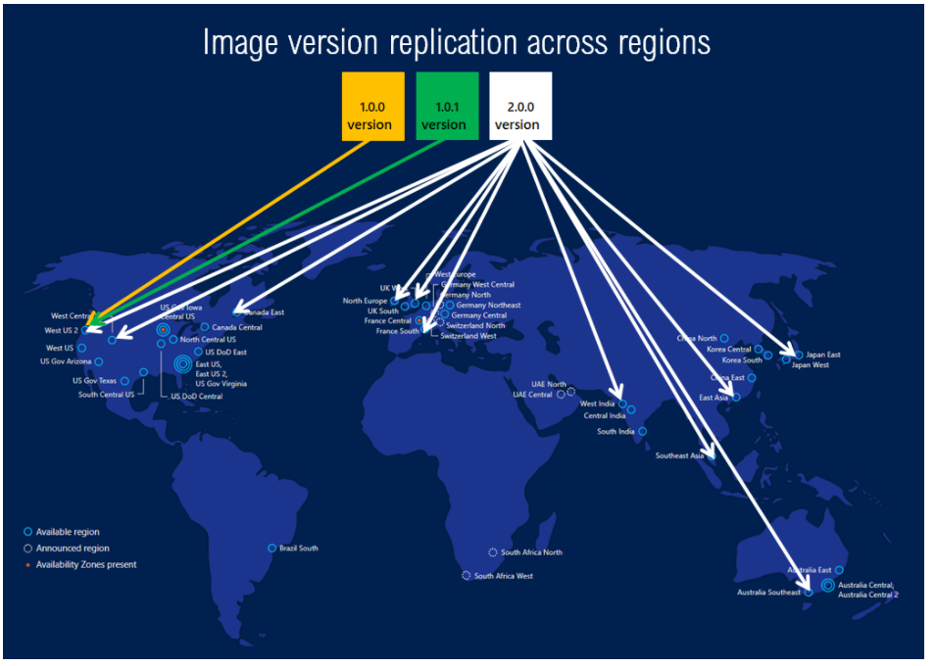
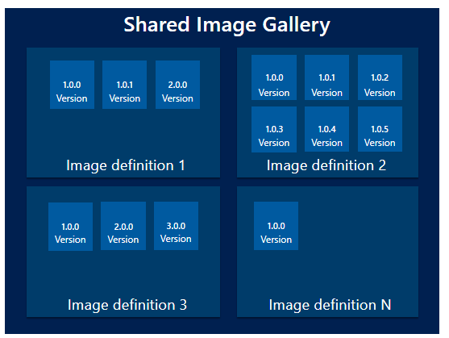
Shared Image Gallery
Shared Image Gallery is a service that helps you build structure and organization around your images. Shared Image Galleries provide:
Global replication of images.
Versioning and grouping of images for easier management.

Slide 9
FSLogix
FSLogix enhances and enables user profiles in Windows remote computing environments. FSLogix may also be used to create more portable computing sessions when using physical devices.
FSLogix includes:
Profile Container
Office Container
Application Masking
Java Version Control
Key capabilities
Redirect user profiles to a network location. Mounting and using the profile over the network eliminates delays often associated with solutions that copy profiles to and from the network location.
Applications use the profile as if it were on the local drive. Because the FSLogix solutions use a filter driver to redirect the profile, applications don't recognize that the profile is on the network. Obscuring the redirection is important because many applications won't work properly with a profile stored on remote storage.
Profile Container is used with Cloud Cache to create resilient and highly available environments. Cloud Cache places a portion of the profile VHD on the local hard drive. Cloud Cache also allows an administrator to specify multiple remote profile locations. The Local Cache, with multiple remote profile containers, insulates users from network and storage failures.
Application Masking manages access to an application, font, printer, or other items. Access can be controlled by user, IP Address range, and other criteria. Application Masking significantly decreases the complexity of managing large numbers of gold images.

Slide 10
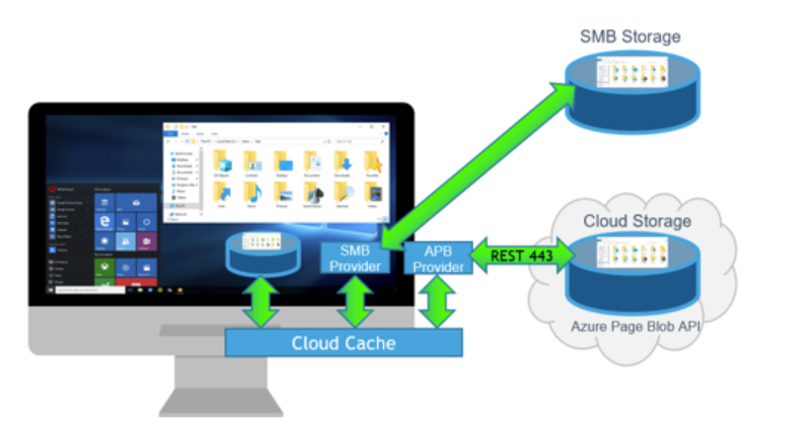
Cloud Cache
Cloud Cache uses one or more remote profile containers, along with meta data.
Cloud Cache uses a Local Profile to service all reads from a redirected Profile or Office Container, after the first read. Cloud Cache also allows the use of multiple remote locations, which are all continually updated during the user session. Using Cloud Cache can insulate users from short-term loss of connectivity to remote profile containers. Cloud Cache can also provide real time, 'active active' redundancy for Profile Container and Office Container.
It's important to understand that, even with Cloud Cache, all initial reads are accomplished from the redirected location. Likewise, all writes occur to all remote storage locations, although writes go to the Local Cache file first.

Slide 11
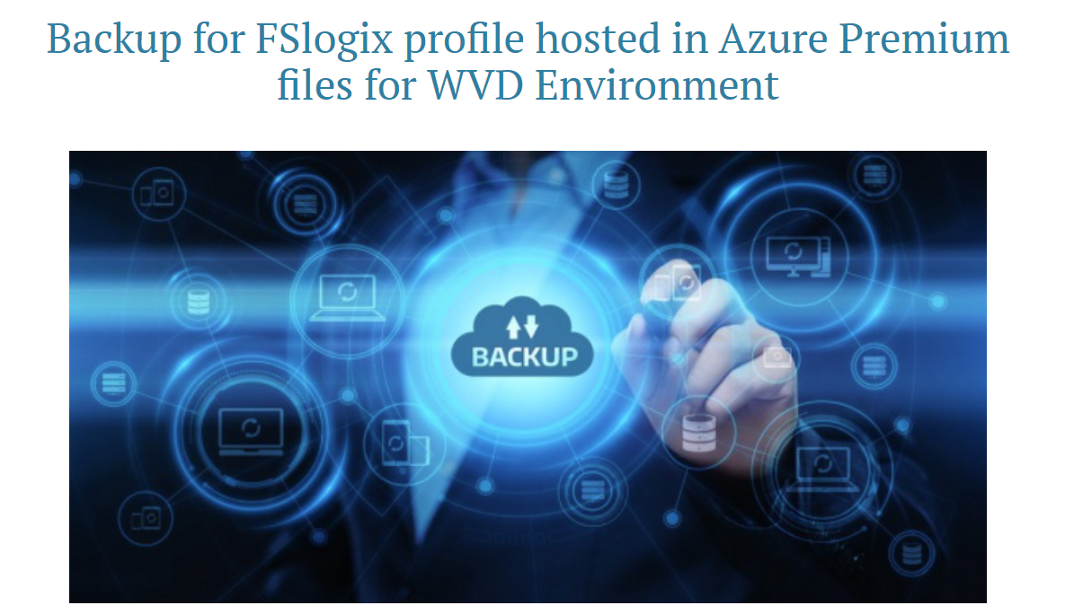
Backup

