Slide 1

Mental Health Support App
COM6023 Final Year Project
Muhammad Ali Khan | Student ID: 2012592

Slide 2
Why This App?
Provide gentle support.
Monitor mood over time.
Recognise trends.

Slide 3
Tools and Technologies
• Android Studio (Java)
• Firebase (Auth + Storage)
• MPAndroidChart (Trends Graph)
• JUnit & Espresso (Testing)
• Figma (UI Design)

Slide 4
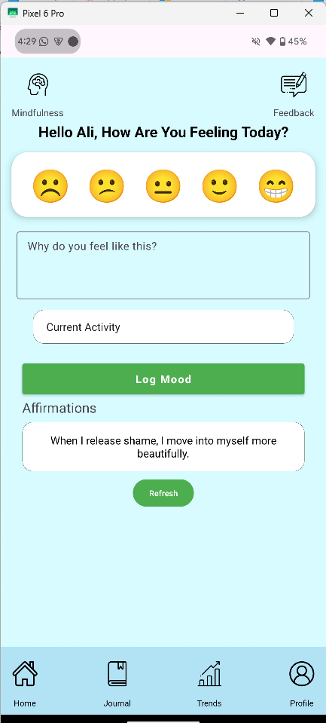
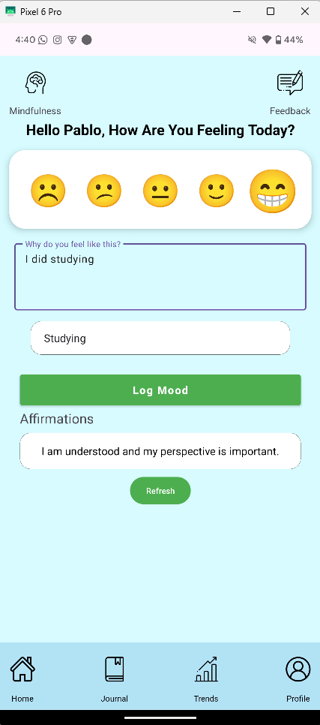
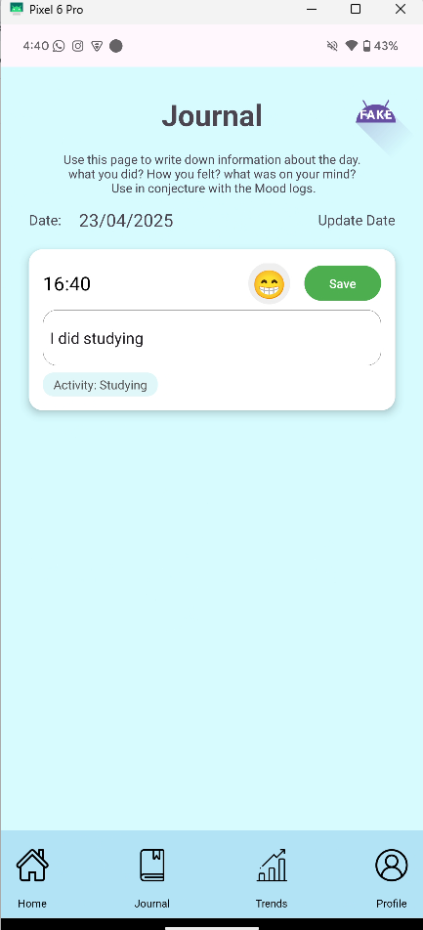
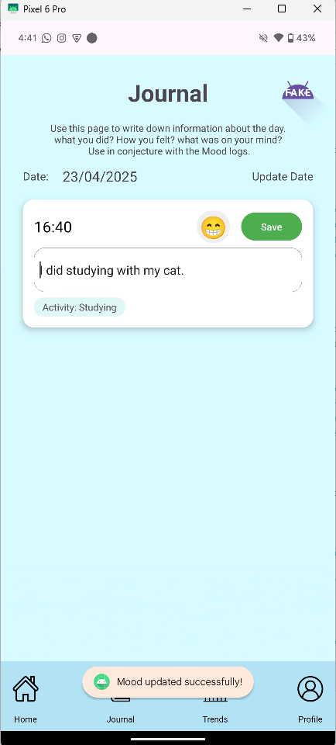
View Trends
Line chart shows mood over time.
Linear regression for direction.
Moving average to smooth out noise.

Slide 5
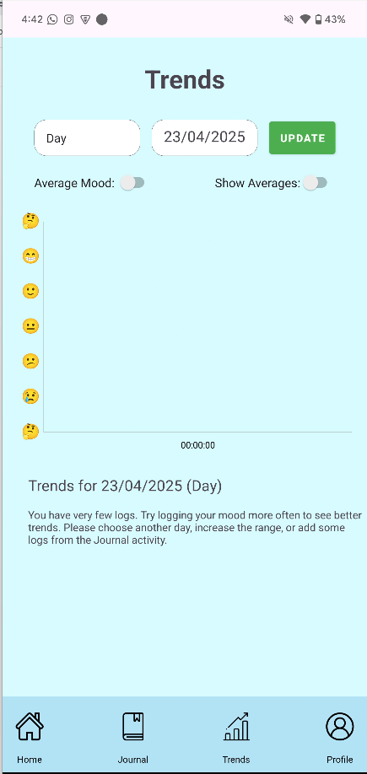
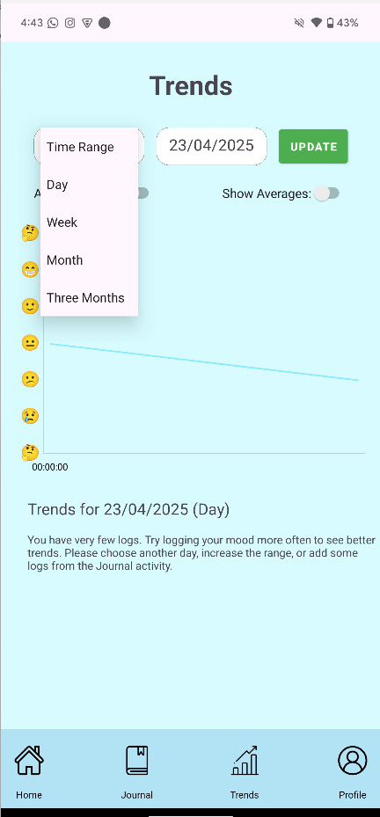
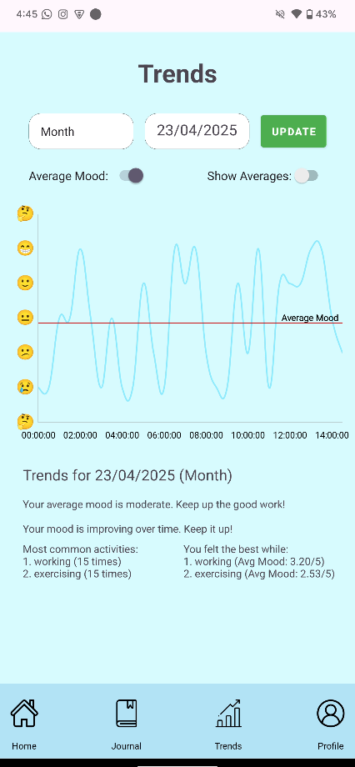
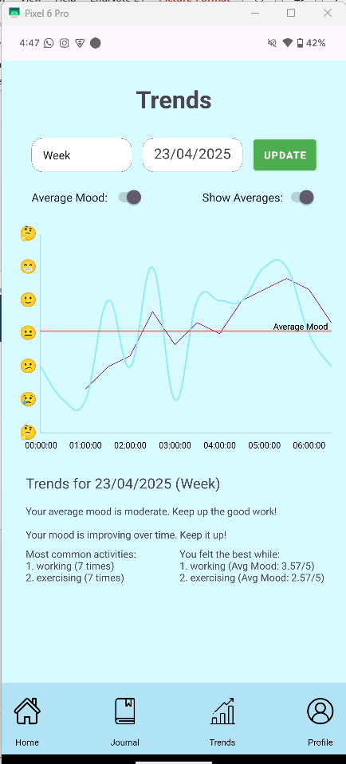
Suggestions
Uses conditional logic based on recent moods.
Offers subtle, context-aware encouragement.

Slide 6
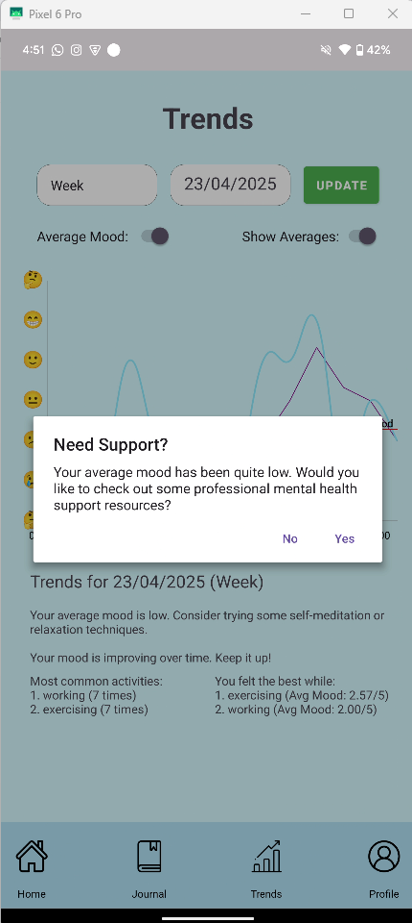
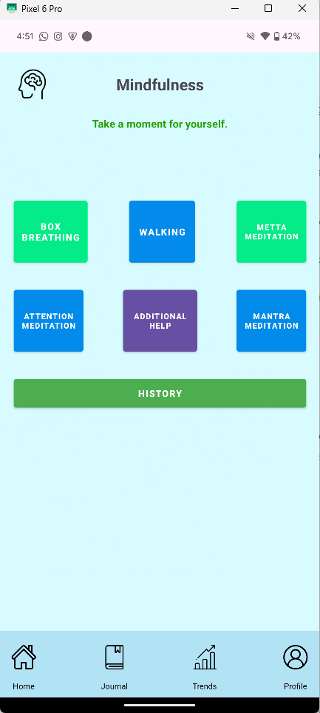
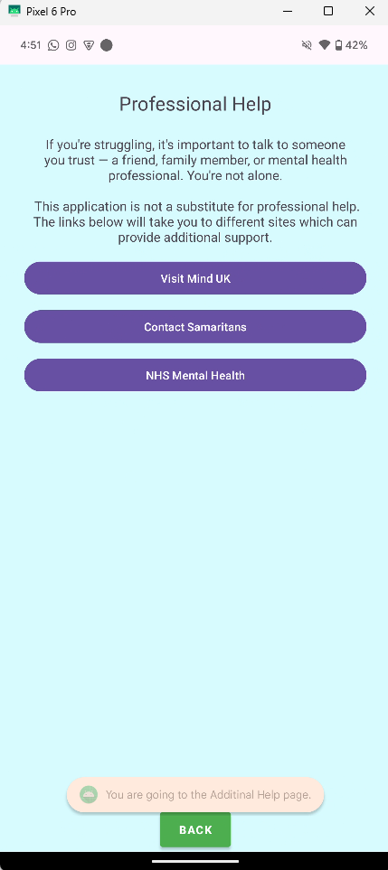
Mindfulness Tools
Built-in meditation tools.
Includes breathing, gratitude, and guided audio.
Encourages calm habits.

Slide 7
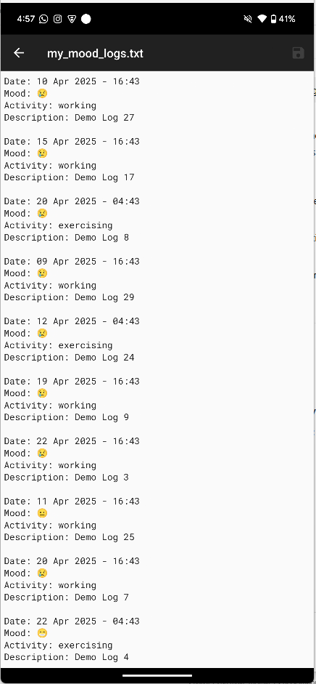
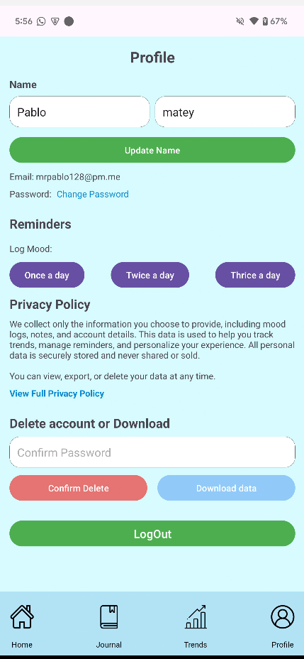
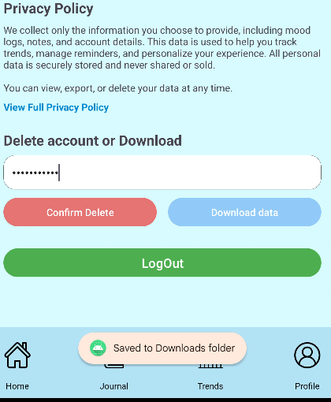

User Management
Users can manage their profiles.
Data can be downloaded or deleted at any time.

Slide 8
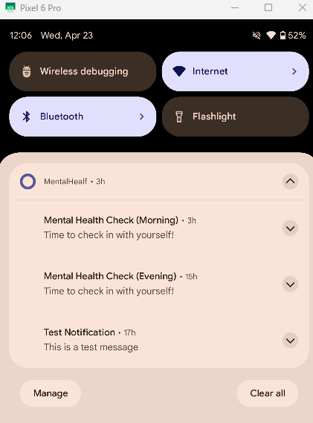
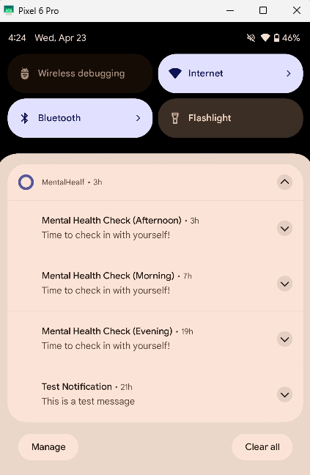
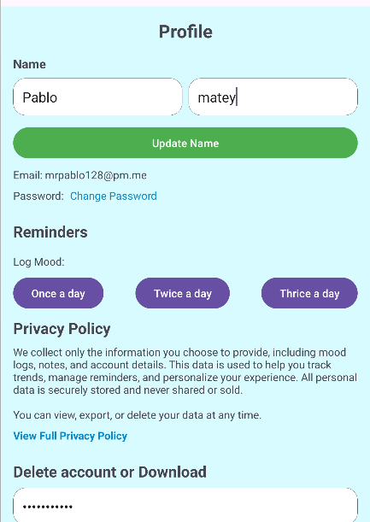
Reminders
• Push notifications remind users to check in daily.
• Helps build consistency in logging.

Slide 9
Challenges & Limitations
No AI: Initially planned but replaced with rule-based logic.
One unknown error remains unresolved.
Documented all issues clearly for future development.
Focused on delivering core features reliably.

Slide 10
Reflections & Lessons Learned
Improved Android development skills
Applied object-oriented principles effectively
Learned to iterate design based on user feedback
Avoid overcomplicating features — simplicity matters
Communication and adaptability through PLTW experience

Slide 11

Thank You
Thanks for your time!
Questions welcome.
2012592@.leedstrinity.ac.uk

