Slide 1

Mental Health Support App
COM6023 Final Year Project
Muhammad Ali Khan | Student ID: 2012592
Notes:
Hi, my name is Muhammad. For my final year project, I built a mental health app to help users track their moods, recognize emotional trends, and journal reflections.

Slide 2
Why This App?
Provide gentle support.
Monitor mood over time.
Recognise trends.
Notes:
Mental health impacts everyone and naturally fluctuates. This app aims to help users become more aware of their moods and offer gentle support through trends and mindfulness

Slide 3
Tools and Technologies
Figma (UI Design)
Android Studio (Java)
Firebase (Auth + Storage)
MPAndroidChart (Trends Graph)
JUnit & Espresso (Testing)
Notes:
I designed the app first using Figma. Then built it with Android Studio. Firebase was used for authentication and storage, MPAndroidChart for data visualization, and JUnit/Espresso for testing.

Slide 4
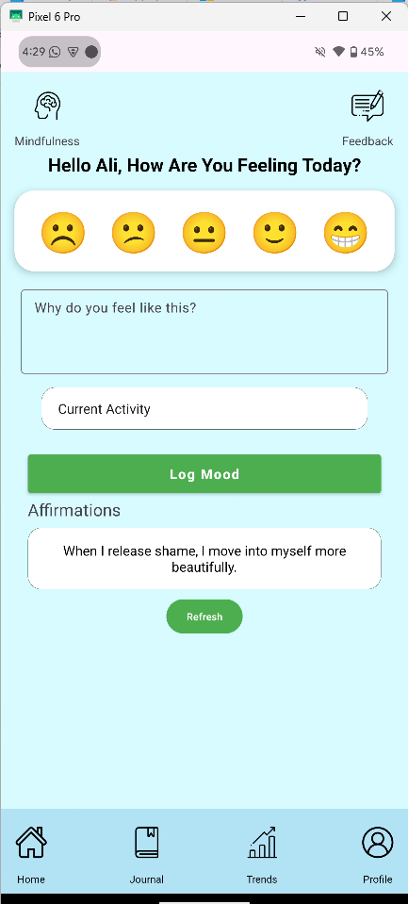
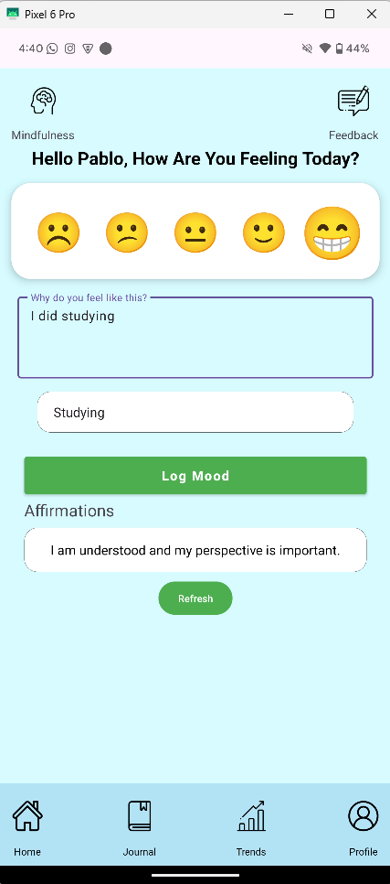
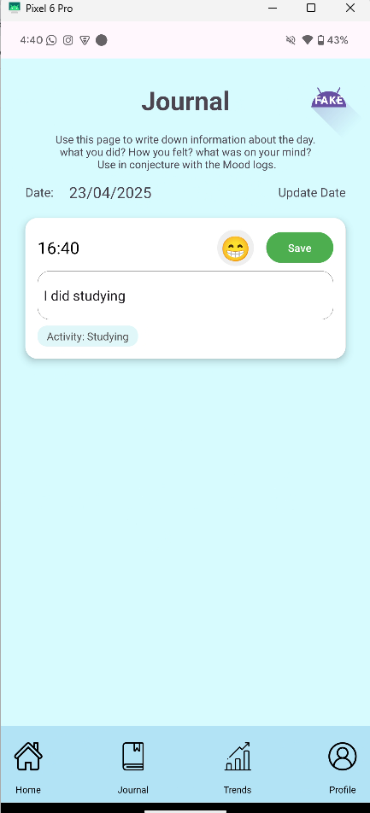
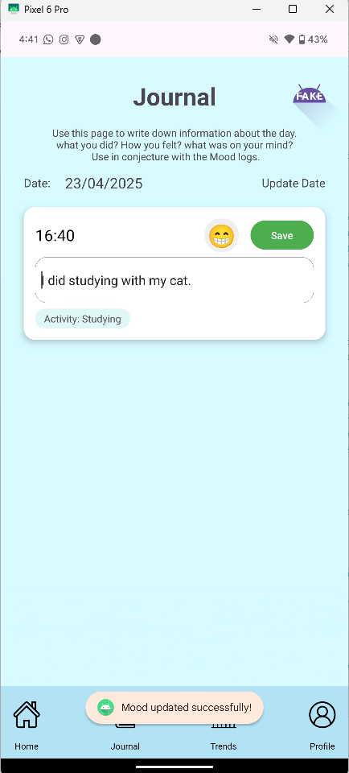
MoodLogs, Affirmations and Journal
Simple UI
Easy to submit
Available immediately in journal
Easy to update
People love affirmations
Notes:
First feature, On the Home screen, users can quickly log moods with emojis and activities. Affirmations also display here, which were very well received.

Slide 5
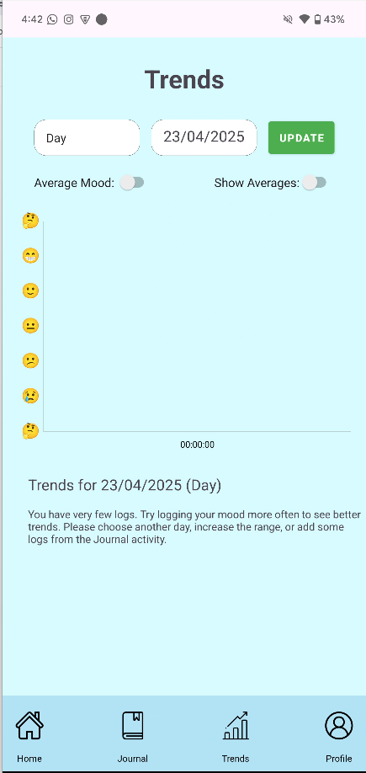
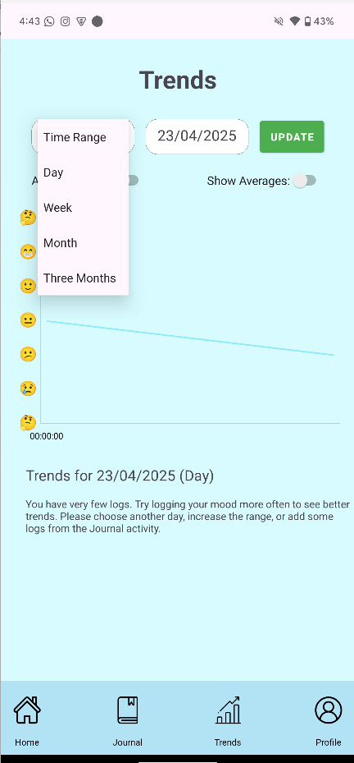
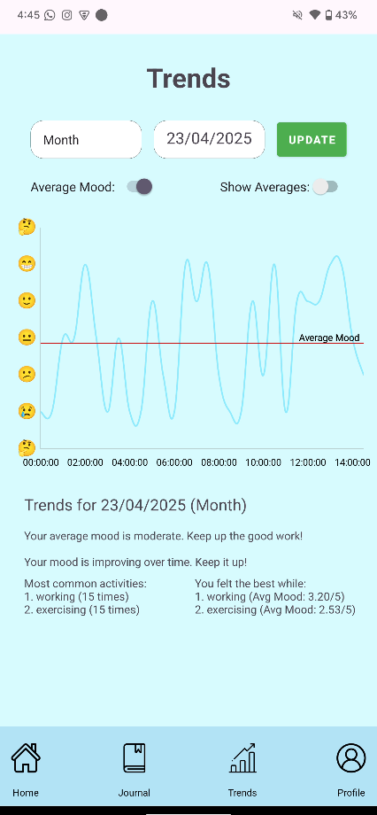
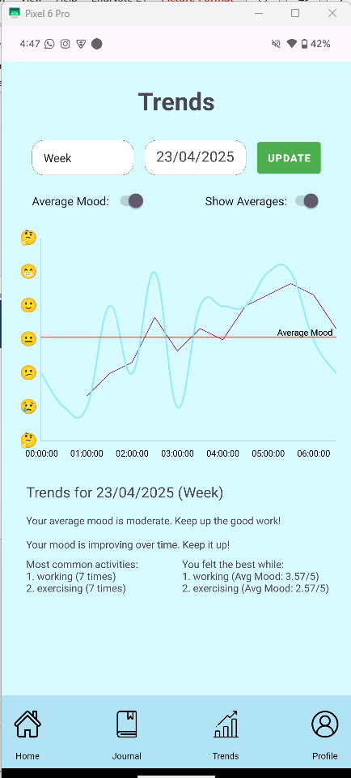
Trends and Suggestions
Line chart shows mood over time.
Linear regression for direction.
Moving average to smooth out noise.
Uses conditional logic based on recent moods.
Offers subtle, context-aware encouragement.
Notes:
The Trends page allows users to select time ranges and view how their mood has changed.
Linear regression analysis detects if moods are improving or declining.
Activity analysis shows which activities make users happiest.

Slide 6
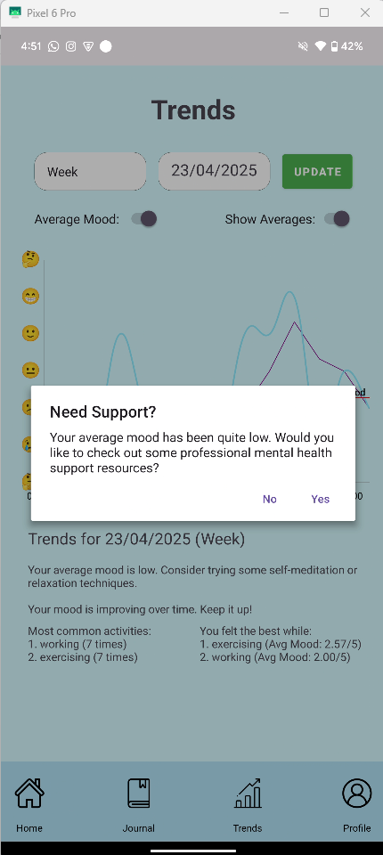
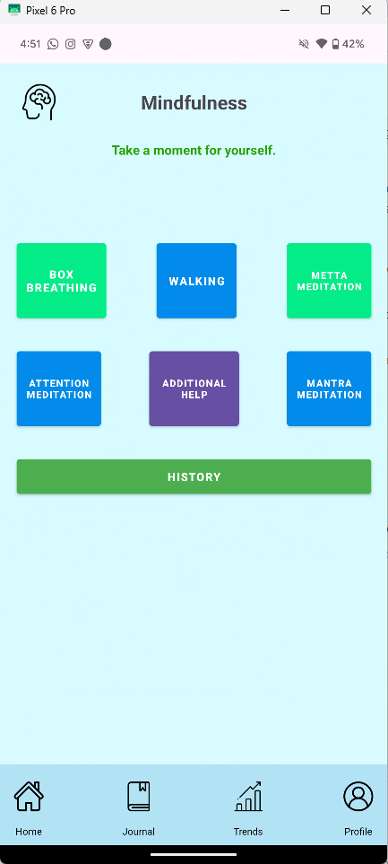
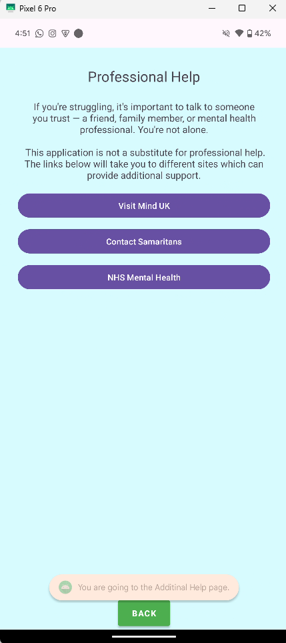
Mindfulness Tools
Built-in meditation tools.
Includes breathing, gratitude, and guided audio.
Encourages calm habits.
Notes:
If a user’s mood is too low, the app shows a popup to encourage using mindfulness exercises to support their wellbeing.
Encourage healthy quick habits

Slide 7
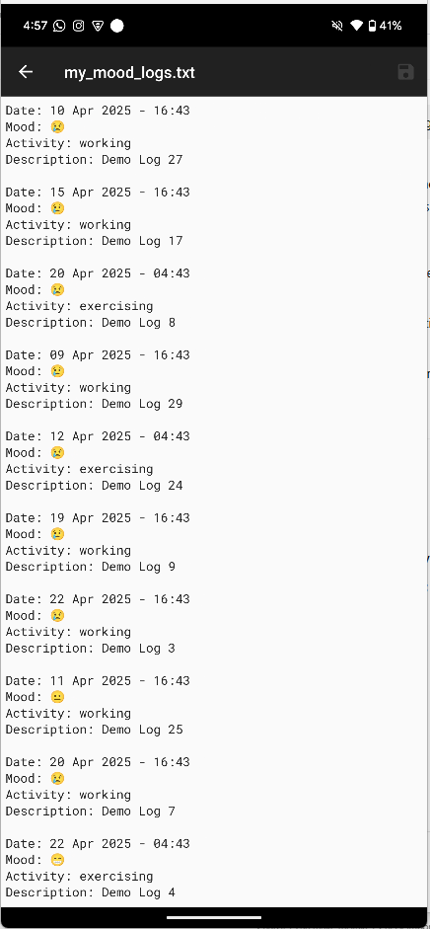
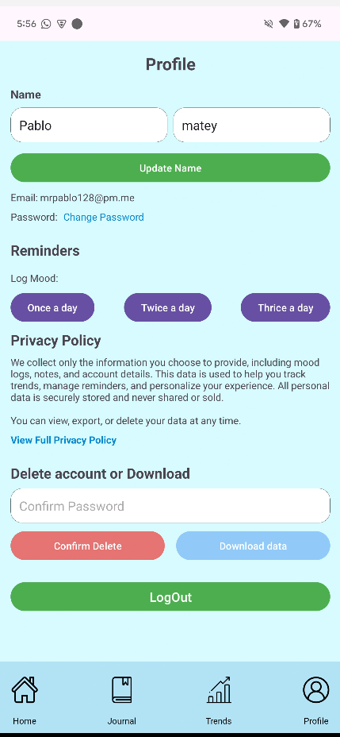
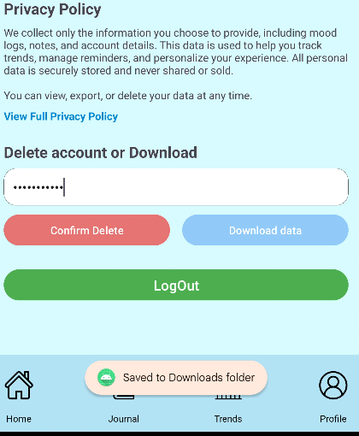

User Management
Users can manage their profiles.
Data can be downloaded or deleted at any time.
Notes:
Users can change their name or password, download or delete their data, and set how often they want reminder notifications.

Slide 8
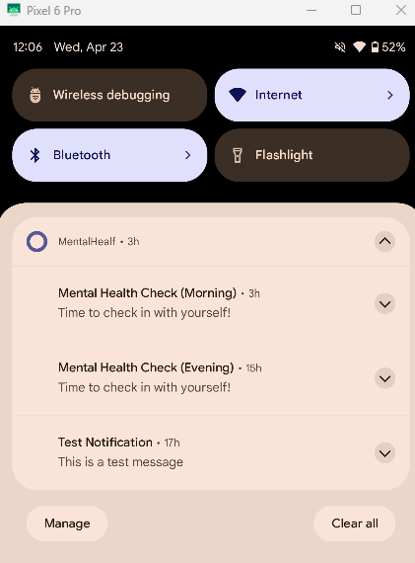
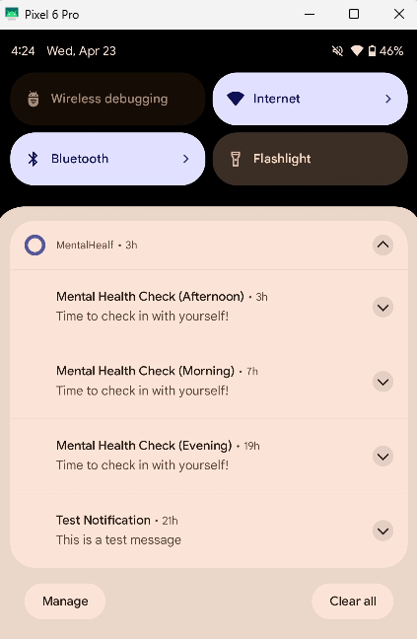
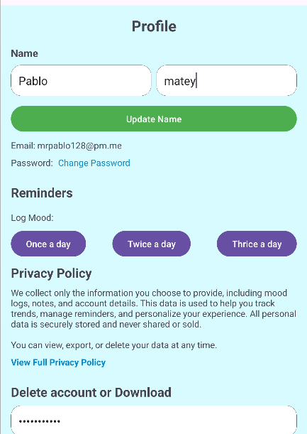
Reminders
• Push notifications remind users to check in daily.
• Helps build consistency in logging.
Notes:
Reminders are subtle and calming — they help build good habits without overwhelming the user.

Slide 9
Challenges & Limitations
No AI: Initially planned but replaced with rule-based logic.
One unknown error remains unresolved.
Documented all issues clearly for future development.
Focused on delivering core features reliably.
Notes:
Originally, I planned AI features, but due to data and device limitations, I replaced them with conditional logic.
I also encountered an error with no real solution but ensured it didn’t affect app performance.
https://issuetracker.google.com/issues/369219148?pli=1

Slide 10
Reflections & Lessons Learned
Improved Android development skills
Applied object-oriented principles effectively
Learned to iterate design based on user feedback
Avoid overcomplicating features — simplicity matters
Communication and adaptability through PLTW experience
Notes:
This project improved my Android development skills, my understanding of user-centered design, and my ability to apply feedback and simplify complex features.

Slide 11

Thank You
Thanks for your time!
Questions welcome.
2012592@.leedstrinity.ac.uk
Notes:
Thank you for listening to my presentation. I’m happy to take any questions you may have.

Slide 12
Links
https://www.youtube.com/watch?v=qZQdLkRkN7M
https://github.com/killerBunny8/mentalhealth-project

