Slide 1
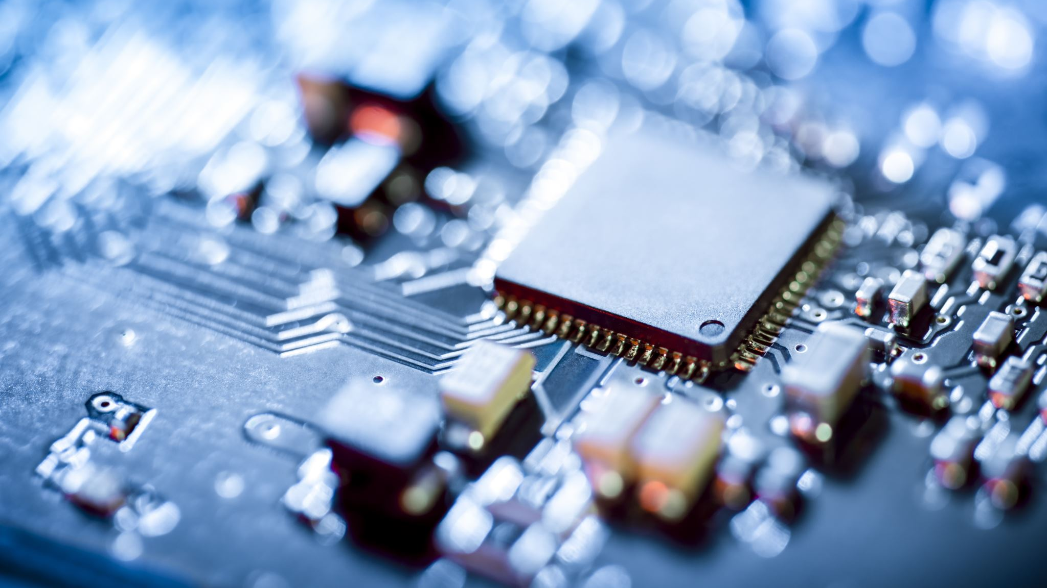
MOB Detector
Garima Arora PC-43
Chetan Vyas PC-45
Abhishek Anand PC-55

Slide 2
AIM
The main aim of taking up this project is to make Mob controllable and more flexible according to the traffic density at that junction. Many a times it so happens that the Mob flow in one direction is very heavy and to the contradictory on the other side (of the same function) it is minimally low. Such conditions result in increase in the rate of contamination of COVID-19.
To reduce such hazards is the main aim of our project. We aim to mimic the COVID-19(Corona) spread by reducing the mob density.

Slide 3

BASIC SCOPE AND BACKGROUND.
As we know covid-19 cases are increasing daily and the main reason behind is that people are not following the COVID protocol which says to maintain social distance and to avoid Mob.
As a result People are loosing their life as well as of there beloved once.
The future scope of this project lies in the successful implementation of a real-time control system by improving the accuracy of the system. Implementation of the proposed system in large-scale yields benefits like less contamination and thereby less no of covid cases.

Slide 4

Objective
To successfully collect real time Mob density.
To mimic real time working of a Detecting signal and maximize the efficiency of the current system.
To control the lights at an intersection based on the data collected.
To minimize wait time and effectively reduce contamination

Slide 5

Block diagram

Slide 6
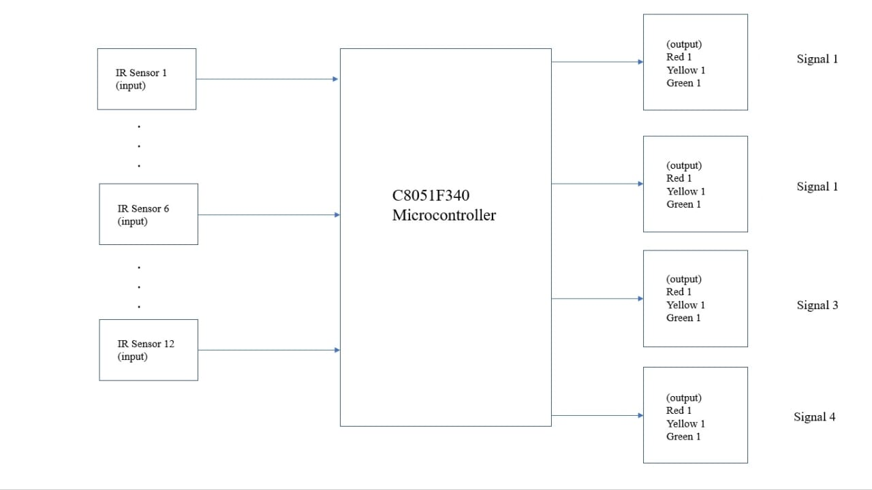

Slide 7

Components
C8051F340-microprocessor
IR sensors
Led
Wires

Slide 8
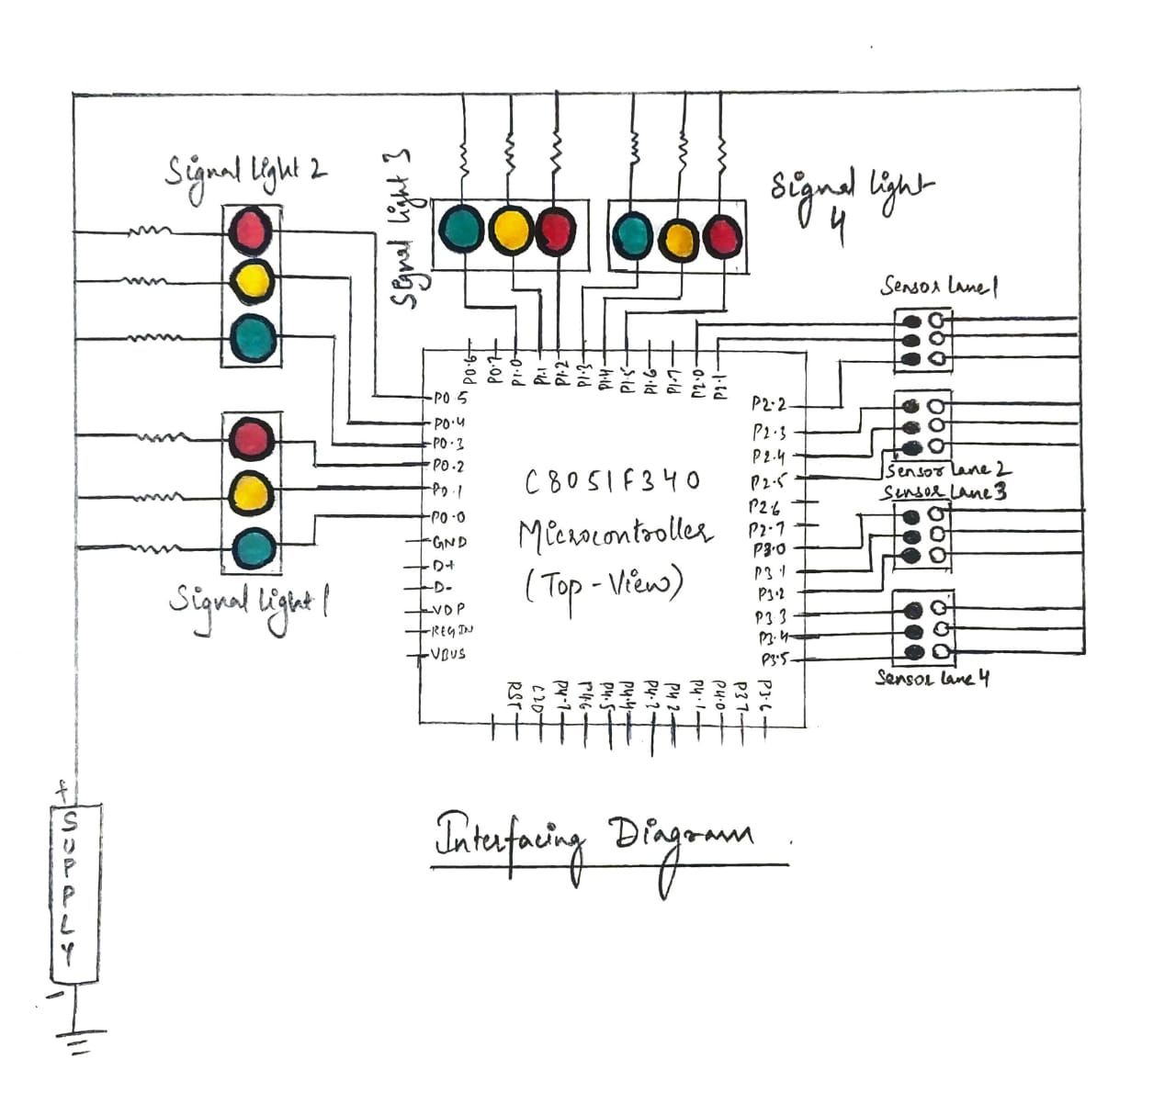
Interfacing diagram:

Slide 9
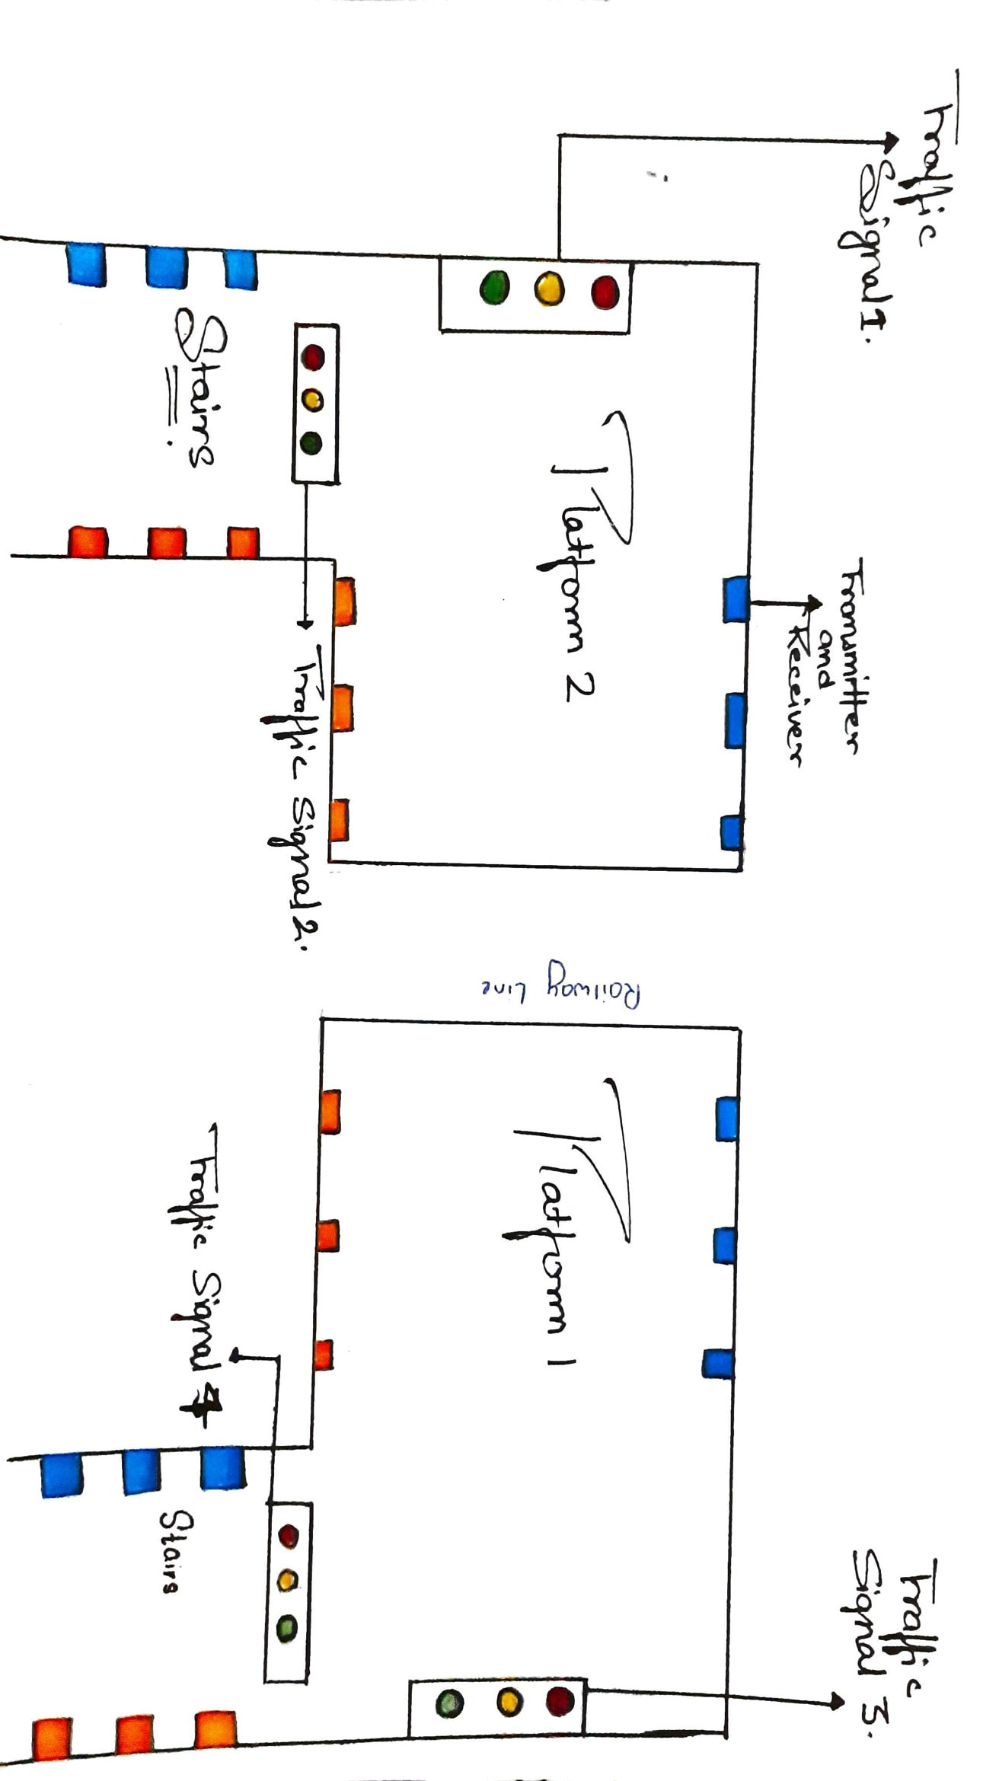
Working Model

Slide 10

Algorithm

Slide 11
Step I: Start
Step II: Assign Ports 0 and 1 to LEDs and Ports 2 and 3 to IR sensors using sbit instruction.
Step III: Define delay() function to generate delay of x milliseconds.
Step IV: Define clear() function to turn off all LEDs.
Step V: Define phase1() function as follows:
Switch off all LEDs.
Switch on Y1.
Switch on R2.
Switch on R3.
Switch on R4.
Delay by 2 sec.
Switch on G1.
Check traffic density and delay accordingly.
Switch on Y1.

Slide 12
Step VI: Define phase2() function as follows:
Switch off all LEDs.
Switch on Y2.
Switch on R1.
Switch on R3.
Switch on R4.
Delay by 2 sec.
Switch on G2.
Check traffic density and delay accordingly.
Switch on Y2.
Step VII: Define phase3() function as follows:
Switch off all LEDs.
Switch on Y3.
Switch on R1.
Switch on R2.
Switch on R4.
Delay by 2 sec.
Switch on G3.
Check traffic density and delay accordingly.
Switch on Y3.

Slide 13
Step VIII: Define phase4() function as follows:
Switch off all LEDs.
Switch on Y4.
Switch on R1.
Switch on R2.
Switch on R3.
Delay by 2 sec.
Switch on G3.
Check traffic density and delay accordingly.
Switch on Y4.
Step IX: In main() function:
Set system clock to 12 MHz.
Initialize Ports 0 and 1 as outputs for LEDs.
Initialise Ports 2 and 3 as inputs for IR sensors.
Enable Crossbar.
In an infinite loop, call phase1(), phase2(), phase3() and phase4() functions.
Step X: Stop.

Slide 14

CODE

Slide 15
#include"c8051f340.h"
sbit R1=P0^0;
sbit Y1=P0^1;
sbit G1=P0^2;
sbit sen11=P2^0;
sbit sen12=P2^1;
sbit sen13=P2^2;
sbit R2=P0^3;
sbit Y2=P0^4;
sbit G2=P0^5;
sbit sen21=P2^3;
sbit sen22=P2^4;
sbit sen23=P2^5;
sbit R3=P1^0;
sbit Y3=P1^1;
sbit G3=P1^2;
sbit sen31=P3^0;
sbit sen32=P3^1;
sbit sen33=P3^2;
sbit R4=P1^3;
sbit Y4=P1^4;
sbit G4=P1^5;
sbit sen41=P3^3;
sbit sen42=P3^4;
sbit sen43=P3^5;
void delay(unsigned int a)
{
unsigned int s,j;
for(s=0;s<a;s++)
for(j=0;j<1275;j++);
}

Slide 16
void clear()
{
R1 = 0xFF;
Y1 = 0xFF;
G1 = 0xFF;
R2 = 0xFF;
Y2 = 0xFF;
G2 = 0xFF;
R3 = 0xFF;
Y3 = 0xFF;
G3 = 0xFF;
R4 = 0xFF;
Y4 = 0xFF;
G4 = 0xFF;
}
void phase1()
{
clear();
Y1=0x00; //first yellow led is turned on
R2=0x00;
R3=0x00;
R4=0x00;
delay(2000);
G1=0x00; // first green led is turned on
R2=0x00;
R3=0x00;
R4=0x00;
if(sen11==1 && sen12==1 && sen13==1)
delay(15000);
else if(sen11==1 && sen12==1)
delay(10000);
else (sen11==1);
delay(5000);
Y1=0x00; //first yellow led is turned on
R2=0x00;
R3=0x00;
R4=0x00;
delay(2000);
}

Slide 17
void phase2()
{
clear();
Y2=0x00; //second yellow led is turned on
R1=0x00;
R3=0x00;
R4=0x00;
delay(2000);
R1=0x00; //second green led is turned on
G2=0x00;
R3=0x00;
R4=0x00;
if(sen21==1 && sen22==1 && sen23==1)
delay(15000);
else if(sen21==1 && sen22==1)
delay(10000);
else(sen21==1);
delay(5000);
Y2=0x00; //second yellow led is turned on
R1=0x00;
R3=0x00;
R4=0x00;
delay(2000);
}
void phase3()
{
clear();
Y3=0x00; //third yellow led is turned on
R2=0x00;
R1=0x00;
R4=0x00;
delay(2000);
R1=0x00; // third green led is turned on
R2=0x00;
G3=0x00;
R4=0x00;
if(sen31==1 && sen32==1 && sen33==1)
delay(15000);
else if(sen31==1 && sen32==1)
delay(10000);
else(sen31==1);
delay(5000);
Y3=0x00; //third yellow led is turned on
R2=0x00;

Slide 18
R1=0x00;
R4=0x00;
delay(2000);
}
void phase4()
{
clear();
Y4=0x00; //fourth yellow led is turned on
R2=0x00;
R1=0x00;
R3=0x00;
delay(2000);
R1=0x00; //fourth green led is turned on
R2=0x00;
R3=0x00;
G4=0x00;
if(sen41==1 && sen42==1 && sen43==1)
delay(15000);
else if(sen41==1 && sen42==1)
delay(10000);
else(sen41==1);
delay(5000);
Y4=0x00; //fourth yellow led is turned on
R2=0x00;
R1=0x00;
R3=0x00;
delay(2000);
}
void main() //Main program
{ OSCICN = 0x83;
P0MDIN = 0x3F; //initializing P0 as input for IR Sensors
P0SKIP = 0xC0; //Skipping pins 6 and 7
P1MDIN = 0x3F; //initializing P1 as input for IR Sensors
P1SKIP = 0xC0; //Skipping pins 6 and 7
P2MDOUT = 0x3F; //Initializing P2 as output for LEDs
P3MDOUT = 0x0F; //initializing P3 as output for leds
XBR1 = 0x40; //enabling the crossbar
while(1) //for infinite loop or continuous operation
{
phase1();
phase2();
phase3();
phase4();
} }

Slide 19
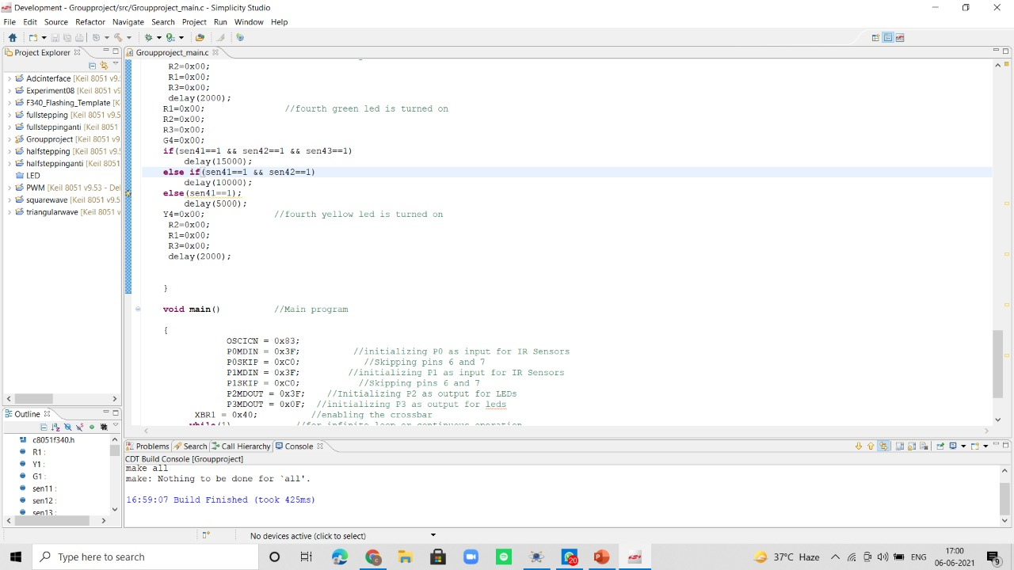

Slide 20

Circuit Diagram.

Slide 21
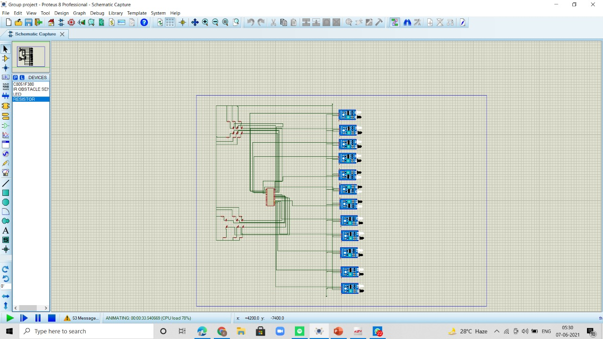

Slide 22
EXPECTED OUTCOME
The proposed system aims to mimic the working of a Signal lights at an intersection in real time conditions and maximize the efficiency by controlling the timing of the lights so as to prioritize high traffic areas where congestion leads to a higher probability of accidents, thus minimizing them.
On implementation, the above system starts reading mob density (as Light, Medium or Heavy according to pre-determined conditions) using IR sensors which continuously transmit Mob density to the microcontroller which allows passing of mob for the stipulated period as mentioned earlier.

Slide 23
Thank you

