Slide 1

Optimization of Bounce rate in pharmaceutical industry

Slide 2
Contents
Business objective
Business Constraints
Project Architecture
Data collection and details
Exploratory Data Analysis
Visualization
Modeling
Evaluation
Deployment

Slide 3
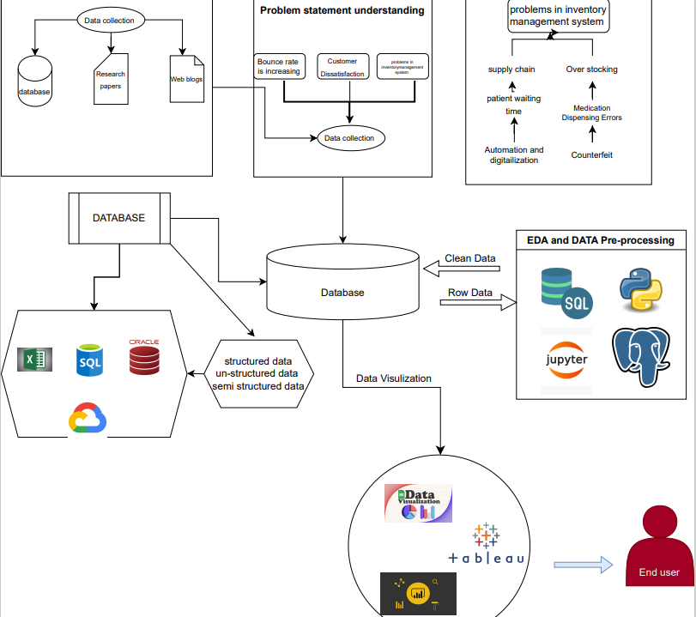
Project Overview and Architecture

Slide 4
Business Problem
Bounce rate increasing significantly leading to patients dissatisfaction
BUSINESS OBJECTIVES
Minimize bounce rate
BUSINESS CONSTRAINTS
Minimize Inventory cost

Slide 5
CRISP-ML(Q) Methodology
There are six stages of CRISP-ML(Q) Methodology
1.Business and data understanding
2.Data preparation
3.model building
4.Model evaluation
5.Model deployment
6.Monitoring and maintenance

Slide 6
Technical Stacks
Python
MySQL
Power BI
Jupiter Notebook
Lucid Chart

Slide 7
Data Collection and cleaning
The institute furnished hospital pharmacy data for analysis.
This data was obtained and transformed into a CSV file format.
Subsequently, the file was securely stored within a database.
The data was then imported into a Python environment, specifically Jupyter Notebook, utilizing pandas and other relevant libraries.
Data cleansing procedures were carried out, encompassing the treatment of missing values, identification and management of outliers, elimination of duplicates, and addressing variance-related concerns.

Slide 8
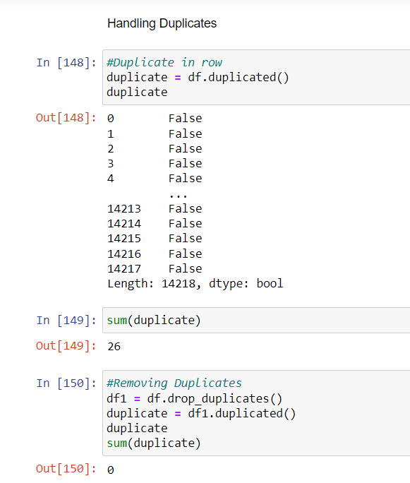
Handling duplicates

Slide 9
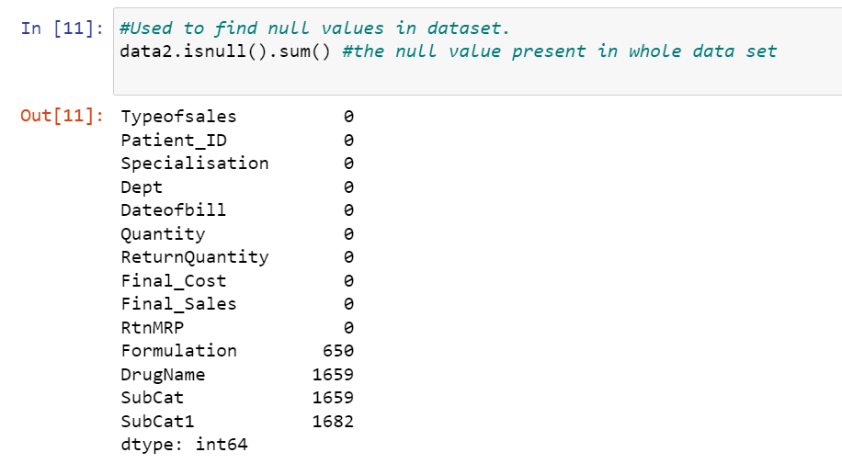
Missing Values Observation

Slide 10
Data Preprocessing ( cleaning)
Duplicate Handling: Eliminating duplicate entries.
Outlier Management: Applying Winsorization to address outliers.
Zero Variance Assessment: Identifying and dealing with variables with zero variance.
Missing Value Handling: Removing or imputing missing values.
Normality Verification: Employing the Shapiro-Wilk test and Q-Q plot or Yeo-Johnson transformation to test and address non-normality in the dataset.

Slide 11
Data Understanding
Exploratory data analysis (EDA) :-
1st moment business decision (mean, median, mode)
2nd moment business decision (standard deviation, variance and range)
3rd moment business decision (skewness)
4th moment business decision(kurtosis)

Slide 12
Data Visualization
Bar Plot
Histogram
Box Plot
Q-Q Plot
Pair Plot

Slide 13
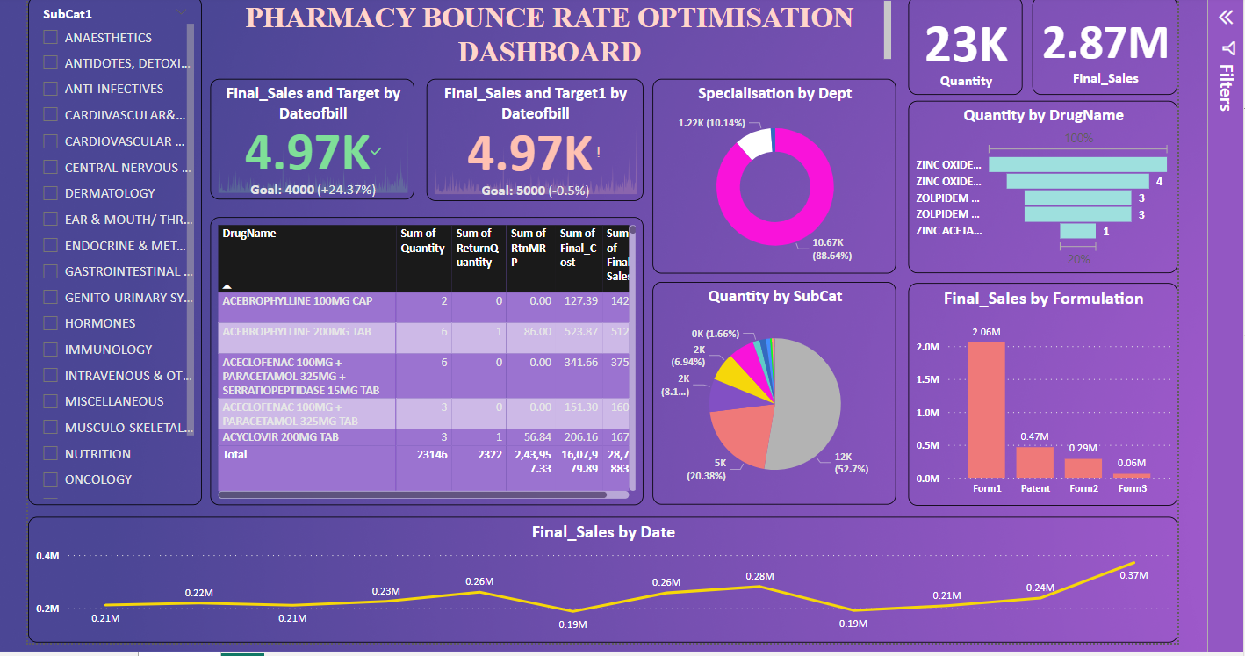
dashboard

Slide 14

Queries ?

Slide 15


