Slide 1
Java 面向对象
高宏宇
电话：13981814271
QQ：12793148

Slide 2
课程安排
课时：32+16，其中16个实验中包含两次共4课时的过程考试。实际实验只有12个课时。
实验安排：周三晚上，如果有冲突，个别调整。
课程难度，对于初步接触面向对象，该课程比较难，往年通过率在75%～80%之间。
成绩：过程化考试20%，实验报告10%；课后作业10%；出勤10%；最后考试（机考）50%
章节内容：目录

Slide 3
Questions
1、Why English for Java?
2、What is Process Oriented?
3、What is Object Oriented?
4、How to study？
5、Now What？

Slide 4
描述一个圆
如何用C描述一个圆(结构体，坐标，r)
类与对象的概念
一个结构体指针的生成
如何操作成员
数据与操作是分离的
如何用Java来做同样的工作

Slide 5
问题
Java定义一个类是如何的？
Java中13～16行中的this代表什么？
Java的语法和C有什么区别？
注意C中33行和Java中32行代码，代表什么意思？
注意C中给结构体指针成员赋值与Java中对象成员赋值的区别。
Java中类包含了函数，这是C中结构体不具备的能力。
C和Java都有主函数Main，他们的写法有什么不一样？

Slide 6
Chapter 1 Introduction to Computers, Programs, and Java

Slide 7
Objectives
计算机基础以及基本术语
几种计算机语言的方式（编译、解释）
Java简介
API、SDK、IDE、Framework
Java Hello world 分析
Java是编译还是解释，还是更特殊？
初步认识Java结构
编程风格
三种错误类型

Slide 8
What is a Computer?
A computer consists of a CPU, memory, hard disk, floppy disk, monitor, printer, and communication devices.

Slide 9
CPU
The central processing unit (CPU) is the brain of a computer. It retrieves instructions from memory and executes them. The CPU speed is measured in megahertz (MHz), with 1 megahertz equaling 1 million pulses per second. The speed of the CPU has been improved continuously. If you buy a PC now, you can get an Intel Pentium 4 Processor at 3 gigahertz (1 gigahertz is 1000 megahertz).

Slide 10
Memory
Memory is to store data and program instructions for CPU to execute. A memory unit is an ordered sequence of bytes, each holds eight bits. A program and its data must be brought to memory before they can be executed. A memory byte is never empty, but its initial content may be meaningless to your program. The current content of a memory byte is lost whenever new information is placed in it.

Slide 11
How Data is Stored?
Data of various kinds, such as numbers, characters, and strings, are encoded as a series of bits (zeros and ones). Computers use zeros and ones because digital devices have two stable states, which are referred to as zero and one by convention. The programmers need not to be concerned about the encoding and decoding of data, which is performed automatically by the system based on the encoding scheme. The encoding scheme varies. For example, character ‘J’ is represented by 01001010 in one byte. A small number such as three can be stored in a single byte. If computer needs to store a large number that cannot fit into a single byte, it uses a number of adjacent bytes. No two data can share or split a same byte. A byte is the minimum storage unit.

Slide 12
Storage Devices
Memory is volatile, because information is lost when the power is off. Programs and data are permanently stored on storage devices and are moved to memory when the computer actually uses them. There are three main types of storage devices:Disk drives (hard disks and floppy disks), CD drives (CD-R and CD-RW), and Tape drives.

Slide 13
Output Devices: Monitor
The monitor displays information (text and graphics). The resolution and dot pitch determine the quality of the display.

Slide 14
Monitor Resolution and Dot Pitch
resolution
The screen resolution specifies the number of pixels in horizontal and vertical dimensions of the display device. Pixels (short for “picture elements”) are tiny dots that form an image on the screen. A common resolution for a 17-inch screen, for example, is 1,024 pixels wide and 768 pixels high. The resolution can be set manually. The higher the resolution, the sharper and clearer the image is.
dot pitch
The dot pitch is the amount of space between pixels, measured in millimeters. The smaller the dot pitch, the sharper the display.

Slide 15
Communication Devices
A regular modem uses a phone line and can transfer data in a speed up to 56,000 bps (bits per second). A DSL (digital subscriber line) also uses a phone line and can transfer data in a speed 20 times faster than a regular modem. A cable modem uses the TV cable line maintained by the cable company. A cable modem is as fast as a DSL. Network interface card (NIC) is a device to connect a computer to a local area network (LAN). The LAN is commonly used in business, universities, and government organizations. A typical type of NIC, called 10BaseT, can transfer data at 10 mbps (million bits per second).

Slide 16
Programs （P7）
Computer programs, known as software, are instructions to the computer.
You tell a computer what to do through programs. Without programs, a computer is an empty machine. Computers do not understand human languages, so you need to use computer languages to communicate with them.
Programs are written using programming languages.

Slide 17
Programming Languages
Machine Language Assembly Language High-Level Language
Machine language is a set of primitive instructions built into every computer. The instructions are in the form of binary code, so you have to enter binary codes for various instructions. Program with native machine language is a tedious process. Moreover the programs are highly difficult to read and modify. For example, to add two numbers, you might write an instruction in binary like this:
1101101010011010

Slide 18
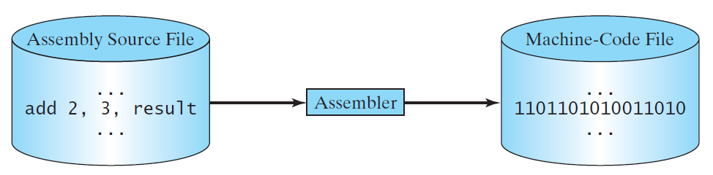
Programming Languages
Machine Language Assembly Language High-Level Language
Assembly languages were developed to make programming easy. Since the computer cannot understand assembly language, however, a program called assembler is used to convert assembly language programs into machine code. For example, to add two numbers, you might write an instruction in assembly code like this:
ADDF3 R1, R2, R3

Slide 19
Programming Languages
Machine Language Assembly Language High-Level Language
The high-level languages are English-like and easy to learn and program. For example, the following is a high-level language statement that computes the area of a circle with radius 5:
area = 5 * 5 * 3.1415;

Slide 20
Popular High-Level Languages

Slide 21
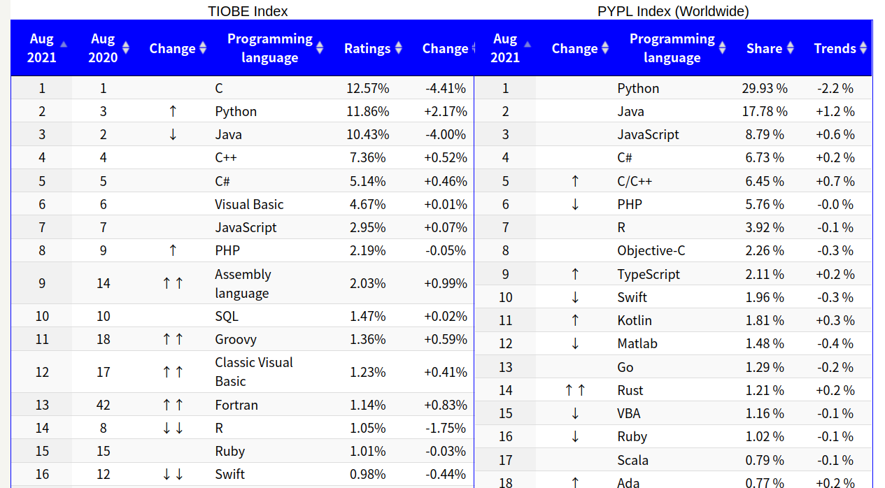

Slide 22
Interpreting/Compiling Source Code
A program written in a high-level language is called a source program or source code. Because a computer cannot understand a source program, a source program must be translated into machine code for execution. The translation can be done using another programming tool called an interpreter or a compiler.

Slide 23
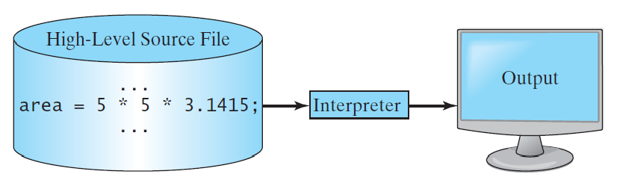
Interpreting Source Code
An interpreter reads one statement from the source code, translates it to the machine code or virtual machine code, and then executes it right away, as shown in the following figure. Note that a statement from the source code may be translated into several machine instructions.

Slide 24
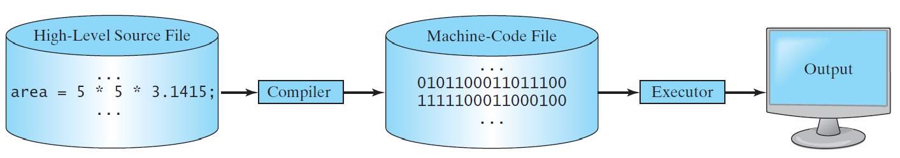
Compiling Source Code
A compiler translates the entire source code into a machine-code file, and the machine-code file is then executed, as shown in the following figure.

Slide 25
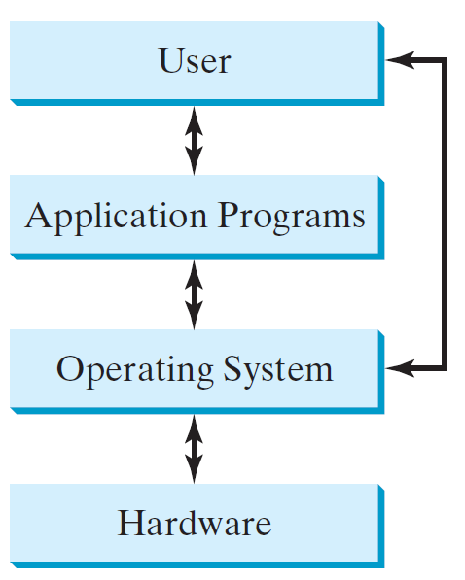
Operating Systems
The operating system (OS) is a program that manages and controls a computer’s activities. The popular operating systems for general-purpose computers are Microsoft Windows, Mac OS, and Linux. Application programs, such as a Web browser or a word processor, cannot run unless an operating system is installed and running on the computer.

Slide 26
Why Java?
The answer is that Java enables users to develop and deploy applications on the Internet for servers, desktop computers, and small hand-held devices. The future of computing is being profoundly influenced by the Internet, and Java promises to remain a big part of that future. Java is the Internet programming language.
Java is a general purpose programming language.
Java is the Internet programming language.

Slide 27
Java, Web, and Beyond
Java can be used to develop standalone applications.
Java can be used to develop applications running from a browser.
Java can also be used to develop applications for hand-held devices.
Java can be used to develop applications for Web servers.

Slide 28
Java’s History
James Gosling and Sun Microsystems
Oak
Java, May 20, 1995, Sun World
HotJava
The first Java-enabled Web browser
Early History Website:
http://www.java.com/en/javahistory/index.jsp

Slide 29
What is OOP?
Struct example for C
struct definition and instance.
how to create a instance from struct pointer type.
how to manipulate struct.
How to impliment in Java.
compare struct definition and class difinition
functions in “struct”
What is class, and object?

Slide 30
API JDK IDE
API: application programming interface
JDK: Java Developing Kit
IDE: Integrated Development Environment

Slide 31
Popular Java IDEs
NetBeans
Eclipse
Idea Intellij

Slide 32
A Simple Java Program
Listing 1.1
// This program prints Welcome to Java!
public class Welcome {
public static void main(String[] args) {
System.out.println("Welcome to Java!");
}
}
问题：如果使用C来写一个Hello world应该怎么写？
问题：对比和C实现的相同和不同

Slide 33

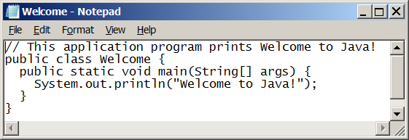
Creating and Editing Using NotePad
To use NotePad, type
notepad Welcome.java
from the DOS prompt.

Slide 34

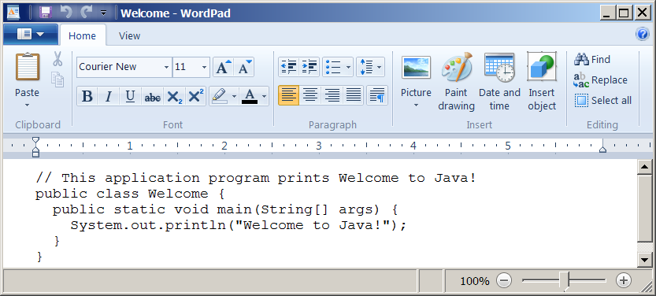
Creating and Editing Using WordPad
To use WordPad, type
write Welcome.java
from the DOS prompt.

Slide 35
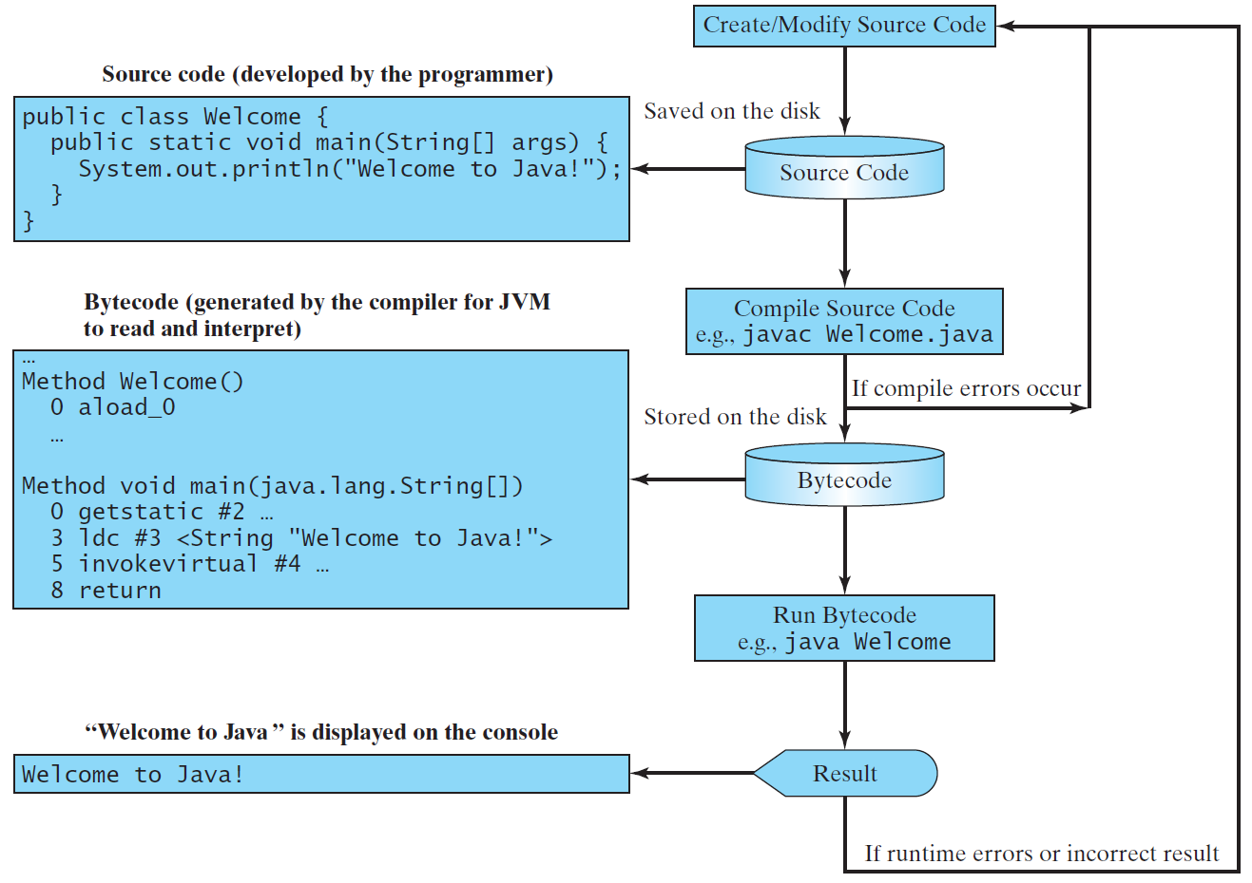
Creating, Compiling, and Running Programs
.java
.class

Slide 36
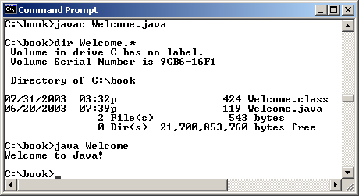
Compiling and Running Java from the Command Window
Set path to JDK bin directory
set path=c:\Program Files\java\jdk1.8.0\bin
Set classpath to include the current directory（单文件可以不做）
set classpath=.
Compile
javac Welcome.java
Run
java Welcome

Slide 37
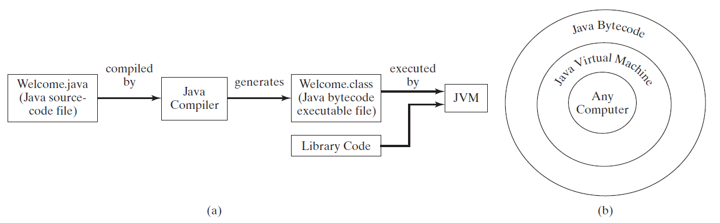
Compiling Java Source Code
You can port a source program to any machine with appropriate compilers. The source program must be recompiled, however, because the object program can only run on a specific machine. Nowadays computers are networked to work together. Java was designed to run object programs on any platform. With Java, you write the program once, and compile the source program into a special type of object code, known as bytecode. The bytecode can then run on any computer with a Java Virtual Machine, as shown below. Java Virtual Machine is a software that interprets Java bytecode.
（p17）对比书上第九页，有什么区别？为什么编译后的java程序可以执行在任何操作系统

Slide 38
Java is only a Java?补充
Java is a programming language
Java is Virtual Machine
What is Virtual Machine?
Like a os on os
Isolate OS from java bytecode
Languages on Java VM
Kotlin、Groovy、JRuby、Jython、Scala …

Slide 39
Eclipse
Download and setup
workspace、project、package、source
Run and debug
http://danny.ronyao.com:2000/books/java/page/java

Slide 40
Anatomy of a Java Program
Class name
Main method
Statements
Statement terminator
Reserved words
Comments
Blocks

Slide 41
Class Name
Every Java program must have at least one class. Each class has a name. By convention, class names start with an uppercase letter. In this example, the class name is Welcome.
// This program prints Welcome to Java!
public class Welcome {
public static void main(String[] args) {
System.out.println("Welcome to Java!");
}
}

Slide 42
Main Method
Line 2 defines the main method. In order to run a class, the class must contain a method named main. The program is executed from the main method.
// This program prints Welcome to Java!
public class Welcome {
public static void main(String[] args) {
System.out.println("Welcome to Java!");
}
}

Slide 43
Statement
A statement represents an action or a sequence of actions. The statement System.out.println("Welcome to Java!") in the program in Listing 1.1 is a statement to display the greeting "Welcome to Java!“.
// This program prints Welcome to Java!
public class Welcome {
public static void main(String[] args) {
System.out.println("Welcome to Java!");
}
}

Slide 44
Statement Terminator
Every statement in Java ends with a semicolon (;).
// This program prints Welcome to Java!
public class Welcome {
public static void main(String[] args) {
System.out.println("Welcome to Java!");
}
}

Slide 45
Reserved words
Reserved words or keywords are words that have a specific meaning to the compiler and cannot be used for other purposes in the program. For example, when the compiler sees the word class, it understands that the word after class is the name for the class.
// This program prints Welcome to Java!
public class Welcome {
public static void main(String[] args) {
System.out.println("Welcome to Java!");
}
}

Slide 46
Blocks
A pair of braces in a program forms a block that groups components of a program.

Slide 47
Special Symbols

Slide 48
Programming Style and Documentation
Appropriate Comments
Naming Conventions
Proper Indentation and Spacing Lines
Block Styles
补充演示IDE的功能

Slide 49
Appropriate Comments
Include a summary at the beginning of the program to explain what the program does, its key features, its supporting data structures, and any unique techniques it uses.
Include your name, class section, instructor, date, and a brief description at the beginning of the program.

Slide 50
Naming Conventions
Choose meaningful and descriptive names.
Class names:
Capitalize the first letter of each word in the name. For example, the class name ComputeExpression.

Slide 51
Proper Indentation and Spacing
Indentation
Indent two spaces.
Spacing
Use blank line to separate segments of the code.

Slide 52
Block Styles
Use end-of-line style for braces.

Slide 53
Programming Errors
Syntax Errors
Detected by the compiler
Runtime Errors
Causes the program to abort
Logic Errors
Produces incorrect result
这三种错误的区别和联系。C语言有吗？

Slide 54
Syntax Errors
public class ShowSyntaxErrors {
public static main(String[] args) {
System.out.println("Welcome to Java);
}
}
ShowSyntaxErrors
Run

Slide 55
Runtime Errors
public class ShowRuntimeErrors {
public static void main(String[] args) {
System.out.println(1 / 0);
}
}
ShowRuntimeErrors
Run

Slide 56
Logic Errors
public class ShowLogicErrors {
public static void main(String[] args) {
System.out.println("Celsius 35 is Fahrenheit degree ");
System.out.println((9 / 5) * 35 + 32);
}
}
ShowLogicErrors
Run

Slide 57
Eclipse 使用演示

