Slide 1
Chapter 2 Elementary Programming

Slide 2
Motivations
In the preceding chapter, you learned how to create, compile, and run a Java program. Starting from this chapter, you will learn how to solve practical problems programmatically. Through these problems, you will learn Java primitive data types and related subjects, such as variables, constants, data types, operators, expressions, and input and output.

Slide 3
Objectives
对C语言比分析Java的简单程序。
通过控制台（命令行界面）读取输入。
初步分析Java的输入实现。
Java的标识符（变量、函数等）命名规则，几乎和C一样。
基本数值类型分析。
通过输入读取不同的数据类型。
浮点类型的精度，与C一样。
数学计算库，对比C语言。
字面量和表示方式
类型转化，以及隐含转化法则。
基本运算符（和C一致）。
开发流程（略）
常见的错误。

Slide 4
Introducing Programming with an Example(p35)
Listing 2.1 Computing the Area of a Circle
This program computes the area of the circle.
和C语言有什么区别？
深入分析一个简单的程序。
ComputeArea

Slide 5
深入分析
文件名和类名？
参数列表：String[] args？
变量命名：与C的区别？
字符串操作和C的区别？
注意到了Public吗？猜是什么？
注意到了Static了吗？猜猜是什么？
我们看看System.out.println 是什么？
初步理解一下什么是（静态）类，对比C语言中是什么？

Slide 6
Reading Input from the Console(p37)
1. Create a Scanner object
Scanner input = new Scanner(System.in);
2. Use the method nextDouble() to obtain to a double value. For example,
System.out.print("Enter a double value: ");
Scanner input = new Scanner(System.in);
double d = input.nextDouble();
ComputeAreaWithConsoleInput

Slide 7
深入分析输入
C中如何读取键盘输入？
new Scanner(System.in) 可能是什么意思？对比C语言
input.nextDouble()是什么意思？
我们看看Scanner 中还有什么？p45，后面详细讲。
import 是什么意思？

Slide 8
Identifiers(p40)
An identifier is a sequence of characters that consist of letters, digits, underscores (_), and dollar signs ($).
An identifier must start with a letter, an underscore (_), or a dollar sign ($). It cannot start with a digit.
An identifier cannot be a reserved word. (See Appendix A, “Java Keywords,” for a list of reserved words).
An identifier cannot be true, false, or null.
An identifier can be of any length.

Slide 9
Variables
// Compute the first area
radius = 1.0;
area = radius * radius * 3.14159;
System.out.println("The area is “ + area + " for radius "+radius);
// Compute the second area
radius = 2.0;
area = radius * radius * 3.14159;
System.out.println("The area is “ + area + " for radius "+radius);

Slide 10
Declaring Variables
int x; // Declare x to be an
// integer variable;
double radius; // Declare radius to
// be a double variable;
char a; // Declare a to be a
// character variable;

Slide 11
Assignment Statements
x = 1; // Assign 1 to x;
radius = 1.0; // Assign 1.0 to radius;
a = 'A'; // Assign 'A' to a;

Slide 12
Declaring and Initializing in One Step
int x = 1;
double d = 1.4;

Slide 13
Named Constants
final datatype CONSTANTNAME = VALUE;
final double PI = 3.14159;
final int SIZE = 3;

Slide 14
Naming Conventions
Choose meaningful and descriptive names.
Variables and method names:
Use lowercase. If the name consists of several words, concatenate all in one, use lowercase for the first word, and capitalize the first letter of each subsequent word in the name. For example, the variables radius and area, and the method computeArea.

Slide 15
Naming Conventions, cont.
Class names:
Capitalize the first letter of each word in the name. For example, the class name ComputeArea.
Constants:
Capitalize all letters in constants, and use underscores to connect words. For example, the constant PI and MAX_VALUE
Why variables use lowercase for first letter?

Slide 16
Numerical Data Types

Slide 17
对比C的基本数据类型 （数值类）
C还有什么？
Java中没有什么？
注意！

Slide 18
Reading Numbers from the Keyboard
Scanner input = new Scanner(System.in);
int value = input.nextInt();

Slide 19
Numeric Operators

Slide 20
Integer Division
+, -, *, /, and %
5 / 2 yields an integer 2.
5.0 / 2 yields a double value 2.5
5 % 2 yields 1 (the remainder of the division)

Slide 21
Remainder Operator
Remainder is very useful in programming. For example, an even number % 2 is always 0 and an odd number % 2 is always 1. So you can use this property to determine whether a number is even or odd. Suppose today is Saturday and you and your friends are going to meet in 10 days. What day is in 10 days? You can find that day is Tuesday using the following expression:

Slide 22
Problem: Displaying Time
P47
简单分析
DisplayTime

Slide 23
NOTE
Calculations involving floating-point numbers are approximated because these numbers are not stored with complete accuracy. For example,
System.out.println(1.0 - 0.1 - 0.1 - 0.1 - 0.1 - 0.1);
displays 0.5000000000000001, not 0.5, and
System.out.println(1.0 - 0.9);
displays 0.09999999999999998, not 0.1. Integers are stored precisely. Therefore, calculations with integers yield a precise integer result.

Slide 24
Exponent Operations P48
System.out.println(Math.pow(2, 3));
// Displays 8.0
System.out.println(Math.pow(4, 0.5));
// Displays 2.0
System.out.println(Math.pow(2.5, 2));
// Displays 6.25
System.out.println(Math.pow(2.5, -2));
// Displays 0.16
这是什么？C语言中又吗？有什么区别？

Slide 25
Number Literals p49 （字面量，字面常量）
A literal is a constant value that appears directly in the program. For example, 34, 1,000,000, and 5.0 are literals in the following statements:
int i = 34;
long x = 1000000;
double d = 5.0;

Slide 26
Integer Literals()
An integer literal can be assigned to an integer variable as long as it can fit into the variable. A compilation error would occur if the literal were too large for the variable to hold. For example, the statement byte b = 1000 would cause a compilation error, because 1000 cannot be stored in a variable of the byte type.
An integer literal is assumed to be of the int type, whose value is between -2³¹ (-2147483648) to 2³¹–1 (2147483647). To denote an integer literal of the long type, append it with the letter L or l. L is preferred because l (lowercase L) can easily be confused with 1 (the digit one).

Slide 27
Floating-Point Literals p49
Floating-point literals are written with a decimal point. By default, a floating-point literal is treated as a double type value. For example, 5.0 is considered a double value, not a float value. You can make a number a float by appending the letter f or F, and make a number a double by appending the letter d or D. For example, you can use 100.2f or 100.2F for a float number, and 100.2d or 100.2D for a double number.
演示代码，为什么出错？float赋值。

Slide 28
double vs. float
The double type values are more accurate than the float type values. For example,
System.out.println("1.0 / 3.0 is " + 1.0 / 3.0);
System.out.println("1.0F / 3.0F is " + 1.0F / 3.0F);

Slide 29
Scientific Notation
Floating-point literals can also be specified in scientific notation, for example, 1.23456e+2, same as 1.23456e2, is equivalent to 123.456, and 1.23456e-2 is equivalent to 0.0123456. E (or e) represents an exponent and it can be either in lowercase or uppercase.

Slide 30
Arithmetic Expressions
is translated to
(3+4*x)/5 – 10*(y-5)*(a+b+c)/x + 9*(4/x + (9+x)/y)

Slide 31
How to Evaluate an Expression
Though Java has its own way to evaluate an expression behind the scene, the result of a Java expression and its corresponding arithmetic expression are the same. Therefore, you can safely apply the arithmetic rule for evaluating a Java expression.

Slide 32
Problem: Converting Temperatures
Write a program that converts a Fahrenheit degree to Celsius using the formula:
Note: you have to write
celsius = (5.0 / 9) * (fahrenheit – 32)
FahrenheitToCelsius

Slide 33
Problem: Displaying Current Time p52
Write a program that displays current time in GMT in the format hour:minute:second such as 1:45:19.
The currentTimeMillis method in the System class returns the current time in milliseconds since the midnight, January 1, 1970 GMT. (1970 was the year when the Unix operating system was formally introduced.) You can use this method to obtain the current time, and then compute the current second, minute, and hour as follows.
System.currentTimeMillis();
ShowCurrentTime

Slide 34
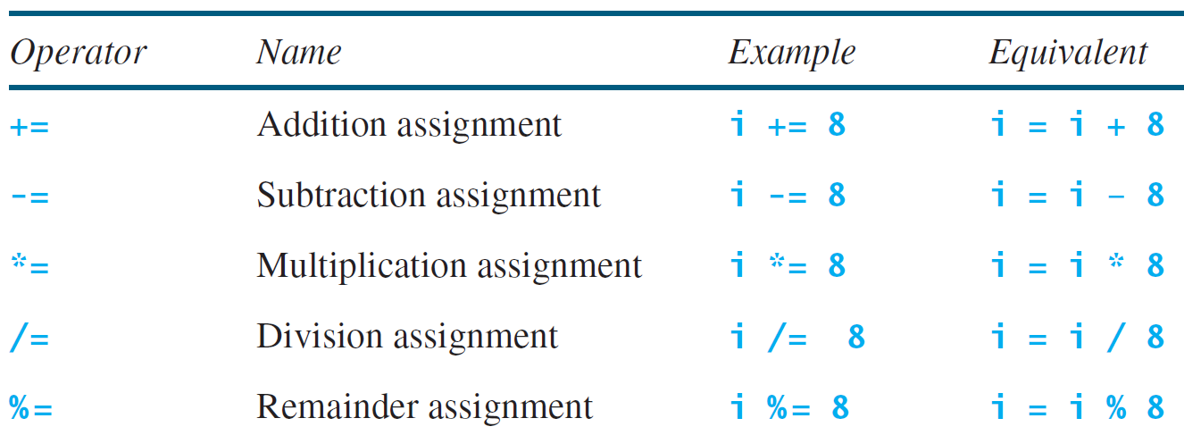
Augmented Assignment Operators

Slide 35
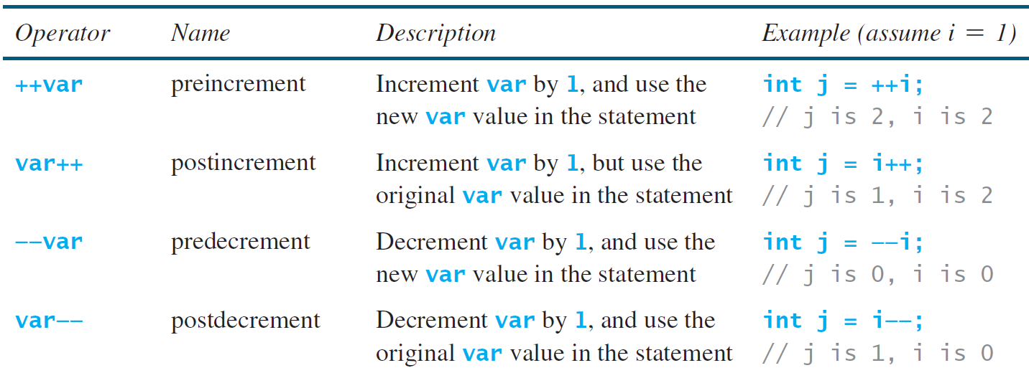
Increment and Decrement Operators

Slide 36
Increment and Decrement Operators, ont.

Slide 37
Increment and Decrement Operators, cont.
Using increment and decrement operators makes expressions short, but it also makes them complex and difficult to read. Avoid using these operators in expressions that modify multiple variables, or the same variable for multiple times such as this: int k = ++i + i.

Slide 38
Assignment Expressions and Assignment Statements
Prior to Java 2, all the expressions can be used as statements. Since Java 2, only the following types of expressions can be statements:
variable op= expression; // Where op is +, -, *, /, or %
++variable;
variable++;
--variable;
variable--;

Slide 39
Numeric Type Conversion p56
Consider the following statements:
byte i = 100;
long k = i * 3 + 4;
double d = i * 3.1 + k / 2;

Slide 40
Conversion Rules
When performing a binary operation involving two operands of different types, Java automatically converts the operand based on the following rules:
1. If one of the operands is double, the other is converted into double.
2. Otherwise, if one of the operands is float, the other is converted into float.
3. Otherwise, if one of the operands is long, the other is converted into long.
4. Otherwise, both operands are converted into int.
一句话，向高精度看齐

Slide 41
Type Casting
Implicit casting
double d = 3; (type widening)
Explicit casting
int i = (int)3.0; (type narrowing)
int i = (int)3.9; (Fraction part is truncated)
What is wrong? int x = 5 / 2.0;

Slide 42
Problem: Keeping Two Digits After Decimal Points
Write a program that displays the sales tax with two digits after the decimal point.
我觉得有些笨，还有什么方法？联想到C语言的输出。
SalesTax

Slide 43
Casting in an Augmented Expression
In Java, an augmented expression of the form x1 op= x2 is implemented as x1 = (T)(x1 op x2), where T is the type for x1. Therefore, the following code is correct.
int sum = 0;
sum += 4.5; // sum becomes 4 after this statement
sum += 4.5 is equivalent to sum = (int)(sum + 4.5).

Slide 44
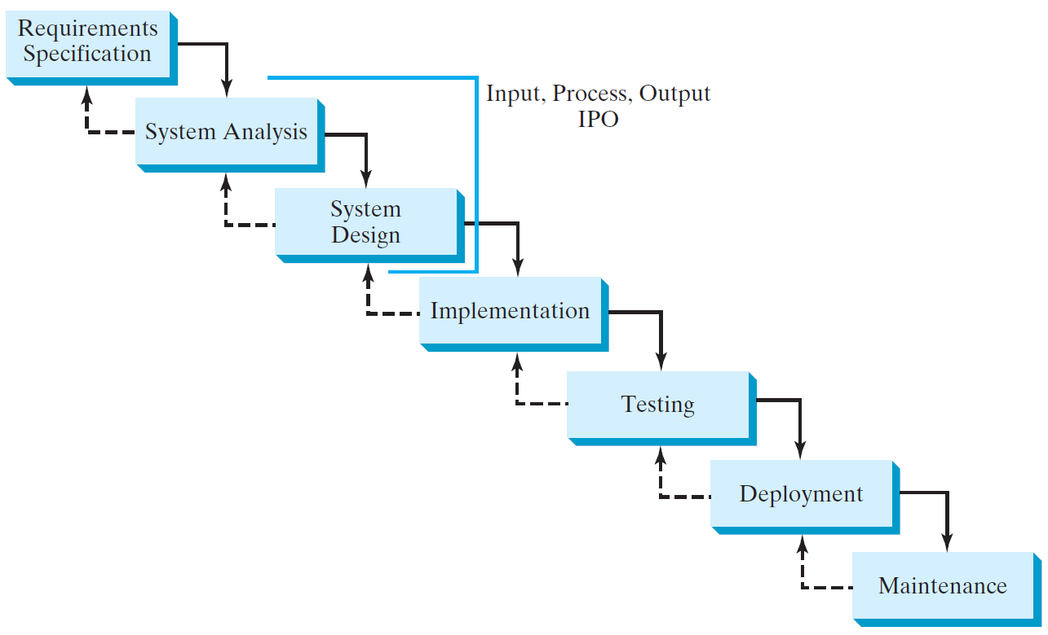
Software Development Process

Slide 45
Requirement Specification
A formal process that seeks to understand the problem and document in detail what the software system needs to do. This phase involves close interaction between users and designers.
Most of the examples in this book are simple, and their requirements are clearly stated. In the real world, however, problems are not well defined. You need to study a problem carefully to identify its requirements.

Slide 46
System Analysis
Seeks to analyze the business process in terms of data flow, and to identify the system’s input and output.
Part of the analysis entails modeling the system’s behavior. The model is intended to capture the essential elements of the system and to define services to the system.

Slide 47
System Design
The process of designing the system’s components.
This phase involves the use of many levels of abstraction to decompose the problem into manageable components, identify classes and interfaces, and establish relationships among the classes and interfaces.

Slide 48
IPO
The essence of system analysis and design is input, process, and output. This is called IPO.

Slide 49
Implementation
The process of translating the system design into programs. Separate programs are written for each component and put to work together.
This phase requires the use of a programming language like Java. The implementation involves coding, testing, and debugging.

Slide 50
Testing
Ensures that the code meets the requirements specification and weeds out bugs.
An independent team of software engineers not involved in the design and implementation of the project usually conducts such testing.

Slide 51
Deployment
Deployment makes the project available for use.
For a Java program, this means installing it on a desktop or on the Web.

Slide 52
Maintenance
Maintenance is concerned with changing and improving the product.
A software product must continue to perform and improve in a changing environment. This requires periodic upgrades of the product to fix newly discovered bugs and incorporate changes.

Slide 53
Problem: Computing Loan Payments
This program lets the user enter the interest rate, number of years, and loan amount, and computes monthly payment and total payment.
ComputeLoan
Run

Slide 54
Problem: Monetary Units
This program lets the user enter the amount in decimal representing dollars and cents and output a report listing the monetary equivalent in single dollars, quarters, dimes, nickels, and pennies. Your program should report maximum number of dollars, then the maximum number of quarters, and so on, in this order.
ComputeChange
Run

Slide 55
Common Errors and Pitfalls p65
Common Error 1: Undeclared/Uninitialized Variables and Unused Variables
Common Error 2: Integer Overflow
Common Error 3: Round-off Errors
Common Error 4: Unintended Integer Division
Common Error 5: Redundant Input Objects
Common Pitfall 1: Redundant Input Objects

Slide 56
Common Error 1: Undeclared/Uninitialized Variables and Unused Variables
double interestRate = 0.05;
double interest = interestrate * 45;

Slide 57
Common Error 2: Integer Overflow
int value = 2147483647 + 1;
// value will actually be -2147483648

Slide 58
Common Error 3: Round-off Errors
System.out.println(1.0 - 0.1 - 0.1 - 0.1 - 0.1 - 0.1);
System.out.println(1.0 - 0.9);

Slide 59
Common Error 4: Unintended Integer Division

Slide 60
Common Pitfall 1: Redundant Input Objects(p67)
Scanner input = new Scanner(System.in);
System.out.print("Enter an integer: ");
int v1 = input.nextInt();
Scanner input1 = new Scanner(System.in);
System.out.print("Enter a double value: ");
double v2 = input1.nextDouble();

