Slide 1
Chapter 4 Mathematical Functions, Characters, and Strings

Slide 2
Objectives
To solve mathematics problems by using the methods in the Math class (§4.2).
To represent characters using the char type (§4.3).
To represent special characters using the escape sequences (§4.4.2).
To cast a numeric value to a character and cast a character to an integer (§4.3.3).
To compare and test characters using the static methods in the Character class (§4.3.4).
To introduce objects and instance methods (§4.4).
To represent strings using the String objects (§4.4).
To return the string length using the length() method (§4.4.1).
To return a character in the string using the charAt(i) method (§4.4.2).
To use the + operator to concatenate strings (§4.4.3).
To read strings from the console (§4.4.4).
To read a character from the console (§4.4.5).
To compare strings using the equals method and the compareTo methods (§4.4.6).
To obtain substrings (§4.4.7).
To find a character or a substring in a string using the indexOf method (§4.4.8).
To program using characters and strings (GuessBirthday) (§4.5.1).
To convert a hexadecimal character to a decimal value (HexDigit2Dec) (§4.5.2).
To format output using the System.out.printf method (§4.6).

Slide 3
Mathematical Functions (static functions)
Java provides many useful methods in the Math class for performing common mathematical functions.

Slide 4
The Math Class
Class constants:
PI
E
Class methods:
Trigonometric Methods
Exponent Methods
Rounding Methods
min, max, abs, and random Methods

Slide 5
Trigonometric Methods
sin(double a)
cos(double a)
tan(double a)
acos(double a)
asin(double a)
atan(double a)
Examples:
Math.sin(0) returns 0.0
Math.sin(Math.PI / 6) returns 0.5
Math.sin(Math.PI / 2) returns 1.0
Math.cos(0) returns 1.0
Math.cos(Math.PI / 6) returns 0.866
Math.cos(Math.PI / 2) returns 0
Radians
toRadians(90)

Slide 6
Exponent Methods
exp(double a)
Returns e raised to the power of a.
log(double a)
Returns the natural logarithm of a.
log10(double a)
Returns the 10-based logarithm of a.
pow(double a, double b)
Returns a raised to the power of b.
sqrt(double a)
Returns the square root of a.
Examples:
Math.exp(1) returns 2.71
Math.log(2.71) returns 1.0
Math.pow(2, 3) returns 8.0
Math.pow(3, 2) returns 9.0
Math.pow(3.5, 2.5) returns 22.91765
Math.sqrt(4) returns 2.0
Math.sqrt(10.5) returns 3.24

Slide 7
Rounding Methods
double ceil(double x)
x round up to its nearest integer. This integer is returned as a double value.
double floor(double x)
x is rounded down to its nearest integer. This integer is returned as a double value.
double rint(double x)
x is rounded to its nearest integer. If x is equally close to two integers, the even one is returned as a double.
int round(float x)
Return (int)Math.floor(x+0.5).
long round(double x)
Return (long)Math.floor(x+0.5).

Slide 8
Rounding Methods Examples
Math.ceil(2.1) returns 3.0
Math.ceil(2.0) returns 2.0
Math.ceil(-2.0) returns –2.0
Math.ceil(-2.1) returns -2.0
Math.floor(2.1) returns 2.0
Math.floor(2.0) returns 2.0
Math.floor(-2.0) returns –2.0
Math.floor(-2.1) returns -3.0
Math.rint(2.1) returns 2.0
Math.rint(2.0) returns 2.0
Math.rint(-2.0) returns –2.0
Math.rint(-2.1) returns -2.0
Math.rint(2.5) returns 2.0
Math.rint(-2.5) returns -2.0
Math.round(2.6f) returns 3
Math.round(2.0) returns 2
Math.round(-2.0f) returns -2
Math.round(-2.6) returns -3

Slide 9
min, max, and abs
max(a, b)and min(a, b)
Returns the maximum or minimum of two parameters.
abs(a)
Returns the absolute value of the parameter.
random()
Returns a random double value in the range [0.0, 1.0).
Examples:
Math.max(2, 3) returns 3
Math.max(2.5, 3) returns 3.0
Math.min(2.5, 3.6) returns 2.5
Math.abs(-2) returns 2
Math.abs(-2.1) returns 2.1

Slide 10
The random Method
Generates a random double value greater than or equal to 0.0 and less than 1.0 (0 <= Math.random() < 1.0).
Examples:
In general,

Slide 11
Case Study: Computing Angles of a Triangle
Write a program that prompts the user to enter the x- and y-coordinates of the three corner points in a triangle and then displays the triangle’s angles.
ComputeAngles

Slide 12
Character Data Type
Four hexadecimal digits.
char letter = 'A'; (ASCII)
char numChar = '4'; (ASCII)
char letter = '\u0041'; (Unicode)
char numChar = '\u0034'; (Unicode)
NOTE: The increment and decrement operators can also be used on char variables to get the next or preceding Unicode character. For example, the following statements display character b.
char ch = 'a';
System.out.println(++ch);

Slide 13
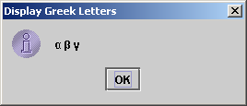
Unicode Format!!
Java characters use Unicode, a 16-bit encoding scheme established by the Unicode Consortium to support the interchange, processing, and display of written texts in the world’s diverse languages. Unicode takes two bytes, preceded by \u, expressed in four hexadecimal numbers that run from '\u0000' to '\uFFFF'. So, Unicode can represent 65535 + 1 characters.
Unicode \u03b1 \u03b2 \u03b3 for three Greek letters

Slide 14
ASCII Code for Commonly Used Characters

Slide 15
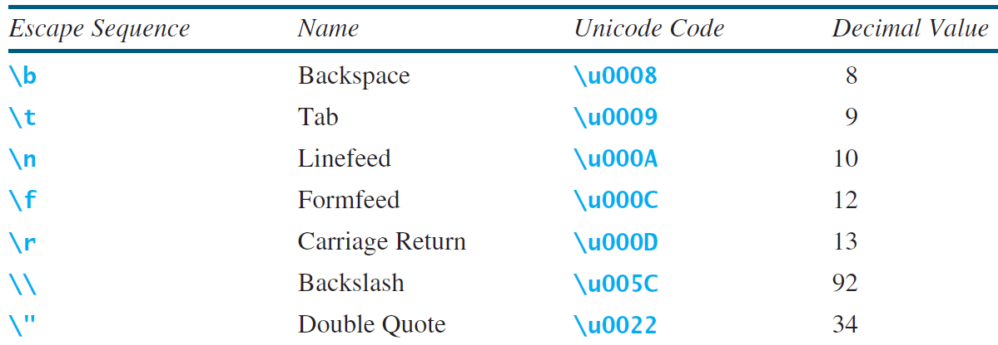
Escape Sequences for Special Characters
转意符号，为什么要转意？
注意Linux和Windows对路径的分割。

Slide 16
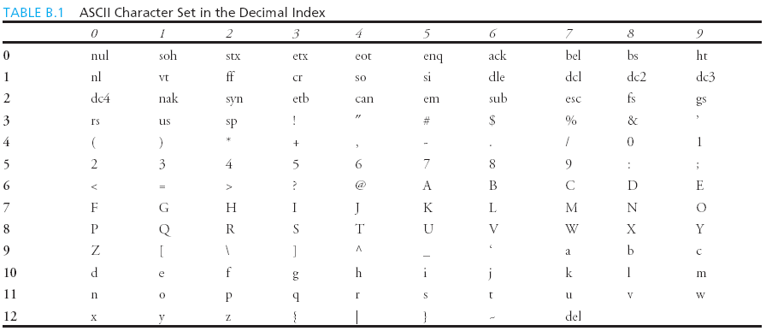
Appendix B: ASCII Character Set
ASCII Character Set is a subset of the Unicode from \u0000 to \u007f

Slide 17
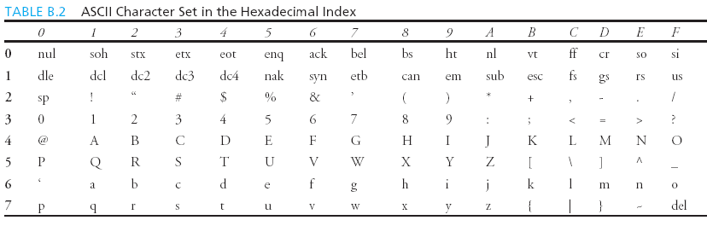
ASCII Character Set, cont.
ASCII Character Set is a subset of the Unicode from \u0000 to \u007f

Slide 18
Casting between char and Numeric Types
int i = 'a'; // Same as int i = (int)'a';
char c = 97; // Same as char c = (char)97;

Slide 19
Comparing and Testing Characters
if (ch >= 'A' && ch <= 'Z')
System.out.println(ch + " is an uppercase letter");
else if (ch >= 'a' && ch <= 'z')
System.out.println(ch + " is a lowercase letter");
else if (ch >= '0' && ch <= '9')
System.out.println(ch + " is a numeric character");

Slide 20
Methods in the Character Class ??
Character.isDigit(cha)
问题：目前学了很多在类上直接调用的方法。这些方法有什么共同的特点？
后面函数部分我们会学到。

Slide 21
The String Type
The char type only represents one character. To represent a string of characters, use the data type called String. For example,
String message = "Welcome to Java";
String is actually a predefined class in the Java library just like the System class and Scanner class. The String type is not a primitive type. It is known as a reference type. Any Java class can be used as a reference type for a variable. Reference data types will be thoroughly discussed in Chapter 9, “Objects and Classes.” For the time being, you just need to know how to declare a String variable, how to assign a string to the variable, how to concatenate strings, and to perform simple operations for strings.

Slide 22
Simple Methods for String Objects ???
stringObj.length()
这里的方法不能在类上面进行调用，只能在对象（实体上进行调用），为什么不能在类上进行调用？
和以前在类上调用的方法有什么区别？联想一下C语言

Slide 23
Simple Methods for String Objects
Strings are objects in Java. The methods in the preceding table can only be invoked from a specific string instance. For this reason, these methods are called instance methods. A non-instance method is called a static method. A static method can be invoked without using an object. All the methods defined in the Math class are static methods. They are not tied to a specific object instance. The syntax to invoke an instance method is
referenceVariable.methodName(arguments).

Slide 24
Getting String Length
String message = "Welcome to Java";
System.out.println("The length of " + message + " is "
+ message.length());

Slide 25
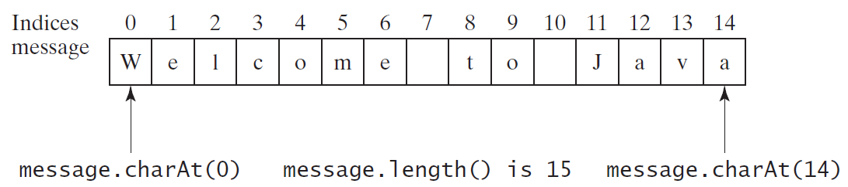
Getting Characters from a String(*)
Why capitalized?
String message = "Welcome to Java";
System.out.println("The first character in message is "
+ message.charAt(0));

Slide 26
Converting Strings
"Welcome".toLowerCase() returns a new string, welcome.
"Welcome".toUpperCase() returns a new string, WELCOME.
" Welcome ".trim() returns a new string, Welcome.

Slide 27
String Concatenation
String s3 = s1.concat(s2); or String s3 = s1 + s2;
// Three strings are concatenated
String message = "Welcome " + "to " + "Java";
// String Chapter is concatenated with number 2
String s = "Chapter" + 2; // s becomes Chapter2
// String Supplement is concatenated with character B
String s1 = "Supplement" + 'B'; // s1 becomes SupplementB
C语言是怎么做的，Java是不是更简单？
注意两种连接方式。

Slide 28
Reading a String from the Console
Scanner input = new Scanner(System.in);
System.out.print("Enter three words separated by spaces: ");
String s1 = input.next();
String s2 = input.next();
String s3 = input.next();
System.out.println("s1 is " + s1);
System.out.println("s2 is " + s2);
System.out.println("s3 is " + s3);

Slide 29
Reading a Character from the Console
Scanner input = new Scanner(System.in);
System.out.print("Enter a character: ");
String s = input.nextLine();
char ch = s.charAt(0);
System.out.println("The character entered is " + ch);
注意区分next()方法和nextLine()方法的区别。
Java没有专门读取Char的函数

Slide 30
Comparing Strings（135）
OrderTwoCities
可以用==进行比较吗？
为什么？

Slide 31
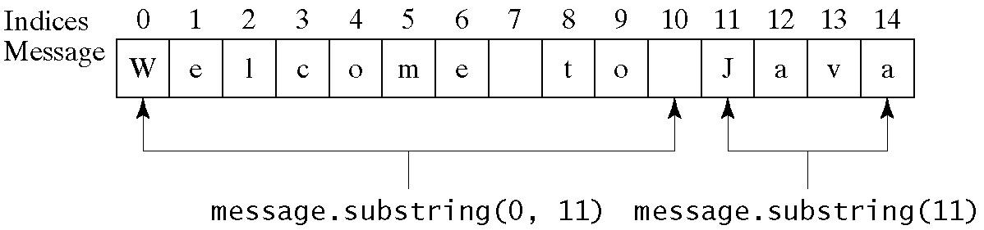
Obtaining Substrings

Slide 32
Finding a Character or a Substring in a String(* overload)

Slide 33
什么是overload？
函数名一样，参数不一样
具有更好的阅读性
函数名不至于过长
注意参数怎么不一样？

Slide 34
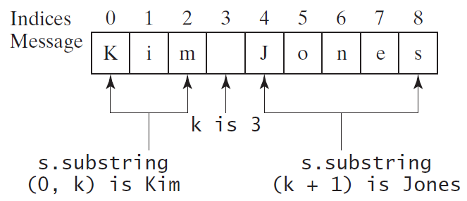
Finding a Character or a Substring in a String
int k = s.indexOf(' ');
String firstName = s.substring(0, k);
String lastName = s.substring(k + 1);

Slide 35
Conversion between Strings and Numbers(Static for class!)
int intValue = Integer.parseInt(intString);
double doubleValue = Double.parseDouble(doubleString);
String s = number + "";
可以用面向对象的方法吗？以后会讲。
两种parseValue 和 valueOf 的区别（不考）

Slide 36
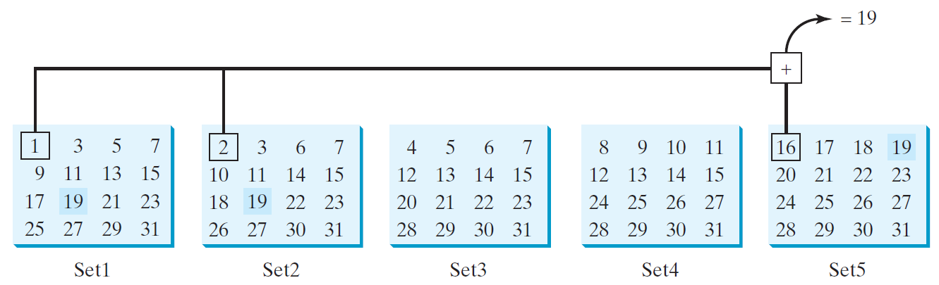
Problem: Guessing Birthday p139
The program can guess your birth date. Run to see how it works.
GuessBirthday

Slide 37
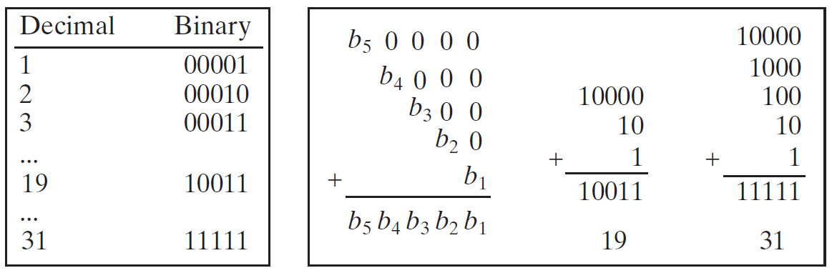
Mathematics Basis for the Game
19 is 10011 in binary. 7 is 111 in binary. 23 is 11101 in binary

Slide 38
Case Study: Converting a Hexadecimal Digit to a Decimal Value
Write a program that converts a hexadecimal digit into a decimal value.
有没有更好的方法？
HexDigit2Dec

Slide 39
Case Study: Revising the Lottery Program Using Strings
A problem can be solved using many different approaches. This section rewrites the lottery program in Listing 3.7 using strings. Using strings simplifies this program.
LotteryUsingStrings

Slide 40
Formatting Output
Use the printf statement.
System.out.printf(format, items);
Where format is a string that may consist of substrings and format specifiers. A format specifier specifies how an item should be displayed. An item may be a numeric value, character, boolean value, or a string. Each specifier begins with a percent sign.

Slide 41
Frequently-Used Specifiers
Specifier Output Example
%b a boolean value true or false
%c a character 'a'
%d a decimal integer 200
%f a floating-point number 45.460000
%e a number in standard scientific notation 4.556000e+01
%s a string "Java is cool"

Slide 42
FormatDemo
The example gives a program that uses printf to display a table.
FormatDemo

Slide 43
另外的字符串格式化
String.format(str, parms...)

