Slide 1
Chapter 5 Loops

Slide 2
Motivations
Suppose that you need to print a string (e.g., "Welcome to Java!") a hundred times. It would be tedious to have to write the following statement a hundred times:
System.out.println("Welcome to Java!");
So, how do you solve this problem?

Slide 3
Objectives
To write programs for executing statements repeatedly using a while loop (§5.2).
To follow the loop design strategy to develop loops (§§5.2.1–5.2.3).
To control a loop with a sentinel value (§5.2.4).
To obtain large input from a file using input redirection rather than typing from the keyboard (§5.2.5).
To write loops using do-while statements (§5.3).
To write loops using for statements (§5.4).
To discover the similarities and differences of three types of loop statements (§5.5).
To write nested loops (§5.6).
To learn the techniques for minimizing numerical errors (§5.7).
To learn loops from a variety of examples (GCD, FutureTuition, Dec2Hex) (§5.8).
To implement program control with break and continue (§5.9).
To write a program that displays prime numbers (§5.11).

Slide 4
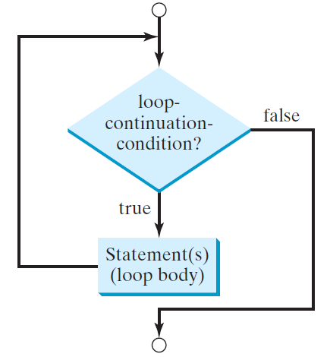
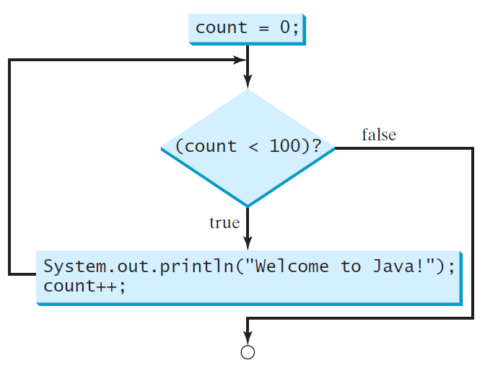
while Loop Flow Chart
int count = 0;
while (count < 100) {
System.out.println("Welcome to Java!");
count++;
}
while (loop-continuation-condition) {
// loop-body;
Statement(s);
}

Slide 5
Problem: Repeat Addition Until Correct p160
Recall that Listing 3.1 AdditionQuiz.java gives a program that prompts the user to enter an answer for a question on addition of two single digits. Using a loop, you can now rewrite the program to let the user enter a new answer until it is correct.
RepeatAdditionQuiz

Slide 6
Problem: Guessing Numbers
Write a program that randomly generates an integer between 0 and 100, inclusive. The program prompts the user to enter a number continuously until the number matches the randomly generated number. For each user input, the program tells the user whether the input is too low or too high, so the user can choose the next input intelligently. Here is a sample run:
GuessNumberOneTime
GuessNumber

Slide 7
Problem: An Advanced Math Learning Tool p164-165
The Math subtraction learning tool program generates just one question for each run. You can use a loop to generate questions repeatedly. This example gives a program that generates five questions and reports the number of the correct answers after a student answers all five questions.
SubtractionQuizLoop

Slide 8
Ending a Loop with a Sentinel Value 165-167
Often the number of times a loop is executed is not predetermined. You may use an input value to signify the end of the loop. Such a value is known as a sentinel value. (167 5.2.5)
Write a program that reads and calculates the sum of an unspecified number of integers. The input 0 signifies the end of the input.
SentinelValue

Slide 9
Caution
Don’t use floating-point values for equality checking in a loop control. Since floating-point values are approximations for some values, using them could result in imprecise counter values and inaccurate results. Consider the following code for computing 1 + 0.9 + 0.8 + ... + 0.1:
double item = 1; double sum = 0;
while (item != 0) { // No guarantee item will be 0
sum += item;
item -= 0.1;
}
System.out.println(sum);

Slide 10
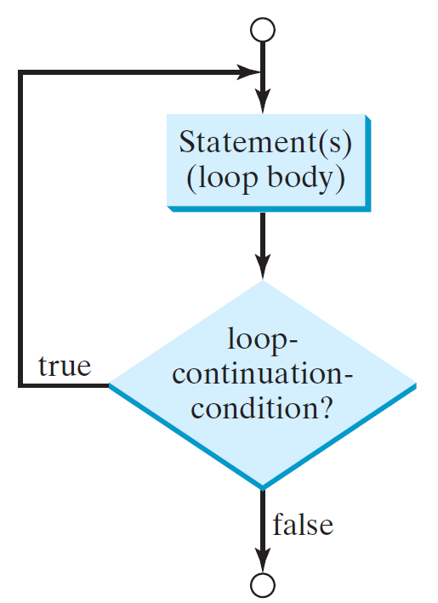
do-while Loop(169)
do {
// Loop body;
Statement(s);
} while (loop-continuation-condition);

Slide 11
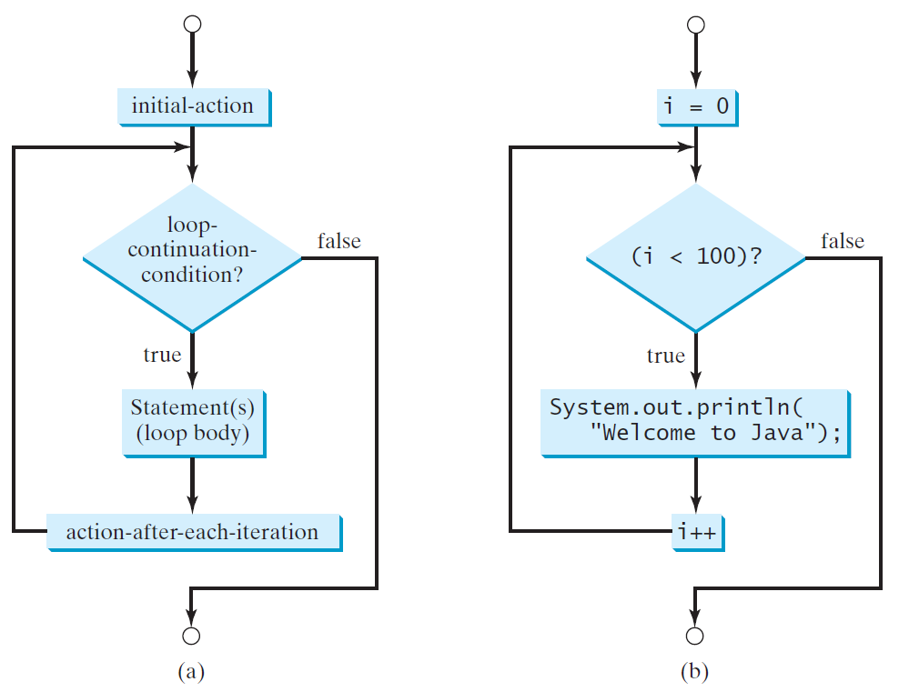
for Loops(171,173)
for (initial-action; loop-continuation-condition; action-after-each-iteration) {
// loop body;
Statement(s);
}
int i;
for (i = 0; i < 100; i++) {
System.out.println(
"Welcome to Java!");
}

Slide 12
Note()
The initial-action in a for loop can be a list of zero or more comma-separated expressions. The action-after-each-iteration in a for loop can be a list of zero or more comma-separated statements. Therefore, the following two for loops are correct. They are rarely used in practice, however. 最好别这么用
for (int i = 1; i < 100; System.out.println(i++));
for (int i = 0, j = 0; (i + j < 10); i++, j++) {
// Do something
}

Slide 13
Note（175）
If the loop-continuation-condition in a for loop is omitted, it is implicitly true. Thus the statement given below in (a), which is an infinite loop, is correct. Nevertheless, it is better to use the equivalent loop in (b) to avoid confusion:

Slide 14
Caution
Adding a semicolon at the end of the for clause before the loop body is a common mistake, as shown below:
Logic Error
for (int i=0; i<10; i++);
{
System.out.println("i is " + i);
}

Slide 15
Caution, cont.
Similarly, the following loop is also wrong:
int i=0;
while (i < 10);
{
System.out.println("i is " + i);
i++;
}
In the case of the do loop, the following semicolon is needed to end the loop.
int i=0;
do {
System.out.println("i is " + i);
i++;
} while (i<10);
Logic Error
Correct

Slide 16
Which Loop to Use?（174）
The three forms of loop statements, while, do-while, and for, are expressively equivalent; that is, you can write a loop in any of these three forms. For example, a while loop in (a) in the following figure can always be converted into the following for loop in (b):
A for loop in (a) in the following figure can generally be converted into the following while loop in (b) except in certain special cases (see Review Question 3.19 for one of them):

Slide 17
Recommendations
Use the one that is most intuitive and comfortable for you. In general, a for loop may be used if the number of repetitions is known, as, for example, when you need to print a message 100 times. A while loop may be used if the number of repetitions is not known, as in the case of reading the numbers until the input is 0. A do-while loop can be used to replace a while loop if the loop body has to be executed before testing the continuation condition.

Slide 18
Nested Loops （176）
Problem: Write a program that uses nested for loops to print a multiplication table.
MultiplicationTable

Slide 19
Minimizing Numerical Errors （178）
Numeric errors involving floating-point numbers are inevitable. This section discusses how to minimize such errors through an example.
Here is an example that sums a series that starts with 0.01 and ends with 1.0. The numbers in the series will increment by 0.01, as follows: 0.01 + 0.02 + 0.03 and so on.
TestSum

Slide 20
Problem:（180） Finding the Greatest Common Divisor
Problem: Write a program that prompts the user to enter two positive integers and finds their greatest common divisor.
Solution: Suppose you enter two integers 4 and 2, their greatest common divisor is 2. Suppose you enter two integers 16 and 24, their greatest common divisor is 8. So, how do you find the greatest common divisor? Let the two input integers be n1 and n2. You know number 1 is a common divisor, but it may not be the greatest commons divisor. So you can check whether k (for k = 2, 3, 4, and so on) is a common divisor for n1 and n2, until k is greater than n1 or n2. (how to for loop?)
GreatestCommonDivisor

Slide 21
Problem: Predicting the Future Tuition、181
Problem: Suppose that the tuition for a university is $10,000 this year and tuition increases 7% every year. In how many years will the tuition be doubled?
FutureTuition

Slide 22
Problem: Predicating the Future Tuition
double tuition = 10000; int year = 0 // Year 0
tuition = tuition * 1.07; year++; // Year 1
tuition = tuition * 1.07; year++; // Year 2
tuition = tuition * 1.07; year++; // Year 3
...

Slide 23
Case Study: Converting Decimals to Hexadecimals（182）
Hexadecimals are often used in computer systems programming (see Appendix F for an introduction to number systems). How do you convert a decimal number to a hexadecimal number? To convert a decimal number d to a hexadecimal number is to find the hexadecimal digits h_{n}, h_{n-1}, h_{n-2}, ... , h₂, h₁, and h₀ such that
These hexadecimal digits can be found by successively dividing d by 16 until the quotient is 0. The remainders are h₀, h₁, h₂, ... , h_{n-2}, h_{n-1}, and h_{n}.
Dec2Hex

Slide 24
Problem: Monte Carlo Simulation
Companion Website
The Monte Carlo simulation refers to a technique that uses random numbers and probability to solve problems. This method has a wide range of applications in computational mathematics, physics, chemistry, and finance. This section gives an example of using the Monto Carlo simulation for estimating π.
circleArea / squareArea = π / 4.
π can be approximated as 4 * numberOfHits / numberOfTrials
MonteCarloSimulation
Run

Slide 25
Using break and continue（184）
Examples for using the break and continue keywords:
TestBreak.java
TestBreak
TestContinue.java
TestContinue

Slide 26
break

Slide 27
continue

Slide 28
Guessing Number Problem Revisited
Here is a program for guessing a number. You can rewrite it using a break statement.
GuessNumberUsingBreak

Slide 29
Problem: Displaying Prime Numbers（188）
Problem: Write a program that displays the first 50 prime numbers in five lines, each of which contains 10 numbers. An integer greater than 1 is prime if its only positive divisor is 1 or itself. For example, 2, 3, 5, and 7 are prime numbers, but 4, 6, 8, and 9 are not.
Solution: The problem can be broken into the following tasks:
For number = 2, 3, 4, 5, 6, ..., test whether the number is prime.
Determine whether a given number is prime.
Count the prime numbers.
Print each prime number, and print 10 numbers per line.
PrimeNumber
Run

Slide 30
Debugging Loops in IDE Tools
Companion Website
Supplements II.C, II.E, and II.G.

