Slide 1
Chapter 7 Single-Dimensional Arrays

Slide 2
Opening Problem
Read one hundred numbers, compute their average, and find out how many numbers are above the average.

Slide 3
Objectives
To declare array reference variables and create arrays (§§7.2.1–7.2.2).
To obtain array size using arrayRefVar.length and know default values in an array (§7.2.3).
To access array elements using indexes (§7.2.4).
To declare, create, and initialize an array using an array initializer (§7.2.5).
To program common array operations (displaying arrays, summing all elements, finding the minimum and maximum elements, random shuffling, and shifting elements) (§7.2.6).
To simplify programming using the foreach loops (§7.2.7).
To apply arrays in application development (AnalyzeNumbers, DeckOfCards) (§§7.3–7.4).
To copy contents from one array to another (§7.5).
To develop and invoke methods with array arguments and return values (§§7.6–7.8).
To define a method with a variable-length argument list (§7.9).
To search elements using the linear (§7.10.1) or binary (§7.10.2) search algorithm.
To sort an array using the selection sort approach (§7.11).
To use the methods in the java.util.Arrays class (§7.12).
To pass arguments to the main method from the command line (§7.13).

Slide 4
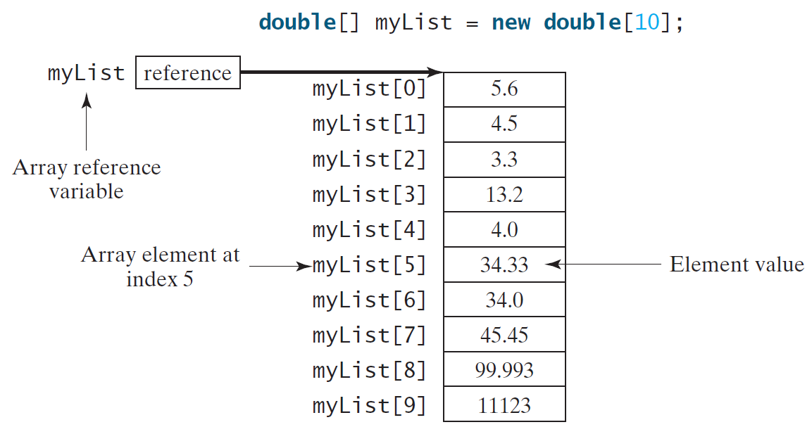
Introducing Arrays
Array is a data structure that represents a collection of the same types of data.

Slide 5
Declaring Array Variables
datatype[] arrayRefVar;
Example:
double[] myList;
datatype arrayRefVar[]; // This style is allowed, but not preferred
Example:
double myList[];

Slide 6
Creating Arrays
arrayRefVar = new datatype[arraySize];
Example:
myList = new double[10];
myList[0] references the first element in the array.
myList[9] references the last element in the array.

Slide 7
Declaring and Creating in One Step
datatype[] arrayRefVar = new
datatype[arraySize];
double[] myList = new double[10];
datatype arrayRefVar[] = new datatype[arraySize];
double myList[] = new double[10];

Slide 8
The Length of an Array
Once an array is created, its size is fixed. It cannot be changed. You can find its size using
arrayRefVar.length
For example,
myList.length returns 10

Slide 9
Default Values
When an array is created, its elements are assigned the default value of
0 for the numeric primitive data types,
'\u0000' for char types, and
false for boolean types.

Slide 10
Indexed Variables
The array elements are accessed through the index. The array indices are 0-based, i.e., it starts from 0 to arrayRefVar.length-1. In the example in Figure 6.1, myList holds ten double values and the indices are from 0 to 9.
Each element in the array is represented using the following syntax, known as an indexed variable:
arrayRefVar[index];

Slide 11
Using Indexed Variables
After an array is created, an indexed variable can be used in the same way as a regular variable. For example, the following code adds the value in myList[0] and myList[1] to myList[2].
myList[2] = myList[0] + myList[1];

Slide 12
Array Initializers
Declaring, creating, initializing in one step:
double[] myList = {1.9, 2.9, 3.4, 3.5};
This shorthand syntax must be in one statement.

Slide 13
Declaring, creating, initializing Using the Shorthand Notation
double[] myList = {1.9, 2.9, 3.4, 3.5};
This shorthand notation is equivalent to the following statements:
double[] myList = new double[4];
myList[0] = 1.9;
myList[1] = 2.9;
myList[2] = 3.4;
myList[3] = 3.5;

Slide 14
CAUTION(249)
Using the shorthand notation, you have to declare, create, and initialize the array all in one statement. Splitting it would cause a syntax error. For example, the following is wrong:
double[] myList;
myList = {1.9, 2.9, 3.4, 3.5};

Slide 15
Processing Arrays
See the examples in the text.
(Initializing arrays with input values)
(Initializing arrays with random values)
(Printing arrays)
(Summing all elements)
(Finding the largest element)
(Finding the smallest index of the largest element)
(Random shuffling)
(Shifting elements)

Slide 16
Initializing arrays with input values
java.util.Scanner input = new java.util.Scanner(System.in);
System.out.print("Enter " + myList.length + " values: ");
for (int i = 0; i < myList.length; i++)
myList[i] = input.nextDouble();

Slide 17
Initializing arrays with random values
for (int i = 0; i < myList.length; i++) {
myList[i] = Math.random() * 100;
}

Slide 18
Printing arrays
for (int i = 0; i < myList.length; i++) {
System.out.print(myList[i] + " ");
}

Slide 19
Summing all elements
double total = 0;
for (int i = 0; i < myList.length; i++) {
total += myList[i];
}

Slide 20
Finding the largest element
double max = myList[0];
for (int i = 1; i < myList.length; i++) {
if (myList[i] > max) max = myList[i];
}

Slide 21
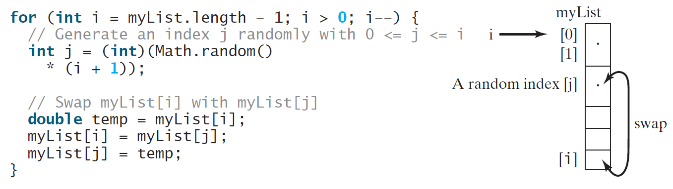
Random shuffling

Slide 22
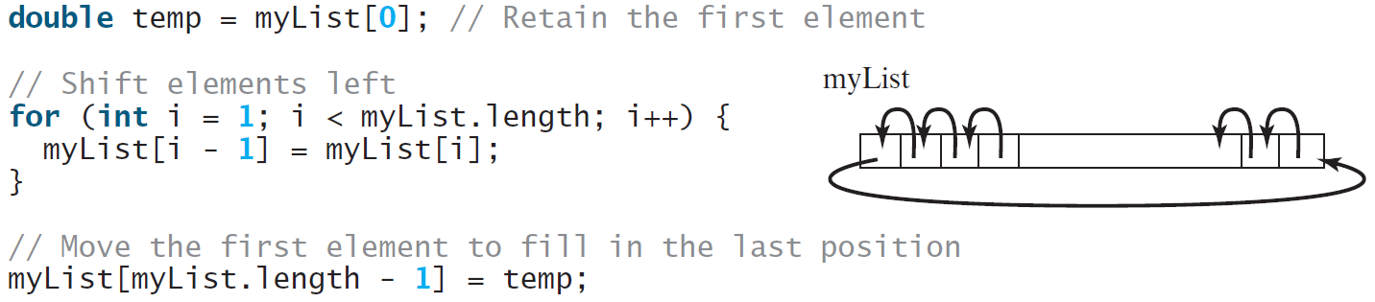
Shifting Elements

Slide 23
Enhanced for Loop (for-each loop) 251
JDK 1.5 introduced a new for loop that enables you to traverse the complete array sequentially without using an index variable. For example, the following code displays all elements in the array myList:
for (double value: myList)
System.out.println(value);
In general, the syntax is
for (elementType value: arrayRefVar) {
// Process the value
}
You still have to use an index variable if you wish to traverse the array in a different order or change the elements in the array.

Slide 24
Opening Problem(p253)
Read one hundred numbers, compute their average, and find out how many numbers are above the average.
AnalyzeNumbers

Slide 25
Problem: Deck of Cards
The problem is to write a program that picks four cards randomly from a deck of 52 cards. All the cards can be represented using an array named deck, filled with initial values 0 to 51, as follows:
int[] deck = new int[52];
// Initialize cards
for (int i = 0; i < deck.length; i++)
deck[i] = i;
Animation
DeckOfCards
Run

Slide 26
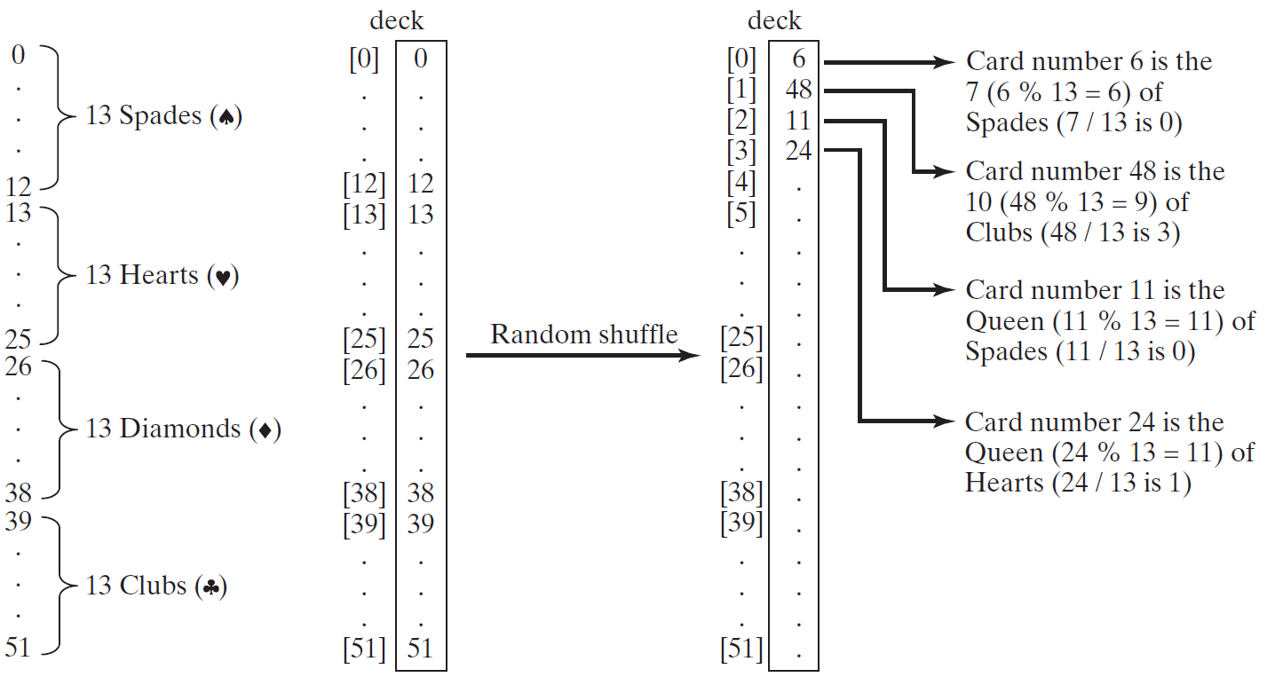
Problem: Deck of Cards, cont.

Slide 27
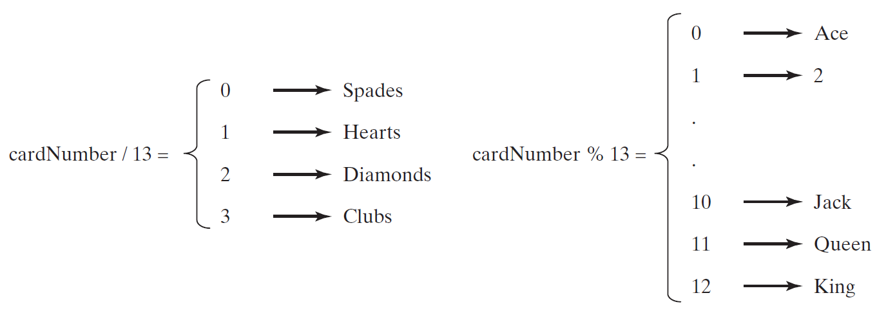
Problem: Deck of Cards, cont.
GUI Demo (picking four cards)
DeckOfCards
Run

Slide 28
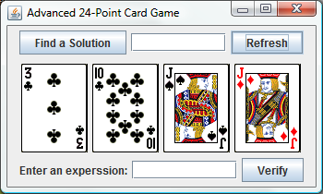
Problem: Deck of Cards
This problem builds a foundation for future more interesting and realistic applications:
See Exercise 22.15.
Run 24 Point Game

Slide 29
Problem: Lotto Numbers
Companion Website
Suppose you play the Pick-10 lotto. Each ticket has 10 unique numbers ranging from 1 to 99. You buy a lot of tickets. You like to have your tickets to cover all numbers from 1 to 99. Write a program that reads the ticket numbers from a file and checks whether all numbers are covered. Assume the last number in the file is 0.
Lotto Numbers Sample Data
LottoNumbers
Run

Slide 30
Problem: Lotto Numbers
Companion Website

Slide 31
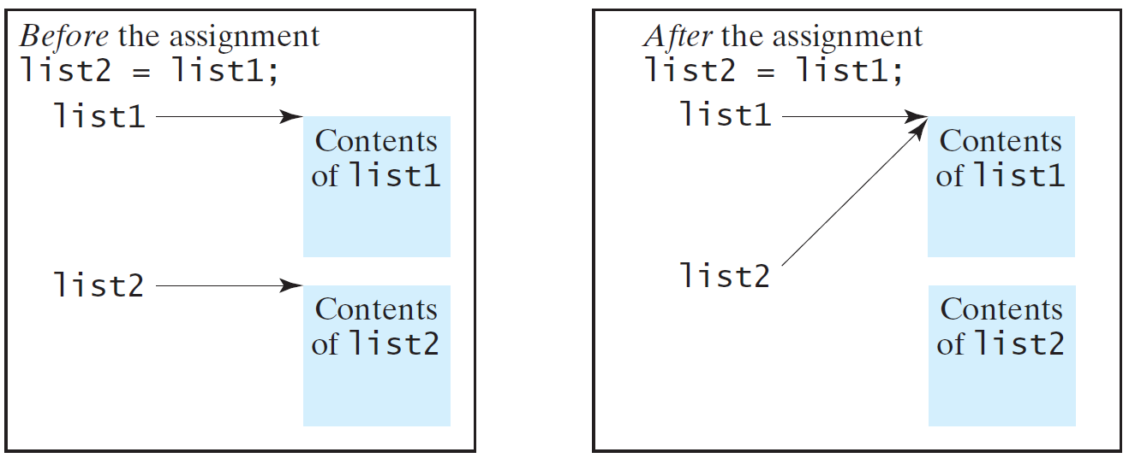
Copying Arrays(like point in C? 256)
Often, in a program, you need to duplicate an array or a part of an array. In such cases you could attempt to use the assignment statement (=), as follows:
should we free list2 before assignment?
list2 = list1;

Slide 32
Copying Arrays
Using a loop:
int[] sourceArray = {2, 3, 1, 5, 10};
int[] targetArray = new int[sourceArray.length];
for (int i = 0; i < sourceArrays.length; i++)
targetArray[i] = sourceArray[i];

Slide 33
The arraycopy Utility
arraycopy(sourceArray, src_pos, targetArray, tar_pos, length);
Example:
System.arraycopy(sourceArray, 0, targetArray, 0, sourceArray.length);

Slide 34
Passing Arrays to Methods
public static void printArray(int[] array) {
for (int i = 0; i < array.length; i++) {
System.out.print(array[i] + " ");
}
}
Invoke the method
int[] list = {3, 1, 2, 6, 4, 2};
printArray(list);
Invoke the method
printArray(new int[]{3, 1, 2, 6, 4, 2});
Anonymous array

Slide 35
Anonymous Array
The statement
printArray(new int[]{3, 1, 2, 6, 4, 2});
creates an array using the following syntax:
new dataType[]{literal0, literal1, ..., literalk};
There is no explicit reference variable for the array. Such array is called an anonymous array.

Slide 36
Pass By Value(like point in C)
Java uses pass by value to pass arguments to a method. There are important differences between passing a value of variables of primitive data types and passing arrays.
For a parameter of a primitive type value, the actual value is passed. Changing the value of the local parameter inside the method does not affect the value of the variable outside the method.
For a parameter of an array type, the value of the parameter contains a reference to an array; this reference is passed to the method. Any changes to the array that occur inside the method body will affect the original array that was passed as the argument.

Slide 37
Simple Example(258)
public class Test {
public static void main(String[] args) {
int x = 1; // x represents an int value
int[] y = new int[10]; // y represents an array of int values
m(x, y); // Invoke m with arguments x and y
System.out.println("x is " + x);
System.out.println("y[0] is " + y[0]);
}
public static void m(int number, int[] numbers) {
number = 1001; // Assign a new value to number
numbers[0] = 5555; // Assign a new value to numbers[0]
}
}

Slide 38
Passing Arrays as Arguments(p259)
Objective: Demonstrate differences of passing primitive data type variables and array variables.
TestPassArray
Run

Slide 39
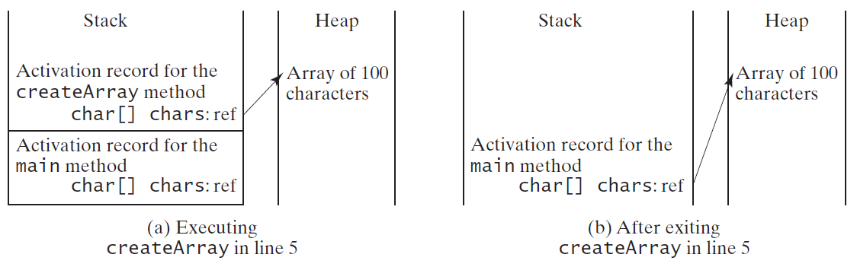
Problem: Counting Occurrence of Each Letter(do yourself)
Generate 100 lowercase letters randomly and assign to an array of characters.
Count the occurrence of each letter in the array.
CountLettersInArray
Run

Slide 40
Searching Arrays
Searching is the process of looking for a specific element in an array; for example, discovering whether a certain score is included in a list of scores. Searching is a common task in computer programming. There are many algorithms and data structures devoted to searching. In this section, two commonly used approaches are discussed, linear search and binary search.

Slide 41
Linear Search(p265)
The linear search approach compares the key element, key, sequentially with each element in the array list. The method continues to do so until the key matches an element in the list or the list is exhausted without a match being found. If a match is made, the linear search returns the index of the element in the array that matches the key. If no match is found, the search returns -1.

Slide 42
Linear Search Animation
animation
Key
List
3
6 | 4 | 1 | 9 | 7 | 3 | 2 | 8
3
6 | 4 | 1 | 9 | 7 | 3 | 2 | 8
3
6 | 4 | 1 | 9 | 7 | 3 | 2 | 8
3
6 | 4 | 1 | 9 | 7 | 3 | 2 | 8
3
6 | 4 | 1 | 9 | 7 | 3 | 2 | 8
3
6 | 4 | 1 | 9 | 7 | 3 | 2 | 8

Slide 43
From Idea to Solution
/** The method for finding a key in the list */
public static int linearSearch(int[] list, int key) {
for (int i = 0; i < list.length; i++)
if (key == list[i])
return i;
return -1;
}
Trace the method
int[] list = {1, 4, 4, 2, 5, -3, 6, 2};
int i = linearSearch(list, 4); // returns 1
int j = linearSearch(list, -4); // returns -1
int k = linearSearch(list, -3); // returns 5

Slide 44
Binary Search
For binary search to work, the elements in the array must already be ordered. Without loss of generality, assume that the array is in ascending order.
e.g., 2 4 7 10 11 45 50 59 60 66 69 70 79
The binary search first compares the key with the element in the middle of the array.

Slide 45
Binary Search, cont.
Consider the following three cases:
If the key is less than the middle element, you only need to search the key in the first half of the array.
If the key is equal to the middle element, the search ends with a match.
If the key is greater than the middle element, you only need to search the key in the second half of the array.

Slide 46
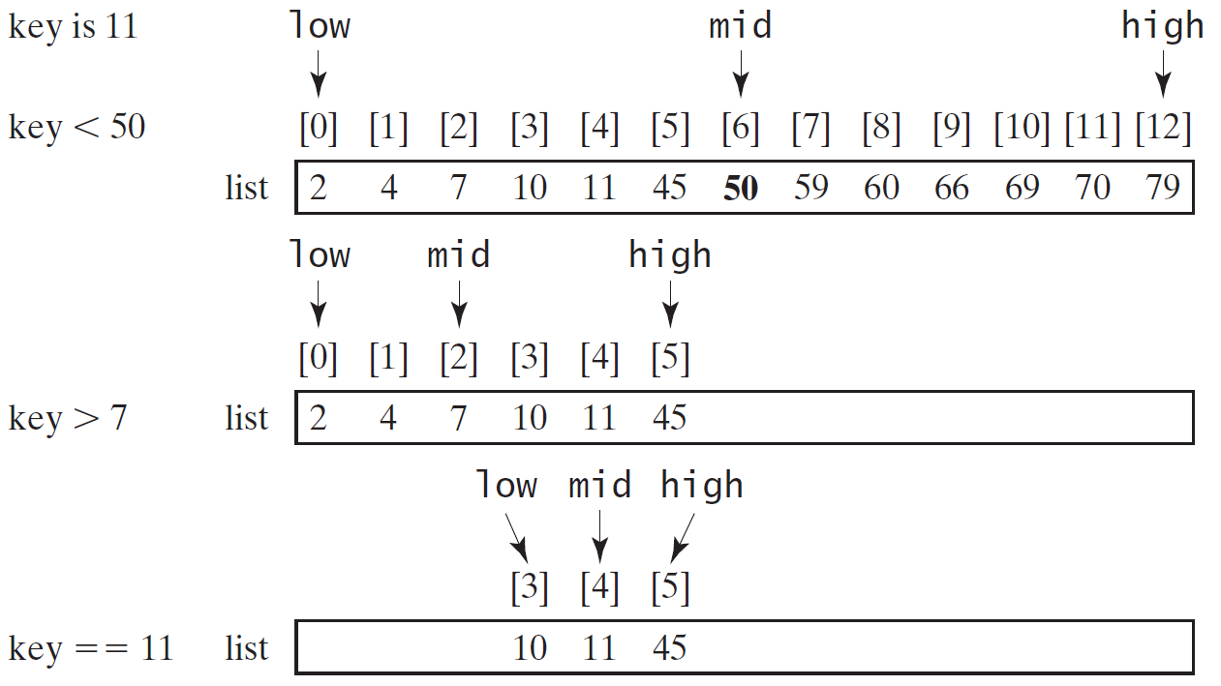
Binary Search, cont.

Slide 47
Binary Search, cont.

Slide 48
Binary Search, cont.
The binarySearch method returns the index of the element in the list that matches the search key if it is contained in the list. Otherwise, it returns
-insertion point - 1.
The insertion point is the point at which the key would be inserted into the list.

Slide 49
From Idea to Soluton
/** Use binary search to find the key in the list */
public static int binarySearch(int[] list, int key) {
int low = 0;
int high = list.length - 1;
while (high >= low) {
int mid = (low + high) / 2;
if (key < list[mid])
high = mid - 1;
else if (key == list[mid])
return mid;
else
low = mid + 1;
}
return -1 - low;
}

Slide 50
The Arrays.binarySearch Method
Since binary search is frequently used in programming, Java provides several overloaded binarySearch methods for searching a key in an array of int, double, char, short, long, and float in the java.util.Arrays class. For example, the following code searches the keys in an array of numbers and an array of characters.
int[] list = {2, 4, 7, 10, 11, 45, 50, 59, 60, 66, 69, 70, 79};
System.out.println("Index is " +
java.util.Arrays.binarySearch(list, 11));
char[] chars = {'a', 'c', 'g', 'x', 'y', 'z'};
System.out.println("Index is " +
java.util.Arrays.binarySearch(chars, 't'));
For the binarySearch method to work, the array must be pre-sorted in increasing order.
Return is 4
Return is –4 (insertion point is 3, so return is -3-1)

Slide 51
Sorting Arrays
Sorting, like searching, is also a common task in computer programming. Many different algorithms have been developed for sorting. This section introduces a simple, intuitive sorting algorithms: selection sort.

Slide 52
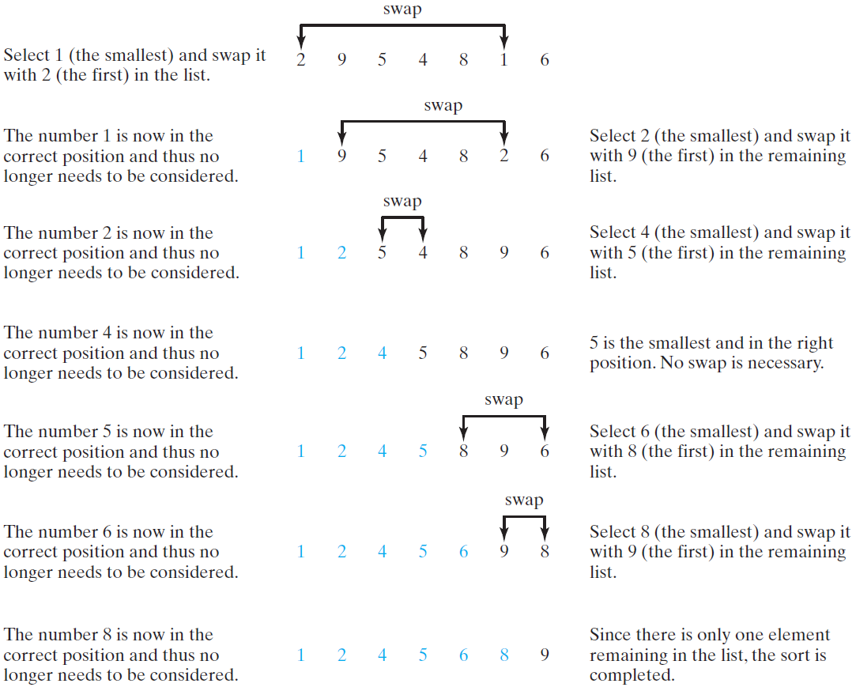
Selection Sort
Selection sort finds the smallest number in the list and places it first. It then finds the smallest number remaining and places it second, and so on until the list contains only a single number.

Slide 53
From Idea to Solution
for (int i = 0; i < list.length; i++) {
select the smallest element in list[i..listSize-1];
swap the smallest with list[i], if necessary;
// list[i] is in its correct position.
// The next iteration apply on list[i..listSize-1]
}
list[0] list[1] list[2] list[3] ... list[10]
list[0] list[1] list[2] list[3] ... list[10]
list[0] list[1] list[2] list[3] ... list[10]
list[0] list[1] list[2] list[3] ... list[10]
list[0] list[1] list[2] list[3] ... list[10]
...
list[0] list[1] list[2] list[3] ... list[10]

Slide 54
Expand
for (int i = 0; i < listSize; i++) {
select the smallest element in list[i..listSize-1];
swap the smallest with list[i], if necessary;
// list[i] is in its correct position.
// The next iteration apply on list[i..listSize-1]
}
double currentMin = list[i];
int currentMinIndex = i;
for (int j = i+1; j < list.length; j++) {
if (currentMin > list[j]) {
currentMin = list[j];
currentMinIndex = j;
}
}

Slide 55
Expand
for (int i = 0; i < listSize; i++) {
select the smallest element in list[i..listSize-1];
swap the smallest with list[i], if necessary;
// list[i] is in its correct position.
// The next iteration apply on list[i..listSize-1]
}
double currentMin = list[i];
int currentMinIndex = i;
for (int j = i; j < list.length; j++) {
if (currentMin > list[j]) {
currentMin = list[j];
currentMinIndex = j;
}
}

Slide 56
Expand
for (int i = 0; i < listSize; i++) {
select the smallest element in list[i..listSize-1];
swap the smallest with list[i], if necessary;
// list[i] is in its correct position.
// The next iteration apply on list[i..listSize-1]
}
if (currentMinIndex != i) {
list[currentMinIndex] = list[i];
list[i] = currentMin;
}

Slide 57
Wrap it in a Method
/** The method for sorting the numbers */
public static void selectionSort(double[] list) {
for (int i = 0; i < list.length; i++) {
// Find the minimum in the list[i..list.length-1]
double currentMin = list[i];
int currentMinIndex = i;
for (int j = i + 1; j < list.length; j++) {
if (currentMin > list[j]) {
currentMin = list[j];
currentMinIndex = j;
}
}
// Swap list[i] with list[currentMinIndex] if necessary;
if (currentMinIndex != i) {
list[currentMinIndex] = list[i];
list[i] = currentMin;
}
}
}
Invoke it
selectionSort(yourList)

Slide 58
The Arrays.sort Method 271
Since sorting is frequently used in programming, Java provides several overloaded sort methods for sorting an array of int, double, char, short, long, and float in the java.util.Arrays class. For example, the following code sorts an array of numbers and an array of characters.
double[] numbers = {6.0, 4.4, 1.9, 2.9, 3.4, 3.5};
java.util.Arrays.sort(numbers);
char[] chars = {'a', 'A', '4', 'F', 'D', 'P'};
java.util.Arrays.sort(chars);
Java 8 now provides Arrays.parallelSort(list) that utilizes the multicore for fast sorting.
可以不可写成：Arrays.sort(chars);

Slide 59
The Arrays.toString(list) Method
The Arrays.toString(list) method can be used to return a string representation for the list.
一般用不到，

Slide 60
Pass Arguments to Invoke the Main Method

Slide 61
Main Method Is Just a Regular Method
You can call a regular method by passing actual parameters. Can you pass arguments to main? Of course, yes. For example, the main method in class B is invoked by a method in A, as shown below:

Slide 62
Command-Line Parameters 272
class TestMain {
public static void main(String[] args) {
...
}
}
java TestMain arg0 arg1 arg2 ... argn

Slide 63
Processing Command-Line Parameters
In the main method, get the arguments from args[0], args[1], ..., args[n], which corresponds to arg0, arg1, ..., argn in the command line.
Notes:
Example 12.4

Slide 64
Problem: Calculator(p273)
Objective: Write a program that will perform binary operations on integers. The program receives three parameters: an operator and two integers.
java Calculator 2 + 3
Calculator
java Calculator 2 - 3
Run
java Calculator 2 / 3
java Calculator 2 . 3

Slide 65
补充
stringObj.split() 方法
String.join（）方法

